Slide 1


And how can your app benefit from it!
By
Yuval Starnes

Slide 2


Who Am I?
I’m Yuval Starnes
A Fullstack JS developer at Sensus HealthCare INC.
yuval@sensusmd.com
Yuval.starnes@gmail.com
github.com/EvilU

Slide 3

About us…
Our state-of-the-art technology provides painless, safe and highly effective non-surgical skin cancer treatment for skin cancers and keloids.
Based in Boca-Raton , Florida And in Tel Aviv -Israel!
We love and Javescript!

Slide 4
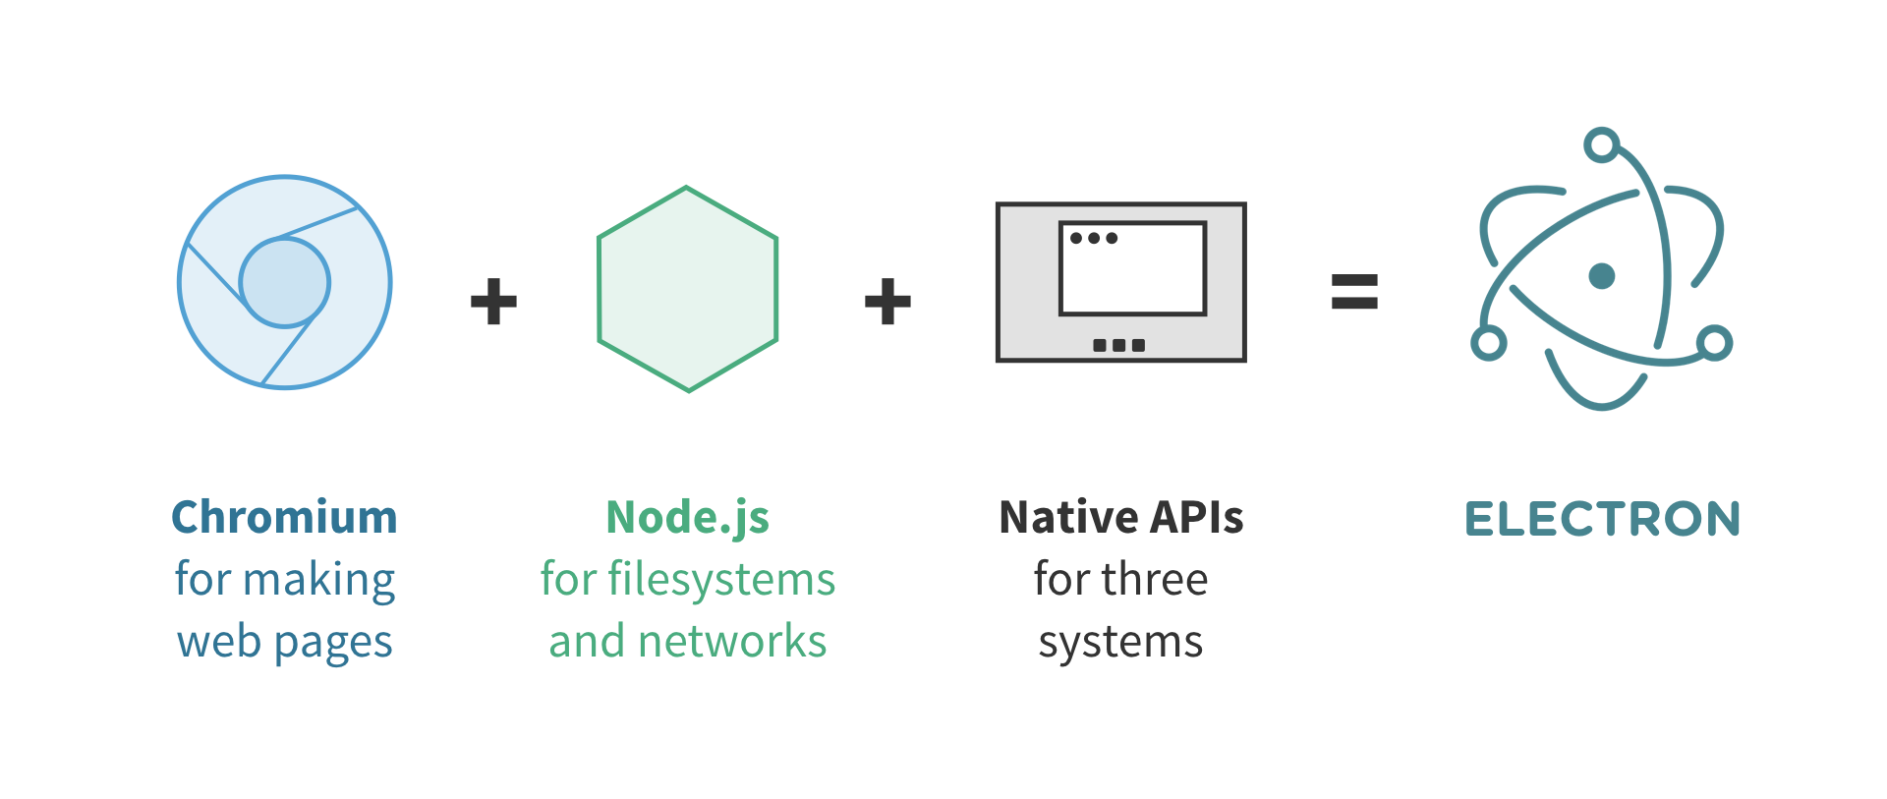
The Electron Framework – Overview

Slide 5





So…is it popular?

Slide 6

Why Go Electron?
Easy to start.
Javascript devs will feel at home.
Highly maintained and supported by GitHub.
Easy to test.
At your service
And…

Slide 7




Multiplatform right out of the box!

Slide 8
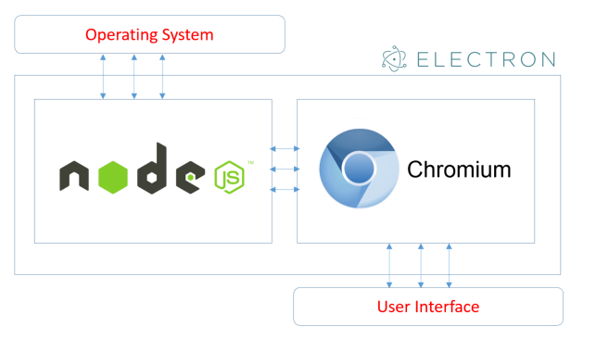
How it works?
Main Process
Renerer Process

Slide 9
Missuse? Not really!
your app is not exacelty client friendly…

Slide 10

Lets Wrap it up!

Slide 11
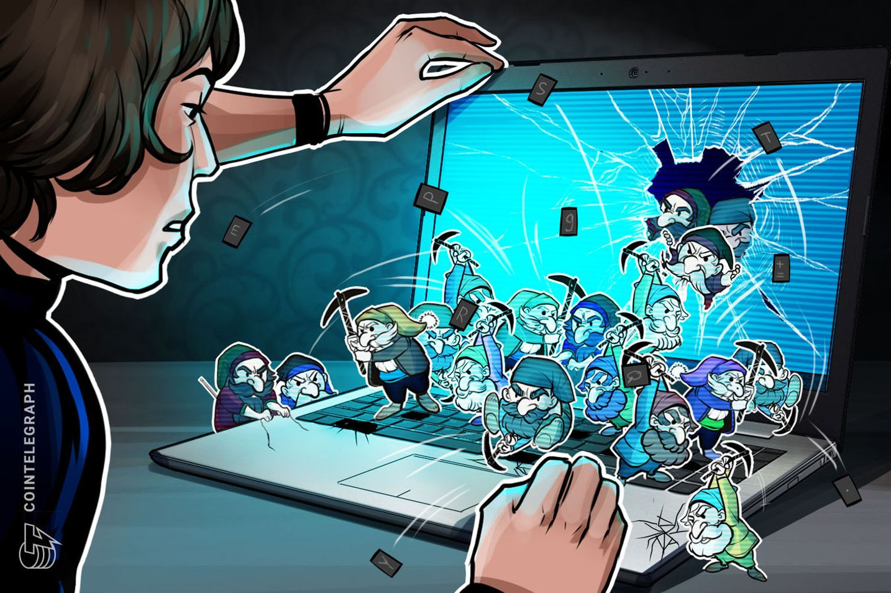
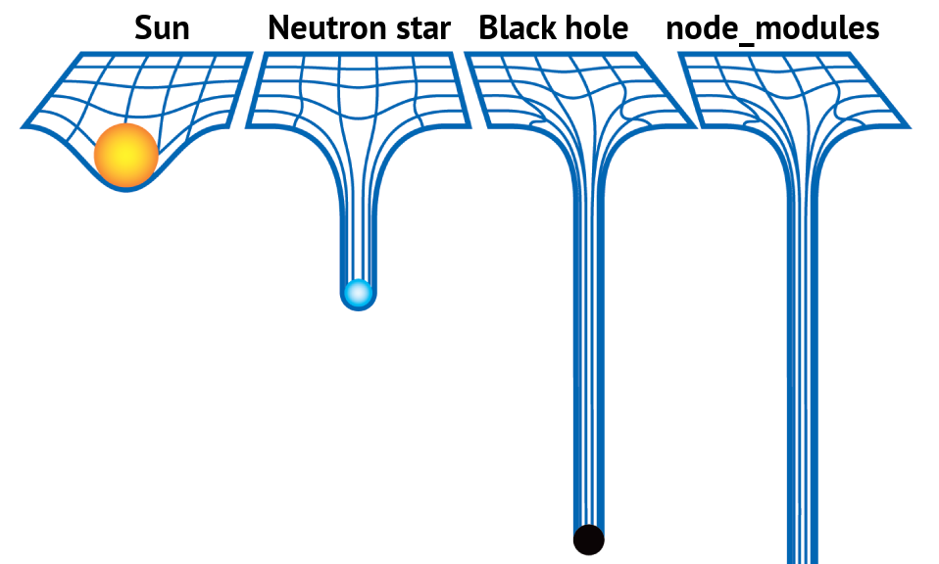
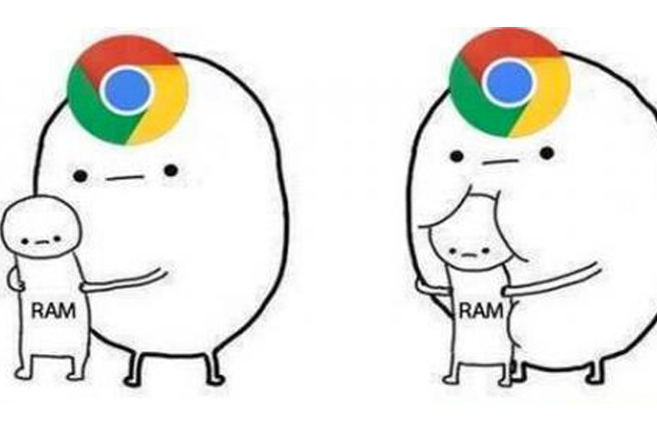
It’s getting complicated…
Security breaches, heavy modules and inefficient code hogging on client’s Ram.

Slide 12
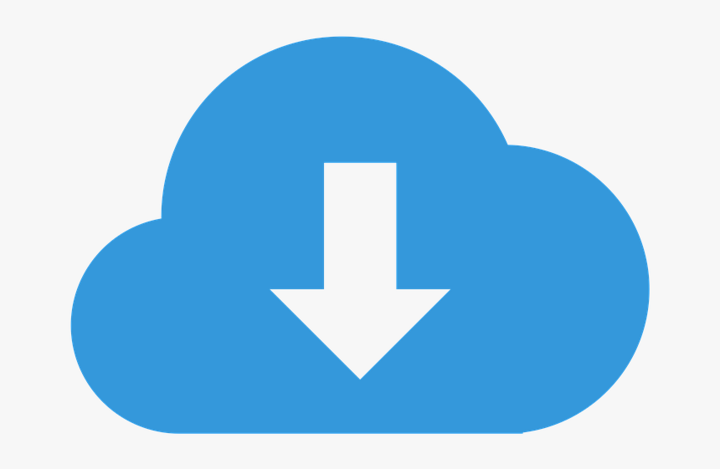
OTA to the rescue!

Slide 13


Danger!
Only load secure content
Disable the Node.js integration in all renderers that display remote content
Enable context isolation in all renderers that display remote content
Use ses.setPermissionRequestHandler() in all sessions that load remote content
Do not disable webSecurity
Define a Content-Security-Policy and use restrictive rules (i.e. script-src 'self’)
Do not set allowRunningInsecureContent to true
Do not enable experimental features

Slide 14

No, really, Stop!
Do not use enableBlinkFeatures
<webview>: Do not use allowpopups
<webview>: Verify options and params
Disable or limit navigation
Disable or limit creation of new windows
Do not use openExternal with untrusted content
Disable the remote module
Filter the remote module
Use a current version of Electron

Slide 15
What we learned?
Your JS skills can allow you to create awsome native desktop apps for all three major systems.
The Main process – Renderer process architecture.
How to wrap your app with
What to be aware of once your app go native
How to give your awsome app some awsome OTA updates superpowers!

Slide 16

Questions?

