Slide 1

WP4 – AI-based DSS models and advanced analytics
T4.2 – Compliance and eHealth literacy evaluation
Konstantinos bromis
ICCS

Slide 2
T4.2 – Compliance and eHealth literacy evaluation
INTRODUCTION TO EHEALTH LITERACY
eHealth literacy refers to the ability to seek, find, understand, and appraise health information from electronic sources and apply the knowledge gained to address or solve health problems.
These skills are essential for individuals to engage in self-care, manage chronic conditions, make informed healthcare choices, and participate actively in their own health management.
eHealth literacy encompasses skills such as navigating health websites, critically evaluating the reliability and credibility of online health information, and effectively communicating with healthcare professionals through digital platforms.
TELEREHAB Task4.2 | 3rd Plenary Meeting | Thailand 13-15/12/2023

Slide 3
T4.2 – Compliance and eHealth literacy evaluation
ASSESSING EHEALTH LITERACY: EHEALS
The eHeals questionnaire is a comprehensive measure of eHealth literacy, aimed at supporting consumer eHealth initiatives in both public health and clinical care settings.
TELEREHAB Task4.2 | 3rd Plenary Meeting | Thailand 13-15/12/2023

Slide 4
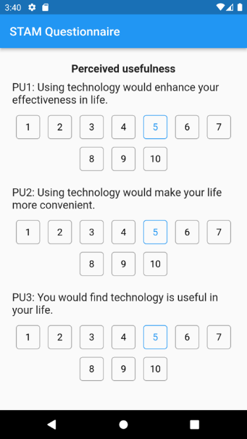
T4.2 – DIGITAL LITERACY IN AN AGING POPULATION
SENIOR TECHNOLOGY ACCEPTANCE MODEL (STAM)
STAM: A framework to understand and predict technology use among older adults.
Incorporates variables such as perceived usefulness, ease of use, and social influence.
Aids in customizing tech-education programs to enhance digital adoption by seniors.
Image Description: A diagram of the STAM framework with annotations explaining each factor's influence.
Notes:
As we focus on digital literacy, we must pay special attention to our aging population. The Senior Technology Acceptance Model, or STAM, is our framework of choice here. It's adapted from the traditional Technology Acceptance Model to account for factors that are particularly relevant to seniors—like ease of use and perceived usefulness. Through STAM, we gain valuable insights that help us tailor technology education programs for older adults, ensuring they're not left behind in the digital era.

Slide 5
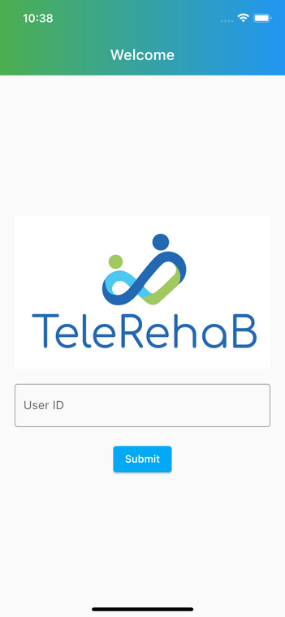
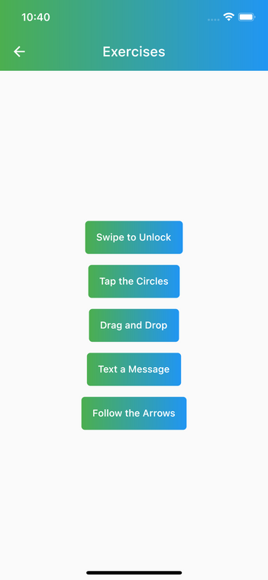
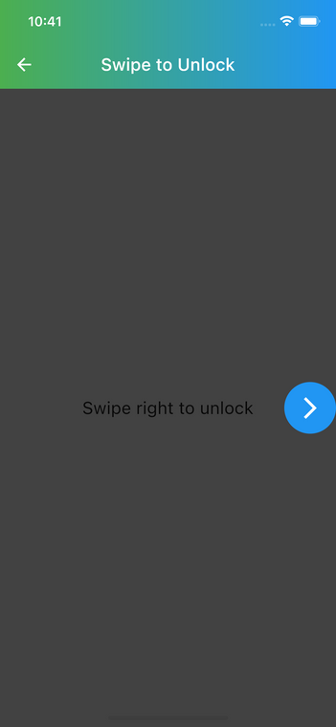
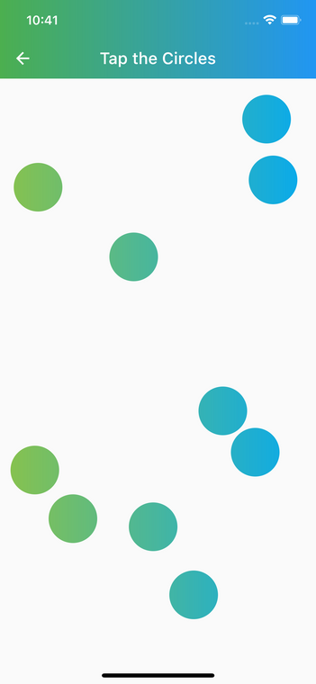
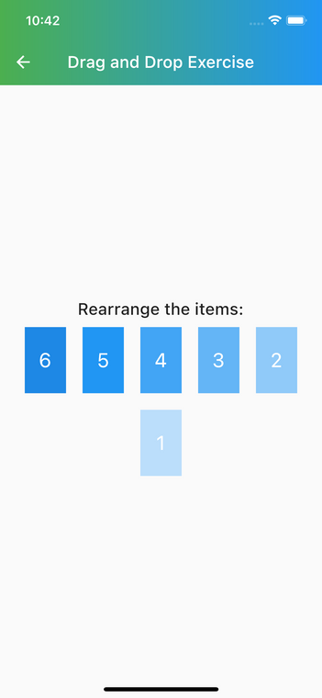
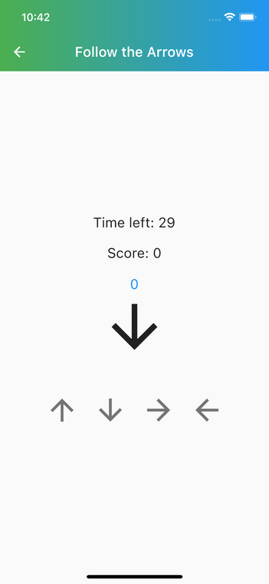
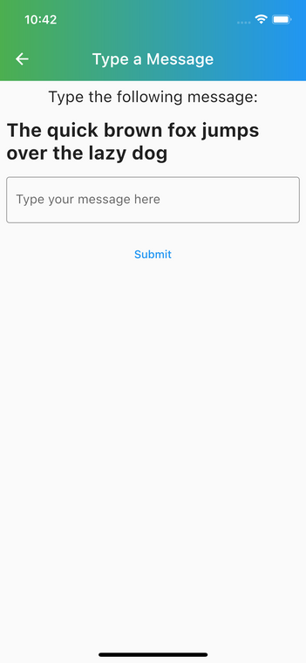
5
TELEREHAB Task4.2 | 3rd Plenary Meeting | Thailand 13-15/12/2023
Notes:
Engagement is key in learning, and what better way to engage than through interactive exercises? Our app includes a variety of exercises, each designed to mimic everyday digital tasks. These exercises not only assess but also build our patients' digital skills in a practical, hands-on way. Each of these exercises offers us a window into the user's digital world, providing actionable metrics that inform how we can better support their journey to digital literacy. From the basic to the complex, these metrics collectively paint a picture of a user's current abilities and pave the way for a personalized and adaptive learning experience.

Slide 6
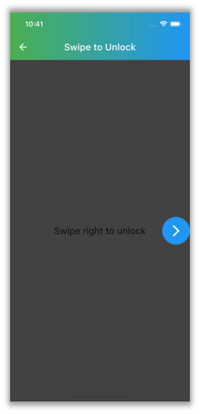
T4.2 – ENGAGEMENT THROUGH INTERACTION
MASTERING DIGITAL SKILLS WITH IN-APP EXERCISES
Swipe to Unlock: Timed exercise measuring proficiency with touch interfaces.
Notes:
Swipe to Unlock' exercise. It's seemingly simple yet reveals a lot about the user's basic navigational skills on a smart device. We measure the time it takes for a user to successfully swipe and unlock, which helps us gauge their initial comfort level with touch-based interfaces.

Slide 7
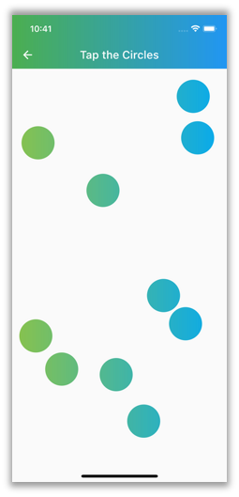
T4.2 – ENGAGEMENT THROUGH INTERACTION
MASTERING DIGITAL SKILLS WITH IN-APP EXERCISES
Tap the Circles: Tests hand-eye coordination and accuracy through a responsive tapping challenge.
Notes:
Users are prompted to tap on a series of randomly appearing circles on the screen. Here, we're not just looking at the number of circles successfully tapped but also tracking missed taps. This exercise assesses hand-eye coordination and response time, both crucial for proficient smart device use.

Slide 8
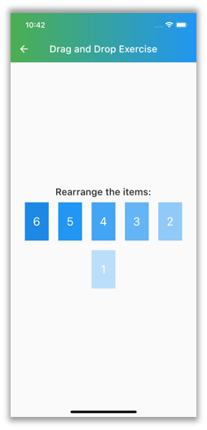
T4.2 – ENGAGEMENT THROUGH INTERACTION
MASTERING DIGITAL SKILLS WITH IN-APP EXERCISES
Drag and Drop: Evaluates cognitive processing by rearranging items to match a pattern.
Notes:
Users are asked to rearrange items on the screen, perhaps numbers or images, into a specific order. The time taken to complete this task and the number of successful drags are recorded. This exercise is instrumental in understanding a user's fine motor skills and their ability to perform more complex navigational tasks.

Slide 9
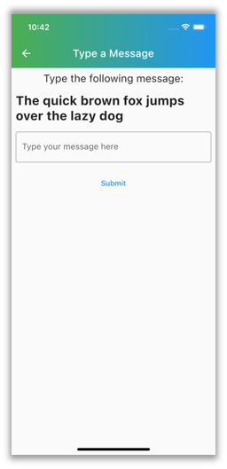
T4.2 – ENGAGEMENT THROUGH INTERACTION
MASTERING DIGITAL SKILLS WITH IN-APP EXERCISES
Text a Message: Measures typing speed and error rate on virtual keyboards.
Notes:
This is where we assess a user's comfort with virtual keyboards—a vital skill in today's text-driven communication. We measure the time it takes to type a given message and the number of typing errors, whether they are wrong or missing words. This helps us understand their typing proficiency and also their ability to navigate autocorrect and predictive text features.

Slide 10
T4.2 – ENGAGEMENT THROUGH INTERACTION
MASTERING DIGITAL SKILLS WITH IN-APP EXERCISES
Follow the Arrows: Assesses ability to process and follow dynamic instructions.
Notes:
'Follow the Arrows' is an exercise designed to assess a user's ability to follow dynamic instructions. Users tap arrows in the sequence they appear within a specific timeframe. We measure the number of correctly followed sequences, which reflects the user's processing speed and accuracy in following instructions.

Slide 11
T4.2 – PRIORITIZING PRIVACY AND DATA INTEGRITY
SECURE PATIENT DATA MANAGEMENT
Adherence to stringent data management protocols to ensure the highest levels of patient data security.
Pseudonymization process safeguards patient identity while allowing for valuable data analytics.
Backend API facilitates secure, controlled access to data for authorized healthcare providers.
Notes:
Security and privacy are of the utmost importance. The eHealth Literacy App is built with stringent data management protocols. Our patients' information is pseudonymized to protect their privacy, and we store data securely in compliance with the highest standards. Our backend API plays a crucial role here, ensuring that patient data is not only secure but also accessible to authorized healthcare providers in a way that maintains its integrity."

Slide 12
Thanks for your attention.
questions?

