Slide 1
Task 4.5 Human and technology resources management
Ilias Trochidis
VILABS

Slide 2
Contents
Timeline
Relationship with the overall platform
Objectives
Work performed (Requirements)
Problems identified
Plan for upcoming months

Slide 3

Task 4.5 Timeline
We are here
Dec 2023
Tasks |  | Lead | 1 | 2 | 3 | 4 | 5 | 6 | 7 | 8 | 9 | 10 | 11 | 12 | 13 | 14 | 15 | 16 | 17 | 18 | 19 | 20 | .. | 28 | 29 | 30 | 31 | 32 | 33 | 34 | 35 | 36
4.5 | Human and technology resources management | VILABS
Deliverables |  | Lead | Due
4.2 | Resources Management Model | VILABS | M24
Participants
1 | ICCS
2 | UOI
4 | VILABS
7 | NKUA
9 | NOVA
10 | QUAN
13 | UCL

Slide 4
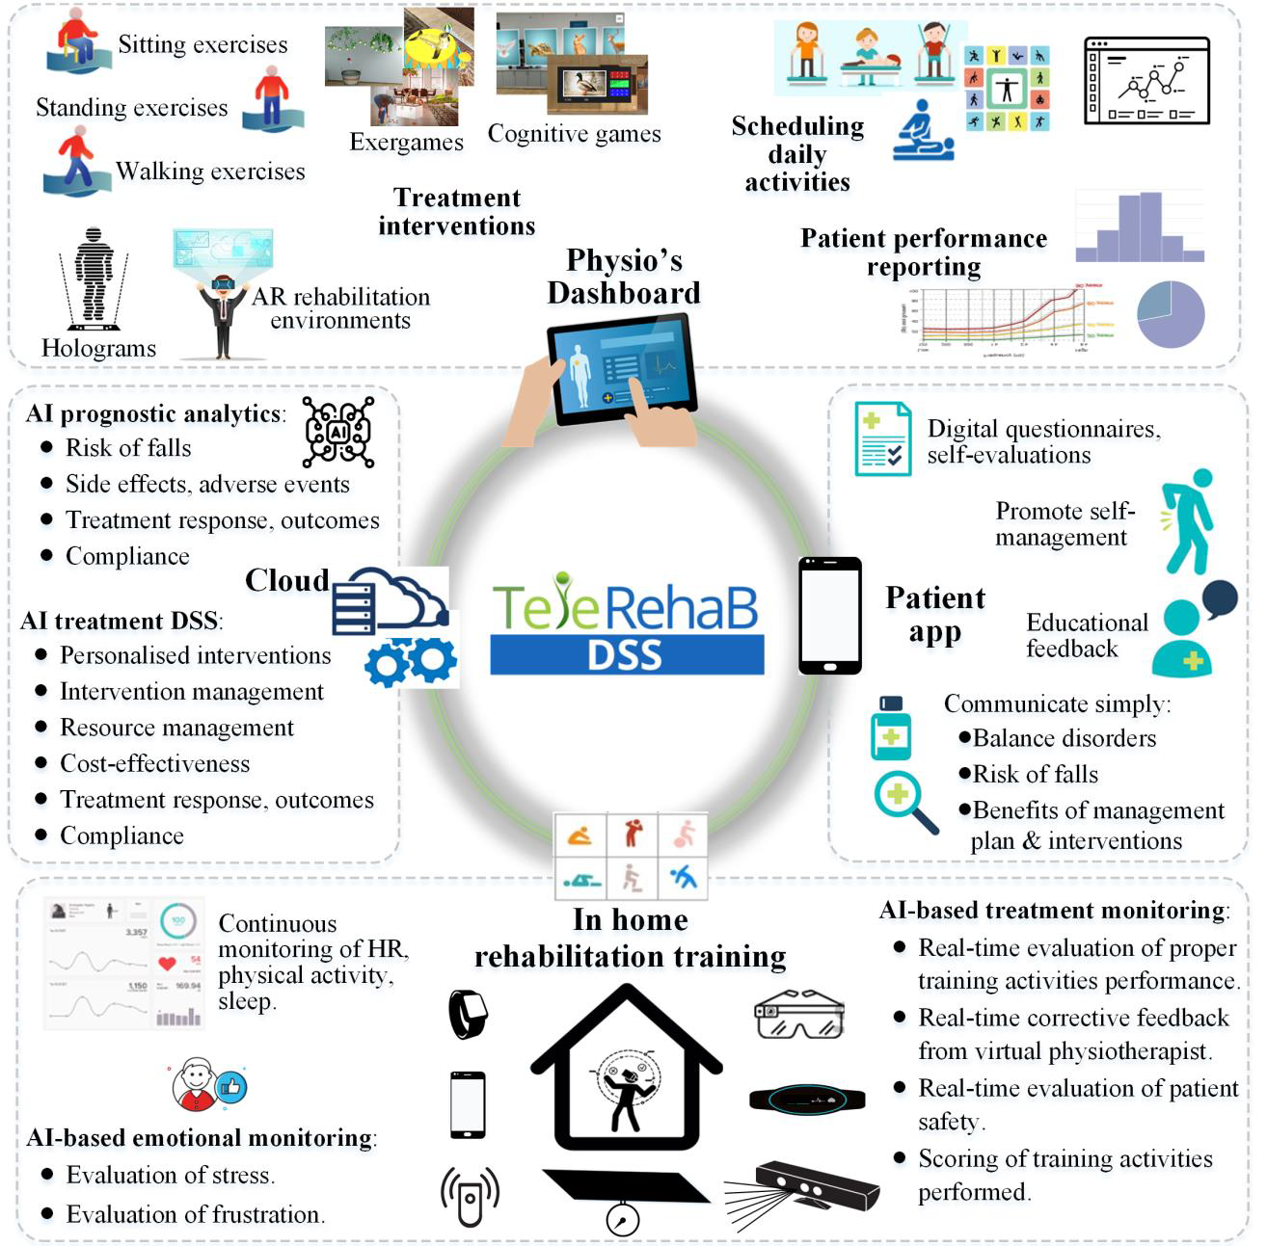
Interconnections and relationships with the overall platform
Task 1.3 Scientific and Technical Coordination
Task 2.1 User requirements analysis
Task 2.2 Expert Dashboard design
Task 2.5 Functional specifications and cloud architecture
Task 3.4 Expert’s dashboard development
WP4 AI-based DSS models and advanced analytics
WP6 Impact and Socioeconomic Analysis

Slide 5
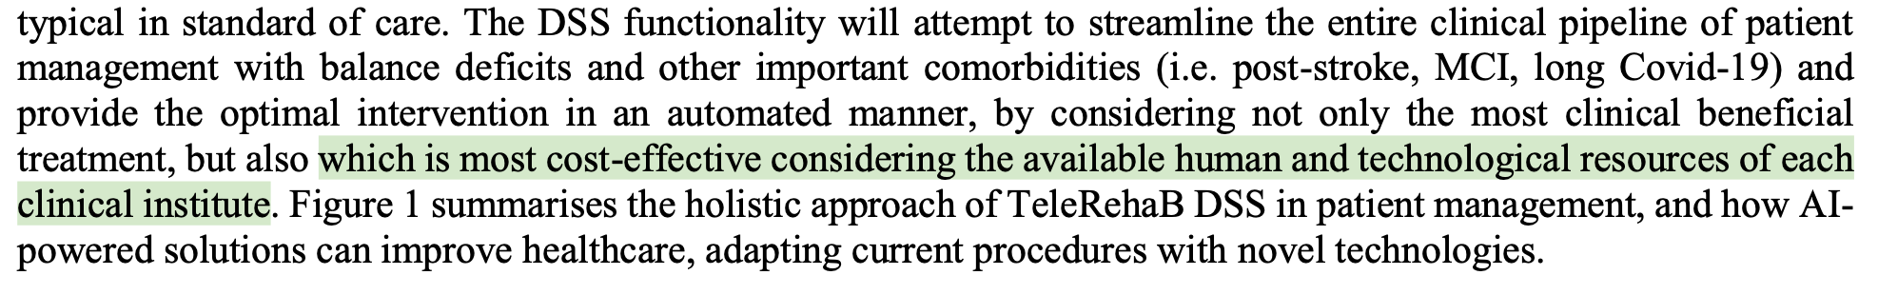
Task 4.5 Objectives
Assist clinical sites in planning, organising and allocating the resources that are necessary to achieve maximum efficiency of patient rehabilitation activities.
DoA

Slide 6
INPUT for T4.5
Input
Combined with
availability of human (clinicians), technology (TeleRehaBDSS equipment) and other (e.g. availability of rooms) resources of the clinic,
the profile of the patient (diagnosis, eHealth literacy, compliance).
cost-related data (cost of treatment e.g. average time a doctor will spend for a specific patient based on his/her profile, equipment costs, cost if fall based on risk of fall assessment) and
expected clinical benefits per intervention plan

Slide 7
OUTPUT of the HTRM tool
Recommendation from the HTRM tool on:
the type of treatment a specific patient should perform (low-tech, high-tech),
which healthcare professional should be appointed to him/her and
whether the intervention will be held completely at home or specific sessions should be performed at the clinic together with the healthcare professional

Slide 8
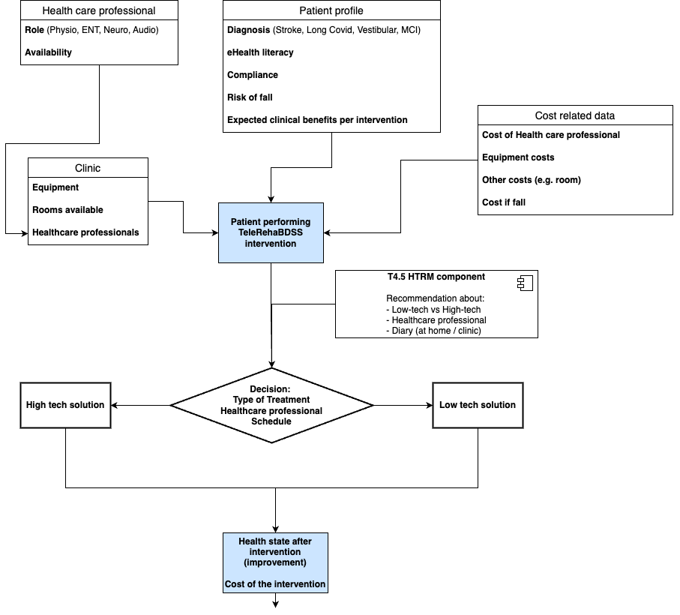

Slide 9
Timeplan
HTRM 1st release (M18)
HTRM Final release (M24)
Data gathering / Model / WP6
Based on data gathered, HTRM should provide recommendations for allocating human and technology resources taking into account cost-effectiveness (input from WP6)

Slide 10
Issues to be discussed
How HTRM will feed into the DSS
Further data needed to be stored (e.g. cost of practitioner, cost of device)
Plan for next six months
Start development
First version integrated into DSS ready on M18 for data gathering
Second version ready on M24 (D4.2)
Final version on M32 (integrating all available TeleRehab-DSS data from the clinical trials

Slide 11
Thanks for your attention.
Any question?

