Slide 1
WP4 – AI-based DSS models and advanced analytics
T4.1 – AI prognostic analytics (retrospective data)
Vassilis Tsakanikas
University of Ioannina

Slide 2
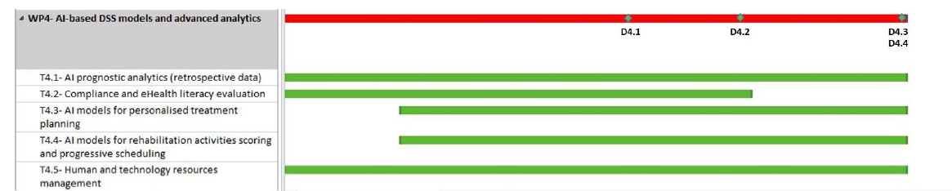
Task 4.3: AI models for personalised treatment planning
Task Description
Leader UOI, Participating partners: BRD, NOVA, NKUA, UCL, ICCS), [M1-M32]
This task will cover the deployment of all prognostic analytics of TeleRehaB DSS, including risk of falls analysis, treatment effectiveness and patient response, risk of occurrence of side effects and adverse events during rehabilitation training. As part of this task, the data harmonization engine will be developed, to align the heterogeneities that are present among the medical data from multiple sources in order to transform them into a common format, using data-driven and computational approaches. The AI models will be developed using the vast amount of retrospective datasets that will become available to the project by the consortium and through accessing open databases. This module will also use the existing research and clinical databases as a reference for the generation of synthetic data, to simulate real patients and their progress over time.
D4.1 TeleRehaB DSS AI models and advanced analytics v1.
This deliverable will provide the first version of the AI models in time for the start of the clinical study. [M18].

Slide 3
Retrospective Data
Source of data | Subjects | Measurements
HOLOBALANCE (Previous Project) | 160 | Demographics, clinical evaluations, questionnaires, raw data.
NKUA (Greece) | 250 (V1-104 + V2-146) | Demographics, symptoms, severity of symptoms, clinical signs, comorbidities, test for balance, falls.
UKLFR* (Germany) | 214 | Demographics, severity of symptoms, clinical signs, comorbidities, examine gait/ speed/ cadence.
KCMH (Thailand) | 9,200 | Demographics, assess ADL, depression, falls, sarcopenia Test, urinary incontinence, polypharmacy, malnutrition, dependency, immobility, gait.
UCL (UK) | 414 (RDF-56+17, dualtask-104, VM-93+60, walkstroke-51, uPV-33) | Demographics, severity of symptoms, clinical signs, comorbidities, falls, gait assessment, ADL, depression.
UK Biobank (UCL) | 500,000 | Demographics, Clinical Information, Imaging data, Medical Information, Questionnaires
Total | 510,338
*UKLFR- sensor: Full body motion capture camera data (12 cameras) during walking, sit to stand, stand to sit, turning, hand coordination task.

Slide 4

Holobalance (Previous project data)
The dataset from HOLOBALANCE concerns at total 80 intervention and 80 control group, aged >40 years old. The clinical evaluation data and sensor data include:
Demographics, clinical evaluations and questionnaires such as EQ-5D5L, MoCA, SUS, FGA, ABC, RAPA, MiniBest, cognitive function
Exercise data from 2 IMUs, pressure insoles, chest HR monitor, depth sensor
Raw data from smartwatch (Steps, activity capture)

Slide 5
NKUA (Greece)
The number of records at total was 250 subjects from 2 different data sets:
V1 29 PPPD patients, 20 VM patients, 15 UVW patients, 19 Meniere’s disease patients, 3 AN patients, 7 BPPV patients, 5 BVW patients, 2 CVD patients, 1 mal de debarquement patient, 1 MS patient, 2 mtbi patients. (Total= 104 subjects)
V2 74 PPPD patients, 26 VM patients, 24 BPPV patients, 8 Meneire’s disease patients, 7 Neuritis patients, 3 UVW patients, 1 CVD patients, 3 fallers. (Total = 146 subjects)
PPPD | Persistent Postural-Perceptual Dizziness
VM | Vestibular Migraine
CVD | Central Vestibular Dysfunction
AN | Acoustic Neuroma
BPPV | Benign Paroxysmal Positional Vertigo
UVW | Unilateral Vestibular Weakness
BVW | Bilateral Vestibular Weakness
mtbi | mild traumatic brain injury
MS | Multiple sclerosis

Slide 6
NKUA (Greece)
The 1st dataset (V1) will be:
Demographic and Clinical Information (age, gender, diagnosis, comorbidities, clinical signs).
Scales: DHI, FGA (2 time-points: baseline, final rehabilitation session).
Tests: Tandem Romber, Unterberger.
The 2nd dataset (V2) will be:
Demographic and Clinical Information (age, gender, diagnosis, education level).
Scales: Dizziness Handicap Inventory (DHI), Functional Gait Assessment (FGA), Activities Specific Balance Confidence Scale (ABC) (2 time-points: baseline, final rehabilitation session), Montreal Cognitive Assessment (MoCA).

Slide 7
NKUA- Attributes
V1 (26 attributes):
Gender[M/F]
Age[years, months]
Diagnosis[several]
DHI-1,3[0-100] Self report questionnaire that quantify the impact of dizziness in daily life
FGA-1,3[0-30] Functional Gait Assessment
Vertigo[Y/N]: Duration[sec/hours/days], When start, Frequency[days/weeks]
Dizziness[Y/N]: Duration[sec/hours/days], When start, Frequency[days/weeks]
Unsteadiness[Y/N]: Duration[sec/hours/days], When start, Frequency[days/weeks]
Motion Discomfort[Y/N]
Hearing loss[Y/N/SIDE]
Comorbiditis[NAMED] (such as Hashimoto)
Tandem Romber[0/1 (negative/positive)] Test that measures the sense of balance
Unterberger [0/1 (negative/positive)] Stepping test
Falls[Y/N/NUMBER]
1 -> final rehabilitation session
3 -> baseline assessment

Slide 8
NKUA- Attributes
V2 (46 attributes):
Gender[M/F]
Age[years, months]
Diagnosis[several]
DHI-1,3[0-100] Self report questionnaire that quantify the impact of dizziness in daily life
FGA-1,3[0-30] Functional Gait Assessment
ABC-1[0-100] Activities Specific Balance Confidence Scale
MOCA-1[0-30]
Education[Years]
MOCA_ VISUOSPATIAL/EXECUTIVE (total score ATM, CUBE CLOCK) [0-5]
MOCA_NAMING (total score LION, RHINO CAMEL) [0-3]
MOCA_DIGIT (total score FWD, BWD) [0-2]
MOCA_LANGUAGE (total score JOHN, CAT) [0-2]
MOCA_ABSTRACTION (total score TRAIN_BICYCLE, WATCH-RULER) [0-2]
MOCA_DELAY RECALL (total score FACE, VELVET, CHURCH, DAISY, RED) [0-5]
MOCA_ORIENTATION (total score DATE, MONTH, YEAR, DAY, PLACE, CITY) [0-6]
1 -> final rehabilitation session
2 -> baseline assessment
MOCA is a test for attention, concentration, memory, orientation.

Slide 9
UKLFR (Germany)
The data from UKLFR concerns at total 214 participants:
60 healthy controls (KG), 3 aged groups
20 Polyneuropathy patients (PNP)
35 Parkinson patients (PD) 16 with deep brain stimulation and 19 without deep brain stimulation
all in ON Medication with UPDRS III
28 L-dopa tests (20 with the diagnosis of Parkinson (LDT)
21 Normal Pressure Hydrocephalus patients (NPH)
50 Holobalance subjects (HBFR)
young (18-34)
middle (34 – 59)
old (60 – 85)
KG = without any disease influencing gait (neurological disease OR orthopaedic disease of the lower extremities)
PNP, PD = only PNP or PD, without any other neurological disease OR orthopaedic disease of the lower extremities
LDT, NPH = Must be able to walk

Slide 10
UKLFR (Germany)
The data will be:
Demographic and Clinical Information (age, gender, weight, BMI, diagnosis, comorbidities, clinical signs, medications).
Raw data from 12 cameras (Full body motion capture- gait speed, step length, step time, cadence, double support phase).

Slide 11
UKLFR- Attributes
Number of attributes>20:
General Informations:
ID
Group-Diagnosis
Date
Age
Weight
Gender
BMI Body Mass Index
Cardiac Index
Medications
Comorbidities
POMA Tinetti Performance-Oriented Mobility Assessment, measures both gait and balance
Dominant Hand (If Parkinson patient, then the pathological side)

Slide 12
UKLFR- Attributes
TUG Parameters:
Gait speed[m/s]
Step length[m]
Step time[s]
Cadence[steps/min]
Double support phase[%]
TUG -> Timed Up and Go
>Assesses mobility, balance, walking ability, and fall risk in older adults.
In some of them there are time points:
Healthy subjects (1 time-point)
PNP (1 time-point)
PD (1 time-point)
PD with L-Dopa test (3 time-point: pre medication, after 30 and 60 minutes)
NPH (2 time-point)
Holobalance subjects (1 time-point)

Slide 13
KCMH (Thailand)
The number of records at total was 9,200 participants with the inclusion criteria:
Age>60 years
Independent in basic ADLs (Activities of daily living)
Able to walk with or without gait aids
No acute life-threatening illnesses 3 months prior to enrolment, such as heart failure, stroke
No active cancer
No unstable psychiatric illnesses, such as schizophrenia
No advanced organ failure, such as advanced cirrhosis, dementia

Slide 14
KCMH (Thailand)
The dataset from KCMH will be:
Demographics and Clinical Information: age, gender, BMI, clinical signs, urinary incontinence, polypharmacy, nocturia, activity, depression, dependency, faller, insomnia, nocturia, grip strength, gait speed, and the presence of sarcopenia.
Scales: Barthel, Lawton, Geriatric Depression Scale (GDS), Mini Nutrition Assessment (MNA), Instrumental Activities of Daily Living (IADL), Montreal Cognitive Assessment (MoCA).
Questionnaires: Dysphagia Symptom Questionnaire (SDG).
Additionally, the researchers will collect data related to the use of multiple medications, particularly sleep pills.

Slide 15
KCMH - Attributes
Number of attributes>20:
Timestamp (The current time of an event that a computer records)
Age
BMI
Barthel (Scale used to measure performance in activities of daily living (ADL))
Lawton (Instrumental Activities of Daily Living Scale)
GDS (Geriatric Depression Scale- monitor depression)
Waist per height (healthy= 0.4-0.49)
Office_SBP (Office mean systolic blood pressure)
Office_DBP (Office mean diastolic blood pressure)
UI_Stress (Urinary Incontinence from stress) [T/F]
UI_Urgency (Urinary Incontinence due to urgent need) [T/F]
UI_Overflow (Urinary Incontinece due to desire to urinate, but release a small amount) [T/F]
UI_Functional (Urinary Incontinece due to cannot use the toilet on time) [T/F]
MNA (Mini Nutrition Assessment in older people)

Slide 16
KCMH - Attributes
SDQ (Dysphagia Symptom Questionnaire)
IADL (Instrumental Activities of Daily Living)
CAN’T_Phone/ Finance/ Shop/ Cook/ Housework/ Laundry/ Travel/ Med/ Change[T/F]
Mobility[normal]
BMI_class_WHO (World Health Organization)
BMI_class_Asian
Activity_low[T/F]
Fiber_low[T/F]
Insomnia_any[T/F]
EATTEN_high[T/F]
Polypharmacy[T/F]
Nocturia[T/F]
Sleep_pill[T/F]
Handgrip_low[T/F]

Slide 17
KCMH - Attributes
Gaitspeed_low[T/F]
Muscle_low[T/F]
Sarcopenia_class (type of muscle atrophy)
Fallrisk_TUG/ _ANY
MOCA
Dependency[T/F]
Immobility[T/F]
Depression[T/F]
BMI_abnormal
Malnutrition[T/F]
Sarcopenia[T/F]
Faller[T/F]
MOCA is a test for attention, concentration, memory, orientation.

Slide 18
UCL (United Kingdom)
The dataset from UCL concerns at total 414 subjects from 5 different datasets:
The 1st dataset corresponds to 56 participants (UCL-Retrospective data fallers)
The 2nd UCL dataset corresponds to 17 participants
The 3rd UCL dataset corresponds to 104 participants (UCL-Datahealthyvest2017ALLdualtask)
The 4th UCL dataset corresponds to 153 subjects (Dataset VM paper)
The 5th UCL dataset concerns to 84 participants from 2 different studies (Walk stroke updated and uPV walk raw)

Slide 19
UCL-Retrospective data fallers
Data from a study that:
Is a comparison of older adults who recruited from neuro-otology or a falls clinic for balance assessment (56 participants).
15 neuro-otology (8 Female-7 Male, mean age(MA): 71years, all vestibular dysfunction)
25 falls clinic (21 F-4 M, MA:76years, 20 vestibular dysfunction)
16 healthy controls ( 13 F-3 M, MA:74 years, 3 vestibular dysfunction)
Comparing OTAGO with MSR exercises. All participants have had multiple falls in the past 12 months.
17 participants (15 F-2 M, MA:78.5 years) 8 OTAGO
7 MSR
1st
2nd
OTAGO is a home-based exercise programme consisting of a warm-up phase, strengthening and balance training exercises phase and cool-down phase.
MSR is test of exercises

Slide 20
UCL-Retrospective data fallers
The 1st dataset corresponds to 56 participants and is a comparison of older adults who recruited from neuro-otology (15), falls clinic for balance assessment (25) and 16 healthy controls. The data will be:
Demographics and Clinical Information (age, gender, clinical signs- fall in past year).
Scales: Functional gait assessment (FGA), Computerized dynamic posturography (CDP), Risk Physiological Profile Assessment (PPA), Vertigo Symptom Scale – vestibular subscale (VSS-V), Vertigo Symptom Scale – anxiety subscale (VSS-A), Vestibular Disorders Activities Daily Living –Functional, -Ambulation, -Instrumental (VDADL-F,-A,-I), Hospital Anxiety and depression scale – Depression subscale, – Anxiety subscale (HAD-D,-A), Scale Activities Specific Balance Confidence scale (ABC).
Questionnaires: Situational characteristic Questionnaire (SCQ).
The 2nd UCL dataset corresponds to 17 participants and is data from a study comparing OTAGO supplemented with MSR exercises. Data will be the same as 1st with the difference that it is collected at baseline (variable_0), 4 weeks (variable_4) and 8 weeks (variable_8).

Slide 21
UCL-RDF- Attributes
1 Number of attributes<20:
Sex [F/M]
Age [years]
Falls past 12/12 (Fall in past year) [number]
FGA Functional gait assessment [Max score is 30, scores < 22 increased risk of falling]
CDP Computerised dynamic posturography [Max is 100, scores < 70 abnormal]
PPA Risk Physiological Profile Assessment composite falls risk [Z scores, 0 = no fall risk]
SCQ Situational characteristic questionnaire [normal : 0-4. Scores >= 0.7 space and motion discomfort]
VSS-V Vertigo Symptom Scale – vestibular subscale [Score >= 0.3 abnormal]
VSS-A Vertigo Symptom Scale – anxiety subscale [Score >= 0.3 abnormal]
VDADL-F,-A,-I Vestibular Disorders Activities Daily Living –Functional, -Ambulation, -Instrumental
HAD-D Hospital Anxiety and depression scale – Depression subscale [Score > 10 clinical symptoms (Max:21)]
HAD-A Hospital Anxiety and depression scale – Anxiety subscale [Score > 10 clinical symptoms (Max:21)]
ABC Scale Activities Specific Balance Confidence scale [Score <= 67 increased falls risk]

Slide 22
UCL-RDF- Attributes
2 Number of attributes>20 and was the same as in first study except VDADL and CDP, that not used. Here data is collected at baseline (variable_0), 4 weeks (variable_4) and 8 weeks (variable_8). So the data set will be:
Sex [F/M]
Age [years]
Falls, Falls_in_study, Falls_6_moths [number]
FGA_0, FGA_4, FGA_8, FGA_Change
PPA_0, PPA_4, PPA_8, PPA_Change
.
.
.

Slide 23
UCL-Datahealthyvest2017ALLdualtask
3nd
The 3rd UCL dataset corresponds to 104 participants and will be:
Demographics and Clinical Information (age, gender, BMI, clinical signs)
Scales: Vertigo Symptom Scale – vestibular subscale (VSS-V), Dizziness Handicap Inventory (DHI), Scale Activities Specific Balance Confidence scale (ABC), Hospital Anxiety and depression scale (HAD), Functional Gait Assessment (FGA), Physical Activity Level (PAL), Vertigo Symptom Scale (VSS)
Questionnaires: Situational characteristic Questionnaire (SCQ).

Slide 24
UCL-Datahealthyvest2017ALLdualtask
The number of records at total was 104 participants.
(MA: 52 years, 62 healthy and 42 vestibular)
Number of attributes(33):
ID
Gender [F/M]
Age [years]
Group [H/V]
SCQ Situational characteristic questionnaire
VSS-V Vertigo Symptom Scale – vestibular subscale
DHI-F,-P,-E Dizziness Handicap Inventory- Functional, -Physical, -Emotional
DHI-SUM
ABC Scale Activities Specific Balance Confidence scale

Slide 25
UCL-Datahealthyvest2017ALLdualtask
HAD-A, -D Hospital Anxiety and depression scale – Anxiety, -Depression subscale
FGA Functional gait assessment
FGA-M, -MDTC –with motor, -with motor dual task
FGA-N, -NDTC -numeracy task, -numeracy dual task
FGA-L, -LDTC -literacy task, -literacy dual task
DM Directional movement, measures both strength and direction of a movement
PAL Physical Activity Level
RTIsimple Runtime infrastracture
RVPmed Systolic pressure ratio of Right venticular
BMI
VSS-A Vertigo Symptom Scale – anxiety subscale
RFGA
RFGA-M, -MDTC –with motor, -with motor dual task
RFGA-N, -NDTC -numeracy task, -numeracy dual task
RFGA -L, -LDTC -literacy task, -literacy dual task

Slide 26
UCL-Dataset VM paper
4th
The 4th UCL dataset corresponds to 153 subjects:
N=93. Group of patients with vestibular migraine (with or without traumatic brain injury). MA:48.7 years, 63F – 30M.
N=60. Group of patients with TBI (Traumatic brain injury). MA:46 years, 30F – 30M.

Slide 27
UCL-Dataset VM paper
The data will be:
Demographics and Clinical Information (age, gender, diagnosis, clinical signs)
Scales: Dizziness Handicap Inventory (DHI), Visual Analog Scale (VAS), Functional Gait Assessment (FGA) (In 2 time-points: pre and post physiotherapy).
Questionnaires: Sexual function-Vaginal changes Questionnaire (SVQ) (In 2 time-points: pre and post physiotherapy).
Tests: Modified Clinical Test of Sensory Interaction in Balance (mCTSIB), Dynamic Visual Activity (DVA) (In 2 time-points: pre and post physiotherapy).

Slide 28
UCL- VM - Attributes
1 Number of attributes(28):
Sex [F/M]
Age [years]
TBI [1=Yes/0=No]
DHI -Pre, -Post, -Change Dizziness Handicap Inventory –Pre, -Post physiotherapy
VAS_Sev -Pre, -Post, -Change Visual Analog Scale for severity –Pre, -Post physiotherapy
VAS_IMP-Pre, -Post, -Change Visual Analog Scale for impact –Pre, -Post physiotherapy
FGA -Pre, -Post, -Change Functional gait assessment –Pre, -Post physiotherapy
SVQ-Pre, -Post, -Change Sexual function-Vaginal changes Questionnaire - Pre, -Post physiotherapy
mCTSIB -Pre, -Post, -Change Modified Clinical Test of Sensory Interaction in Balance –Pre, -Post phys.
DVA -Pre, -Post, -Change Dynamic Visual Activity –Pre, -Post physiotherapy
Physio_assessment day [start date]
Vpend Discharge Date [final date]
Days [number]
Weeks [number]

Slide 29
UCL- VM - Attributes
Number of attributes<20:
Sex [F/M]
Age [years]
Migraine [1=Yes/0=No]
DHI -Pre, -Post, -Change Dizziness Handicap Inventory –Pre, -Post physiotherapy
VAS_Sev -Pre, -Post, -Change Visual Analog Scale for severity –Pre, -Post physiotherapy
VAS_IMP-Pre, -Post, -Change Visual Analog Scale for impact –Pre, -Post physiotherapy
FGA -Pre, -Post, -Change Functional gait assessment –Pre, -Post physiotherapy
Physio_assessment day [start date]
Vpend Discharge Date [final date]
Days [number]
Weeks [number]

Slide 30
UCL-Walk stroke updated and uPV walk raw
5th
The 5th UCL dataset concerns to 84 participants from 2 different studies. The first corresponds to 51 subjects (30 healthy and 21 with unilateral peripheral vestibular disorder) and the other to 33 subjects (16 healthy and 17 stroke). The data will be:
Demographic and Clinical Information (age, gender diagnosis, clinical signs, symptoms duration).
Scales: Functional Gait Assessment (FGA), Hospital Anxiety and depression scale (HAD), Scale Activities Specific Balance Confidence scale (ABC), Functions of Music Listening scale (FMUL).
Tests: Time up and go test (TUG)
Raw data (steps, walk duration, velocity).

Slide 31
UCL-Walk stroke updated
The number of records at total was 51 participants.
30 healthy and 21 with unilateral peripheral vestibular disorder.
Attributes:
ID [number]
Gender [F/M]
Group [H/V]
Age [years]
Steps [number]
Walkduration [minutes or hour]
TUG Time up and go test
FGA Functional gait assessment
TotalHAD-A, -D Hospital Anxiety and depression scale – Anxiety, -Depression subscale
ABC Scale Activities Specific Balance Confidence scale
NSVQ
Symptomsduration [minutes or hour]
FMUL Functions of Music Listening scale
Velocity [m/s]

Slide 32
UCL-uPV walk raw
The number of records at total was 33 participants.
16 healthy and 17 stroke.
Attributes:
ID [number]
Gender [F/M]
Group [H/V]
Age [years]
Steps [number]
Walkduration [minutes or hour]
TUG Time up and go test
FGA Functional gait assessment
meanF, -A, -T Mean -Frequency, -Acceleration, -Time
TotalHAD-A, -D Hospital Anxiety and depression scale – Anxiety, -Depression subscale
ABC Scale Activities Specific Balance Confidence scale
NVertigo if Vertigo exists [1=Y/0=N]
Nautonomic [1=Y/0=N]
NSVQ
Symptomsduration [minutes or hour]
FMUL Functions of Music Listening scale
Velocity [m/s]
An autonomic dysfunction occurs when the autonomic nervous system, which controls functions responsible for well-being and maintaining balance, does not regulate properly.

Slide 33
UK Biobank (UCL)
Include all participants who gave a positive answer (subjects) and a negative answer (controls) to the following question “In the last year have you had any falls?” and we will document the number of falls reported by positive respondents. (500,000 participants). The type of data:
Medical information (Eye problems/disorders, vascular/heart problems diagnosed by doctor, long-standing illness, disability or infirmity, other serious medical condition/disability, hearing difficulty/problems diagnosed by doctor medication for cholesterol, blood pressure or diabetes, participants BMI, height, weight, pulse, overall health rating).
Physical: impedance of leg, overall acceleration summary, genetic principal components.
Socioeconomic: Employment status, Education/professional qualifications, Biomarkers.
Cognitive: Fluid intelligence Pairs matching, Prospective memory, reaction time.
Behavioural: Typical diet, Alcohol consumption, Physical activity assessed by a 24-hour activity monitor for a week.
Psychological/Psychiatric/Mental health: Self reports (Ever felt worried, tense, or anxious for most of a month or longer, Recent feelings or nervousness or anxiety, Recent feelings of depression, Recent feelings of tiredness or low energy, etc.).
Imaging data: T1 structural brain MRI, Resting functional brain MRI, Total volume of white matter hyperintensities.

Slide 34
Analysis of the Holobalance Dataset

Slide 35
Overview of Clinical Endpoints Understanding Key Clinical Endpoints in Rehabilitation
In rehabilitation, clinical endpoints provide vital benchmarks to assess the progress and effectiveness of treatment plans.
These endpoints help in objectively measuring how patients respond to therapy, guiding clinicians in optimizing care strategies.
Endpoint 1 - Risk of Falls
A primary concern in rehabilitation, especially for the elderly and those recovering from injuries.
We assess the risk of falls using measures like balance, gait functionality, and mobility confidence.
Key Metrics: DIF_Minibest_Total, DIF_FGA_Total, DIF_ABC_Total, DIF_5q5d_Mob.
Endpoint 2 - Treatment Effectiveness
This endpoint evaluates the overall success of the rehabilitation program in improving patient health and functionality.
It includes cognitive, physical, and daily activity measures to provide a comprehensive view.
Key Metrics: DIF_MoCA_Total, DIF_Whodas_Total, DIF_Whodas_Standardized, and more.
Endpoint 3 - Side Effects / Adverse Events
An essential aspect of patient safety, focusing on identifying and mitigating any negative outcomes from the treatment.
We monitor aspects like pain and anxiety levels to preemptively address potential issues.
Key Metrics: DIF_5q5d_Pain, DIF_5q5d_Anxiety

Slide 36
Main Targets
Positive, zero or negative change (BL -> FA) on the collected clinical tools
'DIF_FGA_Total’
'DIF_Fesi_Total’
'DIF_MoCA_Total’
'DIF_Whodas_Total’
'DIF_Whodas_Standardized’
'DIF_ABC_Total’
'DIF_Breq3_Amotivation’
'DIF_Breq3_Externalregulation’
'DIF_Breq3_Introjectedregulation’
'DIF_Breq3_Identifiedreg’
'DIF_Breq3_Integratedreg’
'DIF_Breq3_Intrinsicreg’
'DIF_Breq3_RAI’
'DIF_5q5d_Mob’
'DIF_5q5d_Self-care’
'DIF_5q5d_Usual activities
'DIF_5q5d_Pain
'DIF_5q5d_Anxiety’
'DIF_5q5d_General'

Slide 37
Dataset Overview Gender

Slide 38
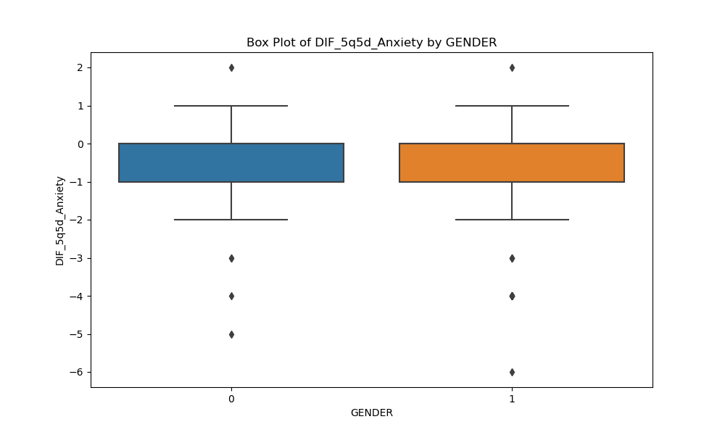
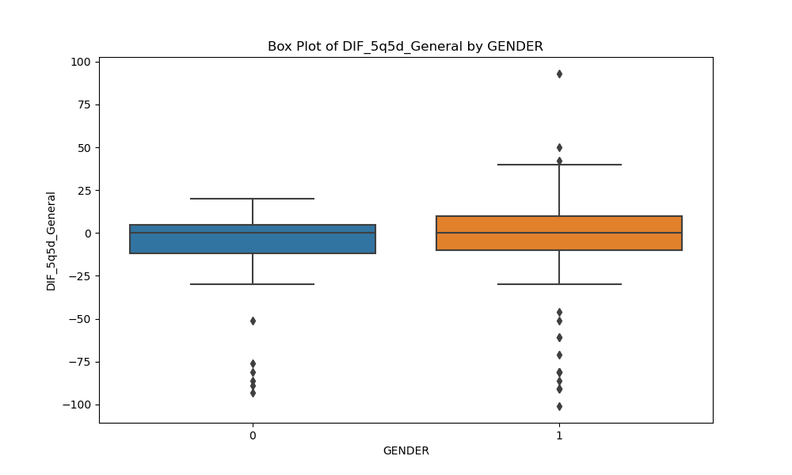
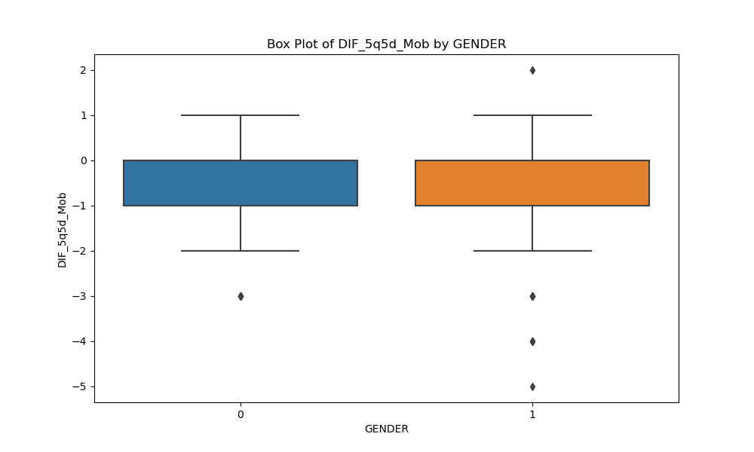
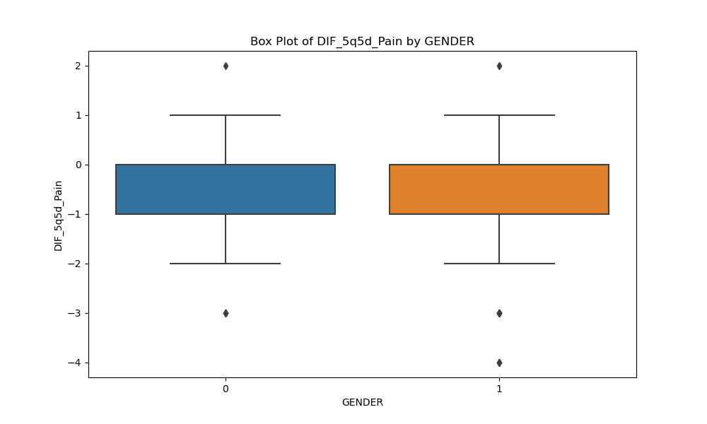

Slide 39

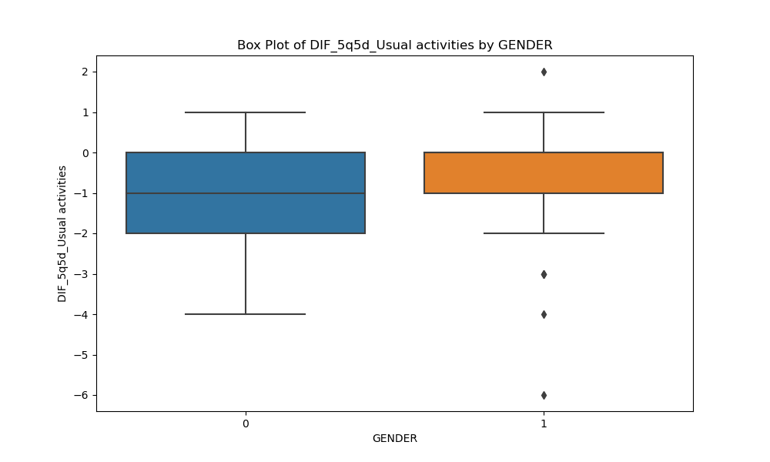
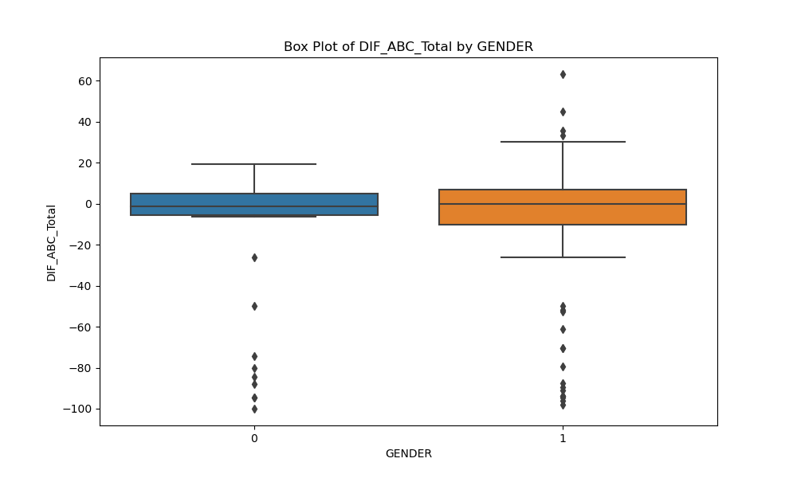
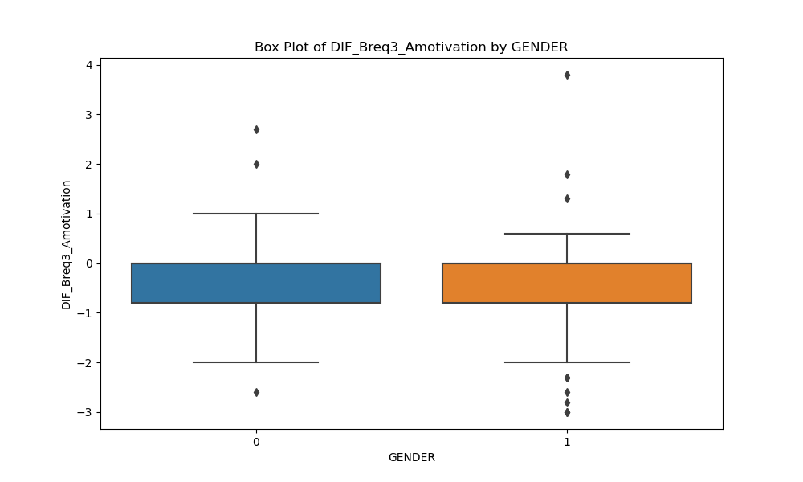

Slide 40
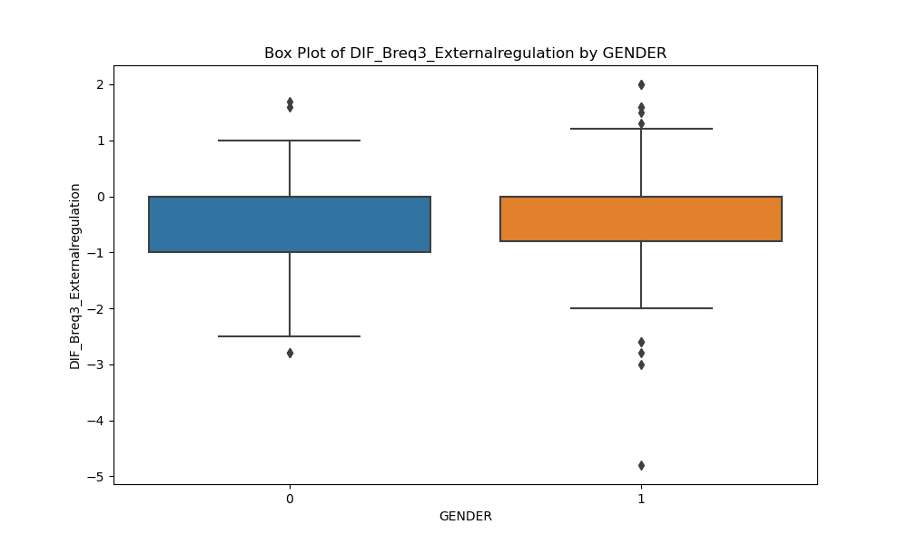
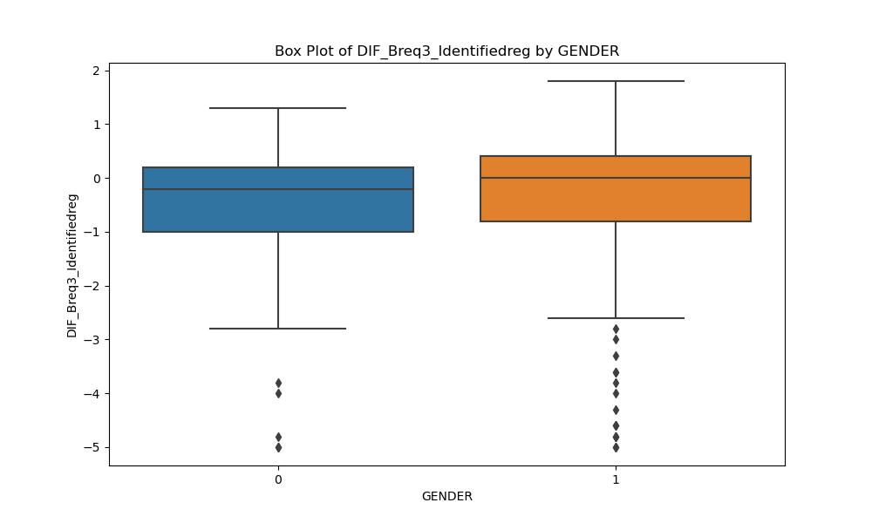
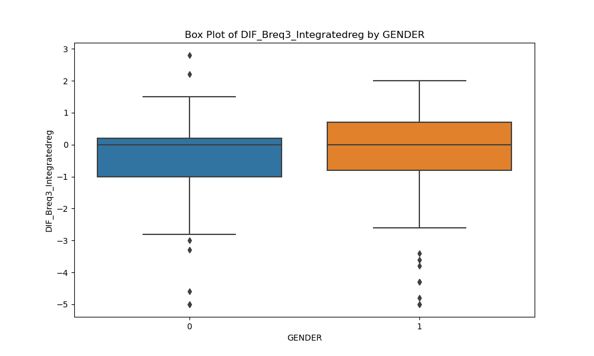
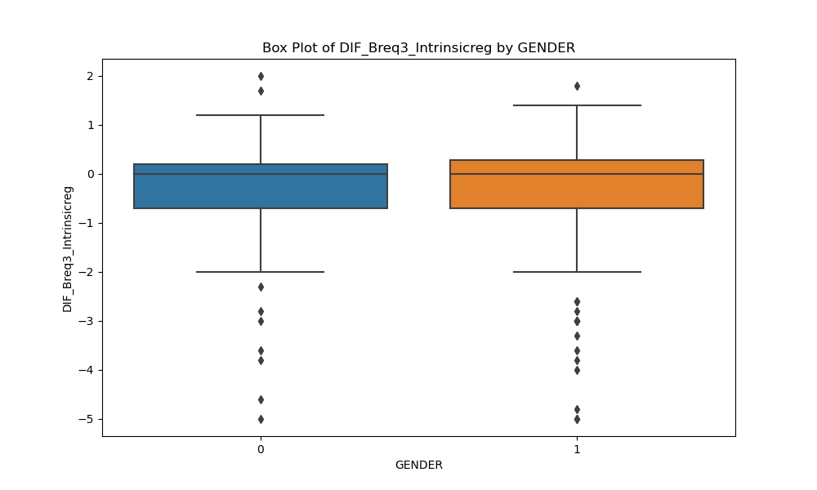

Slide 41
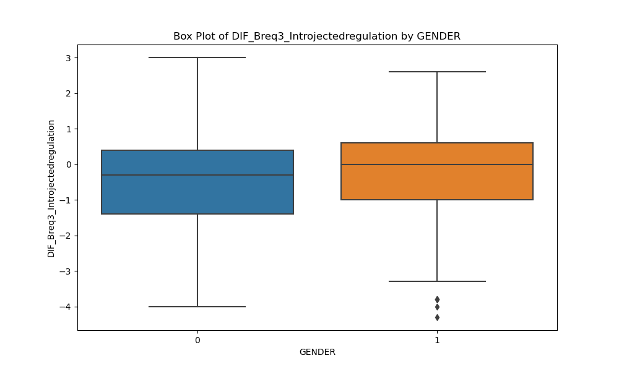
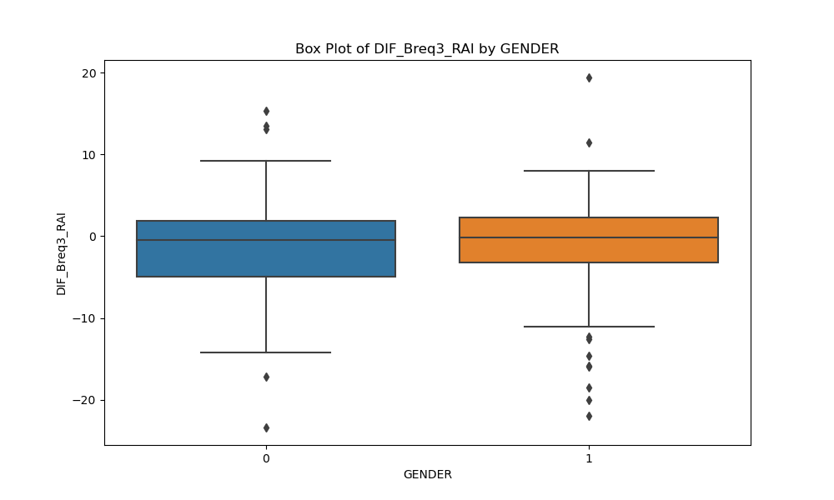
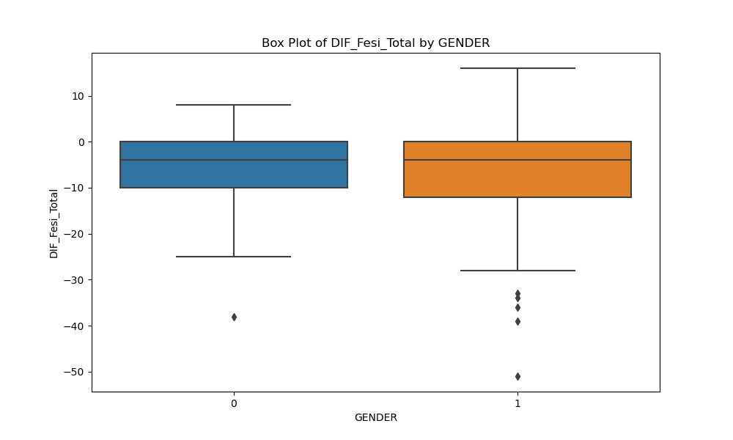
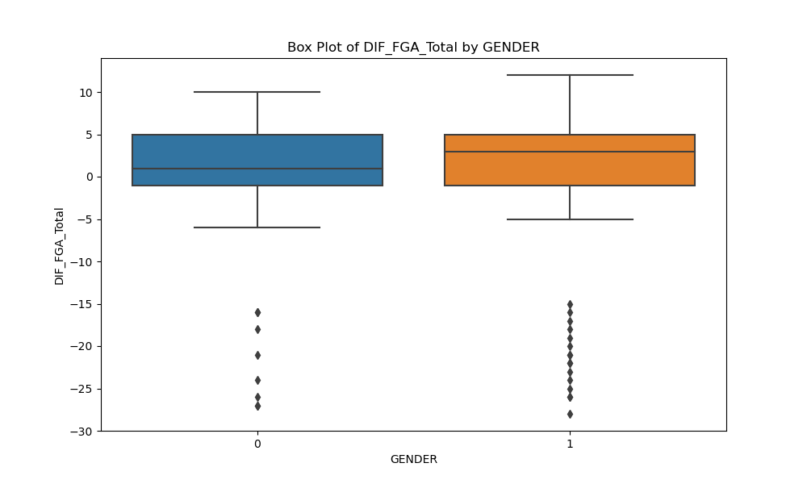

Slide 42
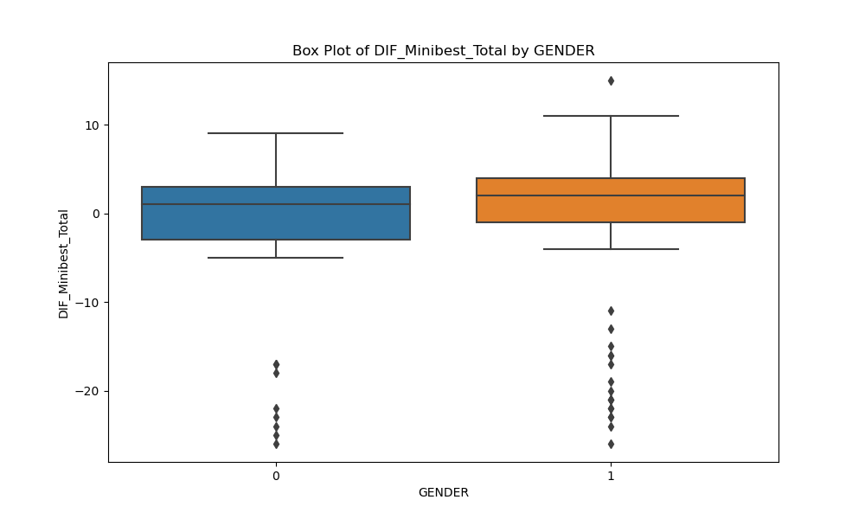
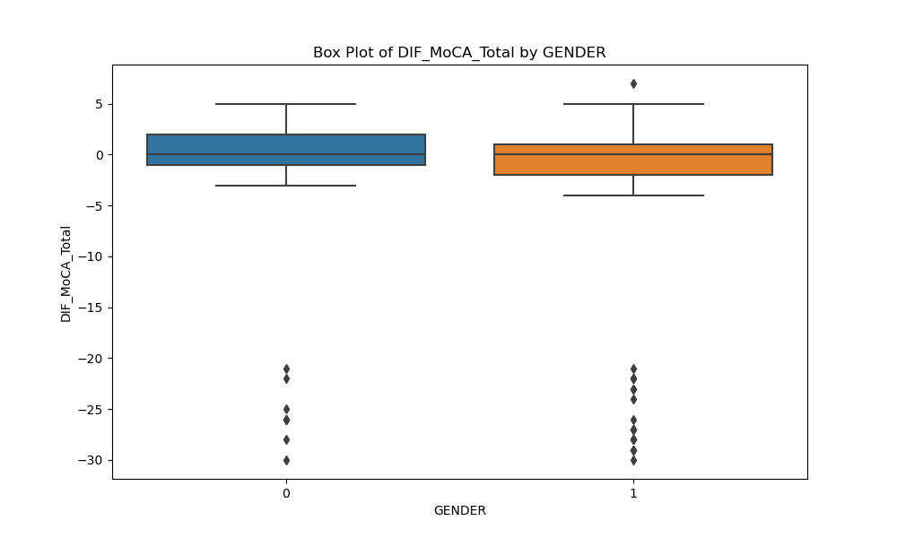
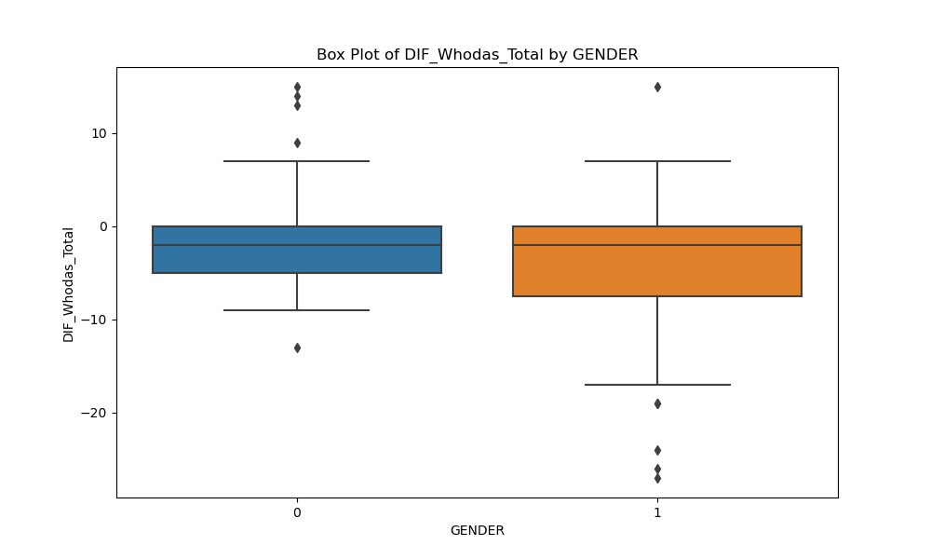

Slide 43
Dataset overview Study group

Slide 44

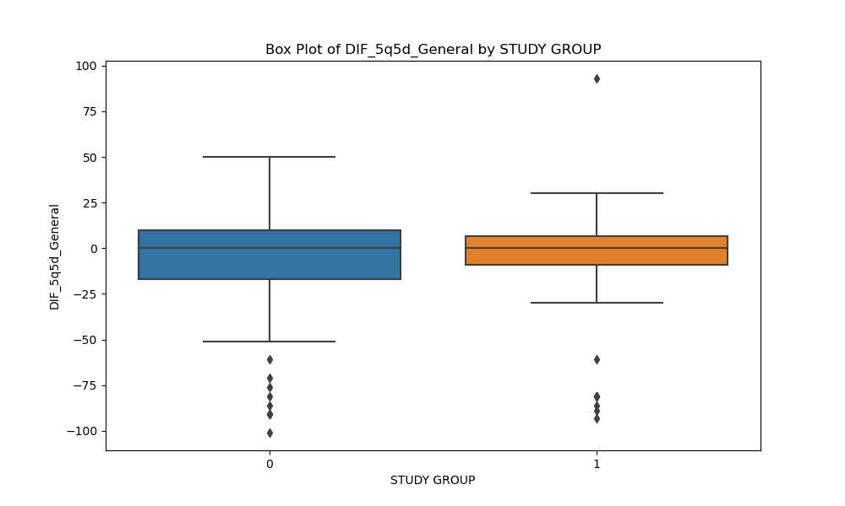
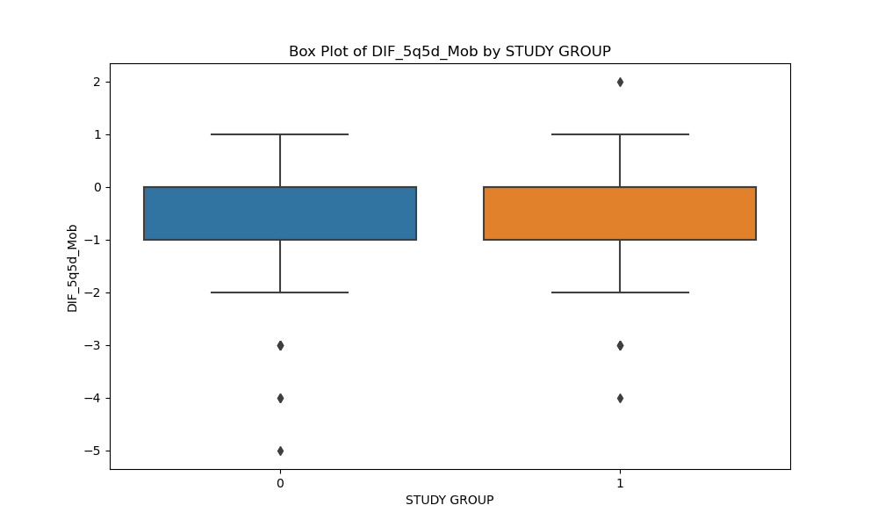


Slide 45
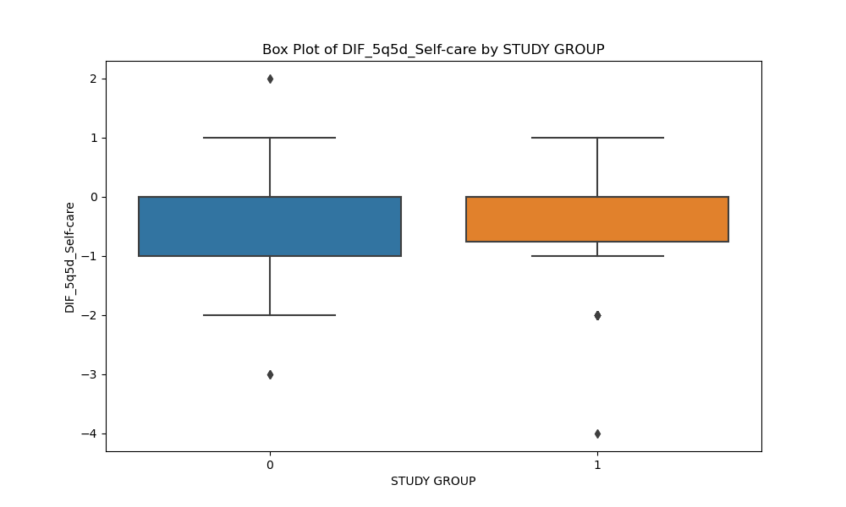

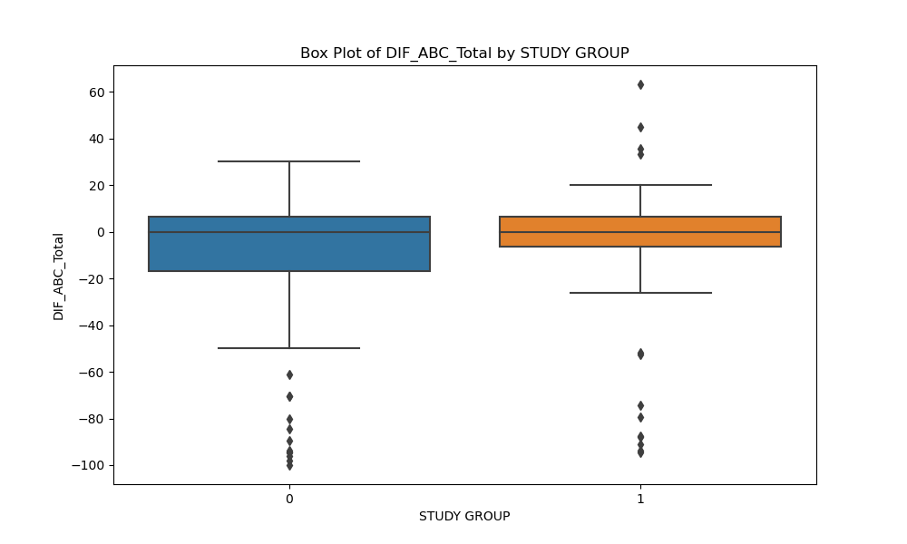
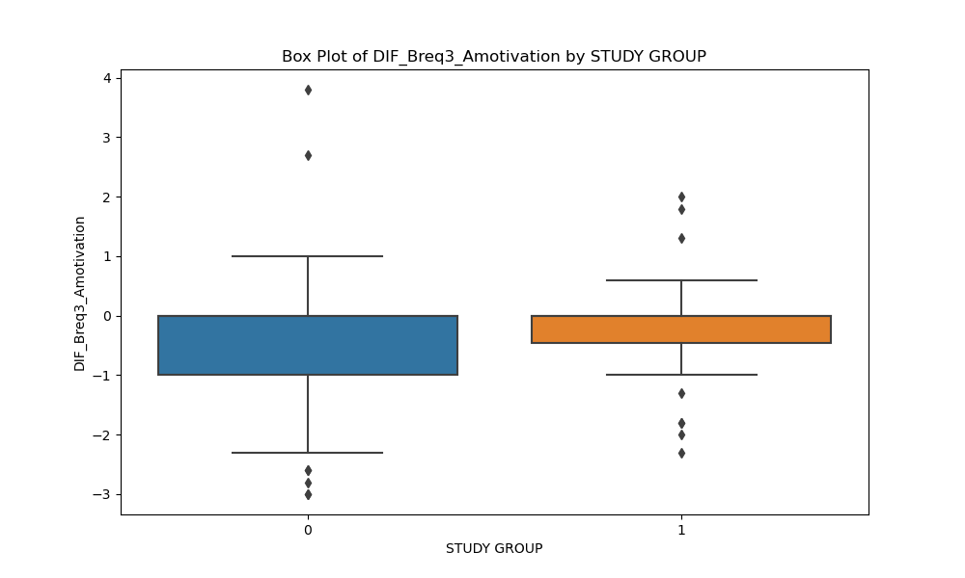

Slide 46
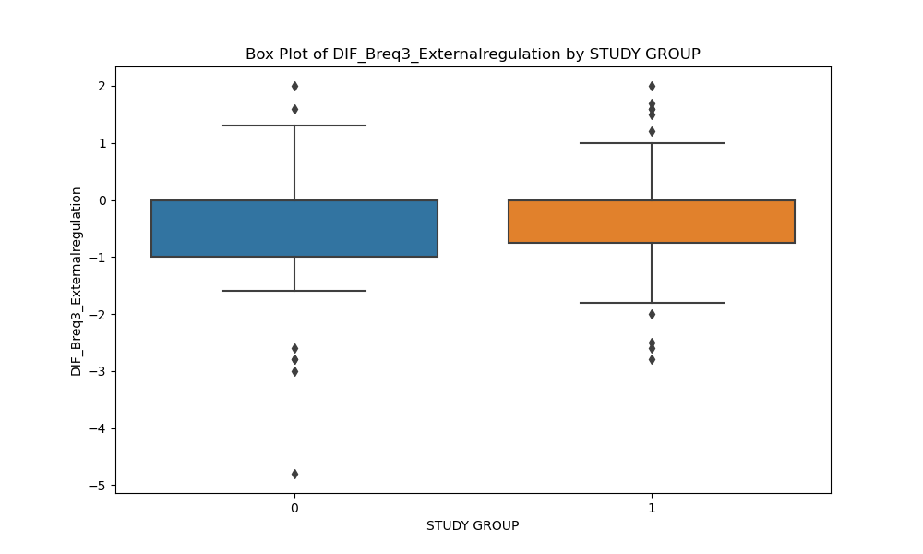
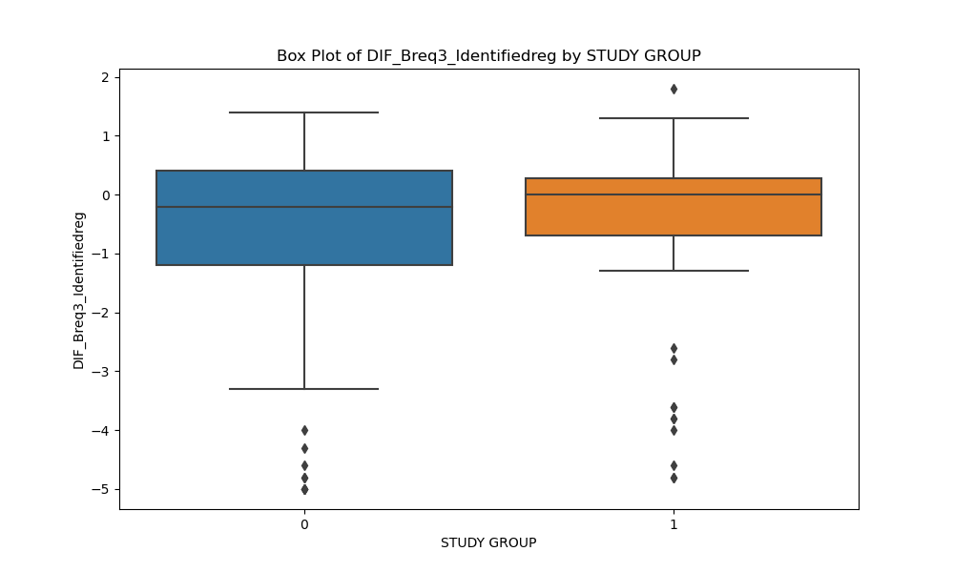
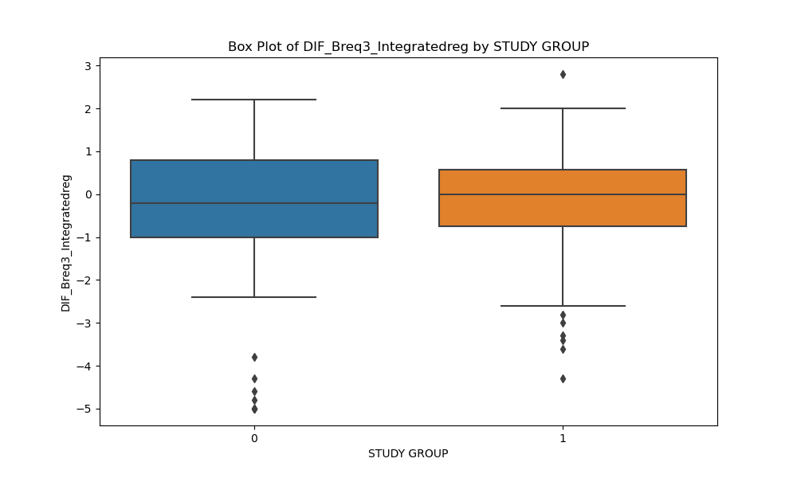
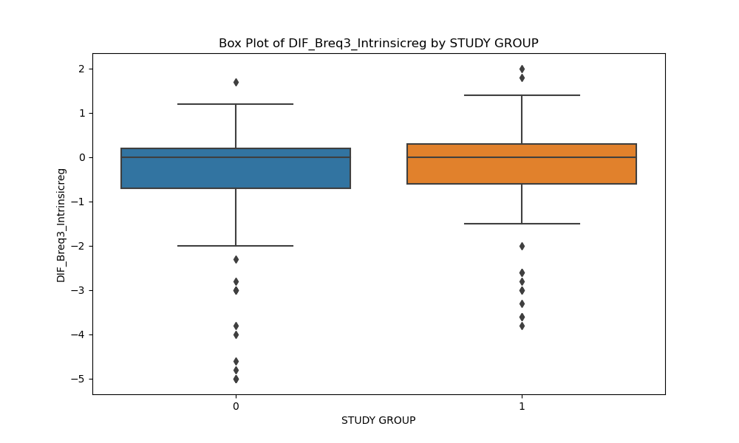

Slide 47

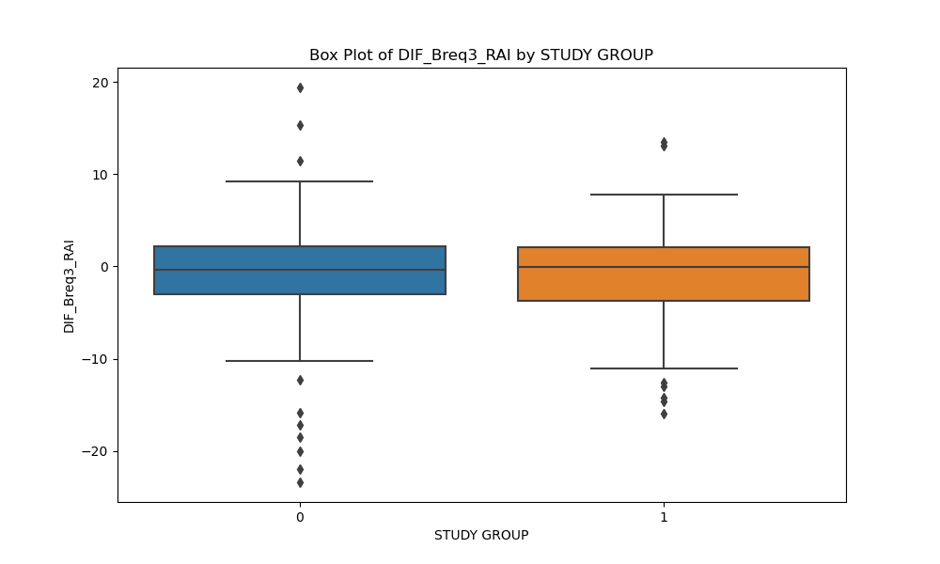

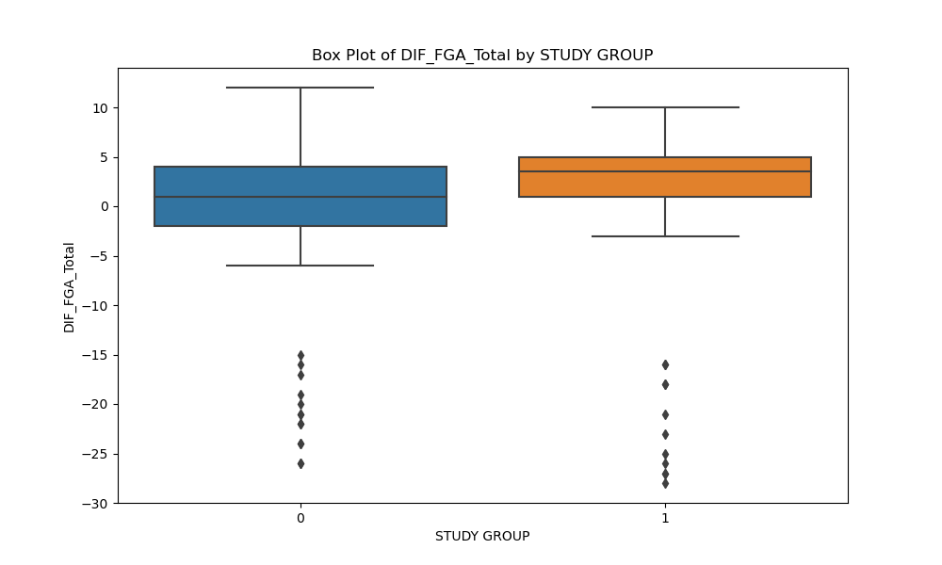

Slide 48
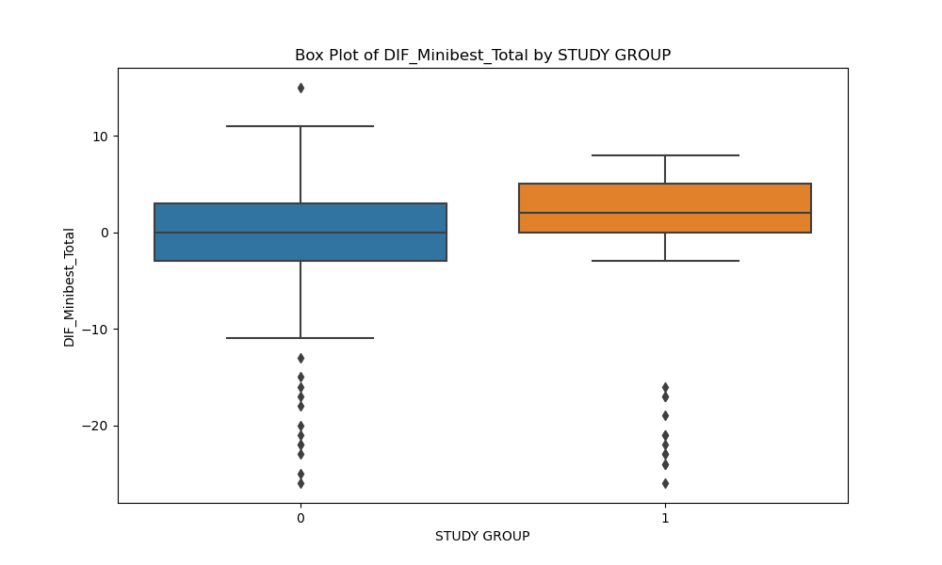
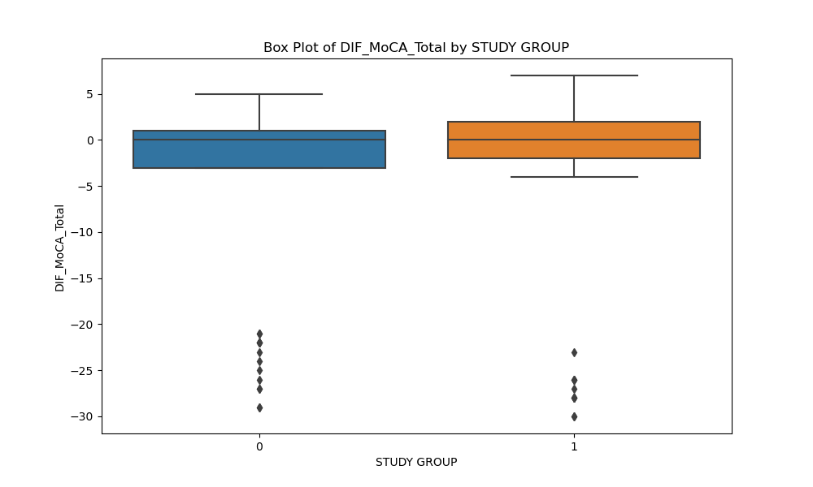

Slide 49
Statistically significant changes Study Group
Target Variable | Group | Test Statistic | P-Value | Significant Difference?
DIF_Minibest_Total | STUDY GROUP | U-stat: 1709.0 | 0.04426 | Yes
DIF_FGA_Total | STUDY GROUP | U-stat: 1600.0 | 0.01194 | Yes
DIF_Fesi_Total | STUDY GROUP | U-stat: 1824.0 | 0.13961 | No
DIF_MoCA_Total | STUDY GROUP | U-stat: 2015.5 | 0.54966 | No
DIF_Whodas_Total | STUDY GROUP | U-stat: 1973.0 | 0.42845 | No
DIF_Whodas_Standardized | STUDY GROUP | U-stat: 1980.5 | 0.44913 | No
DIF_ABC_Total | STUDY GROUP | U-stat: 2063.5 | 0.70916 | No
DIF_Breq3_Amotivation | STUDY GROUP | U-stat: 1738.0 | 0.04569 | Yes
DIF_Breq3_Externalreg | STUDY GROUP | U-stat: 2033.0 | 0.59468 | No
DIF_Breq3_Introjectedreg | STUDY GROUP | U-stat: 1994.5 | 0.48930 | No
DIF_Breq3_Identifiedreg | STUDY GROUP | U-stat: 2001.0 | 0.50794 | No
DIF_Breq3_Integratedreg | STUDY GROUP | U-stat: 2013.0 | 0.54381 | No
DIF_Breq3_Intrinsicreg | STUDY GROUP | U-stat: 2033.0 | 0.60314 | No
DIF_Breq3_RAI | STUDY GROUP | U-stat: 2199.0 | 0.80545 | No
DIF_5q5d_Mob | STUDY GROUP | U-stat: 2286.5 | 0.47655 | No
DIF_5q5d_Self-care | STUDY GROUP | U-stat: 2071.5 | 0.68840 | No
DIF_5q5d_Usual activities | STUDY GROUP | U-stat: 1954.5 | 0.35347 | No
DIF_5q5d_Pain | STUDY GROUP | U-stat: 1883.5 | 0.19933 | No
DIF_5q5d_Anxiety | STUDY GROUP | U-stat: 1868.5 | 0.17328 | No
DIF_5q5d_General | STUDY GROUP | U-stat: 2105.5 | 0.85699 | No
DROPPED OUT | STUDY GROUP | U-stat: 2282.5 | 0.36131 | No

Slide 50
Statistically significant changes Gender
Target Variable | Group | Test Statistic | P-Value | Significant Difference?
DIF_Minibest_Total | GENDER | U-stat: 1604.0 | 0.23099 | No
DIF_FGA_Total | GENDER | U-stat: 1712.0 | 0.50953 | No
DIF_Fesi_Total | GENDER | U-stat: 1926.5 | 0.68727 | No
DIF_MoCA_Total | GENDER | U-stat: 1978.5 | 0.50600 | No
DIF_Whodas_Total | GENDER | U-stat: 2057.0 | 0.29237 | No
DIF_Whodas_Standardized | GENDER | U-stat: 2061.0 | 0.28356 | No
DIF_ABC_Total | GENDER | U-stat: 1740.5 | 0.60560 | No
DIF_Breq3_Amotivation | GENDER | U-stat: 1972.0 | 0.50254 | No
DIF_Breq3_Externalreg | GENDER | U-stat: 1621.0 | 0.25016 | No
DIF_Breq3_Introjectedreg | GENDER | U-stat: 1679.5 | 0.41218 | No
DIF_Breq3_Identifiedreg | GENDER | U-stat: 1596.5 | 0.21732 | No
DIF_Breq3_Integratedreg | GENDER | U-stat: 1752.0 | 0.64521 | No
DIF_Breq3_Intrinsicreg | GENDER | U-stat: 1815.5 | 0.88408 | No
DIF_Breq3_RAI | GENDER | U-stat: 1770.5 | 0.71337 | No
DIF_5q5d_Mob | GENDER | U-stat: 1967.0 | 0.50835 | No
DIF_5q5d_Self-care | GENDER | U-stat: 1905.5 | 0.72229 | No
DIF_5q5d_Usual activities | GENDER | U-stat: 1766.5 | 0.68127 | No
DIF_5q5d_Pain | GENDER | U-stat: 1954.0 | 0.56510 | No
DIF_5q5d_Anxiety | GENDER | U-stat: 1733.5 | 0.55485 | No
DIF_5q5d_General | GENDER | U-stat: 1620.0 | 0.26334 | No
DROPPED OUT | GENDER | U-stat: 1770.5 | 0.59496 | No

Slide 51
Clinical Relevance
Clinical Tool | Description | Increase Implication | Decrease Implication
MiniBest Total | Assesses balance through various tasks to evaluate risk of falls. | Improved balance and reduced fall risk. | Decreased balance, increased fall risk.
FGA Total | Functional Gait Assessment to evaluate postural stability during different walking tasks. | Better walking ability and postural stability. | Poorer walking ability, reduced postural stability.
Fesi Total | Falls Efficacy Scale-International, measuring the fear of falling during daily activities. | Increased fear of falling. | Reduced fear of falling, increased confidence.
MoCA Total | Montreal Cognitive Assessment tests cognitive abilities including memory, attention, and language. | Improved cognitive function. | Decline in cognitive abilities.
Whodas Total | World Health Organization Disability Assessment Schedule assesses overall functioning in daily life. | Decreased disability, improved functioning. | Increased disability, reduced daily life functioning.
Whodas Standardized | Standardized scoring of WHODAS for comparative assessment across populations. | Lower disability scores, enhanced functionality. | Higher disability scores, diminished functionality.
ABC Total | Activities-specific Balance Confidence scale measures the level of confidence in performing activities. | Greater balance confidence in daily activities. | Lower confidence, potential balance issues.
Breq3 Amotivation | Assesses lack of motivation in Behavioral Regulation in Exercise Questionnaire-3. | Lower amotivation towards physical activities. | Increased amotivation or lack of interest.
Breq3 Externalregulation | Measures externally regulated motivation towards exercise. | Decreased external motivation, more self-driven. | Increased reliance on external factors for motivation.
Breq3 Introjectedregulation | Assesses internal pressures as a drive for exercise. | Reduced internal pressure, more balanced motivation. | Higher internal pressure or guilt-driven exercise.
Breq3 Identifiedreg | Measures identified regulation, where exercise is valued and deemed important. | Stronger personal value and importance of exercise. | Less personal valuation of exercise benefits.
Breq3 Integratedreg | Evaluates integrated regulation for exercise, showing a harmony in exercise motivation. | Harmonious motivation for physical activity. | Lack of harmony and internal conflict regarding exercise.
Breq3 Intrinsicreg | Assesses intrinsic motivation, reflecting exercise for inherent satisfaction. | Increased intrinsic motivation and enjoyment. | Lower intrinsic enjoyment or satisfaction from exercise.
Breq3 RAI | Reflective Action Index - assesses the degree of thoughtful engagement in exercise. | More thoughtful and engaged approach to exercise. | Less engagement and reflection in physical activity.
5q5d Mob | 5-item questionnaire assessing mobility aspects. | Enhanced mobility and ease of movement. | Reduced mobility or movement difficulties.
5q5d Self-care | Assesses the ability to perform self-care activities. | Improved self-care abilities. | Difficulty in managing self-care.
5q5d Usual activities | Evaluates performance in usual daily activities. | Better performance in daily activities. | Challenges in usual daily activities.
5q5d Pain | Measures the level of pain and discomfort. | Less pain and discomfort. | Increased pain or discomfort.
5q5d Anxiety | Assesses feelings of anxiety and unease. | Reduced anxiety levels. | Increased anxiety or unease.
5q5d General | General health perception as part of the 5-item questionnaire. | Improved general health perception. | Deterioration in perceived general health.

Slide 52
Endpoints and Targets
Group Category | Clinical Tools | Justification
Risk of Falls | DIF_Minibest_Total, DIF_FGA_Total, DIF_ABC_Total, DIF_5q5d_Mob. | These tools assess balance, gait functionality, mobility, and confidence, which are crucial in evaluating the risk of falls, especially in populations vulnerable to mobility issues.
Treatment Effectiveness | DIF_MoCA_Total, DIF_Whodas_Total, DIF_Whodas_Standardized, DIF_5q5d_Self-care, DIF_5q5d_Usual activities, DIF_5q5d_General, DIF_Breq3_Amotivation to DIF_Breq3_Intrinsicreg. | These measures provide insights into cognitive function, disability level, self-care capability, and motivational factors, which are key indicators of overall treatment effectiveness.
Side Effects / Adverse Events | DIF_5q5d_Pain, DIF_5q5d_Anxiety. | Pain and anxiety levels are essential indicators of potential adverse effects or side reactions to treatment, crucial for patient safety and well-being.

Slide 53
ML Classification Results
Target | Classifier | Accuracy | Sensitivity | ROC AUC
DIF_Minibest_Total | Logistic Regression | 0.65 | 0.68 | 0.67
 | Random Forest | 0.625 | 0.86 | 0.73
 | SVM | 0.575 | 1.0 | 0.57
 | Gradient Boosting | 0.6 | 0.82 | 0.63
 | K-Nearest Neighbors | 0.675 | 0.91 | 0.74
 | Decision Tree | 0.625 | 0.73 | 0.61
 | XGBoost | 0.7 | 0.86 | 0.70
DIF_FGA_Total | Logistic Regression | 0.625 | 0.74 | 0.72
 | Random Forest | 0.725 | 1.0 | 0.82
 | SVM | 0.6 | 1.0 | 0.65
 | Gradient Boosting | 0.6 | 0.87 | 0.74
 | K-Nearest Neighbors | 0.675 | 0.87 | 0.62
 | Decision Tree | 0.625 | 0.87 | 0.58
 | XGBoost | 0.65 | 0.83 | 0.74
DIF_Fesi_Total | Logistic Regression | 0.7 | 0.3 | 0.63
 | Random Forest | 0.75 | 0.0 | 0.5
 | SVM | 0.75 | 0.0 | 0.56
 | Gradient Boosting | 0.7 | 0.0 | 0.57
 | K-Nearest Neighbors | 0.775 | 0.1 | 0.54
 | Decision Tree | 0.65 | 0.3 | 0.53
 | XGBoost | 0.75 | 0.1 | 0.52
Target | Classifier | Accuracy | Sensitivity | ROC AUC
DIF_MoCA_Total | Logistic Regression | 0.6 | 0.56 | 0.66
 | Random Forest | 0.6 | 0.25 | 0.55
 | SVM | 0.6 | 0.0 | 0.44
 | Gradient Boosting | 0.55 | 0.38 | 0.54
 | K-Nearest Neighbors | 0.38 | 0.19 | 0.31
 | Decision Tree | 0.53 | 0.31 | 0.49
 | XGBoost | 0.55 | 0.31 | 0.48
DIF_Whodas_Total | Logistic Regression | 0.7 | 0.18 | 0.65
 | Random Forest | 0.7 | 0.0 | 0.46
 | SVM | 0.73 | 0.0 | 0.57
 | Gradient Boosting | 0.65 | 0.09 | 0.50
 | K-Nearest Neighbors | 0.73 | 0.09 | 0.57
 | Decision Tree | 0.58 | 0.18 | 0.45
 | XGBoost | 0.65 | 0.09 | 0.51
DIF_Whodas_Standardized | Logistic Regression | 0.7 | 0.18 | 0.65
 | Random Forest | 0.73 | 0.18 | 0.44
 | SVM | 0.73 | 0.18 | 0.57
 | Gradient Boosting | 0.65 | 0.09 | 0.49
 | K-Nearest Neighbors | 0.73 | 0.09 | 0.57
 | Decision Tree | 0.63 | 0.27 | 0.52
 | XGBoost | 0.65 | 0.09 | 0.51

Slide 54
ML Classification Results
Target | Classifier | Accuracy | Sensitivity | ROC AUC
DIF_ABC_Total | Logistic Regression | 0.6 | 0.73 | 0.64
 | Random Forest | 0.55 | 0.53 | 0.55
 | SVM | 0.4 | 1.0 | 0.32
 | Gradient Boosting | 0.63 | 0.6 | 0.61
 | K-Nearest Neighbors | 0.45 | 0.53 | 0.43
 | Decision Tree | 0.55 | 0.6 | 0.56
 | XGBoost | 0.58 | 0.6 | 0.59
DIF_Breq3_Amotivation | Logistic Regression | 0.78 | 0.25 | 0.44
 | Random Forest | 0.9 | 0.0 | 0.67
 | SVM | 0.9 | 0.0 | 0.78
 | Gradient Boosting | 0.85 | 0.0 | 0.47
 | K-Nearest Neighbors | 0.88 | 0.0 | 0.72
 | Decision Tree | 0.73 | 0.5 | 0.63
 | XGBoost | 0.88 | 0.25 | 0.63
DIF_Breq3_Externalregulation | Logistic Regression | 0.58 | 0.22 | 0.46
 | Random Forest | 0.78 | 0.0 | 0.47
 | SVM | 0.78 | 0.0 | 0.47
 | Gradient Boosting | 0.68 | 0.0 | 0.38
 | K-Nearest Neighbors | 0.75 | 0.11 | 0.47
 | Decision Tree | 0.58 | 0.0 | 0.37
 | XGBoost | 0.78 | 0.11 | 0.45
Target | Classifier | Accuracy | Sensitivity | ROC AUC
DIF_Breq3_Introjectedregulation | Logistic Regression | 0.58 | 0.54 | 0.74
 | Random Forest | 0.7 | 0.62 | 0.69
 | SVM | 0.68 | 0.0 | 0.57
 | Gradient Boosting | 0.68 | 0.62 | 0.72
 | K-Nearest Neighbors | 0.45 | 0.31 | 0.39
 | Decision Tree | 0.58 | 0.38 | 0.53
 | XGBoost | 0.63 | 0.46 | 0.64
DIF_Breq3_Identifiedreg | Logistic Regression | 0.48 | 0.19 | 0.49
 | Random Forest | 0.6 | 0.19 | 0.75
 | SVM | 0.6 | 0.0 | 0.47
 | Gradient Boosting | 0.73 | 0.5 | 0.80
 | K-Nearest Neighbors | 0.58 | 0.19 | 0.46
 | Decision Tree | 0.7 | 0.56 | 0.68
 | XGBoost | 0.73 | 0.56 | 0.79
DIF_Breq3_Integratedreg | Logistic Regression | 0.63 | 0.36 | 0.6
 | Random Forest | 0.63 | 0.29 | 0.76
 | SVM | 0.65 | 0.0 | 0.61
 | Gradient Boosting | 0.7 | 0.57 | 0.73
 | K-Nearest Neighbors | 0.55 | 0.5 | 0.54
 | Decision Tree | 0.58 | 0.29 | 0.51
 | XGBoost | 0.63 | 0.43 | 0.73

Slide 55
ML Classification Results
Target | Classifier | Accuracy | Sensitivity | ROC AUC
DIF_Breq3_Intrinsicreg | Logistic Regression | 0.5 | 0.17 | 0.38
 | Random Forest | 0.55 | 0.0 | 0.42
 | SVM | 0.55 | 0.0 | 0.44
 | Gradient Boosting | 0.55 | 0.06 | 0.58
 | K-Nearest Neighbors | 0.5 | 0.0 | 0.42
 | Decision Tree | 0.53 | 0.33 | 0.51
 | XGBoost | 0.6 | 0.22 | 0.56
DIF_Breq3_RAI | Logistic Regression | 0.53 | 0.32 | 0.53
 | Random Forest | 0.53 | 0.21 | 0.62
 | SVM | 0.53 | 0.0 | 0.60
 | Gradient Boosting | 0.55 | 0.26 | 0.58
 | K-Nearest Neighbors | 0.53 | 0.47 | 0.45
 | Decision Tree | 0.6 | 0.47 | 0.59
 | XGBoost | 0.55 | 0.42 | 0.55
DIF_5q5d_Mob | Logistic Regression | 0.88 | 0.0 | 0.50
 | Random Forest | 0.88 | 0.0 | 0.61
 | SVM | 0.88 | 0.0 | 0.59
 | Gradient Boosting | 0.88 | 0.0 | 0.41
 | K-Nearest Neighbors | 0.88 | 0.0 | 0.39
 | Decision Tree | 0.88 | 0.0 | 0.5
 | XGBoost | 0.88 | 0.0 | 0.57
Target | Classifier | Accuracy | Sensitivity | ROC AUC
DIF_5q5d_Self-care | Logistic Regression | 0.88 | 0.0 | 0.67
 | Random Forest | 0.88 | 0.0 | 0.70
 | SVM | 0.88 | 0.0 | 0.65
 | Gradient Boosting | 0.88 | 0.0 | 0.61
 | K-Nearest Neighbors | 0.88 | 0.0 | 0.48
 | Decision Tree | 0.83 | 0.0 | 0.47
 | XGBoost | 0.88 | 0.0 | 0.54
DIF_5q5d_Usual activities | Logistic Regression | 0.8 | 0.0 | 0.48
 | Random Forest | 0.85 | 0.0 | 0.46
 | SVM | 0.85 | 0.0 | 0.49
 | Gradient Boosting | 0.85 | 0.0 | 0.51
 | K-Nearest Neighbors | 0.85 | 0.0 | 0.41
 | Decision Tree | 0.83 | 0.0 | 0.49
 | XGBoost | 0.85 | 0.0 | 0.55
DIF_5q5d_Pain | Logistic Regression | 0.73 | 0.3 | 0.53
 | Random Forest | 0.75 | 0.0 | 0.50
 | SVM | 0.75 | 0.0 | 0.69
 | Gradient Boosting | 0.73 | 0.2 | 0.58
 | K-Nearest Neighbors | 0.75 | 0.0 | 0.54
 | Decision Tree | 0.65 | 0.2 | 0.5
 | XGBoost | 0.73 | 0.0 | 0.64

Slide 56
ML Classification Results
Target | Classifier | Accuracy | Sensitivity | ROC AUC
DIF_5q5d_Anxiety | Logistic Regression | 0.85 | 0.0 | 0.65
 | Random Forest | 0.85 | 0.0 | 0.69
 | SVM | 0.85 | 0.0 | 0.75
 | Gradient Boosting | 0.78 | 0.0 | 0.42
 | K-Nearest Neighbors | 0.83 | 0.0 | 0.61
 | Decision Tree | 0.75 | 0.17 | 0.51
 | XGBoost | 0.83 | 0.0 | 0.66
DIF_5q5d_General | Logistic Regression | 0.5 | 0.39 | 0.47
 | Random Forest | 0.55 | 0.39 | 0.52
 | SVM | 0.55 | 0.0 | 0.53
 | Gradient Boosting | 0.6 | 0.61 | 0.57
 | K-Nearest Neighbors | 0.58 | 0.5 | 0.54
 | Decision Tree | 0.55 | 0.56 | 0.55
 | XGBoost | 0.53 | 0.44 | 0.60
DROPPED OUT | Logistic Regression | 0.8 | 0.43 | 0.68
 | Random Forest | 0.88 | 0.29 | 0.89
 | SVM | 0.85 | 0.14 | 0.78
 | Gradient Boosting | 0.85 | 0.43 | 0.75
 | K-Nearest Neighbors | 0.85 | 0.43 | 0.75

Slide 57
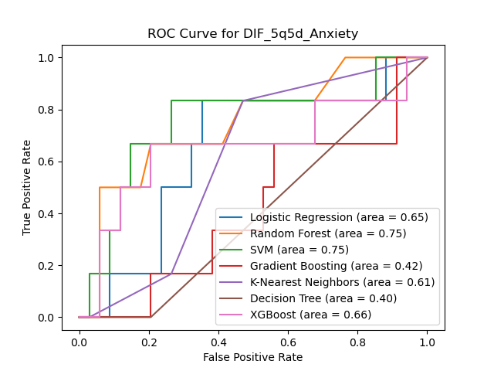
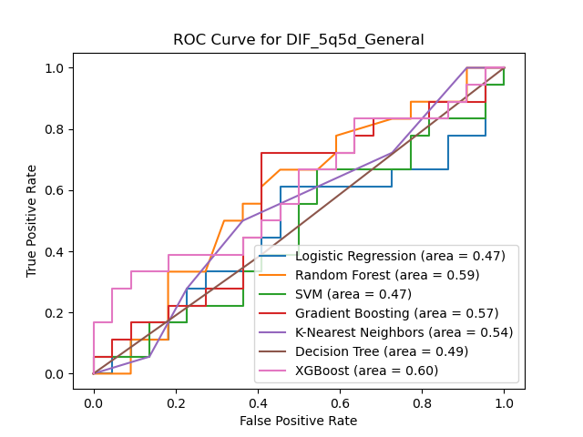
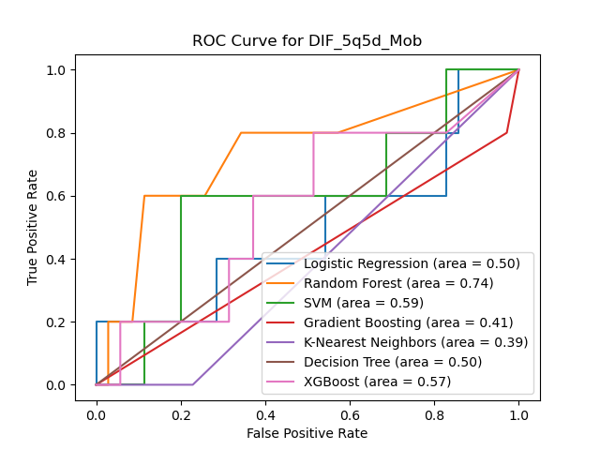
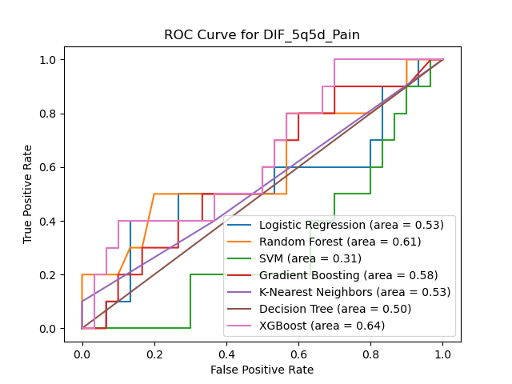

Slide 58
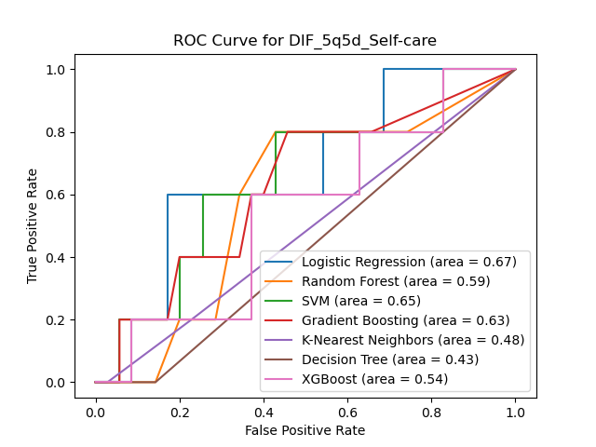
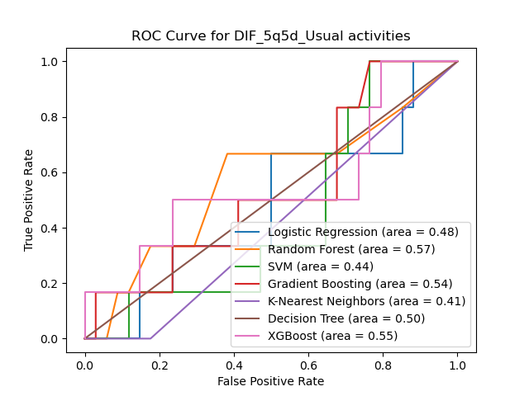
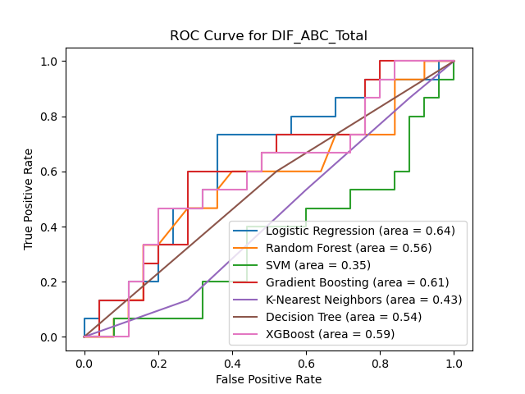
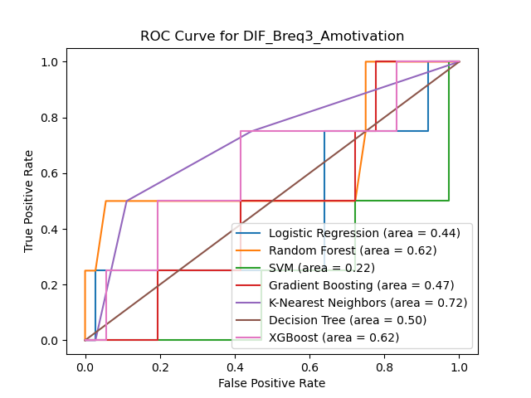

Slide 59
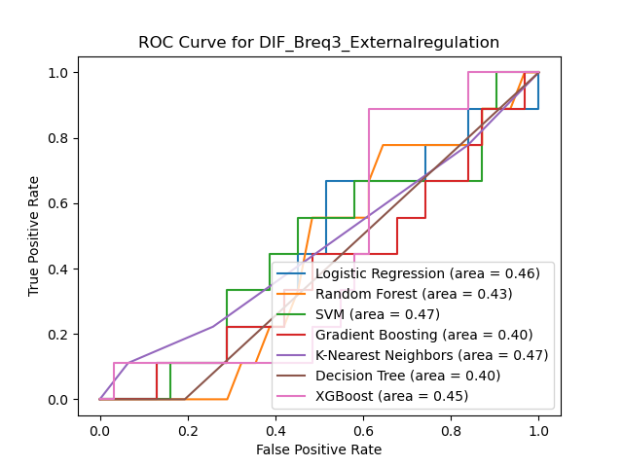
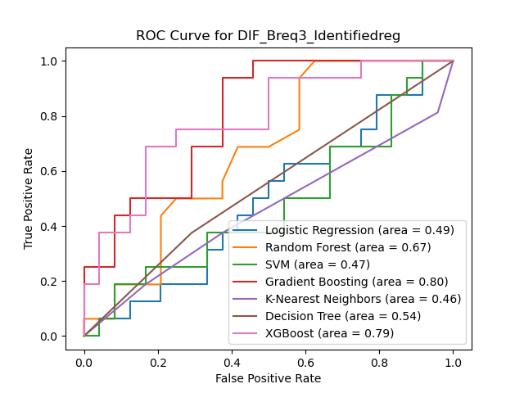
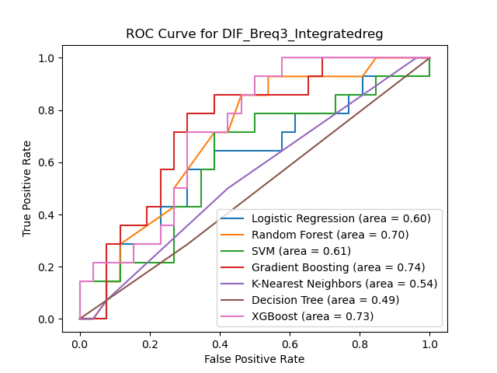
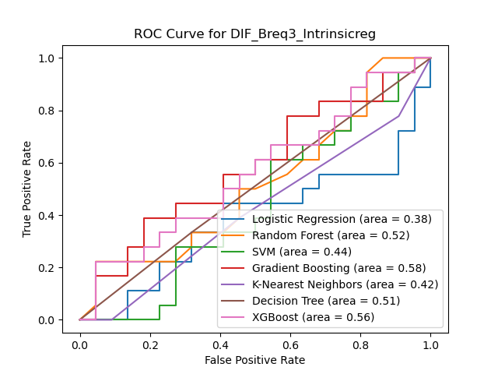

Slide 60
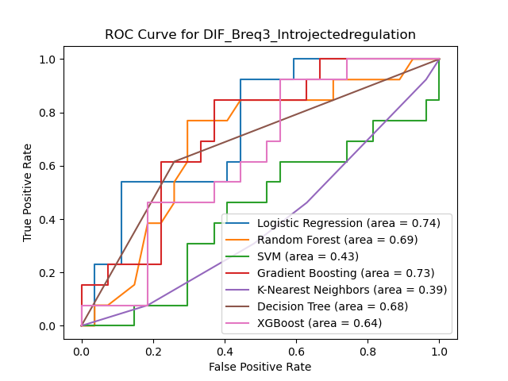
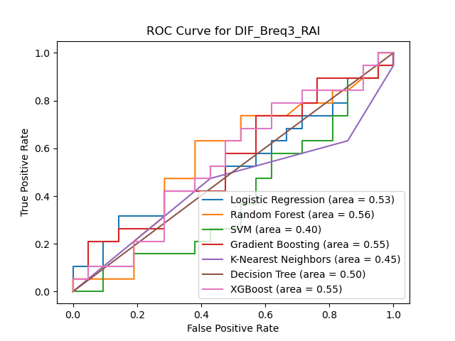
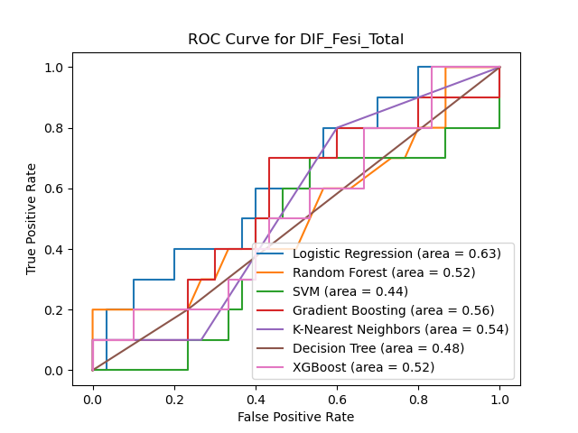
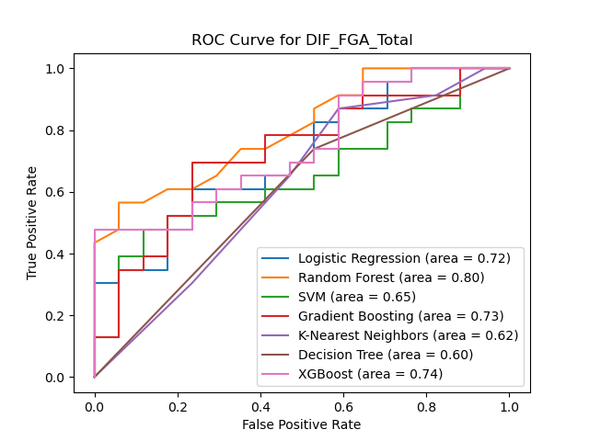

Slide 61
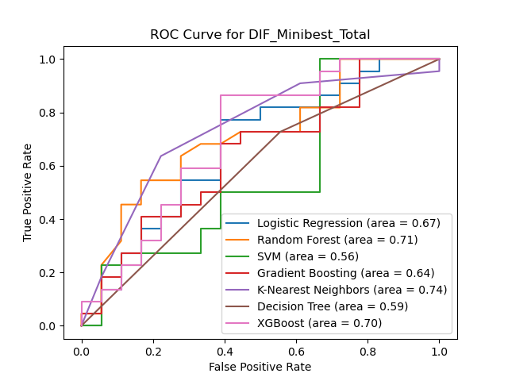
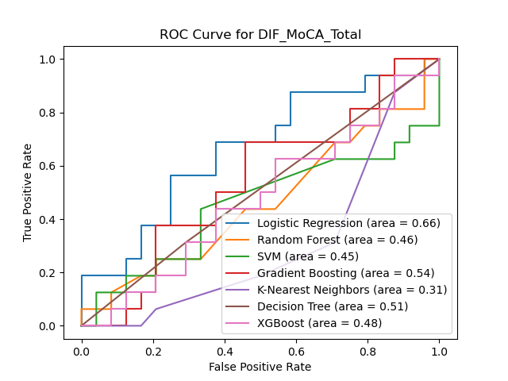



Slide 62


Slide 63
Thanks for your attention.
Any question?

