Slide 1
Stroke Prediction
Using Machine Learning
{
< AUDABC Data Analytics Project 4>
}
...

Slide 2
Tim Cook
}
<Not a doctor!>
*

Slide 3
Contents of this presentation
01} Project Goal | Quick run down on what I have tried to achieve
02} Intro to the Dataset | Quick run down on the dataset and cleaning
03} Machine Learning Exploration | Looking at the models used and the accuracy
04} The webapp | Quick look at the code used to create the webapp
05} Live Demo | Live demonstration of the webapp
06} End Step | Future options, Credits, attributions etc

Slide 4
01
Project goals
{
..
< What I was trying to achieve >
}
..

Slide 5
Can we accurately predict Stroke risk through machine learning?
According to the World Health Organization (WHO) stroke is the 2nd leading cause of death globally, responsible for approximately 11% of total deaths.
This dataset is used to predict whether a patient is likely to get stroke based on the input parameters like gender, age, various diseases, and smoking status.
Each row in the data provides an observation of relevant information about a patient.
I doubt anyone is silly enough, but do not use for medical advice!
}
..

Slide 6
Web Based Diagnosis Application
{
Go See a Doctor!
Also wanted to put the model into a work scenario so created a web app where a user can enter their stats and be classified as low, medium or high-risk
}
...

Slide 7
02
The Dataset
{
..
< Stroke prediction >
}
..

Slide 8
The dataset!
Stroke Prediction Dataset
https://www.kaggle.com/datasets/fedesoriano/stroke-prediction-dataset
5110 records
12 attributes
Relatively clean already
Used in actual published research studies! https://www.sciencedirect.com/science/article/pii/S2665917423002076
“Confidential Source”
Created by Kaggle user Fedesoriano
*

Slide 9
The dataset continued!
1) id: unique identifier
2) gender: "Male", "Female" or "Other"
3) age: age of the patient
4) hypertension: 0 if the patient doesn't have hypertension, 1 if the patient has hypertension
5) heart_disease: 0 if the patient doesn't have any heart diseases, 1 if the patient has a heart disease
6) ever_married: "No" or "Yes"
7) work_type: "children", "Govt_jov", "Never_worked", "Private" or "Self-employed"
8) Residence_type: "Rural" or "Urban"
9) avg_glucose_level: average glucose level in blood
10) bmi: body mass index
11) smoking_status: "formerly smoked", "never smoked", "smokes" or "Unknown"*
12) stroke: 1 if the patient had a stroke or 0 if not
*

Slide 10
Cleaning the Dataset
...
Automated EDA
Using a module called ydata-profiling.
https://ydata-profiling.ydata.ai/docs/master/index.html
Ydata provides 1-line automated EDA that gives a whole heap of information on all variables. Can give a quick demo if anyone has not seen it and is interested.
Followed up with some manual EDA, did not perform any cleaning without first verifying manually.

Slide 11
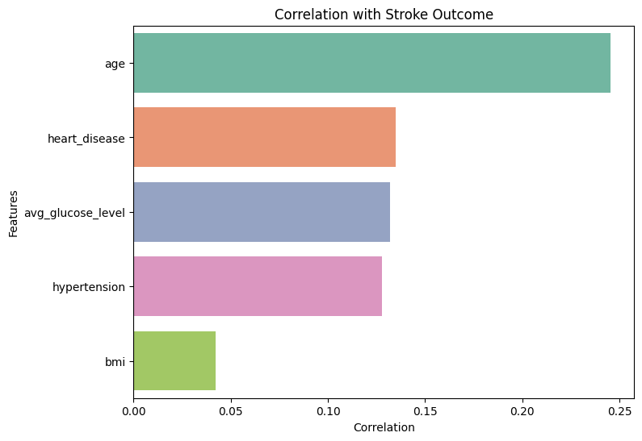
correlation
{
Correlation of features with Stroke outcome
*

Slide 12
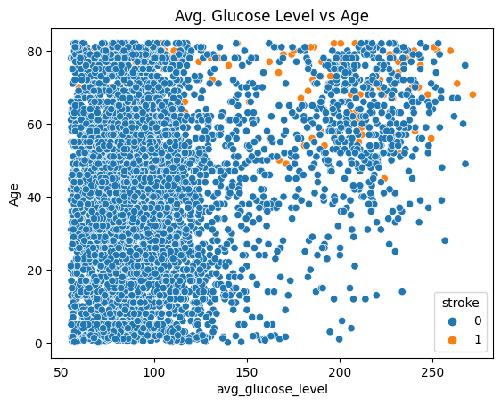
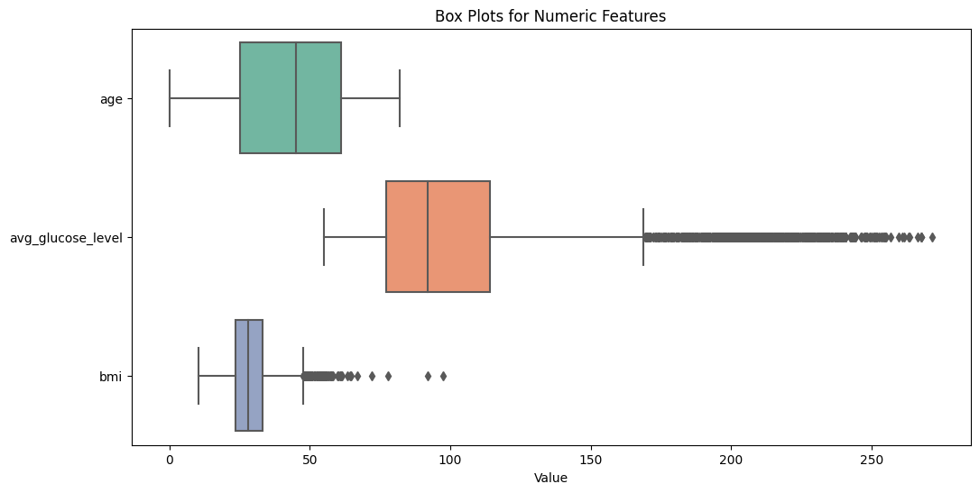
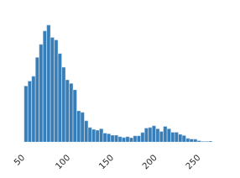
the outliers
{
*

Slide 13
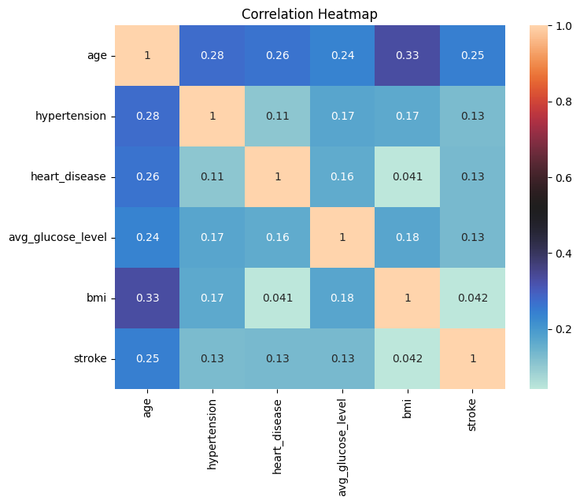
The BMI Problem
202 rows missing BMI.
20% (~40) of those were on rows with stroke = 1
Only 4.8% of total rows had stroke = 1, so around 25% of those would have had BMI missing.
BMI was very imbalanced and posed a large problem options were:
Fill with mean
Drop BMI
Tested decision tree model with both, and the accuracy was very close, also low (0.041) correlation with stroke.
BMI was dropped.
*

Slide 14
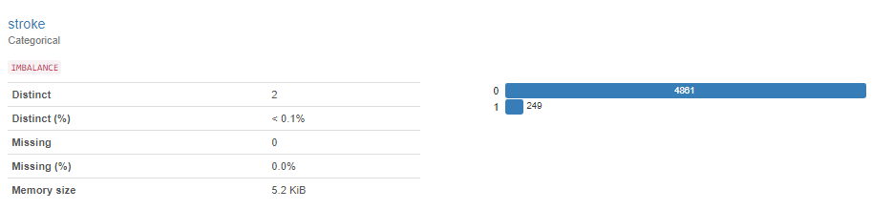
Dataset Skew
Only 249 of the 5100 rows have Stroke = 1
Attempted stratified splitting based on the stroke variable, and there was no effect on the performance of the model.
*

Slide 15
02
Machine Learning Models
{
..
< Review and process of the two models used >
}
..

Slide 16
Machine Learning Methods
Data Scaling
Split
Using StandardScaler()
Using train_test_split()
Hyperparameter Tuning
Encoding
After initial creation each model was hyperparameter tuned to try and improve performance.
LabelEncoder()
pd.get_dummies()

Slide 17
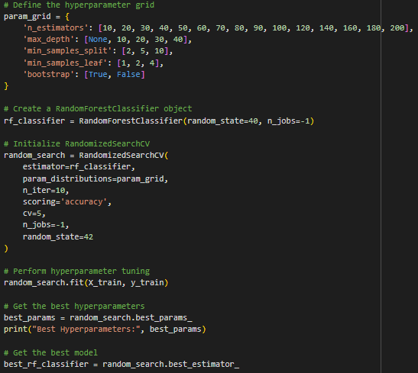
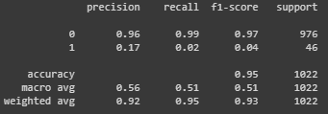
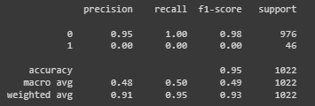
Decision Tree
Initial Model
Hyper Tuned Model
*

Slide 18
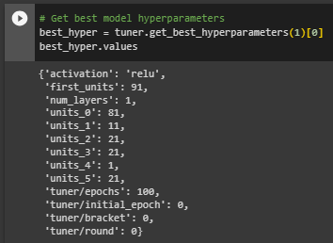

Tensorflow Neural Network
Initial Model
Hyper Tuned Model
*

Slide 19
ML Model Accuracy
95%
95%
*
Decision Tree
Neural Netowrk

Slide 20
Neural Network was More Fun
{
..
}
..

Slide 21
03
The Webapp
{
..
< Not necessary, but I wanted to…>
}
..

Slide 22
How everything fits together
{
..
Python + Pandas + GoogleColab
Ydata_profiler
Seaborn + MatplotLib
StandardScaler + TTS + Encoders
Sklearn + TensorFlow
VS Code
Flask API + JavaScript + D3.js
HTML + CSS
BootStrap.js
*
}
..

Slide 23
Note: Using the Model IRL
A Neural Network model once you save it and load it does not give binary values.
Sigmoid activation gives a decimal value between 0 and 1, but it is not actually a probability either
High Risk: >0.4
Medium Risk: >0.3
Low Risk: <0.3
*

Slide 24
Time for Live Demo
{
< It was working this morning I swear…>
}

Slide 25
04
The End Step
{
..
< future opportunities…>
}
..

Slide 26
Ways to improve The Project
SMOTE
Fix BMI
Synthetic Minority Oversampling Technique
Is there a better way to deal with BMI. Adding via mean is not it.
Outliers
Try Other Models
95% is 5% less than 100%...
I chose not to remove the outliers. Most people who have done the data set agree…
Make the web app prettier...

Slide 27
Thanks!
< Do you have any questions? >
youremail@freepik.com
+34 654 321 432
yourwebsite.com
Please keep this slide for attribution

Slide 28


