Slide 1

PASS ICT283
Session 2
C++

Slide 2
Session 2
Objectives
Arrays
C-Style Strings
Structs
Classes
Notes:
Functions2_example.cpp

Slide 3

The most important thing…
C++
Java
The single most important requisite in programming is to write code that works.
ICT283 will be challenging.
But you need not be afraid; every challenge contains a gift.
Have the courage to take it on and you will be surprised.

Slide 4
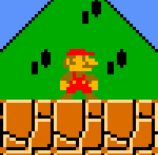



Overview of PASS Sessions
You are here…
Levelling UP!
Exam
Building Applications
Difficulty
Ass1
Ass2
Boring Fundamentals
7
6
8
4
5
9
2
3
10
1
Term
Start
Term
End
Milestone 1
Be able to write very basic working code in C++
Milestone 2
Be able to code, test and implement various data structures in C++
Milestone 3
Be able to code fluently in C++ and make data structure design choices for various programs.

Slide 5
You Have Been Warned… (echo)
WARNING
From here on out, you will need to know the basics of C++ arrays to understand the source code provided.
Remember, picking up C++ is entirely up to you.
C++ Arrays :
https://www.programiz.com/cpp-programming/arrays
Notes:
Reference_example.cpp

Slide 6
Introduction to arrays in C++
An array is a data structure that contains a group of elements.
Typically these elements are of the same data type.
Processing of arrays is the same in C++ as in C or Java, with [ ] giving access to elements.

Slide 7
Arrays 1
Declaring and Initializing an array – 3 different methods
int arr [10];
arr[0] = 1;
arr[1] = 2;
arr[2] = 3;
arr[3] = 4;
arr[4] = 5;
const int SIZE = 10;
int arr [SIZE];
for(int i=0; i<SIZE; i++)
{
arr[i] = i;
}
int arr [] = {1,2,3,4,5,6,7,8,9,10};
cout<< arr; //prints address of the first array element
cout<< *arr //prints ”1” (why?)
Which section of memory are these arrays initialized?

Slide 8
Arrays 2
Passing an Array into a Function
What type of parameter is passed? (hint: pointers)
void incrementArr ( int * a , int size )
{
for(int i=0; i<size; i++)
{
a[i]+=1;
cout<< a[i] <<“ “;
}
}
int arr [] = {1,2,3,4,5,6,7,8,9,10};
incrementArr ( arr , 10 ); // arr is modified
2 3 4 5 6 7 8 9 10 11
Notes:
Array_example.cpp

Slide 9
Code It Yourself!
Arrays
Practice
array_example.cpp
Notes:
array_example.cpp

Slide 10
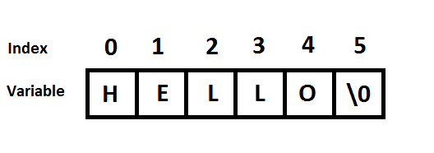
Introduction to C-style strings
C strings are arrays of characters used to represent sentences or words.
The <cstring> header provides functions for dealing with C strings
C strings are null-terminated.

Slide 11
C-style Strings 1
Declaring and Initializing a C string (char array)
#include <cstring>
const int SIZE = 10;
char name [SIZE];
name[0] = ‘B’;
name[1] = ’O’;
name[2] = ‘B’;
char name [] = “bobby”;
char name [10] = “bobby”;
char name [10]; //empty
char name [10] = {’E’,’L’,’I’,’Z’,’A’};
cout<<name; //prints “ELIZA”
cout<<strlen(name); //prints “5” (why not 10?)
cout<<*name; //prints “E” (why?)

Slide 12
C-style Strings 2
Passing a c-style string into a Function
What type of parameter is passed? (hint: pointers)
void clearStr ( char * str )
{
for(int i=0; i<strlen(str); i++)
{
str[i]=’\0’; // null character
}
}
char name [10] = {’E’,’L’,’I’,’Z’,’A’};
clearStr (name); // “name” is modified
cout<<name; // prints nothing

Slide 13
Code It Yourself!
C-style Strings
Practice
cstring_example.cpp
Notes:
Cstring_example.cpp

Slide 14
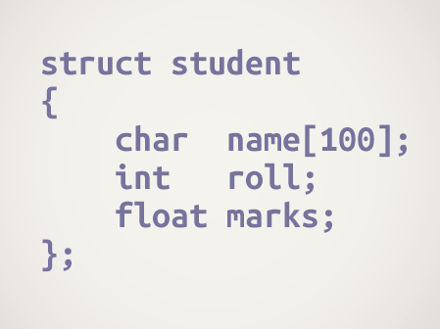
Introduction to records (structs)
We often come around situations where we need to store a group of data whether of similar data types or non-similar data types.
Unlike Arrays, Structs in C++ are user defined data types which are used to store group of items of non-similar data types.

Slide 15
Records (struct) 1
struct Birthday
{
string name;
int day;
int month;
int year;
};
int main (void)
{
Birthday b;
b.name = “Sally”;
b.day = 5;
b.month = 12;
b.year = 2001
return 0;
}
A complex data type…
struct myRecord
{
//some data
};
Access struct with “.” dot operator

Slide 16
Assign References 2 (struct reference)
Birthday b;
b.name = “Sally”;
b.day = 5;
b.month = 12;
b.year = 2001;
//continued
Birthday& a = b;
// a references b
a.year = 2012;
a and b both refer to the same record
cout<<a.name; //prints the string “Sally”
cout<<b.name; //prints the string “Sally”
cout<<a.year; //prints the value 2012
cout<<b.year; //prints the value 2012
Access struct with “.” dot operator

Slide 17
Assign Pointer to Stack Memory 2 ( pointer to struct )
Birthday b;
Birthday * ptr;
ptr=&b; //assign address of b to ptr
Accessing Birthday b’s public methods using a pointer
ptr->name = “Sally”
ptr->day = 5;
ptr->month = 12;
string s = ptr->name;
(*ptr).name = “Sally”;
(*ptr).day = 5;
(*ptr).month = 12;
string s = (*ptr).name;
Method 1: “->” arrow operator
Method 2: “.” dot operator

Slide 18
Assign Pointer to Heap Memory 2 ( pointer to struct )
Birthday* ptr = new Birthday;
//do some work
delete ptr;
ptr=NULL;
The ”new” operator allocates a space in heap memory to store a Birthday record.
The pointer ptr stores the address of that memory location.
ptr->name = “Sally”
ptr->day = 5;
ptr->month = 12;
string s = ptr->name;
(*ptr).name = “Sally”;
(*ptr).day = 5;
(*ptr).month = 12;
string s = (*ptr).name;
Accessing Birthday data
using a pointer
Method 1: “->” arrow operator
Method 2: “.” dot operator

Slide 19
Code It Yourself!
Structs
Practice
struct_example.cpp
Notes:
Struct_example.cpp

Slide 20
Object-Oriented Programming – Designing a Class
In C++ we set up 3 files for each class:
The header file (.h) stores the class interface and data definition.
The implementation file (.cpp) stores the class implementation.
The (unit) test file (.cpp) tests every method for all parameter bounds.
Rules:
Each class should represent only ONE thing. (cohesion)
Every class must be tested in isolation in a test file (maintainability).
The testing must occur before the class is used by any other class.
For every method in the class, you need to test all possible cases.
This forms the class’s Test Plan.
Minimal class:
Constructors
Destructors (important if there are pointers in the data members)
Attribute declarations
Getters
Setters
Output methods (for debugging only)

Slide 21
Class Definition ( .h file )
#ifndef PERSON_H
#define PERSON_H
Class Person
{
public:
Person();
~Person();
string getName();
int getAge();
void setName(string s);
void setAge(int i);
Private:
string name;
int age;
}
#endif
Visibility (public)
Constructor
Destructor
Getters
Setters
Visibility (private)
Variables

Slide 22
Class Implementation ( .cpp file )
#include “Person.h”
Person::Person(){}
Person::~person(){}
string Person::getName()
{
return name;
}
int Person::getAge()
{
return age;
}
void Person::setName(string s)
{
name=s;
}
void Person::setAge(int i)
{
age=i;
}
“::” scope resolution operator
Constructor
Destructor
Getters
Setters

Slide 23
Main Function 2 ( include Person class )
#include <stdio.h>
#include <iostream>
#include <string.h>
#include “Person.h”
using namespace std;
int main (void)
{
Person p1;
p1.setName(“John”);
cout<<p1.getName()<<endl;
return 0;
}

Slide 24
Assign References 3 (object reference)
person p;
person& x = p; // x references p
p and x both refer to the same person object
p.setName(“Larry”);
p.setAge(5);
string s = x.getName(); // s = “larry”
int x = x.getAge(); // x = 5

Slide 25
Assign Pointer to Stack Memory 3 ( pointer to object )
person p;
person * ptr;
ptr=&p; // assign address of p to ptr
Accessing person p’s public methods using a pointer
ptr->setName(“Larry”);
ptr->setAge(5);
string s = ptr->getName();
int x = ptr->getAge();
(*ptr).setName(“Larry”);
(*ptr).setAge(5);
string s = (*ptr).getName();
int x = (*ptr).getAge();
Method 1: “->” arrow operator
Method 2: “.” dot operator

Slide 26
Assign Pointer to Heap Memory 3 ( pointer to object )
person * ptr = new person();
//do some work
delete ptr;
ptr=NULL;
The ”new” operator allocates a space in heap memory to store a Person object.
The pointer ptr stores the address of that memory location.
ptr->setName(“Larry”);
ptr->setAge(5);
string s = ptr->getName();
int x = ptr->getAge();
(*ptr).setName(“Larry”);
(*ptr).setAge(5);
string s = (*ptr).getName();
int x = (*ptr).getAge();
Accessing person’s public methods using a pointer
Method 1: “->” arrow operator
Method 2: “.” dot operator

Slide 27
Code It Yourself!
Class Design
Practice
Person.h
Person.cpp
Person_Test.cpp
(See also: class_example.cpp)

Slide 28
Key Terminology
‘new’ operator | You can allocate memory at run time within the heap for the variable of a given type using a special operator in C++ which returns the address of the space allocated. This operator is called ’new’ operator. https://www.tutorialspoint.com/cplusplus/cpp_dynamic_memory.htm
‘delete’ operator | If you are not in need of dynamically allocated memory anymore, you can use ’delete’ operator, which de-allocates memory that was previously allocated by new operator. https://www.tutorialspoint.com/cplusplus/cpp_dynamic_memory.htm

Slide 29
Topics Covered
Recap
Arrays
C-style Strings
Structs
Classes
Bonus Bits!
Inside
Resources > Session 2
https://ict283.github.io/ict283pass/

Slide 30
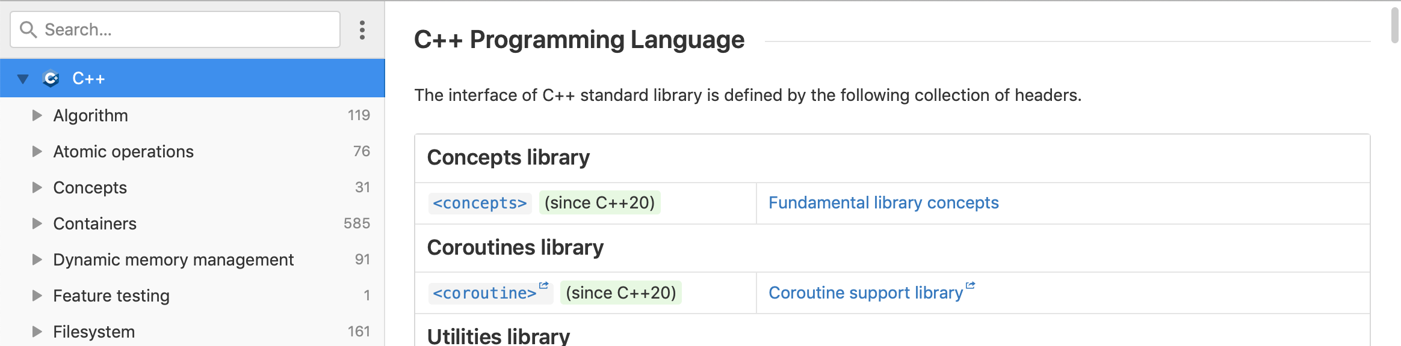
C++ Documentation
Reading C++ Documentation
One aspect of being a competent programmer is being able to source documentation in order to understand a coding language. One great site for C++ documentation is DevDocs. Bookmark it!
DevDocs
https://devdocs.io/cpp/
Notes:
Functions2_example.cpp

Slide 31
Acknowledgement
I inherit much of my material from the following:
Shri Rai , ICT283 Unit Coordinator
Reina Mendoza , former PASS leader
Abdul Bari , Educator , Mastering Data Structures and Algorithms using C and C++ (Udemy)
Abdul Bari, Educator , Learn C++ Programming (Udemy)
Kurt Anderson, Educator , Computer Science 101 (Udemy)
Bucky Roberts (YouTube)
The Cherno (YouTube)
Notes:
Functions2_example.cpp

Slide 32

Pin It!
An enamel pin badge to remind us that, despite what we've been taught, no one really knows all the answers.
Notes:
Functions2_example.cpp

