Slide 1

PASS ICT283
Session 11
beta

Slide 2

The most important thing…
C++
Java
The single most important requisite in programming is to write code that works.
ICT283 will be challenging.
But you need not be afraid; every challenge contains a gift.
Have the courage to take it on and you will be surprised.

Slide 3
Session 11
Objectives
Additional features in C++
Smart Pointers
Lambdas
* Relevant to Assignment 2

Slide 4
Smart Pointers – Unique Pointer
Only single reference to a resource (unique pointer owns the resource).
Does not provide a copy constructor (deleted signature).
Resource can be transferred by using move semantics
“ std::move ”.
Memory is freed automatically once pointer goes out of scope.
Referenced from namespace
“ std ”.
Referenced from header
“ <memory> ”.
unique_ptr<int> num (new int(1));
// do some work
.
.
.
unique_ptr<int> num1 = make_unique<int>(2);
unique_ptr<int> num2 = move(num1);
// do some work
.
.
.
Notes:
Reference_example.cpp

Slide 5
Smart Pointers – Shared Pointer
Multiple references to a resource.
Maintains a count of the number of references.
Memory is freed automatically once pointer goes out of scope and reference count is 0.
Subject to circular referencing.
Referenced from namespace
“ std ”.
Referenced from header
“ <memory> ”.
shared_ptr<int> num (new int(1));
// do some work
.
.
.
shared_ptr<int > num1 = make_shared<int>(2);
shared_ptr<int > num2 = num1;
// do some work
.
.
.
Notes:
Reference_example.cpp

Slide 6
Smart Pointers – Weak Pointer
Allows reference to a shared resource held by Shared Pointer without increasing reference count.
Memory is freed automatically once Shared Pointer is out of scope and reference count is 0, regardless of any Weak Pointers.
Requires conversion to Shared Pointer via “ weak_ptr::lock “, thus providing checking of available resource.
Referenced from namespace
“ std ”.
Referenced from header
“ <memory> ”.
shared_ptr<int > num1 = make_shared<int>(1);
weak_ptr<int > num2(num1);
.
.
.
if (shared_ptr<int> num3 = num2.lock())
{
// resource available
}
else
{
// resource unavailable
}
Notes:
Reference_example.cpp

Slide 7
Code It Yourself!
Smart Pointers
Practice
smart_pointer_example.cpp
Notes:
Pointer_example.cpp

Slide 8
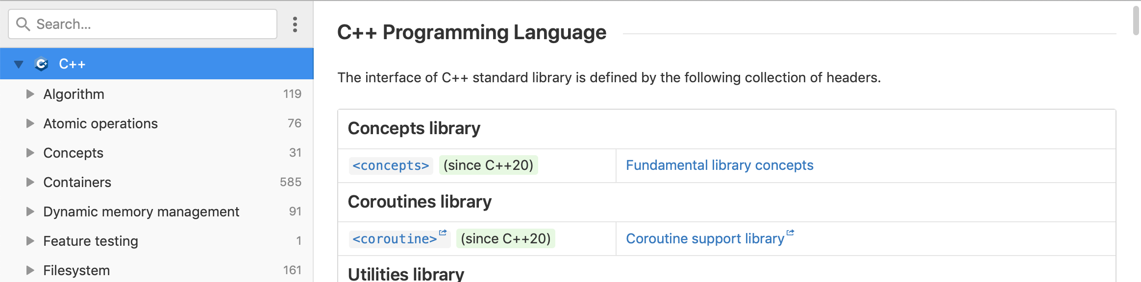
C++ Documentation
Reading C++ Documentation
One aspect of being a competent programmer is being able to source documentation in order to understand a coding language. One great site for C++ documentation is DevDocs. Bookmark it!
DevDocs
https://devdocs.io/cpp/
Notes:
Functions2_example.cpp

Slide 9
Acknowledgement
I inherit much of my material from the following:
Shri Rai , ICT283 Unit Coordinator
Reina Mendoza , former PASS leader
Abdul Bari , Educator , Mastering Data Structures and Algorithms using C and C++ (Udemy)
Abdul Bari, Educator , Learn C++ Programming (Udemy)
Kurt Anderson, Educator , Computer Science 101 (Udemy)
Bucky Roberts (YouTube)
The Cherno (YouTube)
Notes:
Functions2_example.cpp

Slide 10

Pin It!
An enamel pin badge to remind us that, despite what we've been taught, no one really knows all the answers.
Notes:
Functions2_example.cpp

