Slide 1

PASS ICT283
Session 3
C++

Slide 2

The most important thing…
C++
Java
The single most important requisite in programming is to write code that works.
ICT283 will be challenging.
But you need not be afraid; every challenge contains a gift.
Have the courage to take it on and you will be surprised.

Slide 3
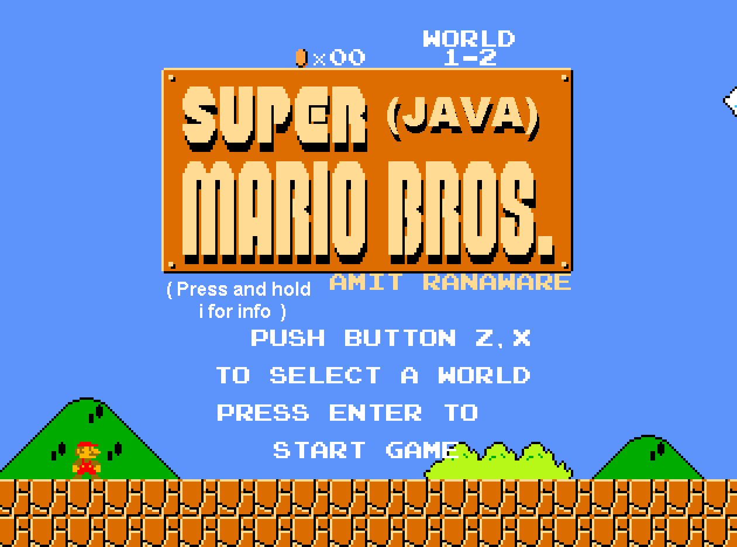



Overview of PASS Sessions
You are here…
Levelling UP!
Exam
Building Applications
Difficulty
Ass1
Ass2
Boring Fundamentals
7
6
8
4
5
9
2
3
10
1
Term
Start
Term
End
Milestone 1
Be able to write very basic working code in C++
Milestone 2
Be able to code, test and implement various data structures in C++
Milestone 3
Be able to code fluently in C++ and make data structure design choices for various programs.

Slide 4
Session 3
Objectives
File I/O
Operator Overloading
Introduction to STL
Template Classes
Introduction to Vectors
* Relevant to Assignment 1
Notes:
Functions2_example.cpp

Slide 5
File I/O (Writing to a File)
#include <fstream>
string someText = “Hello There”;
ofstream outfile (“someFile.txt”);
if(outfile.is_open())
{
outfile<<someText;
outfile.close();
}
else
{
cout<<“Error Writing to File”;
}
Program
Hello There
someFile.txt

Slide 6
File I/O (Reading from a File)
#include <fstream>
string lineOfText;
ifstream infile (“someFile.txt”);
if(infile.is_open())
{
getline(infile,lineOfText);
infile.close();
cout<<lineOfText;
}
else
{
cout<<“Error Reading from File”;
}
Hello There
someFile.txt
Hello There

Slide 7
Code It Yourself!
File I/O
Practice
fileio_example.cpp
Notes:
fileio_example.cpp

Slide 8
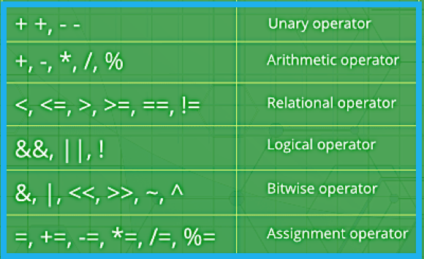
Operator Overloading
C++ allows you to specify more than one definition for a function name or an operator in the same scope.
We overload operators in C++ so that they can be used to act on user-defined data types.
Use google to find out how you can overload these operators in C++.

Slide 9
Operator Overloading ( << )
Overloading the << Operator (declaration)
ostream& operator << (ostream &os, const Person &P);
Overloading the << Operator (implementation)
ostream& operator << (ostream &os, const Person &P)
{
os<<"Name: "<<P.getName()<<", Age: "<<P.getAge()<<endl;
return os;
}

Slide 10
Operator Overloading ( >> )
Overloading the >> Operator (declaration)
istream& operator >> (istream &is, Person &P);
Overloading the >> Operator (implementation)
istream& operator >> (istream &is, Person &P)
{
string name; int age;
getline(is,name,',');
is>>age;
P.setName(name); P.setAge(age);
return is;
}

Slide 11
Code It Yourself!
Operator Overloading
Practice
Person.h
Person.cpp
op_overloading_example.cpp
Notes:
Person.h
Person.cpp
op_overloading_example.cpp

Slide 12
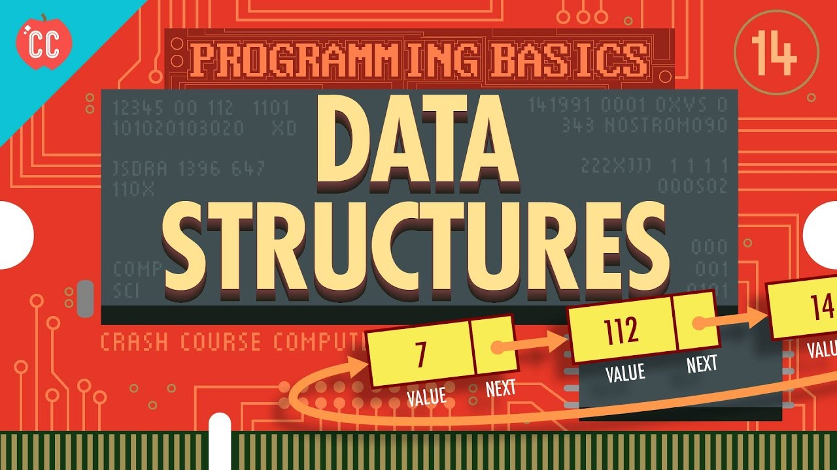
Data Structures: The big picture
What are Data Structures? Data Structures are a way to store data (so that way it can be used as desired). They are a way of collecting and organizing data in such a way that we can perform operations on these data in an effective way.
Watch: https://youtu.be/DuDz6B4cqVc

Slide 13
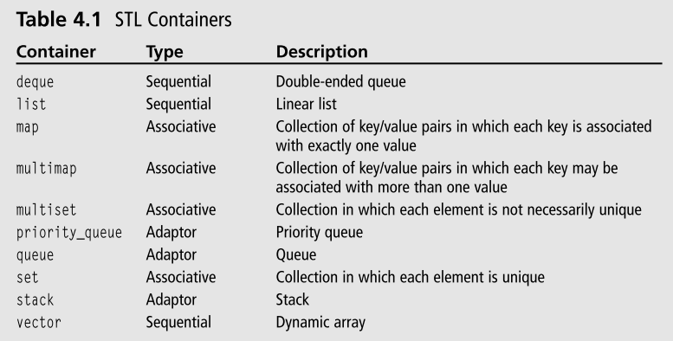
Introduction to STL
The Standard Template Library (STL) is a set of C++ template classes to provide common programming data structures and functions such as lists, stacks, arrays, etc. It is a library of container classes, algorithms, and iterators.
http://www.cplusplus.com/reference/stl/

Slide 14
Introduction to STL
Containers
refer to the data structures
that contain values…
vector
list
deque
queue
stack
set
map
multi-map
Algorithms
are built-in functions to manage information in the containers…
search
sort
binary search
reverse
concatenate
copy
union
intersection
merge
Iterators
are used to access 'containers’

Slide 15
Introduction to STL
Using STL requires only the header files
#include <vector>
#include <list>
#include <map>
#include <stack>
#include <queue>
Implementation
is included within the header files

Slide 16
Code It Yourself!
Intro to STL
Practice
STL_example.cpp

Slide 17
Template Classes
Templates are very useful when implementing generic constructs like vectors, stacks, lists, queues which can be used with any arbitrary type. C++ templates provide a way to re-use source code.
Uses Ternary operator

Slide 18
Creating a Template Class
Simple Class
Template Class
#ifndef Calculator_H
#define Calculator_H
class Calculator
{
Public:
Calculator(int a, int b);
int add();
int sub();
private:
int a;
int b;
};
#endif
#ifndef Calculator_H
#define Calculator_H
template <class T>
class Calculator
{
Public:
Calculator(T x, T y);
T add();
T sub();
private:
T a;
T b;
};
#endif
Implemented in .cpp file
Implemented in .h file

Slide 19
Code It Yourself!
Template Classes
Practice
Calculator.h
calculator_example.cpp

Slide 20
Introduction to Vectors
Vectors (your first container class!)
Vectors are dynamic arrays with the ability to resize itself automatically when an element is inserted or deleted, with their storage being handled automatically by the container.
Performance
Vector elements are placed in contiguous storage so that they can be accessed and traversed using iterators.
In vectors, data is inserted at the end. Inserting at the end takes differential time, as sometimes there may be a need of extending the array.
Removing the last element takes only constant time because no resizing happens.
Inserting and erasing at the beginning or in the middle is linear in time.
Source: https://www.geeksforgeeks.org/vector-in-cpp-stl/

Slide 21
Introduction to Vectors
Contiguous Storage
Push back – differential time
Pop back – constant time
0
1
2
3
4
5
6
7
Initialize new larger array, copy over elements, add element>>
1.
‘A’
‘B’
‘C’
3.
‘A’
‘B’
‘C’
‘D’
2.
‘A’
‘B’
‘C’
‘D’
4.
‘A’
‘B’
‘C’
‘D’
‘E’
Push Back - Best Case
Push Back - Worst Case
‘A’
‘B’
‘C’
‘D’
‘A’
‘B’
‘C’
‘A’
‘B’
Best & Worst Case are the Same

Slide 22
Introduction to Vectors
Insertion– linear time
‘A’
‘B’
‘C’
‘D’
Insert an element ‘#’ at front of array
‘A’
‘B’
‘C’
‘D’
Shift all existing elements to the left
If the array is too small, it will require resizing…(more work)
‘#’
‘A’
‘B’
‘C’
‘D’
Insert the new element
‘A’
‘B’
‘C’
‘D’
Insert an element ‘#’ in the middle of the array
‘A’
‘B’
‘C’
‘D’
Shift half of the elements to the left
If the array is too small, it will require resizing…(more work)
‘A’
‘B’
‘#’
‘C’
‘D’
Insert the new element

Slide 23
Assignment 1 Info
Assignment 1 Information
Do not use STL in Assignment 1!
You will need to code your own vector class!
Your vector class must be templated ! (only .h file)
More next session…

Slide 24
Code It Yourself!
Vector Class
Practice
Folder: Data_Structures_1

Slide 25
Next Session…
Objects, Containers and….
Moving on, we depart from the basics of C++ and consider more complex and interesting topics !

Slide 26
Key Terminology
Standard Template Library (STL) | The C++ STL (Standard Template Library) is a powerful set of C++ template classes to provide general-purpose classes and functions with templates that implement many popular and commonly used algorithms and data structures like vectors, lists, queues, and stacks. At the core of the C++ Standard Template Library are following three well-structured components - Containers, Iterators and Algorithms. https://www.tutorialspoint.com/cplusplus/cpp_stl_tutorial.htm
Data Structure | In computer science, a data structure is a data organization, management, and storage format that enables efficient access and modification. More precisely, a data structure is a collection of data values, the relationships among them, and the functions or operations that can be applied to the data. https://en.wikipedia.org/wiki/Data_structure

Slide 27
Key Terminology
Generic Programming | Generic Programming is implemented to increase the efficiency of the code. Generic Programming enables the programmer to write a general algorithm which will work with all data types. It eliminates the need to create different algorithms if the data type is an integer, string or a character. The advantages of Generic Programming are: -Code Reusability -Avoid Function Overloading -Once written it can be used for multiple times and cases. https://www.geeksforgeeks.org/generics-in-c/
Templates | Generics can be implemented in C++ using Templates. A Template is a simple and yet very powerful tool in C++. The simple idea is to pass a data type as a parameter so that we don’t need to write the same code for different data types. For example, a software company may need a sort() function for different data types. Rather than writing and maintaining multiple sort() function, we can write one sort() function and pass in a data type as a parameter. https://www.geeksforgeeks.org/generics-in-c/

Slide 28
Topics Covered
Recap
File I/O
Operator Overloading
Introduction to STL
Template Classes
Introduction to Vectors
Resources > Session 3
https://ict283.github.io/ict283pass/

Slide 29
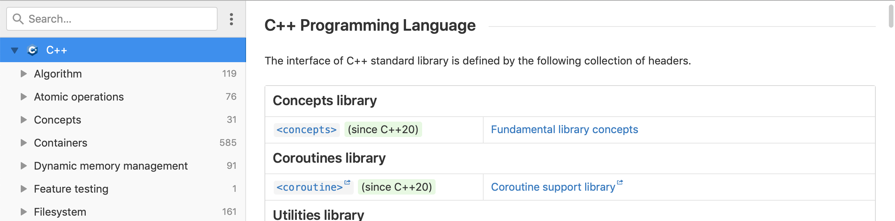
C++ Documentation
Reading C++ Documentation
One aspect of being a competent programmer is being able to source documentation in order to understand a coding language. One great site for C++ documentation is DevDocs. Bookmark it!
DevDocs
https://devdocs.io/cpp/
Notes:
Functions2_example.cpp

Slide 30
Acknowledgement
I inherit much of my material from the following:
Shri Rai , ICT283 Unit Coordinator
Reina Mendoza , former PASS leader
Abdul Bari , Educator , Mastering Data Structures and Algorithms using C and C++ (Udemy)
Abdul Bari, Educator , Learn C++ Programming (Udemy)
Kurt Anderson, Educator , Computer Science 101 (Udemy)
Bucky Roberts (YouTube)
The Cherno (YouTube)
Notes:
Functions2_example.cpp

Slide 31

Pin It!
An enamel pin badge to remind us that, despite what we've been taught, no one really knows all the answers.
Notes:
Functions2_example.cpp

