Slide 1

PASS ICT283
Session 8
C++

Slide 2

The most important thing…
C++
Java
The single most important requisite in programming is to write code that works.
ICT283 will be challenging.
But you need not be afraid; every challenge contains a gift.
Have the courage to take it on and you will be surprised.

Slide 3
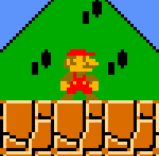



Overview of PASS Sessions
You are here…
Levelling UP!
Exam
Building Applications
Difficulty
Ass1
Ass2
Boring Fundamentals
7
6
8
4
5
9
2
3
10
1
Term
Start
Term
End
Milestone 1
Be able to write very basic working code in C++
Milestone 2
Be able to code, test and implement various data structures in C++
Milestone 3
Be able to code fluently in C++ and make data structure design choices for various programs.

Slide 4
Session 8
Objectives
Recap: Recursion
Recap: BST Traversal
A Note on Complexity
The BST problem
Introduction to AVL Trees
Introduction to Multiway Trees
Introduction to B and B+ Trees
Assignment 2 Discussion
* Relevant to Assignment 2

Slide 5
Recap: Recursion
Pre-Assignment 2
Self-Check ✓
Recursion ( Session 6 )
A recursive algorithm is an algorithm which calls itself with smaller (or simpler) input values.
Certain problems may be solved quite easily with recursive algorithms. (BST Traversals for example)
A recursive algorithm requires a base case to be defined and the recursion ends when the base case is met.
Iterative programs may be used in place of recursive programs and vice versa. Each method has its pros and cons.
A good way to visualise a recursive program is to sketch a recursion ‘tree’.
You will require a good grasp of recursion for Assignment 2

Slide 6
Recap: BST Traversals
Pre-Assignment 2
Self-Check ✓
BST Traversal ( Session 7 )
Recall that traversing a tree involves going to every node.
Traversal is used to process information in a tree.
Operations such as printing, gathering statistics, end-of-month calculations, searching, etc. require the use of traversals.
Traversals can be done in-order, pre-order or post-order.
The order of traversal depends on the application.
In the previous session, we looked at a 2-way or binary tree, as this was the simplest to understand.
You will need to implement a simple BST in Assignment 2.

Slide 7

A Note on Complexity
Recommended Reading for PASS 8-10
What is Complexity Theory?
Complexity theory is a central topic in theoretical computer science.
Complexity helps determine the difficulty of a problem, often measured by how much time and space (memory) it takes to solve a particular problem.
When we discuss the performance of a particular data structure and the types of applications suited to its use; we enter into the discussion of complexity.
Complexity is an important topic in the study of data structures; most notably the understanding of Big O notation.
As Complexity is only covered in brief during the PASS sessions, a recommended reading has been provided for self-study.
Please download the reading entitled “CS 101” by Kurt Anderson.
Folder: CS_101
Complexity theory is the icing on the data structures and abstractions cake.

Slide 8
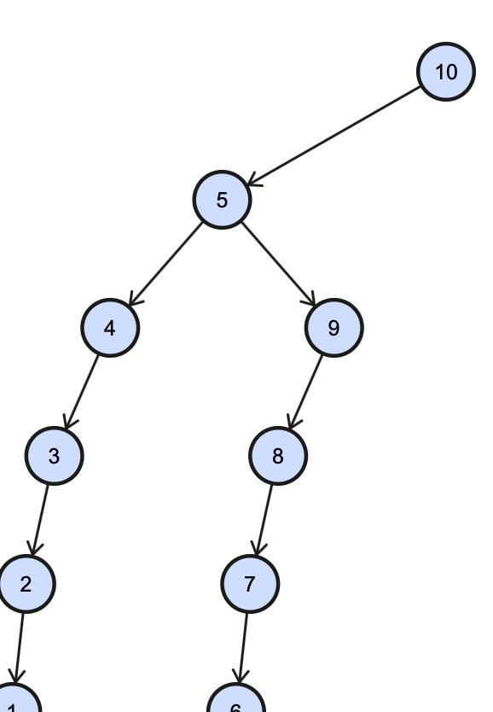
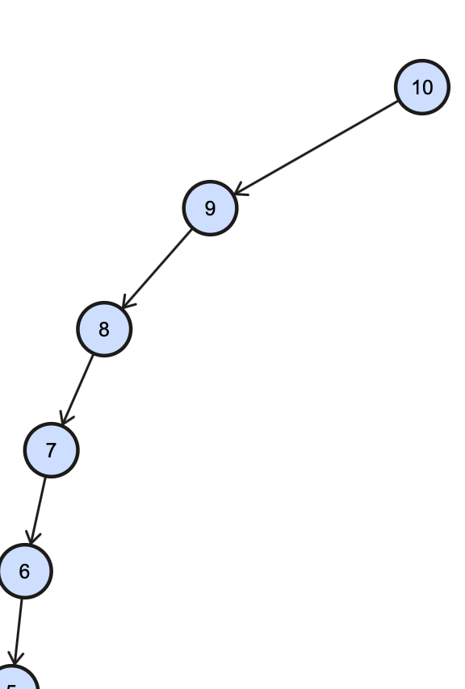
The BST Problem
The BST Problem
Semi-Ordered
Ordered
Input:
10,5,9,4,8,3,7,2,6,1
Input:
10,9,8,7,6,5,4,3,2,1
Notice anything peculiar about the shape of these trees?

Slide 9
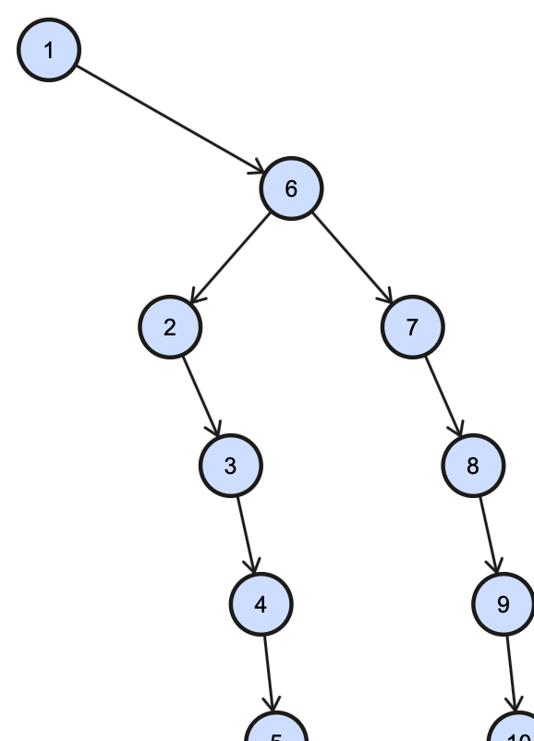
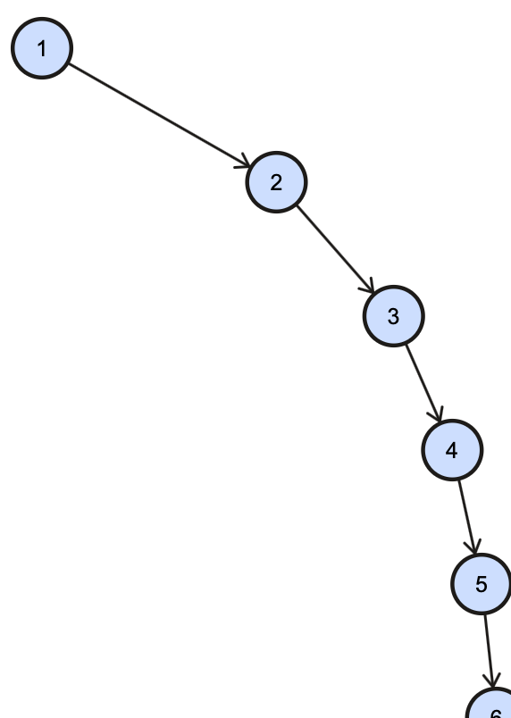
The BST Problem
The BST Problem
Semi-Ordered
Ordered
Input:
1,6,2,7,3,8,4,9,5,10
Input:
1,2,3,4,5,6,7,8,9,10
Notice anything peculiar about the shape of these trees?

Slide 10
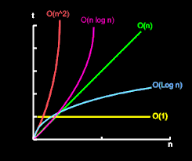
The BST Problem
The BST Problem (using Complexity)
The BST Problem: the trouble with the ordinary BST, is that if ordered data is inserted, you end up with a linked list. This means that searching a BST is O(log n) on average at best, but has a worst case complexity of O(n).
Source: https://medium.com/better-programming/a-gentle-explanation-of-logarithmic-time-complexity-79842728a702
A Simplified Description…
O(n): As the number of elements(n) increase, so does the running time(t) taken to search them (proportional increase).
O(log n): Each increase in the number of elements(n) causes the running time(t) to ‘grow‘ logarithmically. Aka. It is being divided.
To achieve the latter, we can use a balanced BST instead of a simple BST
Complexity Graph

Slide 11
Introduction to AVL Trees
Coding is Optional
AVL Trees
An AVL tree is a subtype of binary search tree. Named after it's inventors Adelson, Velskii and Landis, AVL trees have the property of dynamic self-balancing in addition to all the properties exhibited by binary search trees.
The difference between the depth of right and left subtrees cannot be more than one. In order to maintain this guarantee, an implementation of an AVL will include an algorithm to rebalance the tree when adding an additional element would upset this guarantee.
AVL trees have a worst case lookup, insert and delete time of O(log n).
Application: AVL trees are beneficial in the cases where you are designing some database where insertions and deletions are not that frequent but you have to frequently look-up for the items present in the tree.
Source: https://www.freecodecamp.org/news/avl-tree-insertion-rotation-and-balance-factor/
Sample Code: https://www.geeksforgeeks.org/avl-tree-set-1-insertion/

Slide 12
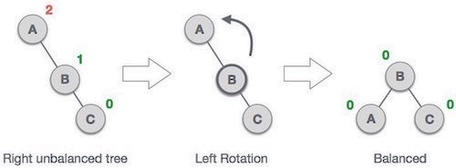
Introduction to AVL Trees
Coding is Optional
AVL Trees
Insertion is conducted similar to a normal Binary Search Tree insertion.
After insertion, the tree is balanced using left or right rotations.
If there is an imbalance in left child of left subtree, then you perform a right rotation.
If there is an imbalance in right child of right subtree, then you perform a left rotation.
If there is an imbalance in right child of left subtree, then you perform a right-left rotation.
If there is an imbalance in left child of right subtree, then you perform a left-right rotation.
Source: https://www.freecodecamp.org/news/avl-tree-insertion-rotation-and-balance-factor/
Sample Code: https://www.geeksforgeeks.org/avl-tree-set-1-insertion/
Example of
a left rotation
Observe how the rotation causes the difference in heights of the right and left subtrees to become 0.

Slide 13
Code It Yourself!
AVL Tree
Visualisation
Folder: AVL_tree_example
See also: Lecture 29

Slide 14
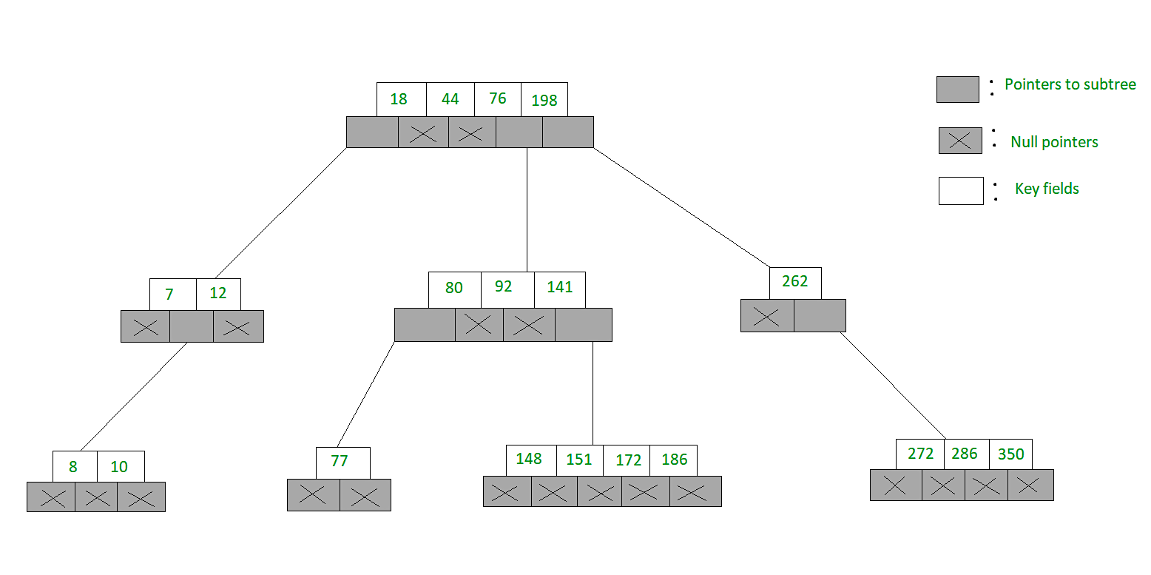
Introduction to Multiway Trees
Coding is Optional
Multiway Trees
The m-way search trees are multi-way trees which are generalised versions of binary trees where each node contains multiple elements. In an m-Way tree of order m, each node contains a maximum of m – 1 key fields and m children.
An example of a 5-Way search tree is shown in the figure below. Observe how each node has at most 5 child nodes & therefore has at most 4 keys contained in it.
Source: https://www.geeksforgeeks.org/m-way-search-trees-set-1-searching/
Multiway tree Visualiser: https://www.cs.usfca.edu/~galles/visualization/BTree.html

Slide 15
Introduction to Multiway Trees
Coding is Optional
Multiway Trees
The goal of m-Way search tree of height h is to ensure O(h) no. of accesses for an insert, delete or retrieval operation. Hence, it ensures that the height h is close to log _{m}(n + 1).
Source: https://www.geeksforgeeks.org/m-way-search-trees-set-1-searching/
Multiway tree Visualiser: https://www.cs.usfca.edu/~galles/visualization/BTree.html
Ma-ma-ma-math...
Degree(m) = 5
Height (h) = 3
Nodes(n) = 28
Complexity
log ₅ (28 + 1)
= 2.1
Put simply, it takes on average 2.1 operations to perform an insert/delete/retrieval on the current tree.

Slide 16
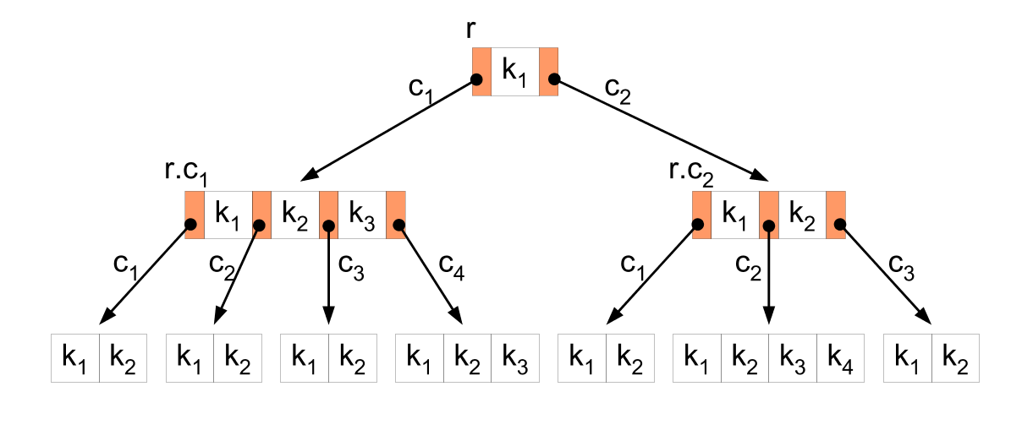
Introduction to B and B+ Trees
Coding is Optional
B Trees
A B-tree is a specialized M-way tree that is widely used for disk access. A B tree of order m can have a maximum of m–1 keys and m pointers to its sub-trees. It was developed in the year 1972 by Bayer and McCreight . A B-tree is designed to store sorted data and allows search, insertion, and deletion operations to be performed in logarithmic running time.
Source: https://www.thedshandbook.com/multiway-trees/
B+ tree Visualiser: https://www.cs.usfca.edu/~galles/visualization/BTree.html

Slide 17
Introduction to B and B+ Trees
Coding is Optional
B Trees
Properties of B-Trees:
All the leaf nodes must be at the same level.
All nodes except root must have at least [m/2]-1 keys and maximum of m-1 keys.
A non-leaf node with n-1 keys must have n number of children.
All the key values within a node must be in Ascending Order.
All internal nodes must have at least m/2 children.
If the root node is a non leaf node, then it must have at least two children.
Source: https://www.thedshandbook.com/multiway-trees/
B+ tree Visualiser: https://www.cs.usfca.edu/~galles/visualization/BTree.html

Slide 18
Code It Yourself!
B Tree
Visualisation
Folder: B_tree_example
See also: Lecture 30

Slide 19
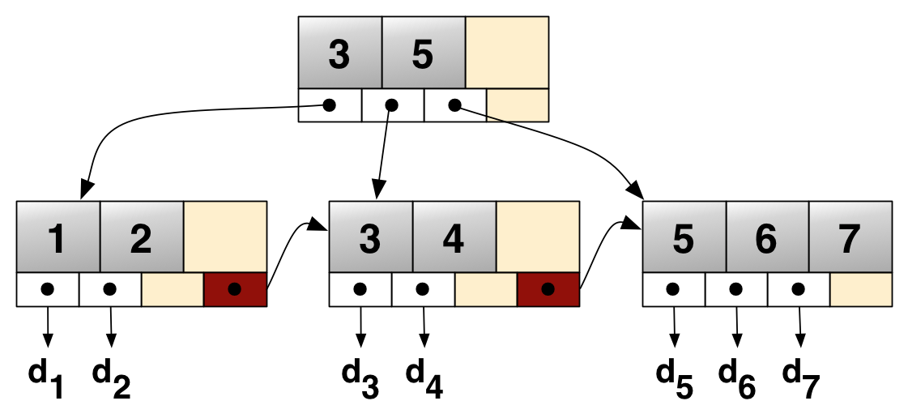
Introduction to B and B+ Trees
Coding is Optional
B+ Trees
A B+ tree can be viewed as a B-tree, but each node contains only keys (not key-value pairs), and it stores all the records at the leaf level of the tree instead.
It has two parts – the first part is the index set that constitutes the interior nodes and the second part is the sequence set that constitutes the leaves.
The linked leaves make it possible for the keys to be accessed sequentially in addition to accessing them directly. This is an advantage over a normal B+ tree as it allows for efficient retrieval of data.
Source: https://www.thedshandbook.com/multiway-trees/
B+ tree Visualiser: https://www.cs.usfca.edu/~galles/visualization/BPlusTree.html
Index Set
Linked
Leaves
Provide
Sequential Access

Slide 20
Introduction to B and B+ Trees
Coding is Optional
B+ Trees
Application: File Indexing- The efficient retrieval of a B+ Tree allows for use in file indexing operations. The high number of pointers to the child nodes in a node help to reduce the number of I/O operations required to find an element in the tree, making it ideal for data retrieval where I/O operations take time.
Properties of B+ Trees:
Inserting a record requires O(log n) operations
Finding a record requires O(log n) operations.
Removing a (previously located) record requires O(log n) operations.
Performing a range query with k elements occurring within the range requires O(log n + k)operations.
Source: https://www.thedshandbook.com/multiway-trees/
B+ tree Visualiser: https://www.cs.usfca.edu/~galles/visualization/BPlusTree.html
directory
files
files
files

Slide 21
Code It Yourself!
B+ Tree
Visualisation
Folder: B+_tree_example
See also: Lecture 30

Slide 22
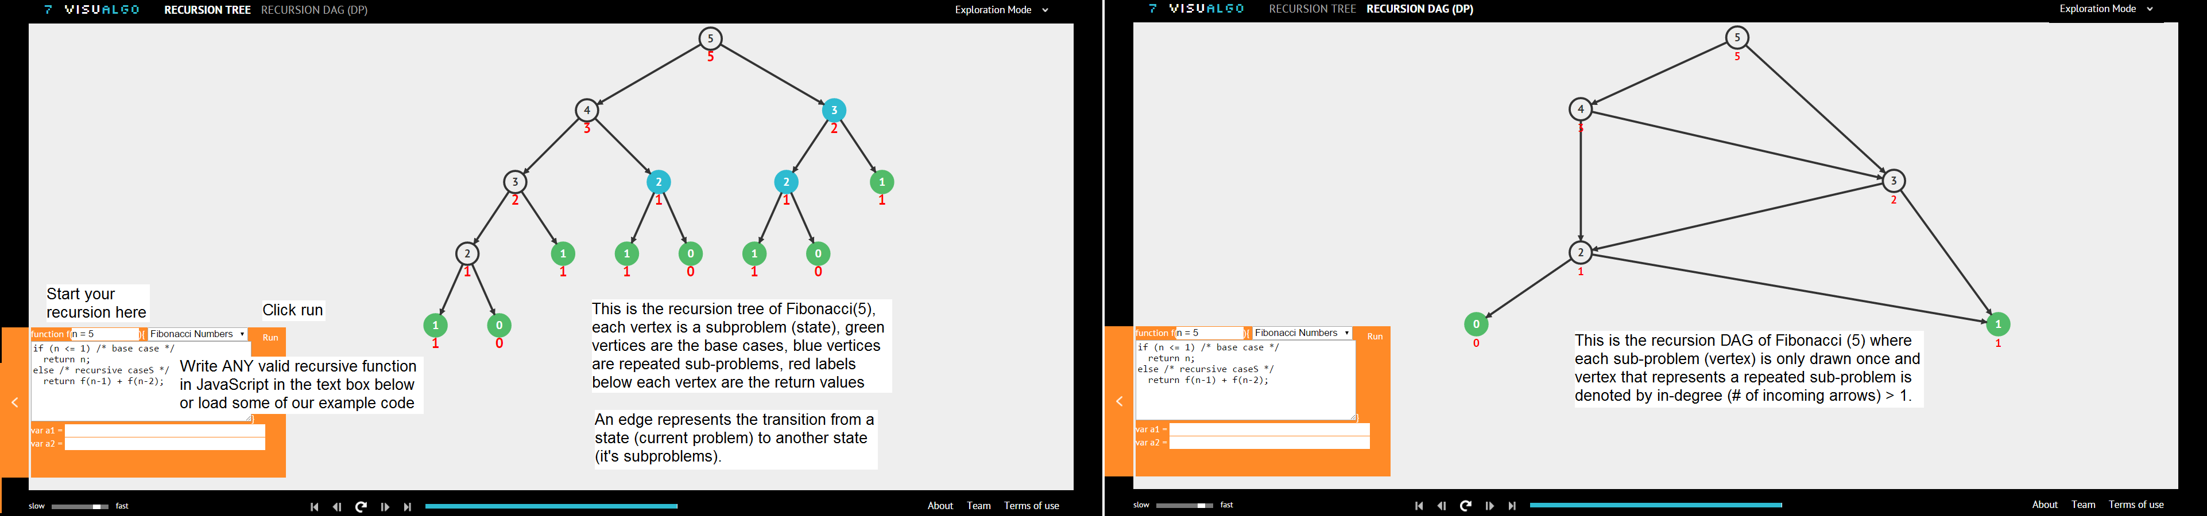
Trees: Additional Information
Tree Visualisations:
When in doubt, use these visualisation tools to understand how trees work
https://visualgo.net/en/bst
http://btv.melezinek.cz/binary-search-tree.html
https://www.cs.usfca.edu/~galles/visualization/BTree.html
https://www.cs.usfca.edu/~galles/visualization/BPlusTree.html
Tip: Be able to illustrate ideas with examples and solve tree-based problems

Slide 23
Assignment 2 Discussion
Ass 2 Program
Your program must load multiple files
Implement and utilise BST and STL Map on options 1-4
Vectors may be used if needed
Only attempt option 5 if option 1-4 is working
Use Excel to check if your values are correct
Program must load the data first before processing the data
Program folder must contain executable files
Read Q and A file provided in assignment pack

Slide 24
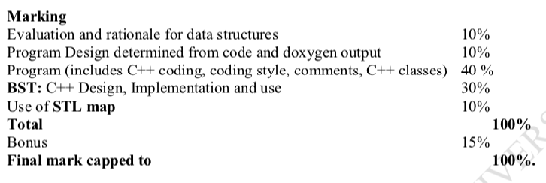
Assignment 2 Documentation
Give one-week lead time for documentation!
Ass 2 Documentation
You may copy paste from your previous documentation (if applicable)
Provide a rationale for your design and data structures used
High-level UML Diagram
Doxygen-style Comments (.h files) and html output
Provide a test plan and test output for your program
Executive Summary (evaluation.txt)

Slide 25
Key Terminology
Time Complexity | The time complexity of an algorithm quantifies the amount of time taken by an algorithm to run as a function of the length of the input. https://www.hackerearth.com/practice/basic-programming/complexity-analysis/time-and-space-complexity/tutorial/#:~:text=Time%20complexity%20of%20an%20algorithm,the%20length%20of%20the%20input.&text=Let%20each%20operation%20takes%20time.
Space Complexity | The space complexity of an algorithm quantifies the amount of space or memory taken by an algorithm to run as a function of the length of the input. https://www.hackerearth.com/practice/basic-programming/complexity-analysis/time-and-space-complexity/tutorial/#:~:text=Time%20complexity%20of%20an%20algorithm,the%20length%20of%20the%20input.&text=Let%20each%20operation%20takes%20time.

Slide 26
Topics Covered
Recap
Recap: Recursion
Recap: BST Traversal
A Note on Complexity
The BST problem
Introduction to AVL Trees
Introduction to Multiway Trees
Introduction to B and B+ Trees
Assignment 2 Discussion
Bonus Bits!
Inside
Resources > Session 8
https://ict283.github.io/ict283pass/

Slide 27

Next Session…
Searching, Sorting and….
MOOCs
Watch: https://youtu.be/eW3gMGqcZQc

Slide 28
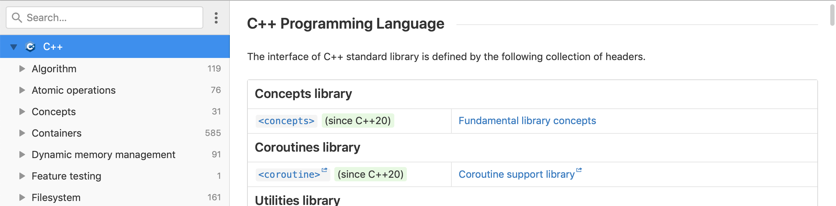
C++ Documentation
Reading C++ Documentation
One aspect of being a competent programmer is being able to source documentation in order to understand a coding language. One great site for C++ documentation is DevDocs. Bookmark it!
DevDocs
https://devdocs.io/cpp/
Notes:
Functions2_example.cpp

Slide 29
Acknowledgement
I inherit much of my material from the following:
Shri Rai , ICT283 Unit Coordinator
Reina Mendoza , former PASS leader
Abdul Bari , Educator , Mastering Data Structures and Algorithms using C and C++ (Udemy)
Abdul Bari, Educator , Learn C++ Programming (Udemy)
Kurt Anderson, Educator , Computer Science 101 (Udemy)
Bucky Roberts (YouTube)
The Cherno (YouTube)
Notes:
Functions2_example.cpp

Slide 30

Pin It!
An enamel pin badge to remind us that, despite what we've been taught, no one really knows all the answers.
Notes:
Functions2_example.cpp

