Slide 1

PASS ICT283
Session 11
Special Edition

Slide 2

The most important thing…
C++
Java
The single most important requisite in programming is to write code that works.
ICT283 will be challenging.
But you need not be afraid; every challenge contains a gift.
Have the courage to take it on and you will be surprised.

Slide 3
Session 11
Objectives
New features in C++ 11
ICT283 & Beyond
* Relevant to Assignment 2

Slide 4
Topics Covered
Recap
-
Resources > Session 11
https://ict283.github.io/ict283pass/
Song Credit: Fun (ft. Chris Brown) by Pitbull

Slide 5
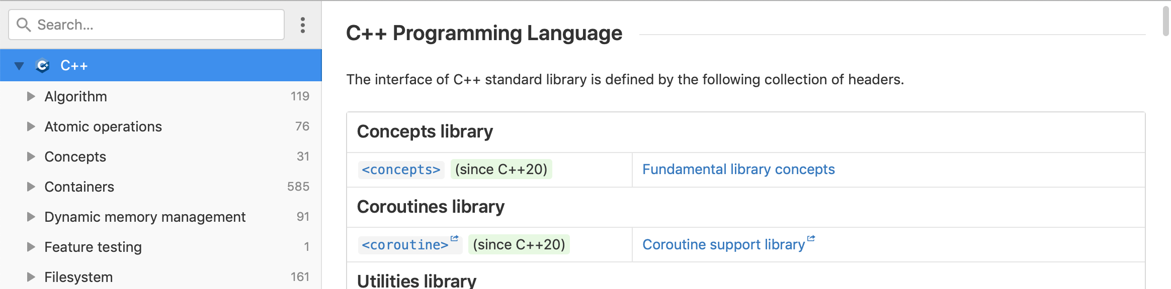
C++ Documentation
Reading C++ Documentation
One aspect of being a competent programmer is being able to source documentation in order to understand a coding language. One great site for C++ documentation is DevDocs. Bookmark it!
DevDocs
https://devdocs.io/cpp/
Notes:
Functions2_example.cpp

Slide 6
Acknowledgement
I inherit much of my material from the following:
Shri Rai , ICT283 Unit Coordinator
Reina Mendoza , former PASS leader
Abdul Bari , Educator , Mastering Data Structures and Algorithms using C and C++ (Udemy)
Abdul Bari, Educator , Learn C++ Programming (Udemy)
Kurt Anderson, Educator , Computer Science 101 (Udemy)
Bucky Roberts (YouTube)
The Cherno (YouTube)
Notes:
Functions2_example.cpp

Slide 7

Pin It!
An enamel pin badge to remind us that, despite what we've been taught, no one really knows all the answers.
Notes:
Functions2_example.cpp

