Slide 1
The Effect of Education on Society
Yuqi Kang, Yuzhang Zhu

Slide 2
Outline
Introduction
Hypothesis I - more and more receive higher degree
Hypothesis II - education reduce poverty
Hypothesis III - education reduce unemployment rate
Conclusion

Slide 3

Why Education is so important?
Removing Poverty
Education helps in removing poverty
Women Empowerment
Raise voice against injustice
Employment
Reduce unemployment rate
Education Helps in Creation of a better society.

Slide 4
Overview of Dataset
Education Data
Number of people receive four degrees( < high school, high school, associate, college) separately.
Poverty Data
Population and number of poverty
Unemployment Data
Number of unemployed people in different areas of U.S
Data Source: https://www.ers.usda.gov/data-products & https://www.census.gov

Slide 5
Hypothesis I - More and more people receives higher Degree

Slide 6
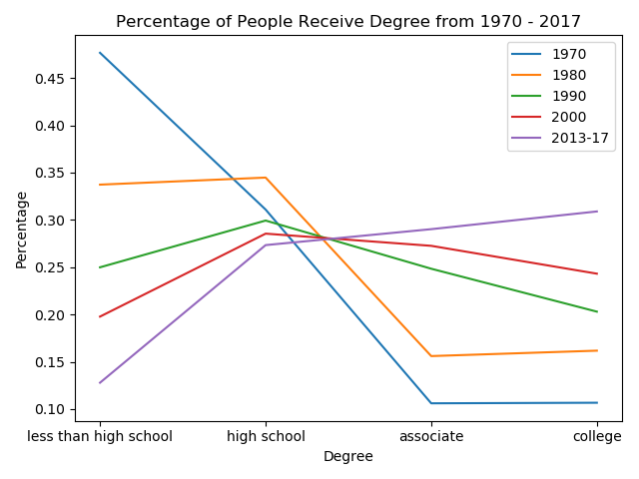
Hypothesis I - More and more people receive higher degree.
The percentage of people receives less than high school is decreasing.
The percentage of people receive college degree is increasing.
In year 2017, the percentage of people receives college degree is higher than other degrees.

Slide 7
Top 5 states with the most college degree
1970 | 1980 | 1990 | 2000 | 2013- 2017
Washington, D.C. | Washington, D.C. | Washington, D.C. | Washington, D.C. | Washington, D.C.
Colorado | Colorado | Massachusetts | Massachusetts | Massachusetts
Alaska | Alaska | Connecticut | Colorado | Colorado
Utah | Connecticut | Colorado | Maryland | Maryland
Hawaii | Maryland | Maryland | Connecticut | Connecticut

Slide 8
Top 5 states with college degree
1970 | 1980 | 1990 | 2000 | 2013-2017
Utah | Alaska | Alaska | Alaska | Montana
Alaska | Utah | Utah | Minnesota | New Hampshire
Nevada | Colorado | Colorado | Wyoming | Minnesota
Colorado | Wyoming | Washington | Utah | Wyoming
Washington | Washington | Wyoming | New Hampshire | Alaska

Slide 9
Hypothesis II - Education will Reduce Poverty

Slide 10
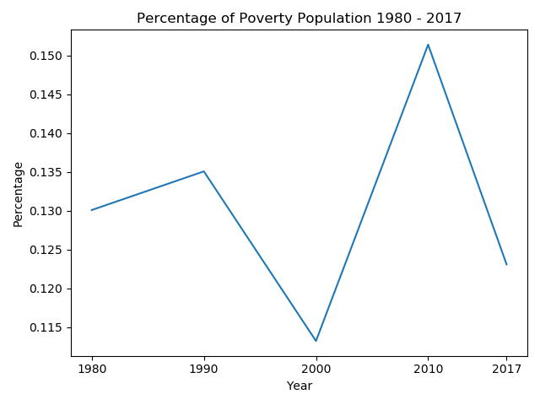
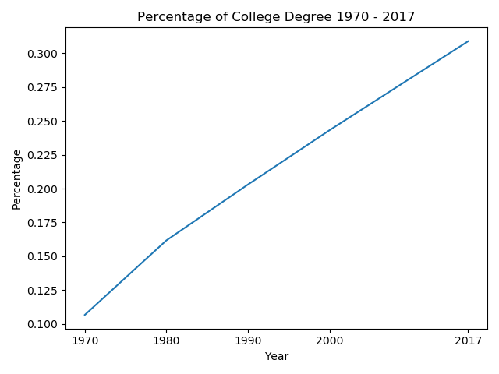
Hypothesis II - Education will Reduce Poverty

Slide 11
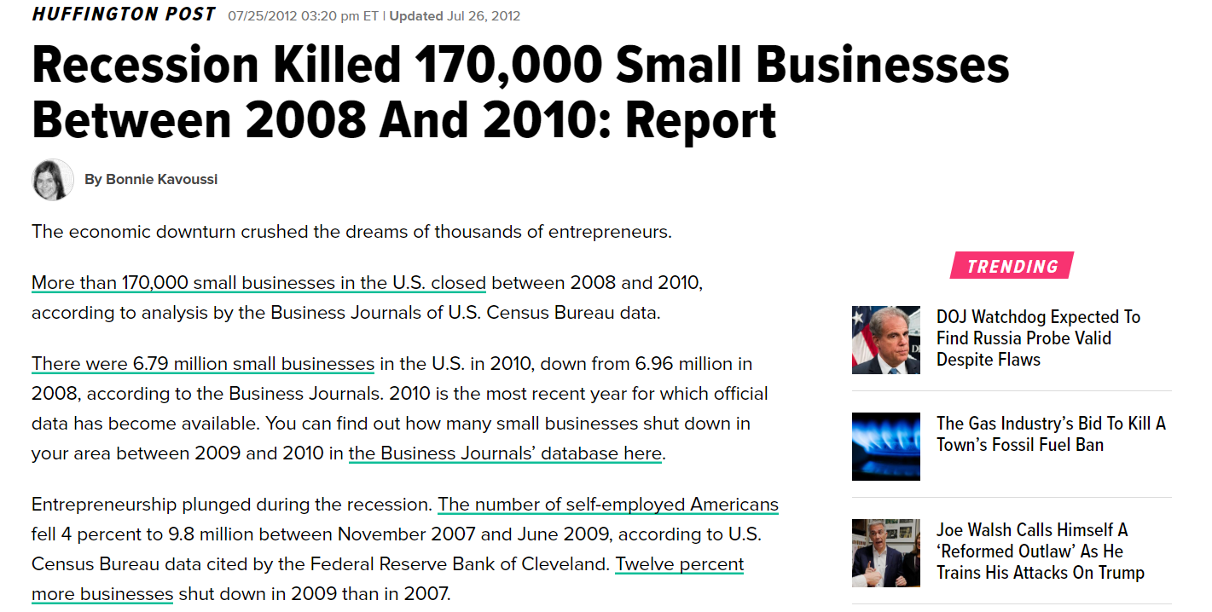
What happened in 2010?

Slide 12
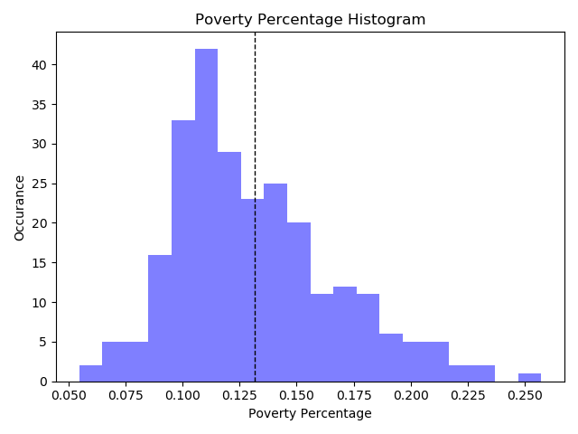
Poverty in the United States 2013 - 2017

Slide 13
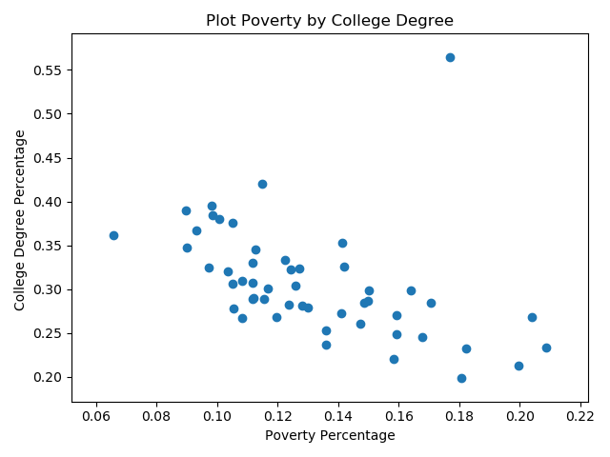
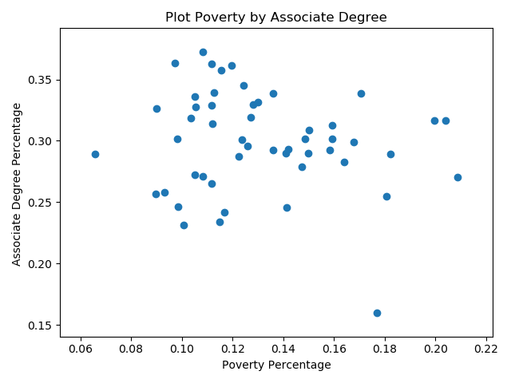
Correlation Between Poverty and Different Degree receiving 2013 - 2017

Slide 14
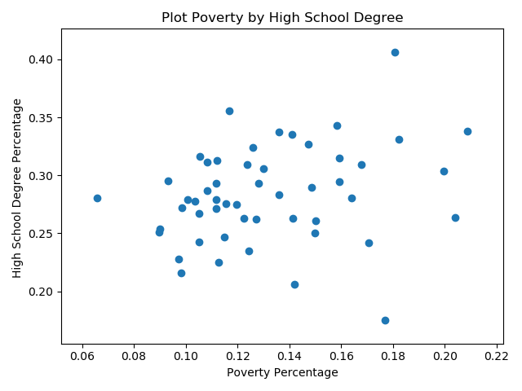
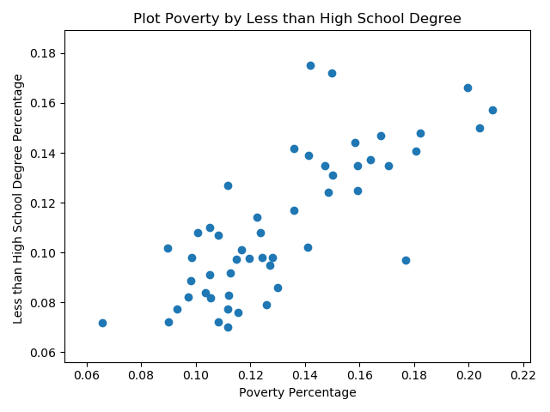
Correlation Between Poverty and Different Degree receiving 2013 - 2017

Slide 15
R-Squared between Four Education Degrees
 | Pearson correlation with Poverty
Less than high school degree | 0.77
High school Degree | 0.25
Associate Degree | -0.13
College Degree | -0.44
Less than high school degree and college degree affect the poverty most
Less than high school degree and high school degree have positive relationship with poverty
Associate degree and college degree have negative relationship with poverty

Slide 16
Hypothesis III - Correlations between unemployment and educational attainment

Slide 17
Pearson correlation coefficient
“It is a measure of the linear correlation between two variables X and Y. According to the Cauchy–Schwarz inequality it has a value between +1 and −1, where 1 is total positive linear correlation, 0 is no linear correlation, and −1 is total negative linear correlation.”
Before we calculate Pearson correlation coefficient between unemployment and certain level of educational attainment, we have used scipy to do normality test for each variable. In this case, the variables are unemployment number and certain level of educational attainment from 2007-2018.
Reference: https://en.wikipedia.org/wiki/Pearson_correlation_coefficient

Slide 18

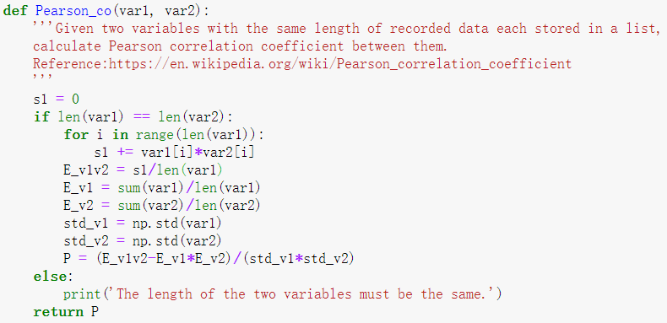
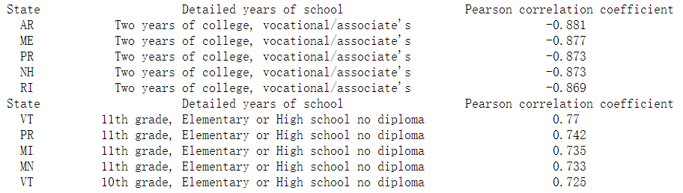
Formula:
Function:
Result:

Slide 19

Normalization
Since the number of unemployed people and the number of people with certain educational attainment have very different scale, We normalized the dimensions of the different variables in the analysis.
Formula:
That is, we take the linear transformation of the original data and map it to [0,1].
Reference: https://www.codecademy.com/articles/normalization

Slide 20
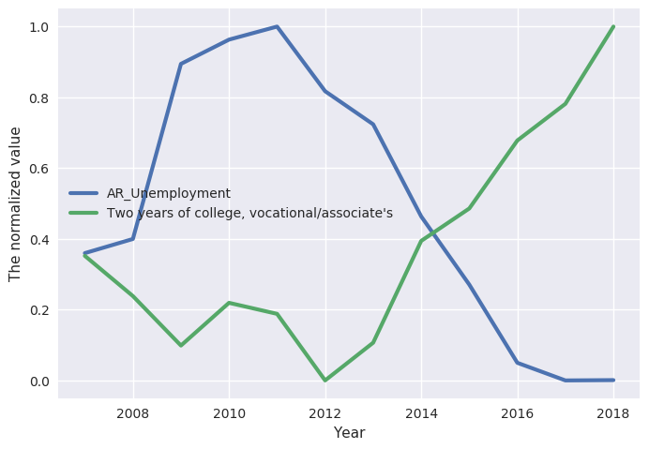
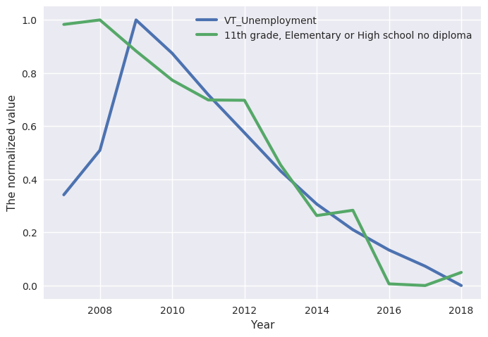
The left side is the strongest negative correlation, while the strongest positive one is on the right.
Left: As the number of people with education experience of two years of vocational/associate college increases, the unemployment number decreases.
Right: As the number of people with education experience of quitting elementary or high school at 11th grade with no diploma decreases, the unemployment number decreases.
* AR: Arkansas VT:Vermont

Slide 21
Conclusion
Hypothesis I:
More and more people are educated in the United States
Hypothesis II:
Education reduce poverty
Hypothesis III:
As the number of people with education experience of two years of vocational/associate college increases, the unemployment number decreases.
As the number of people with education experience of quitting elementary or high school at 11th grade with no diploma decreases, the unemployment number decreases.

Slide 22
Thank you

