Slide 2
Example of a posterior distribution of selection pressure among sites
NOTE: This is NOT the distribution for the nef gene

Slide 8
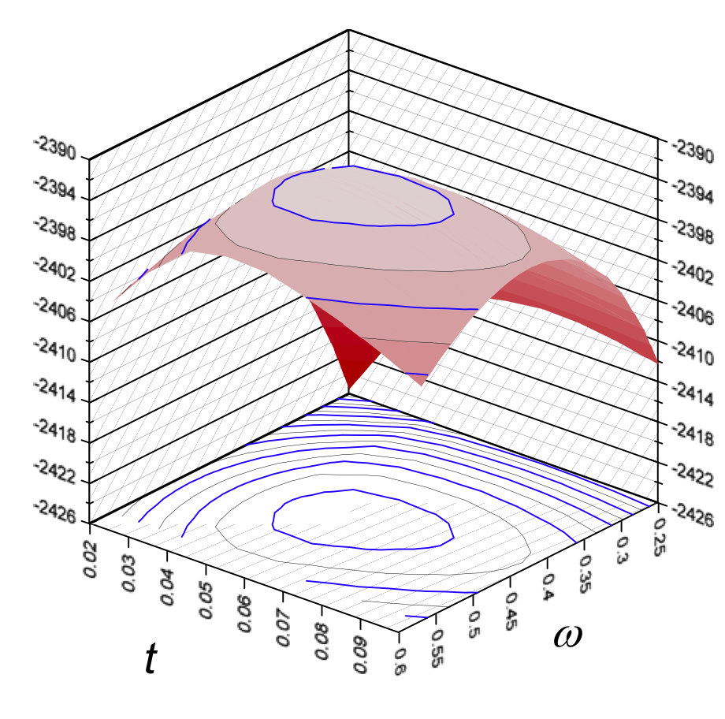
Parameters: t and ω
Gene: GstD
species 1
species 2
common
ancestor
You will work with THIS “knob”

Slide 9
transitions vs. transversions:
Kappa (ts/tv) = 2.71
preferred vs. un-preferred codons:
partial codon usage table for the GstD gene of Drosophila
------------------------------------------------------------------------------
Phe F TTT 0 | Ser S TCT 0 | Tyr Y TAT 1 | Cys C TGT 0
TTC 27 | TCC 15 | TAC 22 | TGC 6
Leu L TTA 0 | TCA 0 | *** * TAA 0 | *** * TGA 0
TTG 1 | TCG 1 | TAG 0 | Trp W TGG 8
------------------------------------------------------------------------------
Leu L CTT 2 | Pro P CCT 1 | His H CAT 0 | Arg R CGT 1
CTC 2 | CCC 15 | CAC 4 | CGC 7
CTA 0 | CCA 3 | Gln Q CAA 0 | CGA 0
CTG 29 | CCG 1 | CAG 14 | CGG 0
------------------------------------------------------------------------------

Slide 10
Example: A → C
AAA → CAA
AAA → ACA
AAA → AAC
 | Target codon (nucleotide)
 | CAA | ACA | AAC | NP
Fequal | 1/61 | 1/61 | 1/61 | 0
F3×4 (GY) |  |  |  | 9
F61 (GY) | π_{CAA} | π_{ACA} | π_{AAC} | 61
NOTE: There are even more ways to model frequencies; but these are the only one we will deal with in this lab.

Slide 11
Further details for about the assumptions tested in Excercise 2
Assumption set 1: Codon bias = none; Ts/Tv bias = none
Control file.. CodonFreq=0; kappa=1; fix_kappa=1
Assumption set 2: Codon bias = none; Ts/Tv bias = Yes
Control file.. CodonFreq=0; kappa=1; fix_kappa=0
Assumption set 3: Codon bias = yes [F3x4]; Ts/Tv bias = none
Control file.. CodonFreq=2; kappa=1; fix_kappa=1
Assumption set 4: Codon bias = yes [F3x4]; Ts/Tv bias = Yes
Control file.. CodonFreq=2; kappa=1; fix_kappa=0
Assumption set 5: Codon bias = yes [F61]; Ts/Tv bias = none
Control file.. CodonFreq=3; kappa=1; fix_kappa=1
Assumption set 6: Codon bias = yes [F61]; Ts/Tv bias = Yes
Control file.. CodonFreq=3; kappa=1; fix_kappa=0

