Slide 1
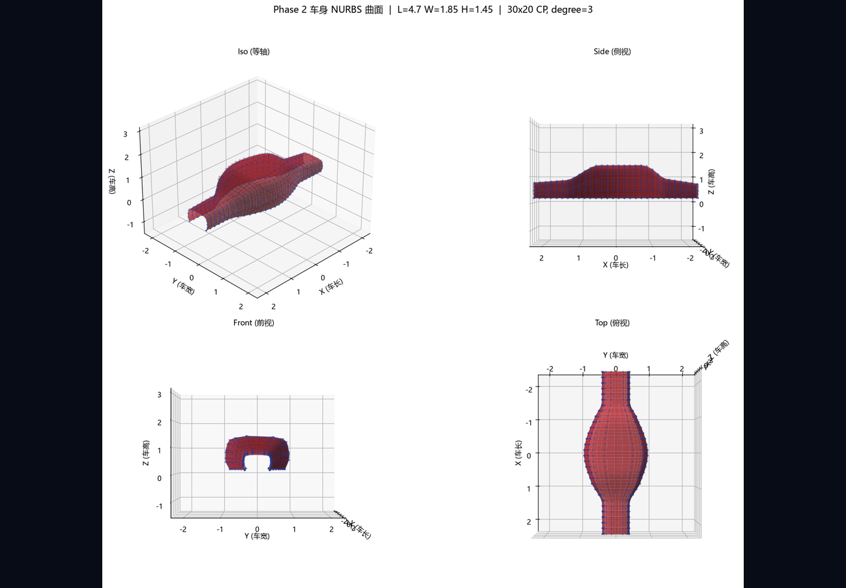
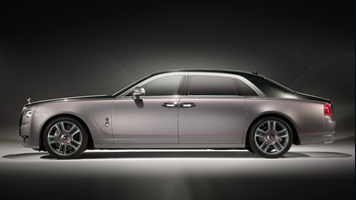
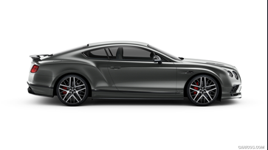

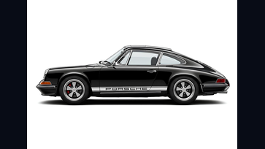
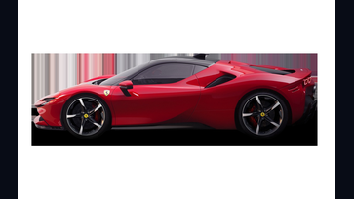
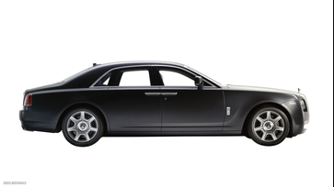
EVOLUTION AI
Parametric × AI-Driven
Automotive Design
Platform
Class-A Surfacing · Brand DNA · Intelligent Creation
evolution-ai.design · 2026
evolution-ai.design
Parametric × AI-Driven

Slide 2
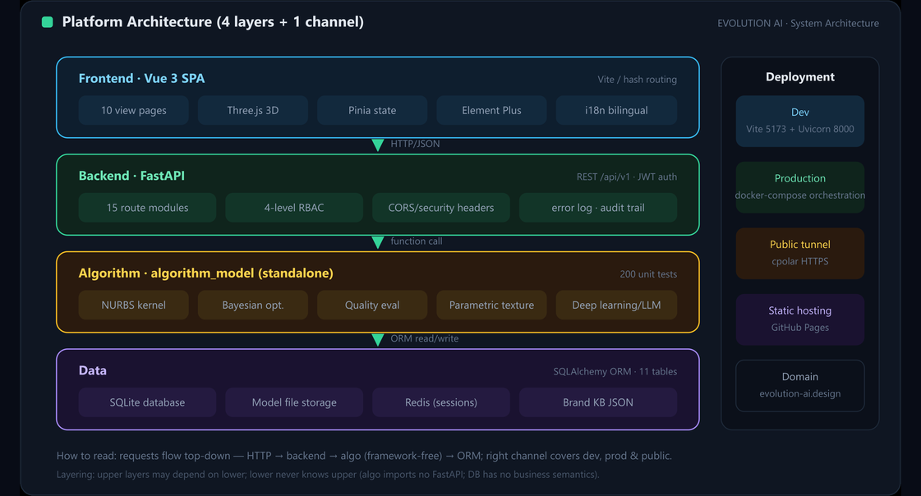
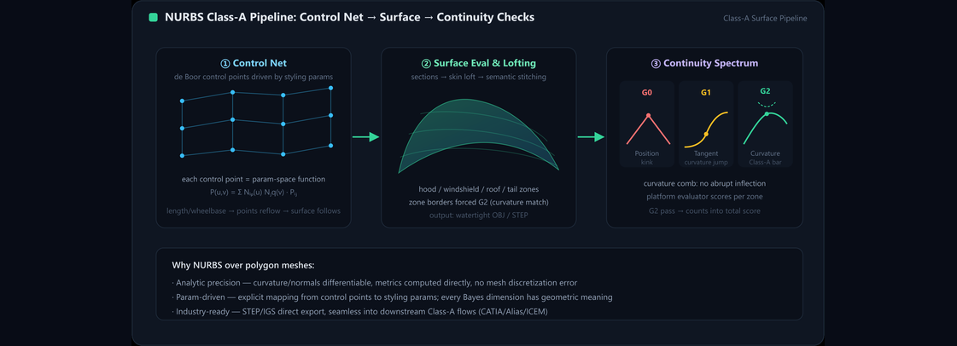
EVOLUTION AI
Architecture
Six-Layer Architecture
Frontend
Vue 3 + Vite · i18n · 14 views
Gateway
nginx · gzip · WebSocket · TLS
Backend
FastAPI · ~118 endpoints · JWT
Data
PostgreSQL 16 + Redis 7 · Alembic
Algorithm
Cython NURBS · QC scoring · CLIP
AI Services
6 LLM proxies · Ollama knowledge
evolution-ai.design
Parametric × AI-Driven
02

Slide 3
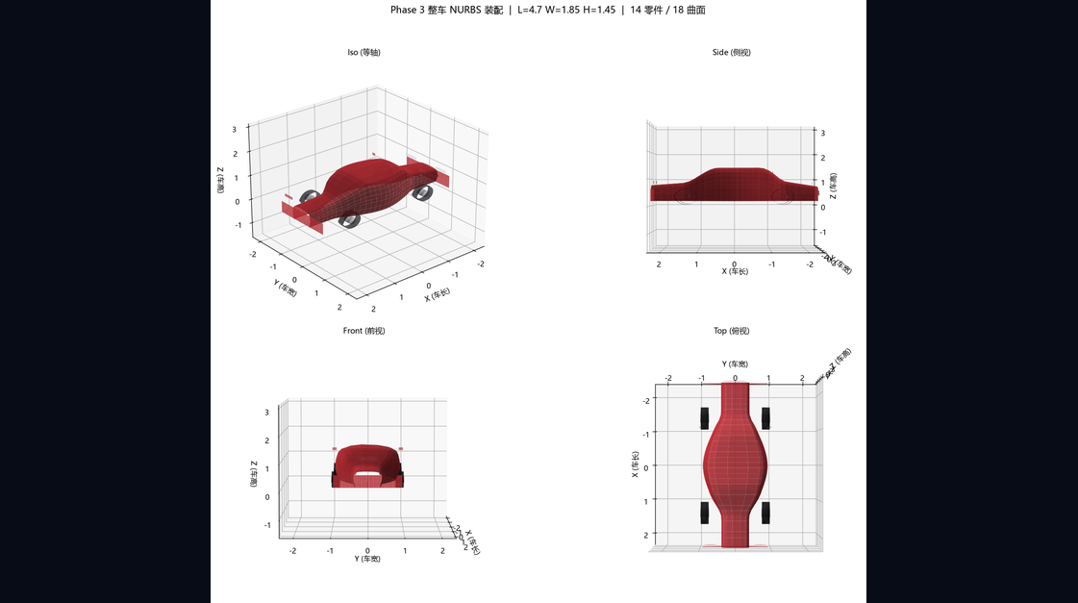
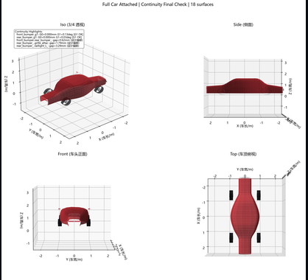
EVOLUTION AI
Surfacing Engine
Parametric Class-A Surfacing Engine
NURBS Parametric Gen
Geometry driven by spec params
Cython Compilation
100–400× on core geometry
Continuity Check
G0/G1/G2 · four-view viz
Persistent Data
G0 / G1 / G2
Multi-order continuity verified in four views
JSON storage · variant management
Quality Scoring
Reflection · curvature · tolerance
evolution-ai.design
Parametric × AI-Driven
03

Slide 4
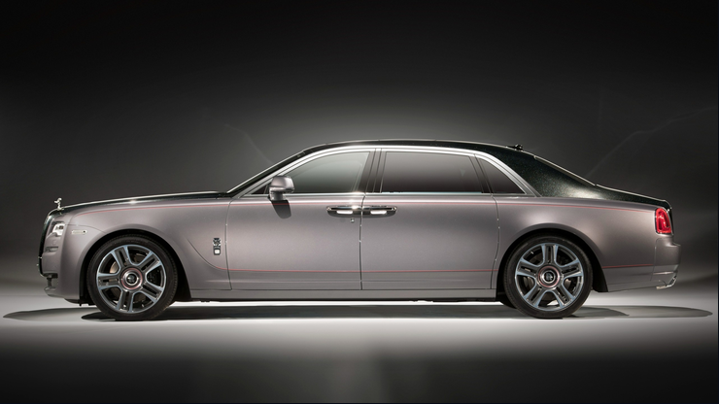
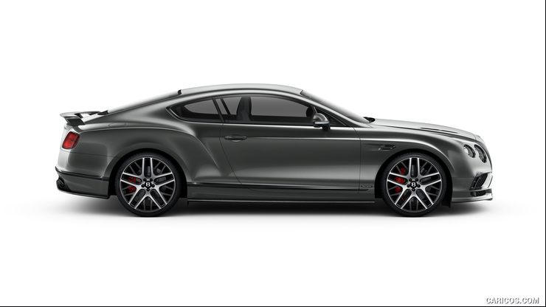
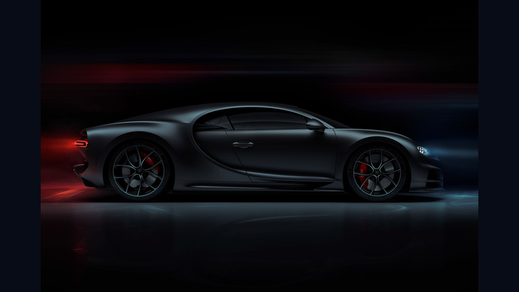



EVOLUTION AI
Brand Knowledge
5 Premium Brands · 19 Flagship Models
Rolls-Royce Phantom
Bentley Continental GT
Bugatti Chiron
Porsche 911
Ferrari SF90
Rolls-Royce Ghost
evolution-ai.design
Parametric × AI-Driven
04

Slide 5
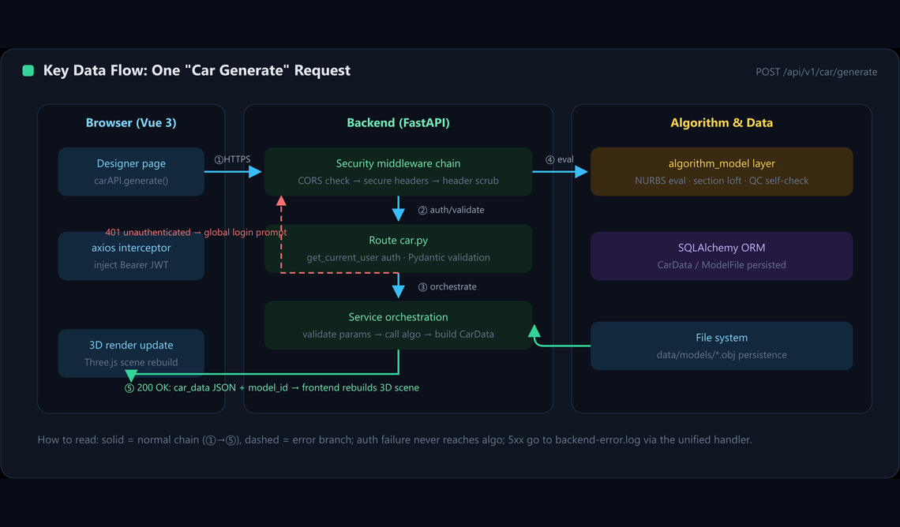
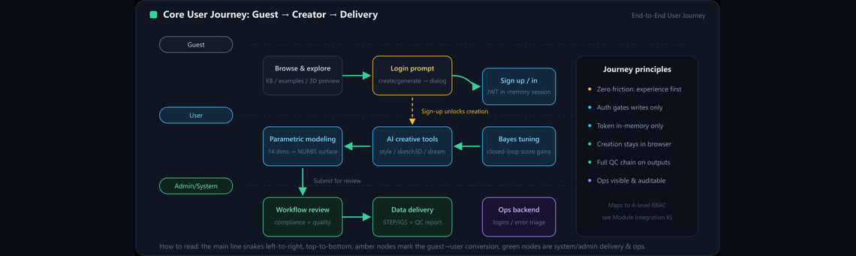
EVOLUTION AI
AI Tools
From Inspiration to 3D: Four Creative Paths
Style Transfer
Brand DNA fusion on designs
Sketch to 3D
Hand lines to editable body
Dream Design
Natural language to form
Parametric Texture
Patterns on freeform surfaces
evolution-ai.design
Parametric × AI-Driven
05

Slide 6
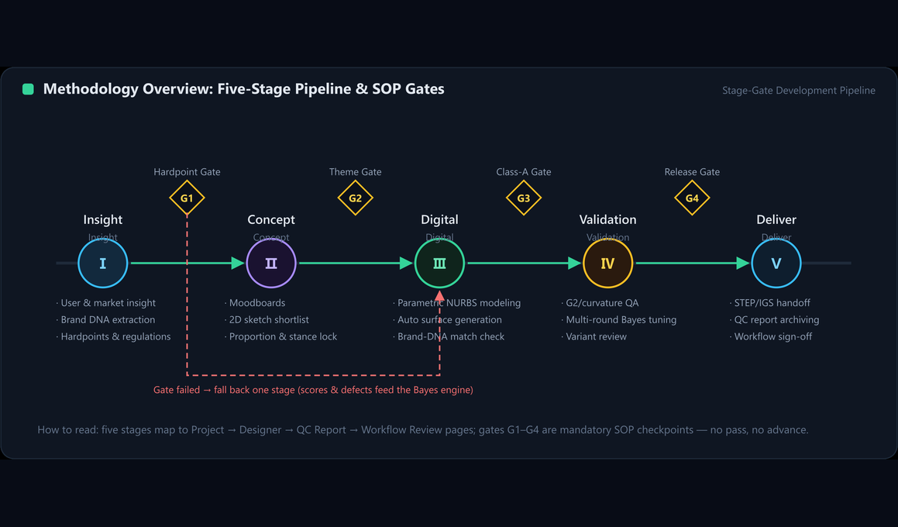
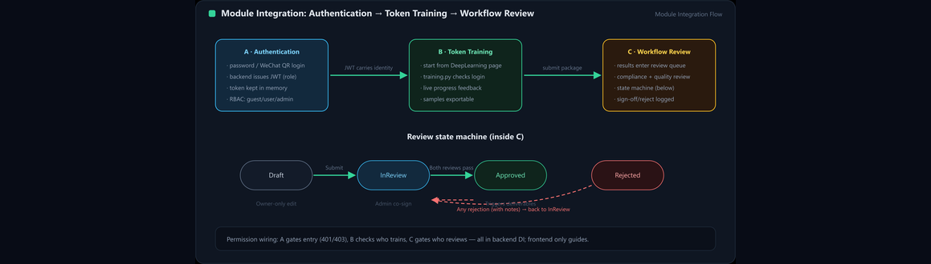
EVOLUTION AI
LLM Service
Three-Block Knowledge + 21 Anchors
G1/G0/G2 Definition
Precision continuity defs
Body-Bumper Value
Assembly gap metrics
Gap Classification
Recess / bulge / tolerance
Route Isolation
Strict cross-block isolation
Dual Mode
Docker / local auto-fallback
evolution-ai.design
Parametric × AI-Driven
06

Slide 7
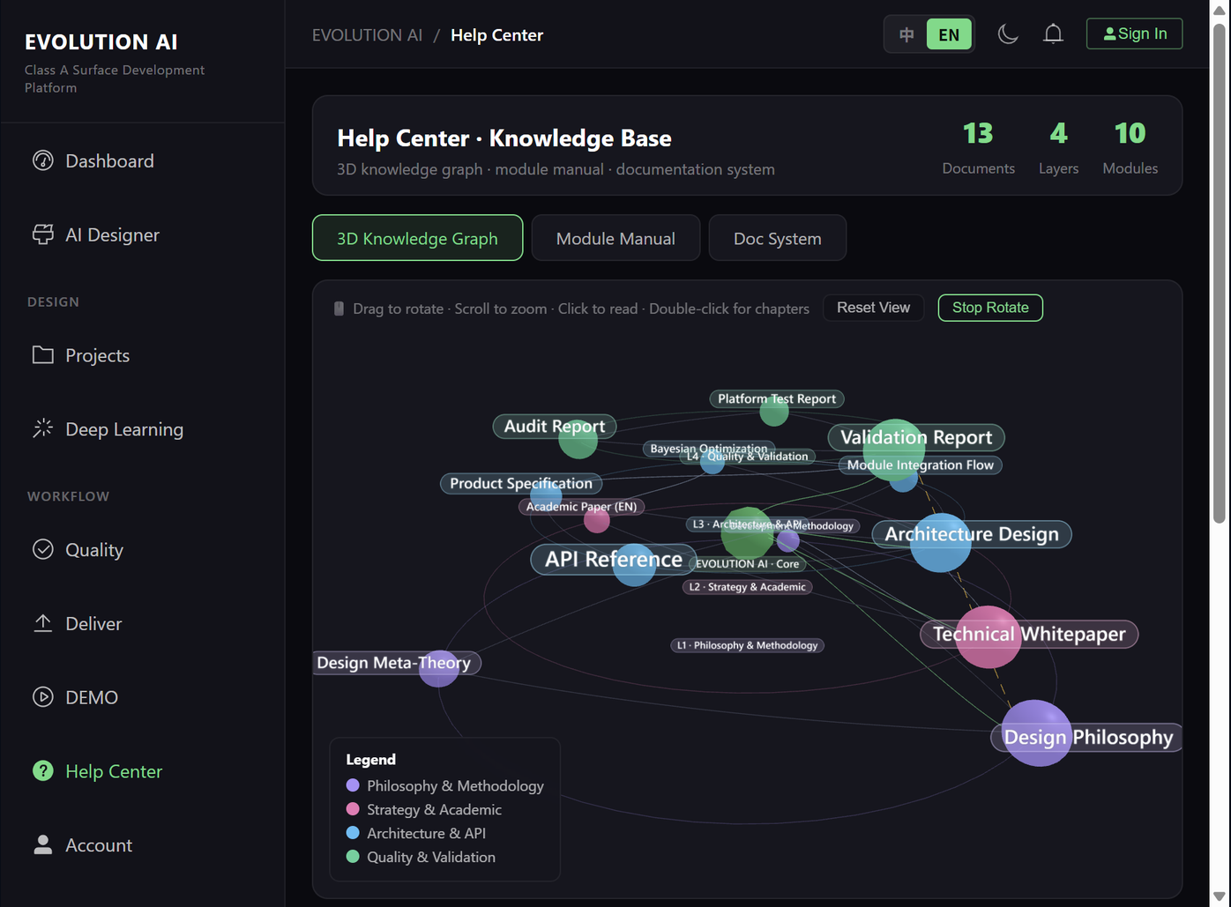
EVOLUTION AI
HELP Map
3D Knowledge Graph · 12 Docs · 4 Clusters
4 Clusters
Philosophy · Strategy
Architecture · Quality
Interaction
Drag · zoom
Click node to load doc
Formats
Read as Markdown
Download PDF
evolution-ai.design
Parametric × AI-Driven
07

Slide 8
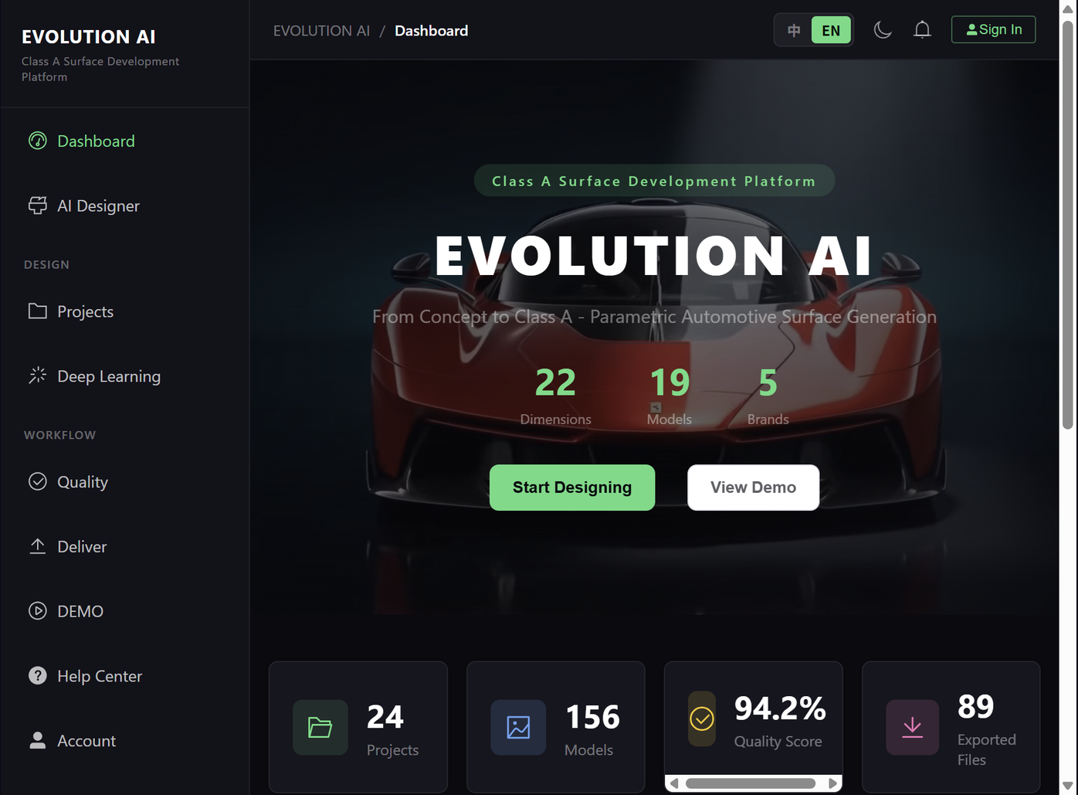
EVOLUTION AI
Experience
Dashboard Homepage · Guest-Browsable
Hero Area
3D car showcase
AI tool card entries
Content
Project list
Quality report overview
Access
Guest / User
Admin / Super Admin
evolution-ai.design
Parametric × AI-Driven
08

Slide 9
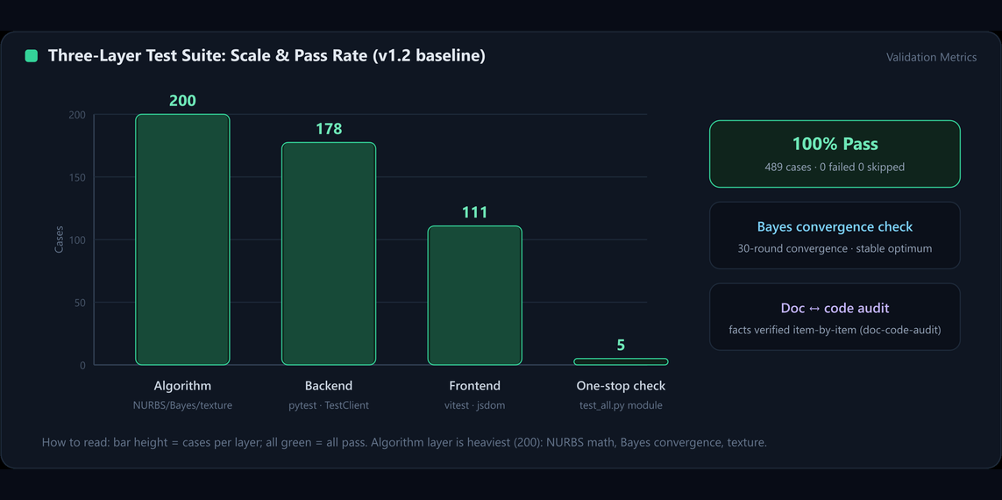
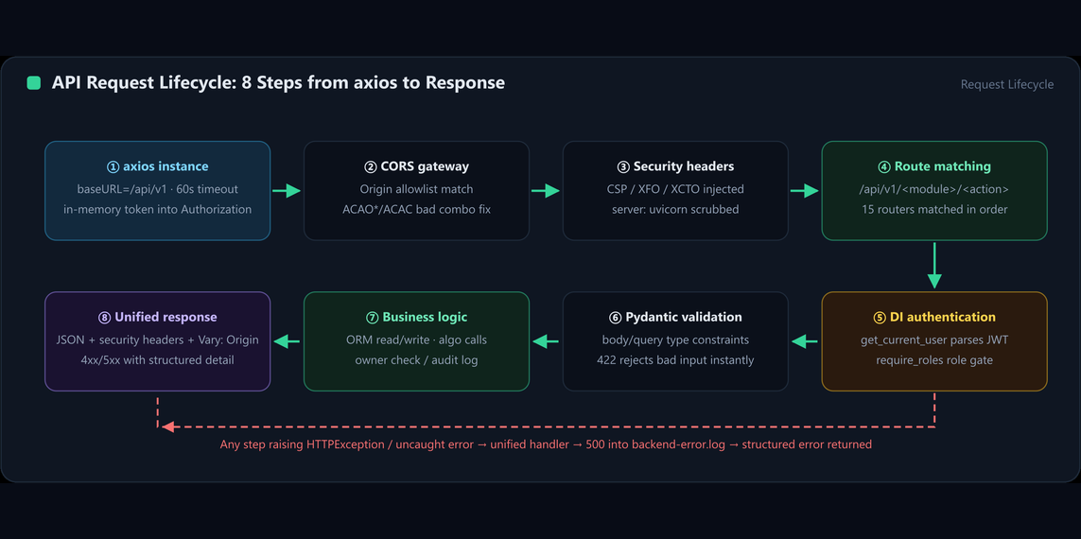
EVOLUTION AI
Data & Security
Defense-in-Depth · 204/204 Green
Rate-Limit
Headers
JWT Auth
Auth/LLM: 10 per min
CSP·XFO·XCTO·HSTS
HS256 · fail-fast
Key Encryption
RBAC Guards
Audit Log
Fernet · user keys
Backend + frontend
Full trace · IP + time
evolution-ai.design
Parametric × AI-Driven
09

Slide 10
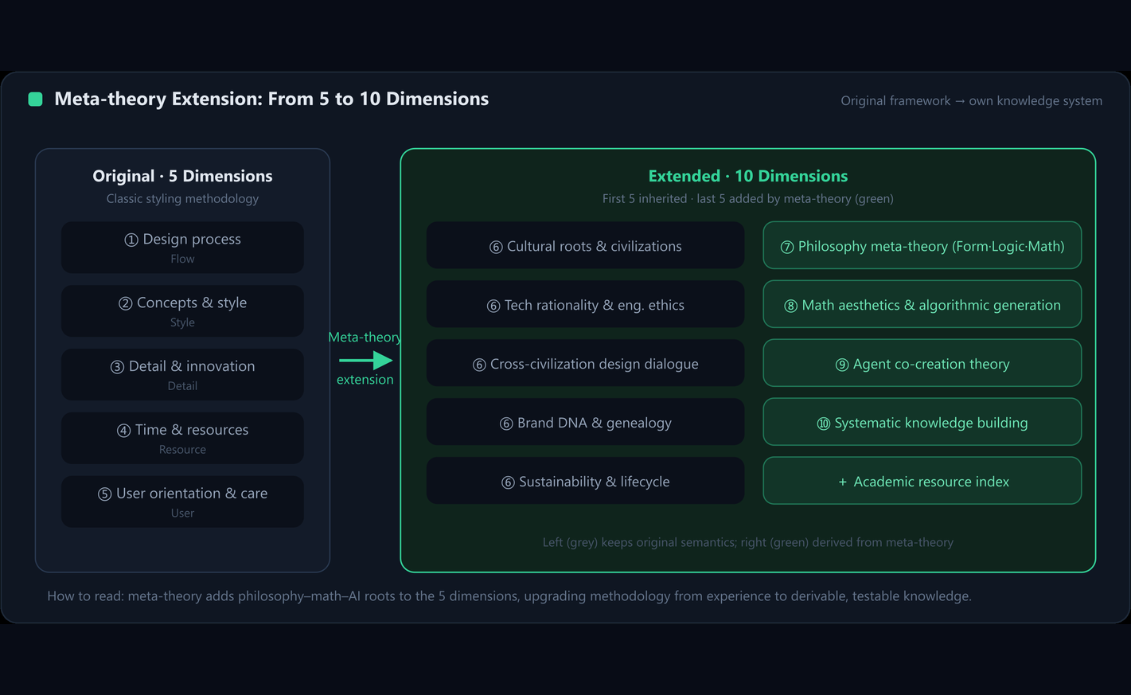
EVOLUTION AI
Deployment
Dual-Mode: GitHub Pages + Docker Stack
GitHub Pages
Static · dist/ sync · bilingual
Docker Stack
nginx+backend+PG+Redis
LLM Standalone
compose.llm · dual mode
TLS Production
443+certbot · HSTS 1yr
First run: .env → npm build → Alembic → compose up -d
evolution-ai.design
Parametric × AI-Driven
10

Slide 11
EVOLUTION AI
Capabilities
Parametric Precision · AI Creativity · Quality Loop
Parametric Class-A
Brand DNA Knowledge
AI Creative Workflow
NURBS · Cython speed
5 brands 19 models
Transfer · sketch-to-3D
Surface Quality
LLM Knowledge
HELP Knowledge Map
Curvature/tolerance reports
Three-block · 21 anchors
3D graph · Markdown+PDF
evolution-ai.design
Parametric × AI-Driven Platform · Class-A Surfacing · Brand DNA · Intelligent Creation
evolution-ai.design
Parametric × AI-Driven
11

Slide 12

Precision in Parametrics. Beauty in Form.
evolution-ai.design
Parametric × AI-Driven Automotive Design Platform · 2026

