Slide 1
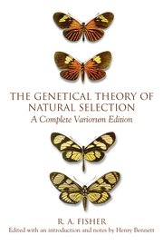


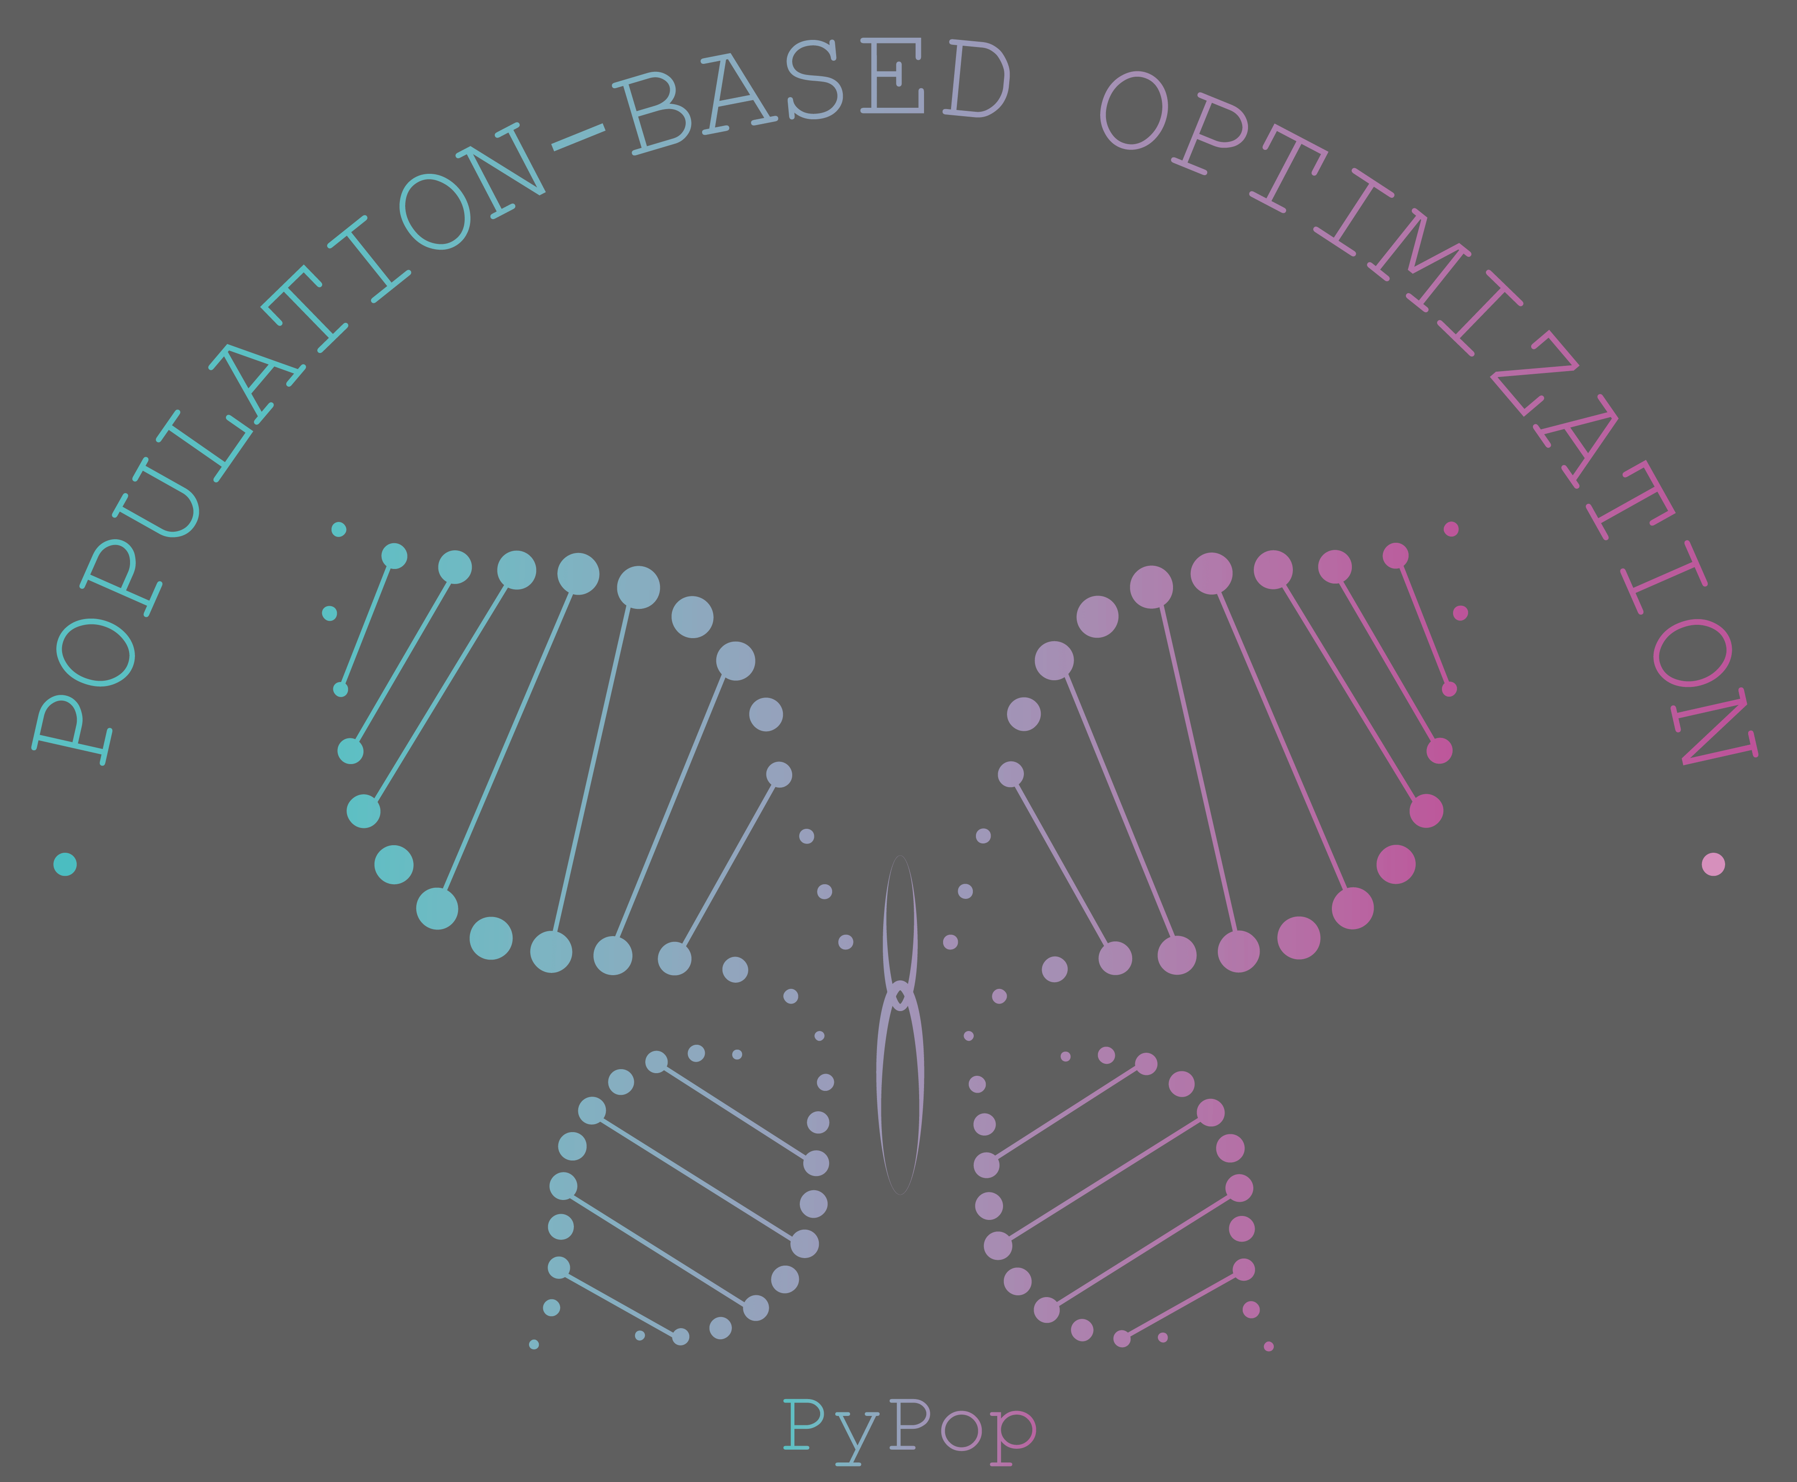
PyPop7 A Pure-PYthon open-source library of POPulation-based Global Optimization (in [JMLR-2024])
©OUP
Evolutionary-Intelligence (led by Dr. Duan and Prof. Shi)
HIT & SUSTech
(2017 – 2020 / 2021 – 2024 / 2025 -)
https://github.com/Evolutionary-Intelligence/pypop
Docs: https://pypop.rtfd.io/ (pdf)

Slide 2

[J2C] PyPop7 A Pure-PYthon open-source library of POPulation-based Global Optimization (in [JMLR-2024])
© https://www.cec2025.org/
Evolutionary-Intelligence (led by Dr. Duan and Prof. Shi)
HIT & SUSTech
(2017 – 2020 / 2021 – 2024 / 2025 -)
https://github.com/Evolutionary-Intelligence/pypop
Docs: https://pypop.rtfd.io/ (pdf)

Slide 3
Three Main Goals of This Open-Source Pure-Python Library (PyPop7) for Global Derivative-Free Optimization
In order to facilitate
Real-world complex (e.g., non-linear) applications (expected as an open-access interface between academy and industry)
Global optimization (in black-box scenarios)
Particularly large-scale optimization (LSO)
Research repeatability (expected as one of widely-recognized platforms to test, compare, and improve existing or adding new)
Mainly from the optimizers perspective
Rather than test functions, though also of equal importance
Off-the-shelf Python API (especially for non-CS users)
To ease tedious and error-prone programming practices
To easily check and feedback correctness of open-source code
Systematic benchmarking of BBO (when combined with e.g., COCO/NeverGrad/…)
* Ordered in the first word for the following journals
ACM Transactions on Evolutionary Learning and Optimization
Artificial Life
Evolutionary Computation
IEEE Transactions on Evolutionary Computation
International Journal of Swarm Intelligence Research
Swarm Intelligence
…… (etc.)

Slide 4
General Global Optimization (GO): Unsolvable
“In our opinion, the main fact, which should be known to any person dealing with optimization models, is that in general, optimization problems are unsolvable. This statement, which is usually missing in standard optimization courses, is very important for understanding optimization theory and the logic of its development in the past and in the future.”
From Prof. Yurii Nesterov’s book Lectures on Convex Optimization
“In general, computing a global minimum in a smooth nonconvex NLP (Non-Linear Program) is a hard problem.”
From Murty, K.G. and Kabadi, S.N., 1987. Some NP-complete problems in quadratic and nonlinear programming. Mathematical Programming, 39(2), pp.117-129.

Slide 5
Algorithm Diversity in Global Optimization of Complex (e.g., Non-Linear, Non-Convex) Systems
Black-Box Optimization: Population-Based Optimization
Derivative-Free Optimization
Direct Search
Gradient-Free Optimization
Non-Differentiable Optimization
Randomized/Stochastic/Pattern Search
Simulation Optimization
Zeroth-Order Optimization
Evolutionary Computation: Population-Based Optimization
Swarm Intelligence: Population-Based Optimization
Artificial Intelligence
Automatic Control
Machine Learning
Mathematical Programming
Meta-Heuristics
Operations Research
etc.

Slide 6
Design Philosophy: How to Choose from “the Elephant in the Room” (An Open Question)
Molina, D., Del Ser, J., Poyatos, J., et al.,2025. The paradox of success in evolutionary and bioinspired optimization: Revisiting critical issues, key studies, and methodological pathways. arXiv preprint arXiv:2501.07515.
Martí, R., Sevaux, M. and Sörensen, K., 2024. 50 years of metaheuristics. European Journal of Operational Research. Early Access.
Campelo, F. and Aranha, C., 2023. Lessons from the evolutionary computation Bestiary. Artificial Life, 29(4), pp.421-432.
Swan, J., Adriaensen, S., Brownlee, A.E., et al., 2022. Metaheuristics “in the large”. European Journal of Operational Research, 297(2), pp.393-406.
Kudela, J., 2022. A critical problem in benchmarking and analysis of evolutionary computation methods. Nature Machine Intelligence, 4(12), pp.1238-1245.
Aranha, C., Camacho Villalón, C.L., Campelo, F., et al., 2022. Metaphor-based metaheuristics, a call for action: The elephant in the room. Swarm Intelligence, 16(1), pp.1-6.
de Armas, J., Lalla-Ruiz, E., Tilahun, S.L., et al., 2022. Similarity in metaheuristics: A gentle step towards a comparison methodology. Natural Computing, 21(2), pp.265-287.
Sörensen, K., Sevaux, M. and Glover, F., 2018. A history of metaheuristics. In Handbook of Heuristics (pp. 791-808). Springer, Cham.
Sörensen, K., 2015. Metaheuristics—the metaphor exposed. International Transactions in Operational Research, 22(1), pp.3-18.
https://oneweirdkerneltrick.com/part2.pdf (obvious sarcasm from e.g., CMU Ph.D. and NYU Prof.)
…… (etc.)
https://pypop.readthedocs.io/en/latest/design-philosophy.html

Slide 7
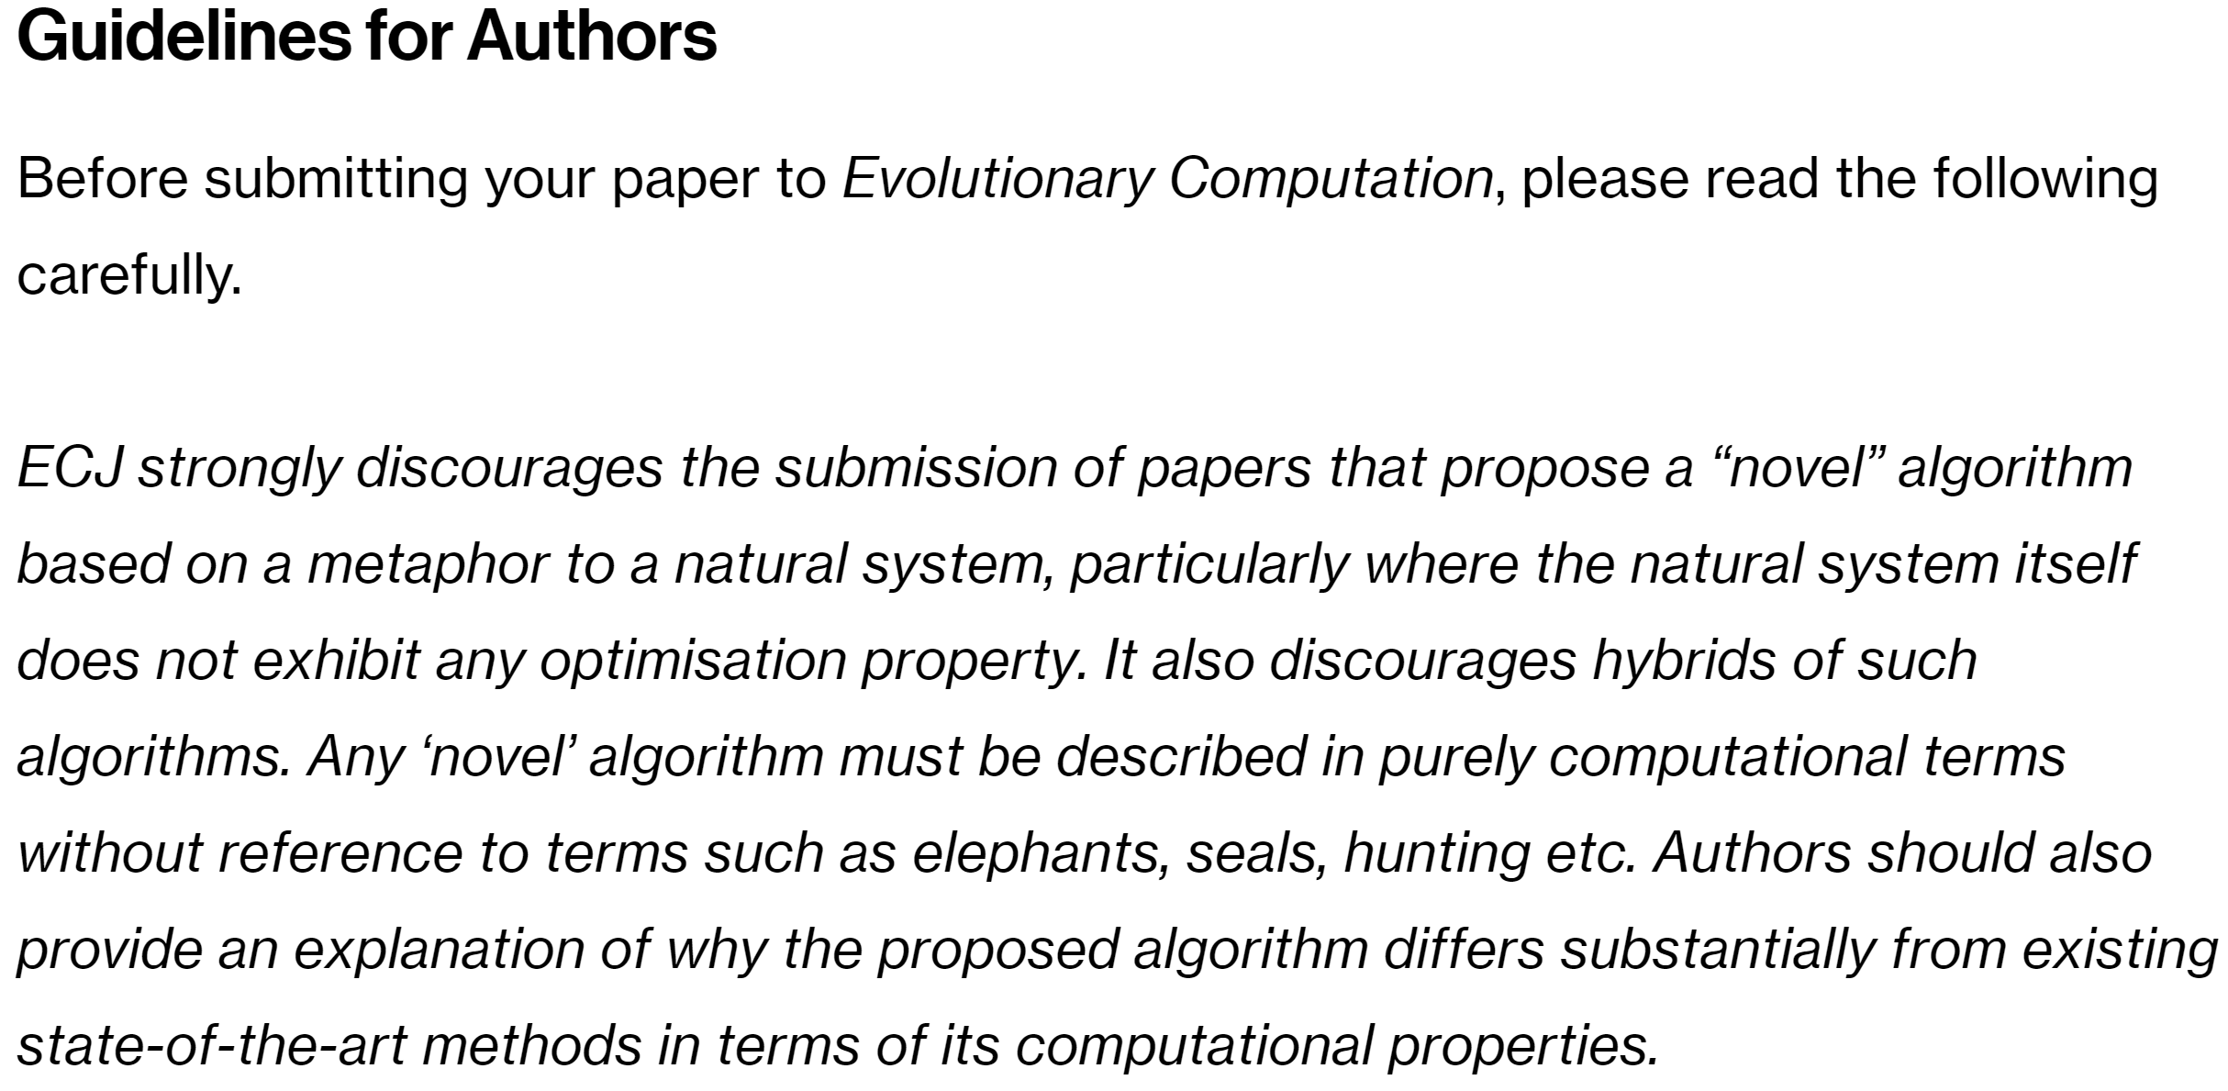
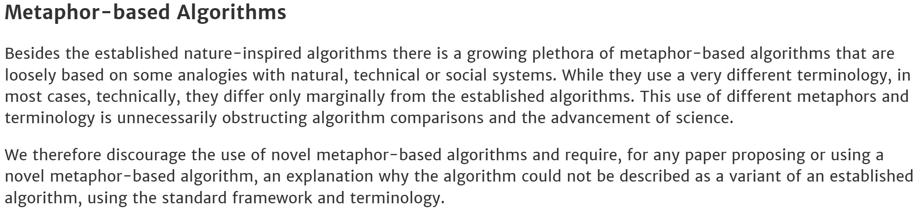
Design Philosophy: How to Choose from “the Elephant in the Room” (An Open Question)
https://direct.mit.edu/evco/pages/submission-guidelines (Access time: Oct. 31, 2024)
https://dl.acm.org/journal/telo/author-guidelines (Access time: Oct. 31, 2024)

Slide 8
From Biological to Computational Evolution
Toward a postmodern synthesis of evolutionary biology [Koonin, 2011]
“Variously constrained randomness is at the very heart of the entire history of life.” [Koonin, 2011, “The logic of chance: The nature and origin of biological evolution”]
Biological evolution as a form of learning [Valiant, 2020, GECCO]
“We formulate evolution as a form of learning from examples. … We formulate a notion of evolvability that distinguishes function classes that are evolvable with polynomially bounded resources from those that are not.”
“The dilemma is that if the function class that describes the expression levels of proteins in terms of each other, is too restrictive, then it will not support biology, while if it is too expressive then no evolution algorithm will exist to navigate it.”
https://dl.acm.org/doi/abs/10.1145/3377930.3398731

Slide 9
Some (rather all) Popular Open-Source Libraries for Evolutionary Computation (EC) and/or Swarm Intelligence (SI) https://pypop.readthedocs.io/en/latest/software-summary.html
Matlab
https://github.com/BIMK/PlatEMO (>1.5k stars & >2k citations)
Ye Tian, Ran Cheng, Xingyi Zhang, and Yaochu Jin, PlatEMO: A MATLAB platform for evolutionary multi-objective optimization [Educational Forum], IEEE Computational Intelligence Magazine, 2017, 12(4): 73-87.
https://www.mathworks.com/products/global-optimization.html (Global Optimization Toolbox)
ga | gamultiobj
particleswarm
patternsearch
surrogateopt
……
https://divis-gmbh.de/es-software/
The Octave source code (proprietary implementations) can be downloaded only for non-commercial use
It seems to be NOT open-access now
http://www.cmap.polytechnique.fr/~nikolaus.hansen/cmaes_inmatlab.html
……

Slide 10
Some (rather all) Popular Open-Source Libraries for Evolutionary Computation (EC) and/or Swarm Intelligence (SI) https://pypop.readthedocs.io/en/latest/software-summary.html
Python
https://github.com/CMA-ES/pycma (~10M downloads)
https://team.inria.fr/randopt/
Nikolaus Hansen, Anne Auger, Dimo Brockhoff, Youhei Akimoto, etc.
https://esa.github.io/pygmo2/
……

Slide 11






Online
Docs
PyPI Installation
Design Philosophy
User
Guide
Online Tutorials
API Docs of Optimizers
Development Guide
Applications & Citations
Benchmarking
Black-Box Optimizers (BBO)
Optimizer
(as an open interface to add new/missed BBO)
Large-scale BBO:
Test local search abilities
Test global search abilities
Black-box classification:
Test on 25 cases (=5 datasets * 5 loss functions)
COCO/BBOB interface:
Test on 24 different functions
NeverGrad interface:
Test on photonics problems
Direct (neural) policy search:
Test on 6 simulation robotics (from gymnasium)
Lennard-Jones cluster optimization (from pygmo)
Evolution Strategies (ES)
Particle Swarm Optimizers (PSO)
Differential Evolution (DE)
MMES
LMMAES
CPSO
CCPSO2
SHADE
JADE
LMCMA
LMCMAES
CLPSO
IPSO
CDE
TDE
RMES
CCMAES
SPSO
SPSOL
R1ES
SEPCMAES
Estimation of Distribution (EDA)
Cross-Entropy Method (CEM)
DDCMA
FMAES
CMAES
… …
RPEDA
UMDA
DSCEM
MRAS
AEMNA
EMNA
SCEM
Natural Evolution Strategies (NES)
Test Protocols
Cooperative Co-evolution (CC)
Evolutionary Programming (EP)
Repeatability reports
Automatic testing (pytest)
VDCMA
VKDCMA
SNES
R1NES
HCC
COCMA
LEP
FEP
Util Functions
Plot 2-D/3-D landscapes
Save optimization data (pickle)
Check optimization results
Plot convergence curves (matplotlib)
Compare multiple optimizers
Accelerate computation (Numba)
XNES
ENES
COSYNE
COEA
CEP
Genetic Algorithms
(GA)
Direct/Pattern Search (DS)
Random Search (RS)
GL25
G3PCX
POWELL
NM
BES
GS
GENITOR
HJ
CS
SRS
PRS
Computing
Engine

Slide 12
Random Search (RS)
Control/Cybernetics
Homeostat [Ashby, 1952]
https://link.springer.com/book/10.1007/978-94-015-1320-3

Slide 13
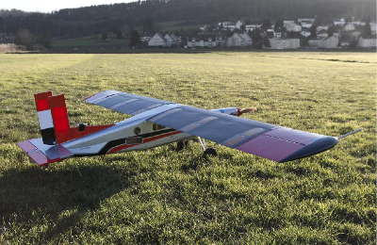
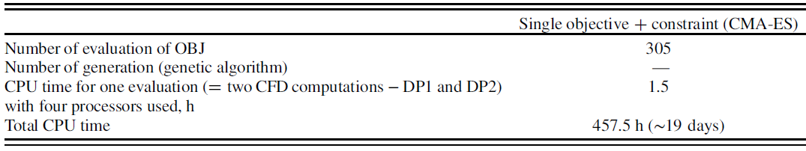
Evolution Strategies (ES)
[Molinari et al.,, 2016, AIAAJ]
For aeronautics&astronautics
Distributed compliance morphing wings [Molinari et al.,, 2016, AIAAJ]
https://arc.aiaa.org/doi/10.2514/1.J055073 [Molinari et al.,, 2016, AIAAJ]
https://github.com/Evolutionary-Intelligence/DistributedEvolutionaryComputation/blob/main/Pub/AIAA-Journal-(AIAAJ).md

Slide 14
Evolution Strategies (ES)
For bioinspiration&biomimetics (bioinspired robotics)
Bipedal muscle-actuated systems [Badie&Schmitt, 2024, Bioinspiration&Biomimetics] (University of Stuttgart)
Multilevel swarm-based models of collective behaviours [Cazenille et al., 2022, Bioinspiration&Biomimetics] (CNRS)
Fish-inspired robots [Sharifzadeh et al., 2021, Bioinspiration&Biomimetics]
https://doi.org/10.1088/1748-3190/ad3602 [Badie&Schmitt, 2024]
https://doi.org/10.1088/1748-3190/ac165d [Sharifzadeh et al., 2021]

Slide 15
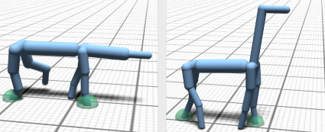
Evolution Strategies (ES)
For computer graphics
Animal locomotion [Wampler&Popović, 2009, TOG] (University of Washington)
https://dl.acm.org/doi/10.1145/1531326.1531366 [Wampler&Popović, 2009, TOG]
[Wampler&Popović, 2009, TOG]

Slide 16
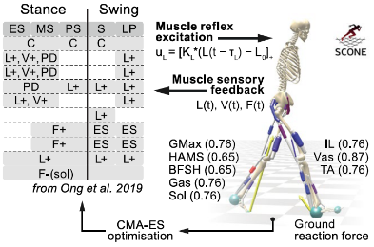
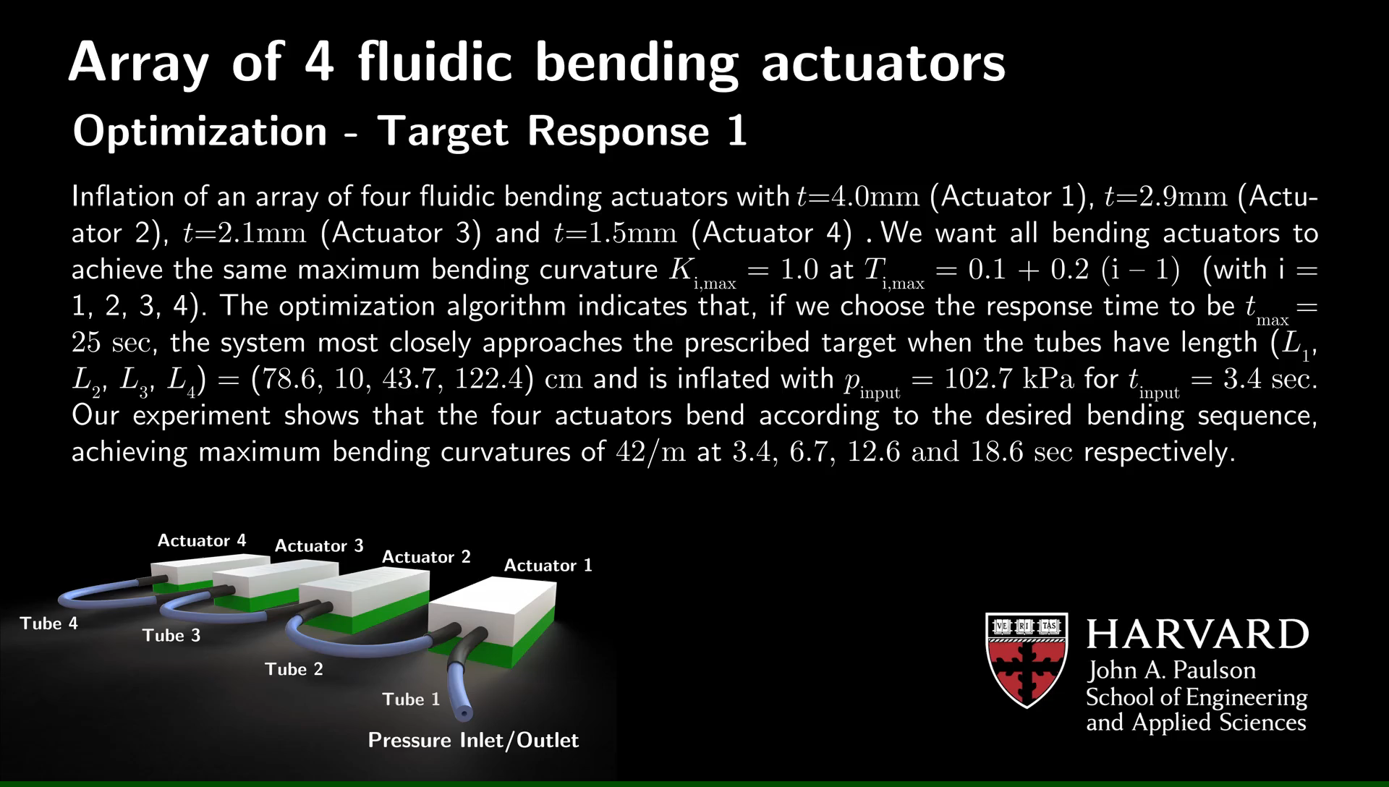
Evolution Strategies (ES)
[Milekovic et al., 2023, Nature Medicine]
For robotics [Siciliano&Khatib, Springer Handbook of Robotics, 2016]
Robotic propulsors self-repair [Hooper et al., 2024, RSIF] (California Institute of Technology), trajectory optimization [Martin&Gharib, 2018, Bioinspiration&Biomimetics] (California Institute of Technology)
Biorobotics [Bruel et al., 2024] (EPFL, Auke Ijspeert)
Personalized neurobiomechanical model [Milekovic et al., 2023, Nature Medicine] (EPFL + Lausanne University Hospital + China Academy of Medical Sciences + Institute of Laboratory Animal Sciences + Brown University + University of California, San Francisco + Oxford University + …)
Soft exosuits for gait rehabilitation [Quinlivan, 2021, Doctoral Dissertation, Harvard University]
Fluidic soft robots [Vasios et al., 2020, SORO] (Harvard University)
[Vasios et al., 2020]
https://royalsocietypublishing.org/doi/10.1098/rsif.2024.0141 [Hooper et al., 2024, RSIF]
https://www.biorxiv.org/content/10.1101/2024.04.12.589164v1 [Bruel et al., 2024]
https://www.nature.com/articles/s41591-023-02584-1 [Milekovic et al., 2023, Nature Medicine]
https://dash.harvard.edu/handle/1/37369463 [Quinlivan, 2021]
https://www.liebertpub.com/doi/full/10.1089/soro.2018.0149 [Vasios et al., 2020]
https://iopscience.iop.org/article/10.1088/1748-3190/aaefa5 [Martin&Gharib, 2018]

Slide 17
Evolution Strategies (ES)
Physics
Holographic microscopy [Martin, 2024, Doctoral Dissertation, Harvard University], [Barkley, 2021, Doctoral Dissertation, Harvard University]
https://dash.harvard.edu/handle/1/37378922 [Martin, 2024]
https://dash.harvard.edu/handle/1/37368472 [Barkley, 2021]

Slide 18
Evolution Strategies (ES)
Neuroscience
Neural-guided image synthesis [Wang&Ponce, 2024] (Washington University in St Louis + Harvard Medical School)
https://doi.org/10.1101/2024.06.20.596072

Slide 19
Evolution Strategies (ES)
Materials
Bio-inspired metamaterials [Fernandes et al., 2021, Nature Materials], [Fernandes, 2021, Doctoral Dissertation, Harvard University]
https://www.nature.com/articles/s41563-020-0798-1 [Fernandes et al., 2021]
https://dash.harvard.edu/handle/1/37370084 [Fernandes et al., 2021]

Slide 20
Evolution Strategies (ES)
Engineering
Dassault Systèmes
https://www.3ds.com/products/simulia/cst-studio-suite/automatic-optimization

Slide 21
Particle Swarm Optimizer (PSO)
Control Optimization
Flight [Melis et al., 2024, Nature] (California Institute of Technology + Howard Hughes Medical Institute)

Slide 22
An Open Interface for Missed/New BBO
Welcome anyone to contribute freely
More benchmarking

