Slide 1

Hydrogen in the Annual Decarbonization Perspective
October 31, 2022
Prepared for:
Breakthrough Energy Foundation

Slide 2
Agenda
Model Approach and Key Inputs
Results
Discussion

Slide 3
Model Approach and Key Inputs

Slide 4
Model Approach – Hydrogen Demand
Model determines an exogenous demand based on scenario assumptions for hydrogen deployment in direct industrial process heating and transportation
Model can endogenously deploy hydrogen in industrial steam production (hydrogen boilers), synthetic fuel production (Fischer-Tropsch hydrocarbons, Haber-Bosch ammonia), and thermal power plants

Slide 5
Model Approach – Hydrogen Supply
Hydrogen is balanced on an hourly basis across model regions. Hydrogen can be stored in salt cavern storage (where available regionally) or a generic storage technology at a higher cost (represented with underground pipes)
Hydrogen pipelines can be constructed between model regions to balance supply and demand
Hydrogen production processes are bpth built and operated endogenously as model decisions (i.e. utilization factor for electrolyzers depends on hourly renewable production, storage availability, flexibility of hydrogen uses, etc. )

Slide 6
Technology Assumptions
Technology | Source | Notes | Today | 2030 | 2050
Electrolysis | IEA Future of Hydrogen | 66% efficiency | $1531 (output) $1018 (input) | $961 (output) $642 (input) | $391 (output) $260 (input)
BECCS | IEA – CCS in Biofuels Production | 50% efficiency; 90% CO2 capture | $4711 | $4711 | $4711
Steam Reformation w/CC | IEA Future of Hydrogen | 69% efficiency; 90% CO2 capture | $1896 | $1638 | $1482
Steam Reformation | IEA Future of Hydrogen | 76% efficiency | $1048 | $1048 | $1048

Slide 7
Scenario Results

Slide 8
Scenarios
Scenario | Description
Central | This is the least-cost pathway for achieving net-zero greenhouse gas emissions by 2050 in the U.S. It is economy-wide and includes energy and industrial CO₂, non-CO₂ GHGs, and the land CO₂ sink. It is built using a high electrification demand-side case, and on the supply-side has the fewest constraints on technologies and resources available for decarbonization.
Drop-In | This net-zero scenario prioritizes maintaining the use of existing infrastructure to the greatest extent possible consistent with carbon neutrality, implemented by placing cost penalties on new infrastructure build, delaying the uptake of electrification technologies by twenty years, and avoiding the uptake of other zero-carbon fuel-using technologies (hydrogen and ammonia). It is designed to explore the effects of trying to minimize dislocation on the existing energy industry in the U.S.
High Hydrogen | This net-zero scenario emphasizes the direct use of hydrogen in some applications in which the potential for electrification is uncertain, specifically in industry and heavier vehicles. It is designed to explore the effects of a hydrogen economy that extends all the way to energy end-users.
Low Demand | This net-zero scenario reduces the demand for energy services from that used in the other net-zero scenarios. It is designed to explore how high levels of conservation and energy efficiency, achieved through behavior, planning, policy, and other means, could reduce requirements for low-carbon infrastructure and land.
Low Land | This net-zero scenario limits the use of land-intensive mitigation solutions, including bioenergy crops, wind and solar power generating plants, and transmission lines. It is designed to explore the effect of societal barriers to the siting of low-carbon energy infrastructure for environmental and other reasons.
Slow Consumer Uptake | This net-zero scenario delays by twenty years the uptake of fuel-switching technologies including electric vehicles, heat pumps, fuel-cell vehicles, etc. It is designed to explore the effects of slow consumer adoption on energy system decarbonization, including the impacts on electricity and alternative fuel demand.
100% Renewables | This net-zero scenario allows only wind, solar, biomass, and other forms of renewable energy by 2050. It is designed to explore the effects of eliminating fossil fuels and nuclear power altogether on energy infrastructure, electric power, and the production of alternative fuels and feedstocks.

Slide 9
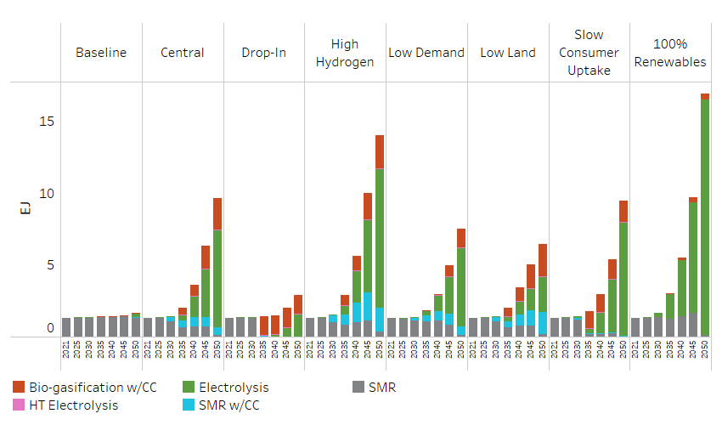
Hydrogen Supply
Production dominated by electrolytic hydrogen
Significant growth in the 2030s due to increase in renewable penetration
Small amount of BECCS H2 and Steam Reforming w/CC in almost all case

Slide 10
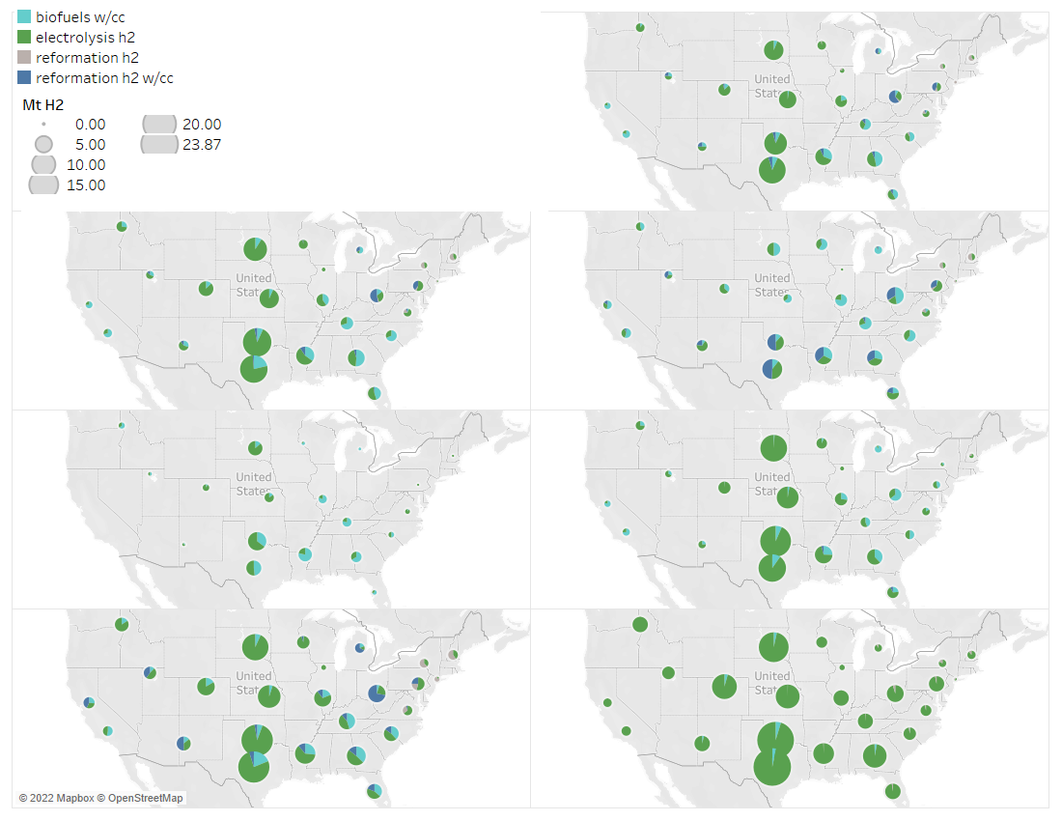
Hydrogen Supply - Regional
Electrolytic hydrogen production concentrated in the wind belt
BECCS H2 principally deployed in the Southeast
Blue H2 deployment primarily in the Northeast
Low Demand
Central
Low Land
Drop-In
Slow Consumer Uptake
High Hydrogen
100% Renewables

Slide 11
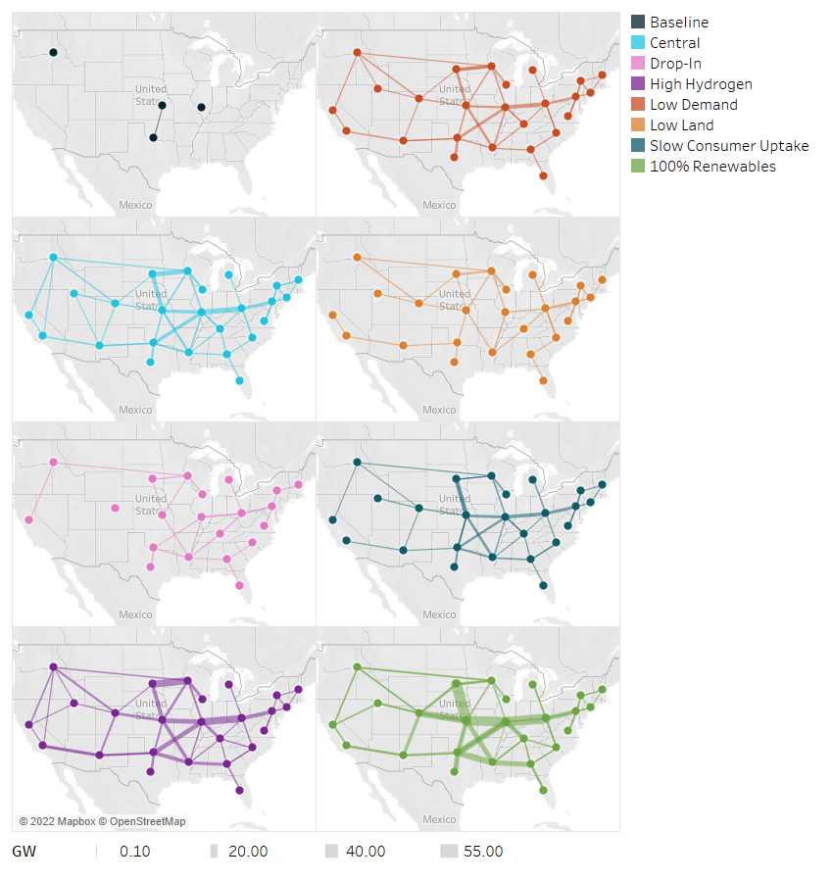
Hydrogen Supply – Pipeline Network
Pipeline network deployed to access lower-cost hydrogen in the middle of the country
Provides an alternative to accessing high-quality renewable only with electric transmission
Hydrogen networks develop to move hydrogen for direct uses as well as to areas with available CO2 for fuel synthesis

Slide 12
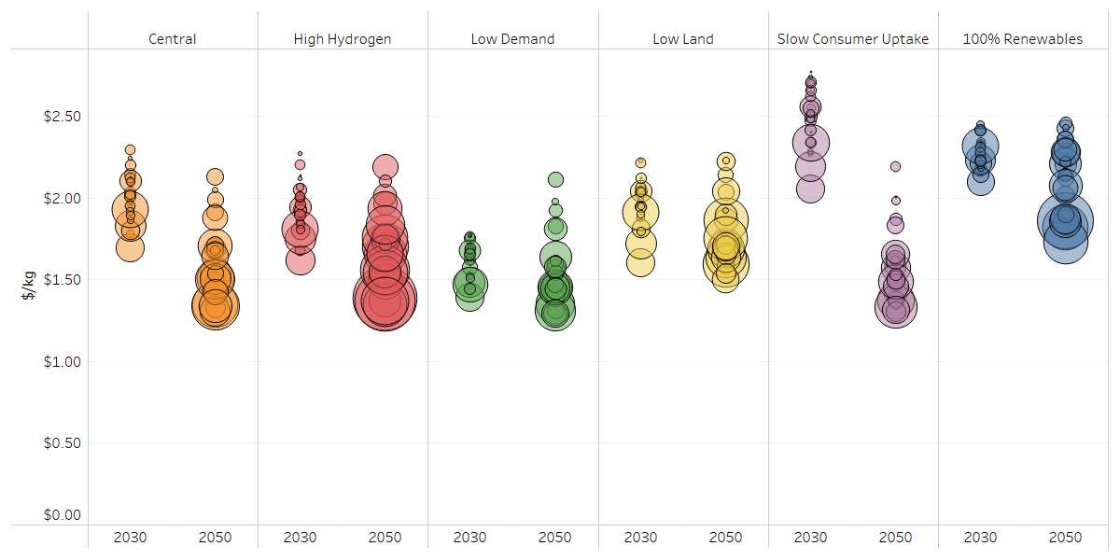
Hydrogen Production Costs
Marginal cost of electrolytic hydrogen is dependent on costs of renewables, share of production that runs on otherwise curtailed renewables (economically inaccessible to other loads), and cost of electrolyzers
In a system context, hydrogen generally ends up from $1.50 - $2/kg in most regions

Slide 13
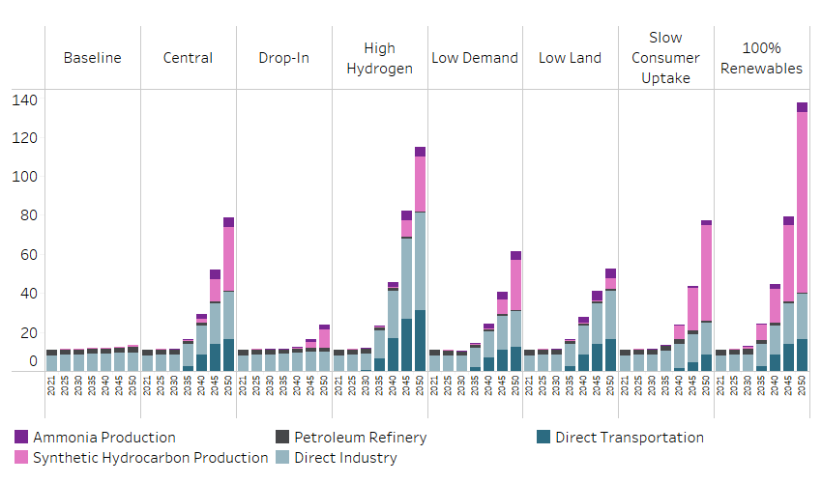
Hydrogen Demand
Hydrogen demanded by limited on-road and off-road deployment for transportation and high-temp industrial process heating as well as a feedstock for synthetic fuel production (used in aviation and other off-road transportation as well as bulk chemicals)

Slide 14
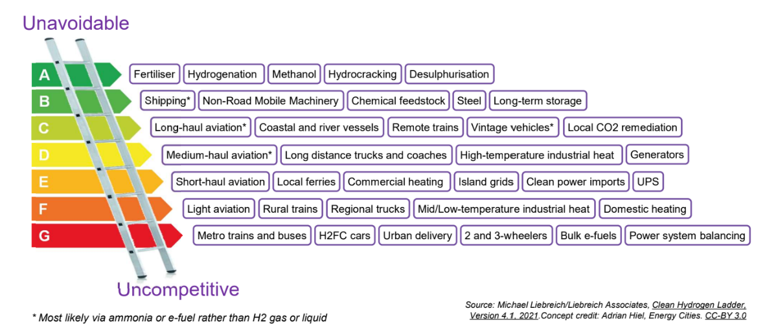
Hydrogen Ladder
Interpreted as H2 Turbines w/Storage

Slide 15
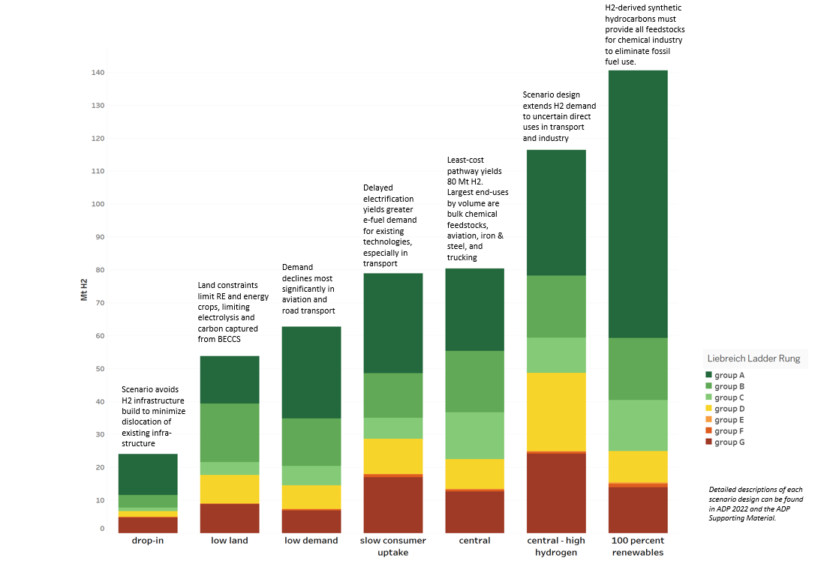
ADP Hydrogen Ladder Comparison
General agreement with hydrogen ladder. We have some additional deployment in on-road transportation reflecting conservative assumptions about some vehicle duty-cycles.

Slide 16
Key Findings

Slide 17
Key Findings
In every decarbonization pathway, hydrogen production grows dramatically over the next thirty years, and the majority is produced by electrolysis. Still, even with this expansion it remains uncompetitive against most end-uses with a direct electrification alternative.
The results of the Annual Decarbonization Perspective are closely aligned with the hierarchy of the Clean Hydrogen Ladder; hydrogen applications in the top three rungs of the ladder account for over 70% of hydrogen used in ADP’s Central scenario
Hydrogen pipelines and synthesis of zero-carbon fuels (hydrocarbons or ammonia) allow additional delivery pathways (other than electric transmission) for low-cost wind found in the U.S. midwest
The competitiveness of e-fuels derived from hydrogen is highly dependent on renewable deployment; constraints on the land available for renewables or the pace of renewable deployment make biofuels more competitive and shrink the role of hydrogen in the energy system.
Additional finding from subsequent analysis: IRA, and renewable/hydrogen tax credits speeds up the pace of hydrogen deployment ~5-10 years from ADP.

