Slide 1
Smart Correlation
A review?
11. 8. 2022
Notes:
Thank you Keith, for the introduction.
Let us start.

Slide 2
Agenda
New approach to correlation in 4.6 and beyond
Configuration samples …
...
Notes:
Today we’d like to present the current status of ID Match integration, just before the release of midPoint 4.5 planned at the beginning of April.
*
We’d like to gather your feedback. Mainly to see if the solution that we have created matches your needs.
*
This is the second presentation. The first one was 6 weeks ago. We won’t repeat all the details shown at that time, but instead we’ll concentrate on features that make working with identity matching more convenient and productive: Email notifications, dashboards, and reporting.
*
We’ll also show how we solved the question of updating attributes in ID Match database when already-matched identities in the systems of record change.

Slide 3
Algorithm (technical view)
There is a root correlator.
  It may contain other (child) ones, forming a tree structure.
When correlating, each correlator produces a set of candidate owners, each with a confidence value from [0,1].
  filter correlator executes specified filter or filters against the repository
  expression correlator executes specified expression
  items correlator executes a query based on a list of items and their definitions (indexing, matching)
  ID Match correlator invokes the external ID Match service and interprets its answer.
  composite correlator invokes its children and combines their results.
Finally (after the root correlation is evaluated), thresholds determine the overall result:
  existing owner, no owner, uncertain (disputed);
  which candidates to completely hide.

Slide 4
Computing the Confidence Value
Primitive correlators (filter, expression, items) set a confidence of 1 for all candidates
  can be overridden using a confidence expression
ID Match correlator returns the confidence provided by the external service (rescaled from [0,100] to [0,1] and limited by given value).
Composite correlator
  evaluates its child correlators (each provides a set of candidates)
  takes a union of these candidate sets
  computes the confidence for each candidate:
total confidencecand = total confidence for candidate cand
confidencecand,cor = confidence of candidate cand provided by child correlator cor
weightcor = weight of child correlator cor in this composition
scale = scale of the given composite correlator (default: 1)
red = output of this composite correlator
blue = inputs provided by child correlators
green = configuration parameters of this composite correlator

Slide 5
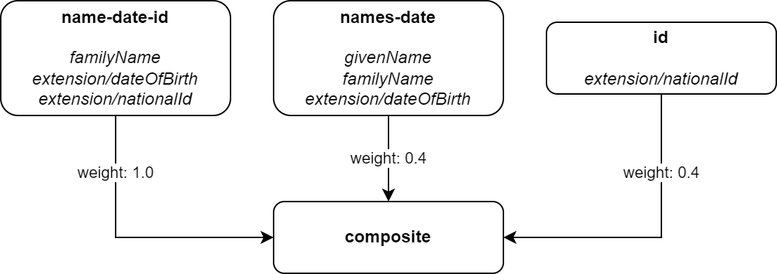
A (Naive) Example
Correlating Ian Smith, 2004-02-06, 040206/1328
Candidate John Smith, 2004-02-06, 040206/1328
  name-date-id: confidence = 1.0, weight = 1.0, increment: 1.0
  names-date: (no match)
  id: confidence = 1.0, weight = 0.4, increment: 0.4
Total confidence: 1.4, cropped down to 1.0

Slide 6
„Ignore if matched by“
ignore if matched
by “name-date-id”
Correlating Ian Smith, 2004-02-06, 040206/1328
Candidate John Smith, 2004-02-06, 040206/1328
  name-date-id: confidence = 1.0, weight = 1.0, increment: 1.0
  names-date: (no match)
  id: confidence = 1.0 but ignored
Total confidence: 1.0

Slide 7
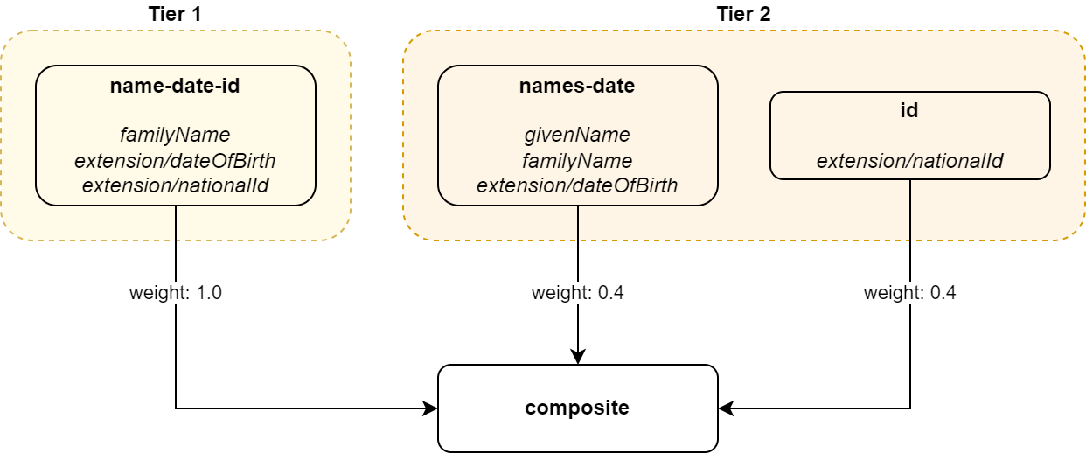
Tiers
Correlating Ian Smith, 2004-02-06, 040206/1328
name-date-id yields candidate John Smith, 2004-02-06, 040206/1328
  Confidence = 1.0, weight = 1.0, increment: 1.0
  This reaches the level of “owner certainty” so the evaluation stops here – other correlators are not run.
Total confidence for this candidate: 1.0

Slide 8
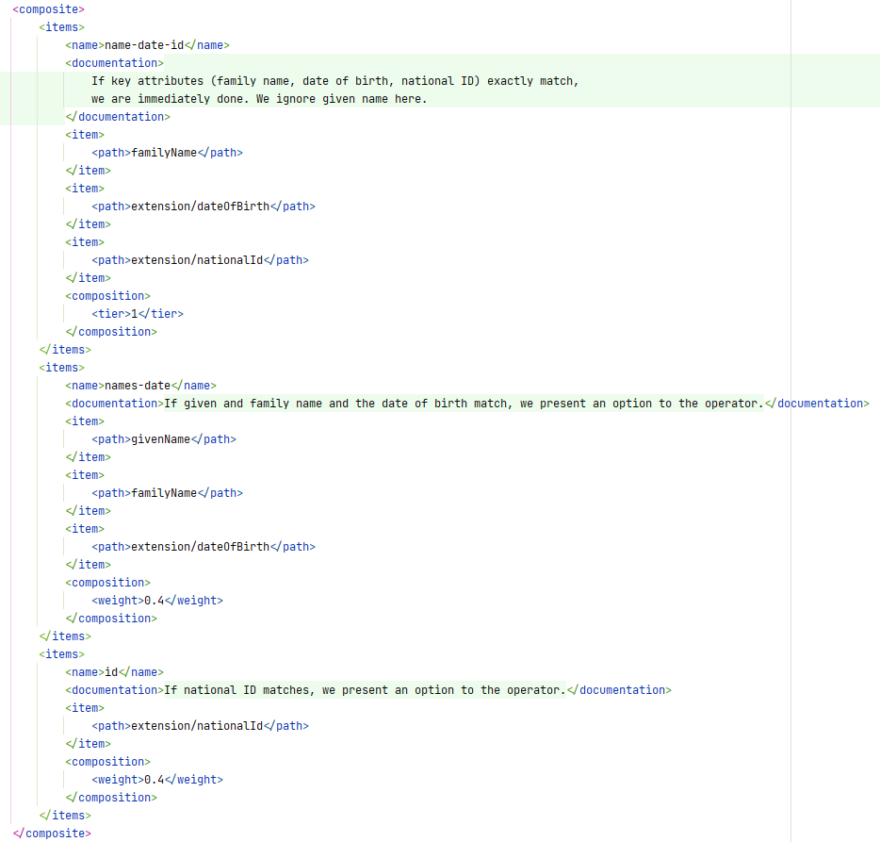
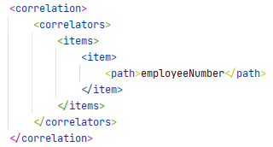
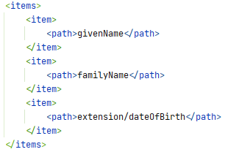
Some Configuration Examples

Slide 9
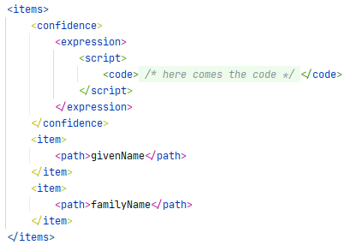
Custom Confidence Values

