Slide 1
Associations in 4.9

Slide 2
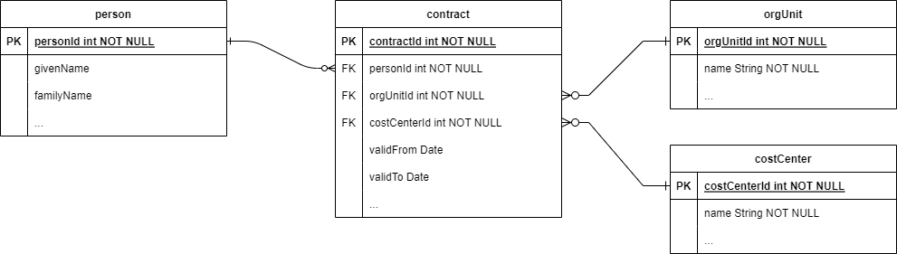
Scenario 1: HR

Slide 3
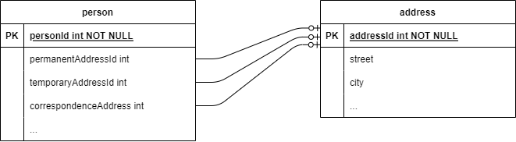

Slide 4
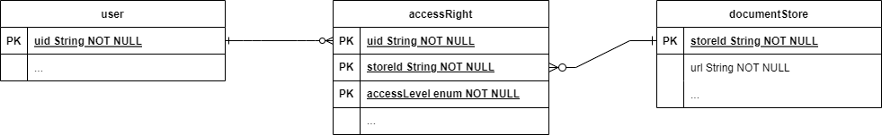
Scenario 2: Document Management System

Slide 5
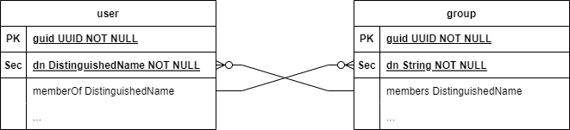
Scenario 3: Active Directory

Slide 6
ConnId Support (Preliminary)
Minimal changes so far
New attribute type: ConnectorObjectReference
  Contains either the full object (ConnectorObject) or its part (ConnectorObjectIdentification – usually only a single identifier)
The attribute represents the particular side of the association
  Readable (or not), updatable (or not), retrieved by default (or not), minOccurs/maxOccurs
  Later: expanded by default?
Its subtype is the association class name + role suffix
  person.contracts = ConnectorObjectReference: personContract#1, readable/updatable, 0..*
  contract.person = ConnectorObjectReference: personContract#2, -/-, 1..1
  contract.org = ConnectorObjectReference: contractOrg#1, readable/updatable, 1..1
  org.contracts = ConnectorObjectReference: contractOrg#2, readable/updatable, 0..*
Q: primary IDs for associated objects?

Slide 7
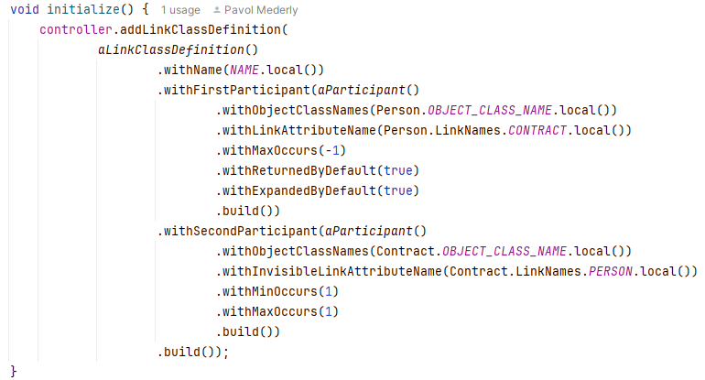
Dummy Resource/Connector Support
Fully customizable object classes
Customizable association classes

Slide 8
Support in midPoint: Provisioning
UCF layer (ConnIdObjectConvertor) converts embedded connector objects (or connector object identifiers/fragments) into ShadowType objects
ShadowAssociationValueType (~ ShadowAssociationValue)
  shadowRef
    contains embedded shadow, even if it’s identifiers-only
  identifiersOnly
    True or false; probably temporary (will be replaced by some kind of metadata)
Resource objects layer does minimal processing for now, but will do everything (e.g., simulated activation) in the future
Shadows layer does the same as for regular shadows: acquires repo shadows, and classifies them as needed (only filters out unwanted objects)
  the repo shadow creation for embedded objects can be skipped in the future
  when providing shadow OID, the whole (cached) shadow will be provided for clients

Slide 9
Model: Inbound Mappings
Manual assignment creation – no more
Instead, for each projection context / shadow:
  attribute mappings are collected first (in the standard way)
  each association value is inspected
    If there are inbound mappings and if the object is associated then
      compute pre-focus
      correlate (“items” only, no disputes, no correlation cases, no owner links)
      determine synchronization reaction (unmatched, linked/unlinked, later deleted)
      execute the reaction (add, synchronize, later delete)
    descend recursively while relevant

Slide 10
Example account
shadow: (cd31652b-c069-476b-9be2-2fdc1043fd2c, v0, ShadowType)
objectClass: {...resource/instance-3}CustompersonObjectClass
resourceRef: oid=ded54130-8ce5-4c8d-ac30-c3bf4fc82337(ResourceType)('hr')[default]
kind: ACCOUNT
intent: person
attributes:
lastName: Doe
name: john
firstName: John
title: Ing.
uid: john
associations:
contract:
id=null
shadowRef: shadow: (84fff868-ec21-49fd-bb74-f2c0d8341bc0, v0, ShadowType)
objectClass: {...resource/instance-3}CustomcontractObjectClass
kind: ASSOCIATED
intent: contract
attributes:
note: needs review
name: 10703321
uid: 10703321
associations:
org:
ResourceObjectClassDefinitionImpl{native=Native object class 'CustomorgUnitObjectClass' ... }
shadowRef: shadow: (a7a51eb5-d221-44ab-a4f8-94ac10f33400, v0, ShadowType)
objectClass: {...resource/instance-3}CustomorgUnitObjectClass
kind: UNKNOWN
intent: unknown
attributes:
description: Faculty of Sciences
name: sciences
uid: sciences
costCenter:
ROTD: GENERIC/costCenter
shadowRef: shadow: (203eb71a-dda7-4269-9c02-1accd82132a4, v8, ShadowType)
objectClass: {...resource/instance-3}CustomcostCenterObjectClass
kind: GENERIC
intent: costCenter
attributes:
name: cc1000
uid: cc1000

Slide 11
Configuration
associatedObjectType
  kind (associated) + intent
  association class towards “the owner”
  delineation + focus specification
    item (typically assignment) + assignment subtype
  attributes + associations
  correlation
  synchronization

Slide 12
Shadow
John (ri:person)
  First contract (10703321)
    Org: sciences
    Cost center: cc1000
    Note: needs review
  Second contract (10409314)
    Org: law
    Cost center: cc1000

Slide 13
Result
John (c:UserType)
  Assignment 1:
    Identifier: contract:10703321
    Subtype: contract
    Extension/costCenter: cc1000
    TargetRef: sciences (org)
    OrgRef: cc1000 (org)
    Description: needs review
  Organization: sciences, law
  Assignment 2:
    Identifier: contract:10409314
    Subtype: contract
    Extension/costCenter: cc1000
    TargetRef: law (org)
    OrgRef: cc1000 (org)

Slide 14
Open questions: Updates!
Hard
  Outbound mappings for associated objects?
Easy
  Creating a shadow (including associated objects by value)
  Adding/deleting associated objects
Hard
  Modifying only a part of associated object

Slide 15
Legalization
Similar to legalization of an account:
  Account exists → let’s create an assignment for it
  Association value exists → let’s create an assignment for it
    Referencing a shadow (by name)?
    Or even referencing a corresponding application role? (Which one?)
It’s not a synchronization
We’d need perhaps a policy for this

Slide 16
Association class vs type?
Association class: deals with object classes
Association type: deals with object types
Is that OK?
Do we need more association types for single association class?

Slide 17
Misc
Mapping of multiaccounts to assignments?
  Individual contracts are modelled as multiaccounts
  We’d need two levels of correlation
    Finding a user
    Finding an assignment within that user
    The rest would be the same
The idea of assignment – shadow link (~ user-shadow)
  Assignment.linkRef? Shadow.owner?
  What about other kinds of focus items?

Slide 18
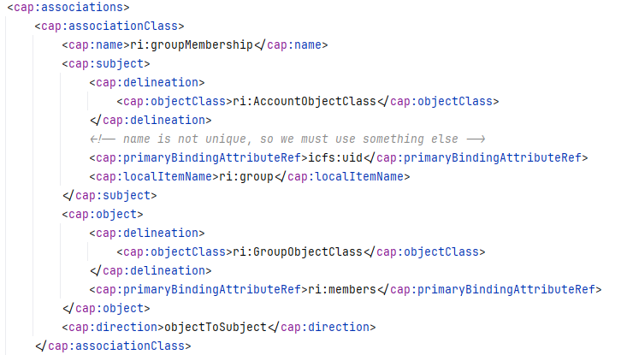
Simulated Associations: Object Links

Slide 19
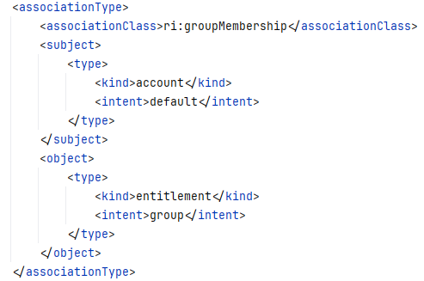
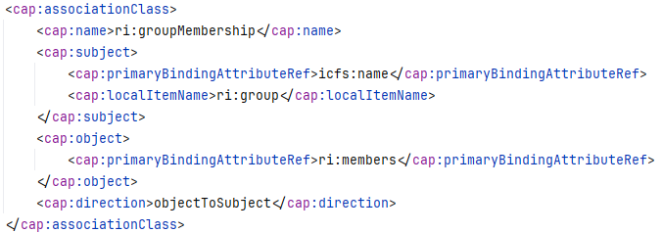
Simulation, refering to object types

Slide 20

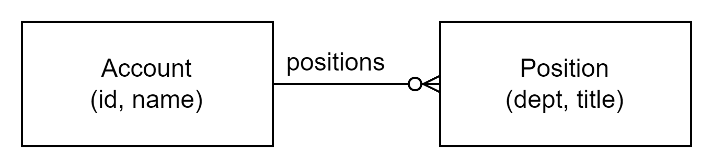
Simulation: Other Ideas
Converting embedded CSV or JSON into associated objects
Can be supported natively by a connector or via simulation

