Slide 1
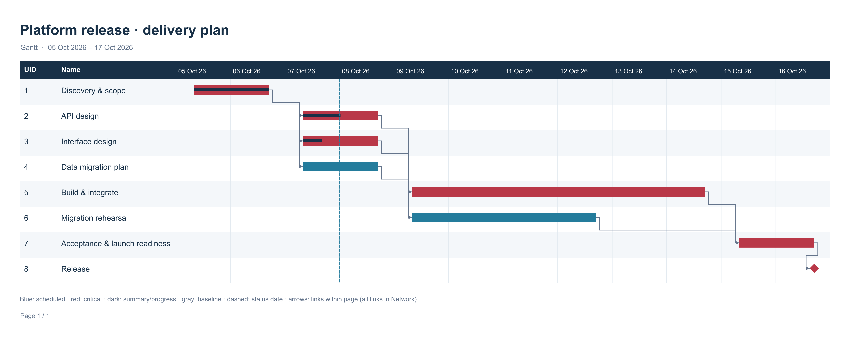

Slide 2
Platform release · delivery plan
Gantt
UID | Name
1 | Discovery & scope
2 | API design
3 | Interface design
4 | Data migration plan
5 | Build & integrate
6 | Migration rehearsal
7 | Acceptance & launch readiness
8 | Release
Notes:
Editable report data. Source revision 106. Gantt

Slide 3
Platform release · delivery plan
Status and groups
UID | Name | Status | Group
1 | Discovery & scope | Task; critical
2 | API design | Task; critical
3 | Interface design | Task; critical
4 | Data migration plan | Task
5 | Build & integrate | Task; critical
6 | Migration rehearsal | Task
7 | Acceptance & launch readiness | Task; critical
8 | Release | Task; critical
Notes:
Editable report data. Source revision 106. Gantt

Slide 4
Platform release · delivery plan
Dependencies
Predecessor UID | Successor UID | Type | Lag
1 | 2 | Finish to start (FS) | 0
1 | 3 | Finish to start (FS) | 0
1 | 4 | Finish to start (FS) | 0
2 | 5 | Finish to start (FS) | 0
3 | 5 | Finish to start (FS) | 0
4 | 6 | Finish to start (FS) | 0
5 | 7 | Finish to start (FS) | 0
6 | 7 | Finish to start (FS) | 0
7 | 8 | Finish to start (FS) | 0
Notes:
Editable report data. Source revision 106. Gantt

