Slide 1
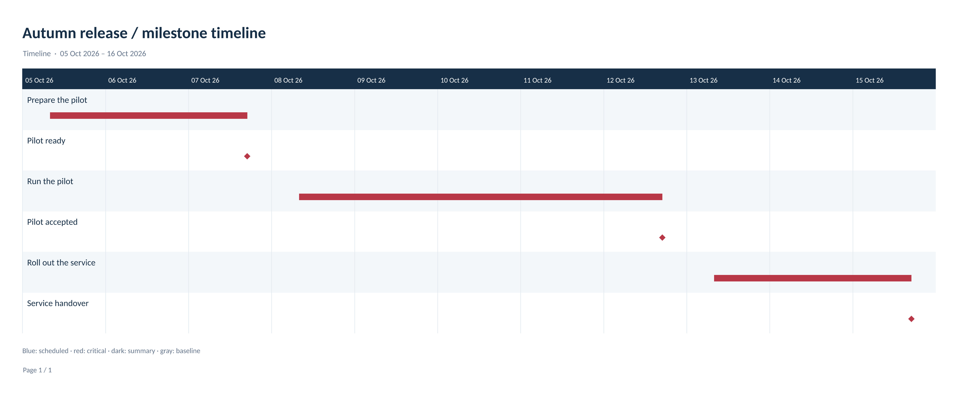

Slide 2
Autumn release / milestone timeline
Timeline
Name
Prepare the pilot
Pilot ready
Run the pilot
Pilot accepted
Roll out the service
Service handover
Notes:
Editable report data. Source revision 86. Timeline

Slide 3
Autumn release / milestone timeline
Status and groups
UID | Name | Status | Group
1 | Prepare the pilot | Task; critical
2 | Pilot ready | Task; critical
3 | Run the pilot | Task; critical
4 | Pilot accepted | Task; critical
5 | Roll out the service | Task; critical
6 | Service handover | Task; critical
Notes:
Editable report data. Source revision 86. Timeline

Slide 4
Autumn release / milestone timeline
Dependencies
Predecessor UID | Successor UID | Type | Lag
1 | 2 | Finish to start (FS) | 0
2 | 3 | Finish to start (FS) | 0
3 | 4 | Finish to start (FS) | 0
4 | 5 | Finish to start (FS) | 0
5 | 6 | Finish to start (FS) | 0
Notes:
Editable report data. Source revision 86. Timeline

