Slide 1


EvoTrees.jl
Efficient Boosted Trees on CPUs & GPUs
Jérémie Desgagné-Bouchard, FCAS
Head of Science - Evovest

Slide 2
Motivation
Key operations of the Boosted Trees learning algo
And Performance tricks used by EvoTrees.jl
Overview of EvoTrees.jl performance against peers XGBoost, LightGBM, CatBoost
Beyond gradient-based learning: mean-absolute error and volatility-adjusted losses
Future development paths:
Improved GPU acceleration
Auto-diff support
Multi-target losses
Enhanced support of categorical variables

Slide 3
Algo Overview
Boosted algorithm
First tree = bias

Slide 4
Tree Bagging
Tree bagging allows to train model similar to RandomForest
for tree in tree_size
update_gradients!
for bag in bag_size
subsample_row_cols!
grow_tree!
predict!
end
end
EvoTreeRegressor(
nrounds=1,
bagging_size=1,
eta=1.0,
row_sample=0.5,
col_sample=0.5,
loss=:mse,
kwargs…
)

Slide 5

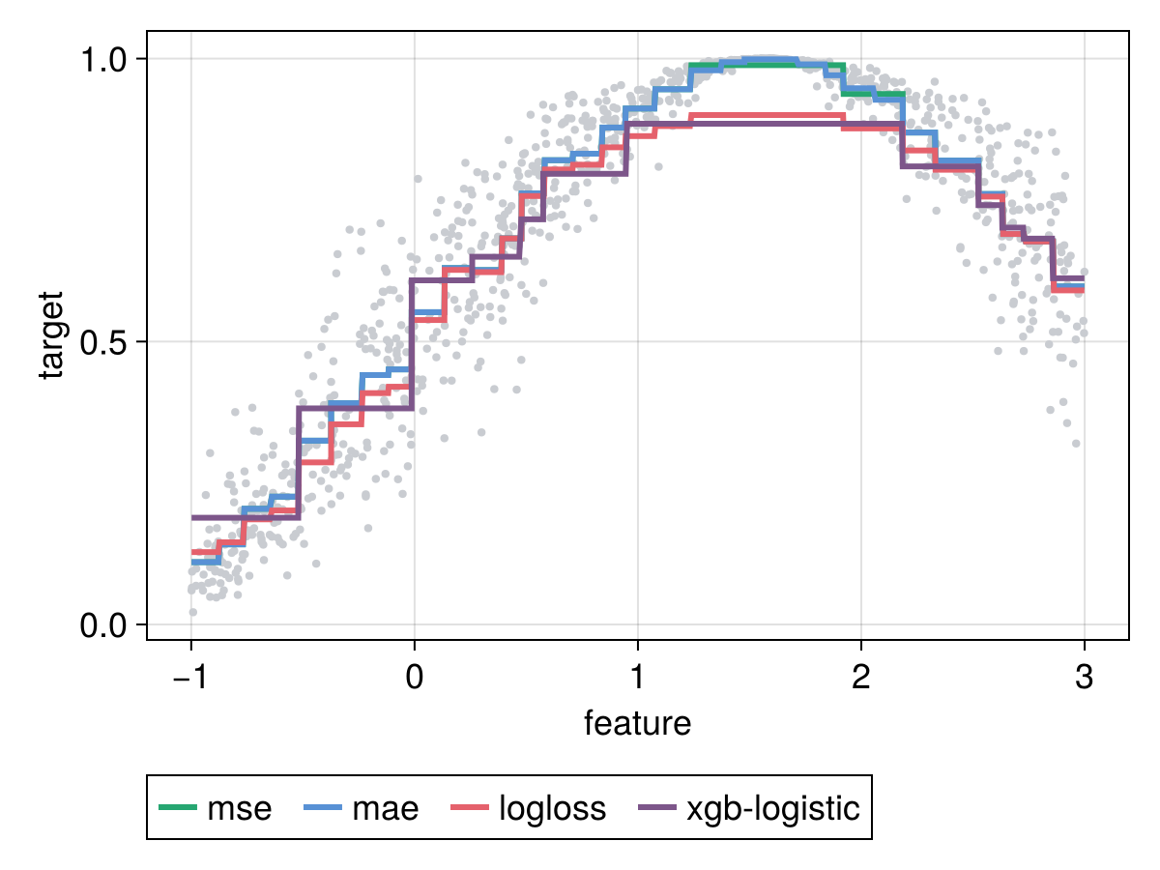
Tree Bagging
Only few loss functions can return a good model with a RandomForest emulation: nrounds = 1; eta = 1.0
Limitation intrinsic to gradient learning method. A single tree quality is limited to the quality of second-order approximation vs. the original loss curve.

Slide 6
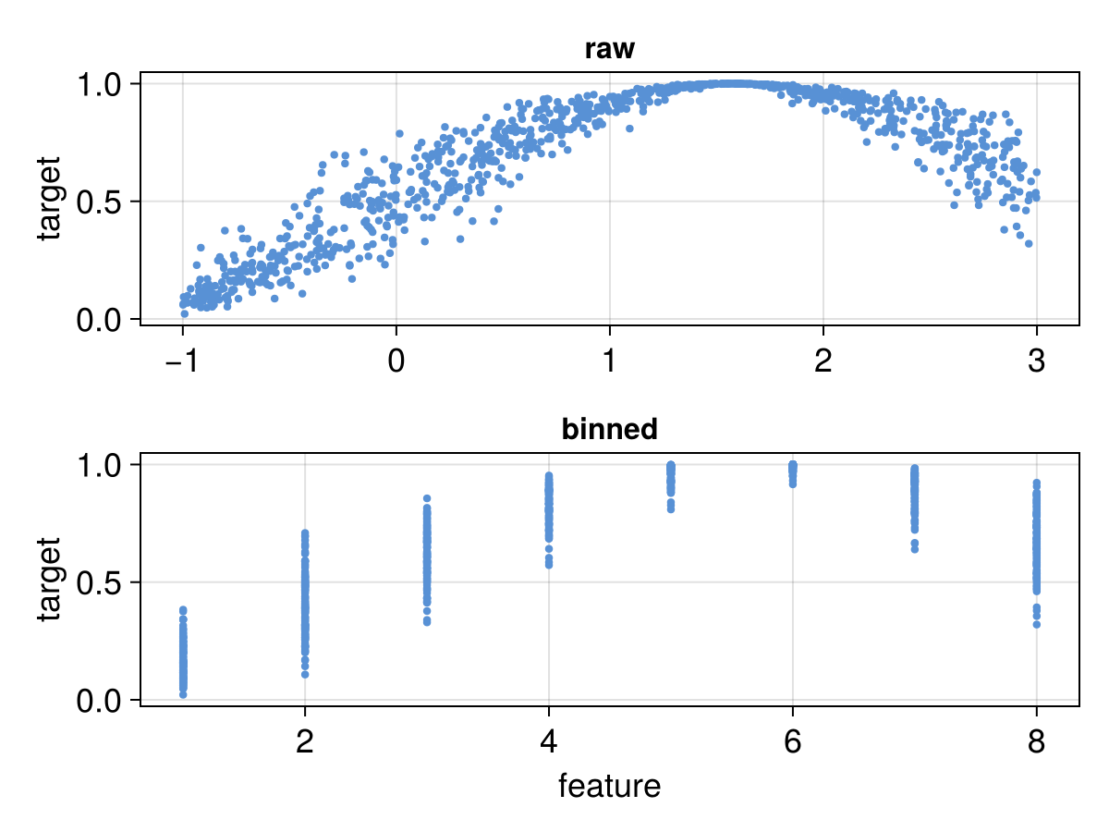
Algo – Histogram-based
A core methodology for fast training used by all performant implementations (XGBoost, LightGBM, CatBoost)
Note how the binarization renders the features scale and distribution invariant

Slide 7
Oblivious Tree Structure
Binary
EvoTreeRegressor(
tree_type = :binary,
kwargs…
)
Oblivious
EvoTreeRegressor(
tree_type = :oblivious,
kwargs…
)
feat-3
<= 1.23
feat-3
<= 1.23
feat-1
<= 1.23
feat-3
<= 4.56
feat-2
<= 4.56
feat-2
<= 4.56
leaf-1
leaf-2
leaf-3
leaf-4
leaf-1
leaf-2
leaf-3
leaf-4

Slide 8
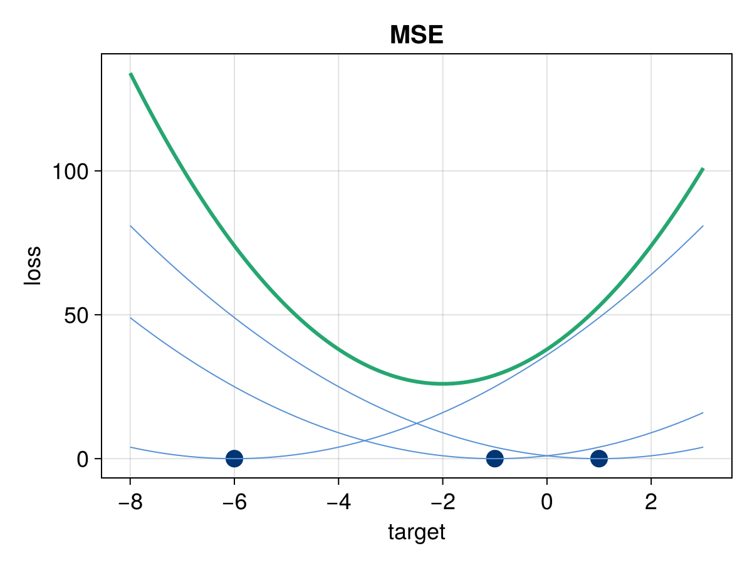
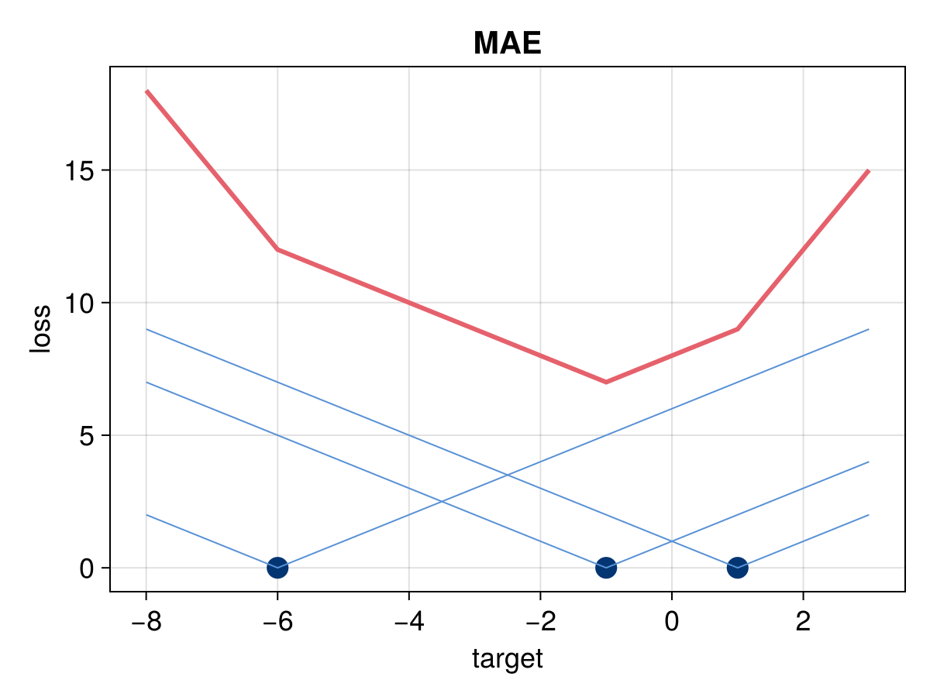
Loss Without Gradients - MAE
Are the 2 first moments needed if all we want is to move predictions towards the mean?
New perspective for tree-split gain: any metric derived from histogram statistics.
For MAE proxy: gain = sum of absolute change in predicted value.
A single metric is needed, the residual: target - pred
Cannot work beyond depth 2 without a trick gain valuation: gains need to be derived from the context of the parent node statistics.

Slide 9
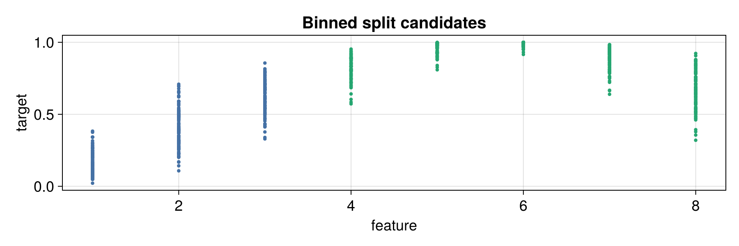
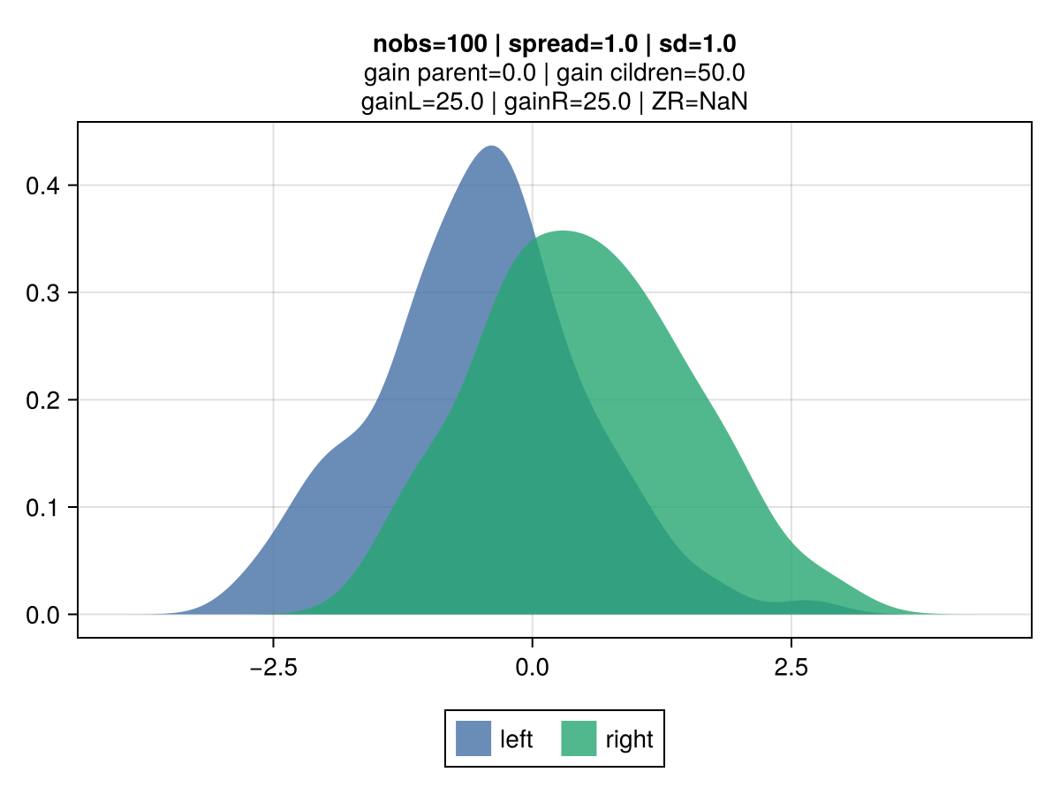
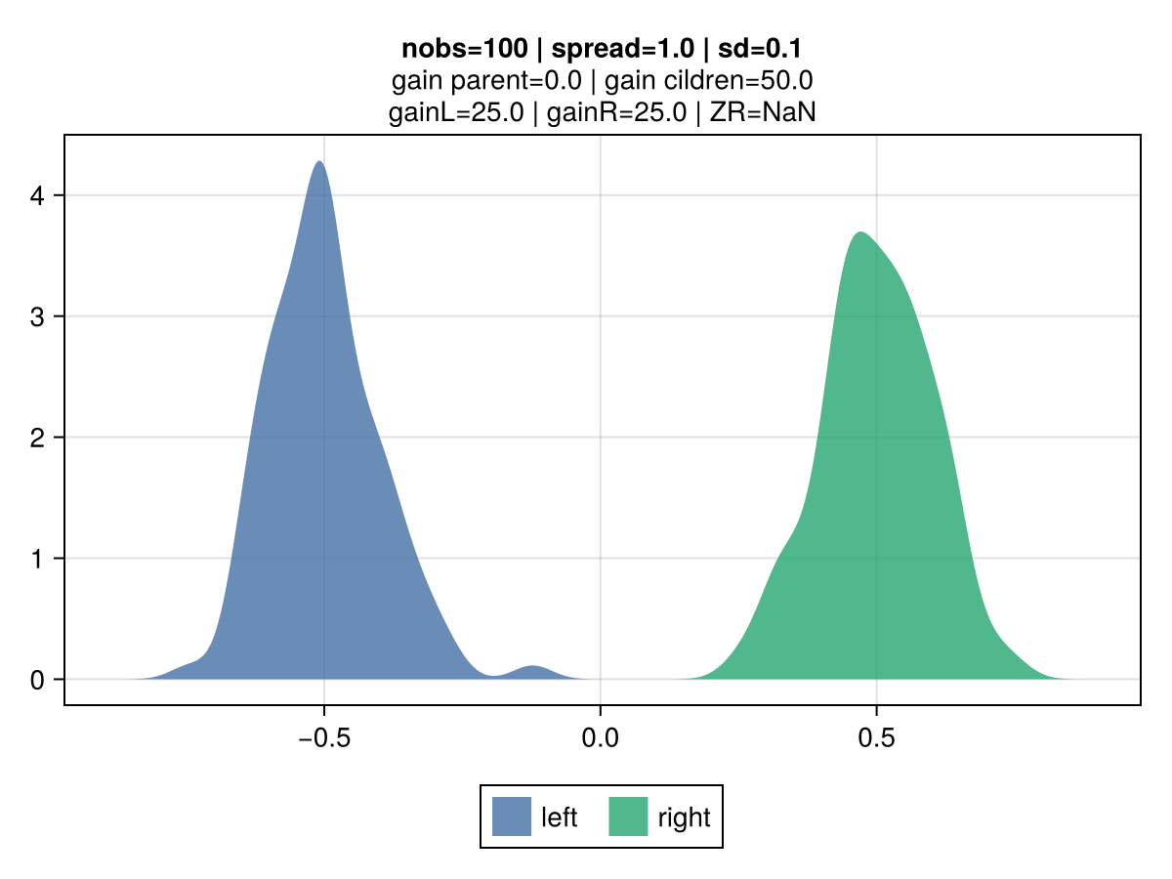
Loss Without Gradients - Credibility
All other things being equal, the gain for two split candidates will be the same regardless of the volatility of observations within each leaf.
In regular regression, the gain is entirely driven by the mean of observations.

Slide 10
Loss Without Gradients - Credibility
The gain is derived as the credibility adjusted leaf mean.
Credibility is inversely proportional to the volatility of the leaf’s observations.
Z = VHM / (VHM + EVPV)
Variance of the Hypothetical Means (VHM): if large differences between candidates means are expected, a greater credibility is assigned.
Expected Value of the Process Variance (EVPV): if the data generation process of a given candidate has a large volatility, a smaller credibility is assigned.

Slide 11
Training Performance
CPU
# obs | depth | EvoTrees | XGBoost | log-diff
100K | 6 | 0.83 | 1.31 | -20%
100K | 10 | 3.43 | 3.33 | 1%
1M | 6 | 5.50 | 13.57 | -39%
1M | 11 | 15.72 | 18.79 | -8%
10M | 6 | 79.99 | 147.04 | -26%
10M | 11 | 185.47 | 189.04 | -1%
GPU
# obs | depth | EvoTrees | XGBoost | log-diff
100K | 6 | 1.64 | 0.66 | 40%
100K | 10 | 17.98 | 3.77 | 68%
1M | 6 | 3.53 | 3.19 | 4%
1M | 11 | 30.11 | 8.58 | 55%
10M | 6 | 21.56 | 27.49 | -11%
10M | 11 | 65.96 | 49.85 | 12%

Slide 12
Roadmap
GPU improvement
SciML’s small grant to bring GPU at XGBoost level (USD 1,500-2,000)
Multi-target support
Scenarios where the tree structure generate a vector of predictions, one for each of the multiple target variables
EvoTrees.fit(
config,
dtrain;
target_name = [y1, y2, y3],
kwargs…
)

Slide 13
Questions?

