Slide 1


EvoTrees.jl
Efficient Boosted Trees on CPUs & GPUs
Jérémie Desgagné-Bouchard, FCAS
Head of Science - Evovest

Slide 2
Motivation
Key operations of the Boosted Trees learning algo
And Performance tricks used by EvoTrees.jl
Overview of EvoTrees.jl performance against peers XGBoost, LightGBM, CatBoost
Beyond gradient-based learning: mean-absolute error and volatility-adjusted losses
Future development paths:
Improved GPU acceleration
Auto-diff support
Multi-target losses
Enhanced support of categorical variables

Slide 3
Algo Overview
Boosted algorithm

Slide 4
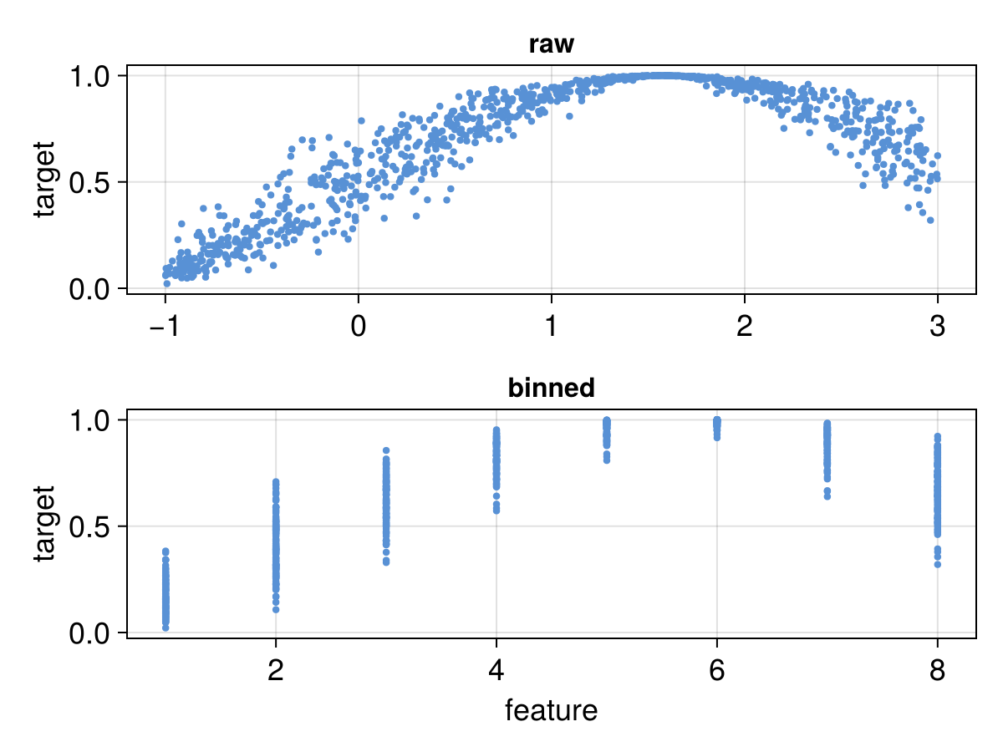
Algo – Histogram-based
A core methodology for fast training used by all performant implementations (XGBoost, LightGBM, CatBoost)

Slide 5
Oblivious Tree Structure

Slide 6
Tree Bagging
Tree bagging allows to train model similar to RandomForest
function fit()
for tree in tree_size
update_gradients!()
for bag in bag_size
update_gradients!()
end
end
end
function fit()
for tree in tree_size
update_gradients!()
for bag in bag_size
update_gradients!()
end
end
end

Slide 7
Tree Bagging
Warning! only few loss functions can result in a good model with a RandomForest emulation, where nrounds = 1
This is due to gradient learning method. If the second order results in rough approximation, so will the model ability for a single tree to produce a good prediction.
TODO: insert plot for MSE vs logistic regression

Slide 8
Tree Bagging
Warning! only few loss functions can result in a good model with a RandomForest emulation, where nrounds = 1
This is due to gradient learning method. If the second order results in rough approximation, so will the model ability for a single tree to produce a good prediction.
TODO: insert plot for MSE for logistic regression

Slide 9
Computing Node and Leaf Weights
function leaf_weights!(nw)
cw = ones(eltype(nw), 2 * size(nw, 1) + 1, size(nw)[2:3]...)
for batch in axes(nw, 3)
for tree in axes(nw, 2)
for i = 2:2:size(cw, 1)
cw[i, tree, batch] = cw[i>>1, tree, batch] * nw[i>>1, tree, batch]
cw[i+1, tree, batch] = cw[i>>1, tree, batch] * (1 - nw[i>>1, tree, batch])
end
end
end
@views lw = cw[size(nw, 1)+1:size(cw, 1), :, 1:size(nw, 3)]
return (cw, lw)
end

Slide 10
Training Performance
CPU
# obs | depth | EvoTrees | XGBoost
100K | 6 | 0.83 | 1.31
100K | 10 | 3.43 | 3.33
1M | 6 | 5.50 | 13.57
1M | 11 | 15.72 | 18.79
10M | 6 | 79.99 | 147.04
10M | 11 | 185.47 | 189.04
GPU
# obs | depth | EvoTrees | XGBoost
100K | 6 | 0.83 | 1.31
100K | 10 | 3.43 | 3.33
1M | 6 | 5.50 | 13.57
1M | 11 | 15.72 | 18.79
10M | 6 | 79.99 | 147.04
10M | 11 | 185.47 | 189.04

Slide 11
Benchmarks – Ranking (MSE)
MSRank 1,200,192 observations, 136 features
model_type | train_time | mse | ndcg
neurotrees | 85.1 | 0.577 | 0.467
evotrees | 39.8 | 0.554 | 0.505
xgboost | 19.4 | 0.554 | 0.501
lightgbm | 38.5 | 0.553 | 0.507
catboost | 112.0 | 0.553 | 0.504
Yahoo 709,877 observations, 519 features
model_type | train_time | mse | ndcg
neurotrees | 299.0 | 0.583 | 0.781
evotrees | 442.0 | 0.545 | 0.797
xgboost | 129.0 | 0.544 | 0.797
lightgbm | 215.0 | 0.539 | 0.798
catboost | 241.0 | 0.555 | 0.796

Slide 12
Future
GPU improvement
Grant to bring GPU at XGBoost level

Slide 13
Questions?

