Slide 1

NeuroTree
A differentiable tree operator for tabular data
Jérémie Desgagné-Bouchard
Head of Science - Evovest

Slide 2
Motivation
Tabular data is most common in many fields of practice, incl. finance and insurance
Why do tree-based models still outperform deep learning on tabular data? https://arxiv.org/pdf/2207.08815
Boosted tree based algos (XGBoost, CatBoost, LightGBM, EvoTrees.jl) have remained on top
Tackle design shortcomings of trees:
Myopic view during tree construction
No foresight on future split opportunities
Hard splits: a sub efficient way to represent linear or smooth feature to predictions relationships
Opportunity for signal diversification

Slide 3
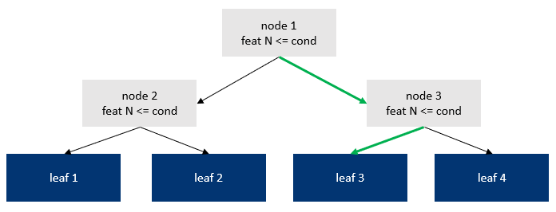
Architecture - Back to trees
Different perspectives on the nature of the task performed by trees:
Associate an observation to a leaf index based on its features using « depth » binary conditions
Associate an observation to a probability of belonging to each leaf, by using « depth » binary conditions

Slide 4
NeuroTree Struct
Feat 1
sigmoid
W1
W2
x
+
bias
=
NW
Feat 2
Differentiable node weights are derived by emulating the two-steps procedure found in traditionnal trees:
Select a feature
dot product of (normalized) features with learnable weights
Results in a linear reprojection of the features, not a hard single feature selection which wouldn’t be differentiable
Select a threshold for that feature
Apply a sigmoid activation following the addition of a bias to the above feature reprojection

Slide 5
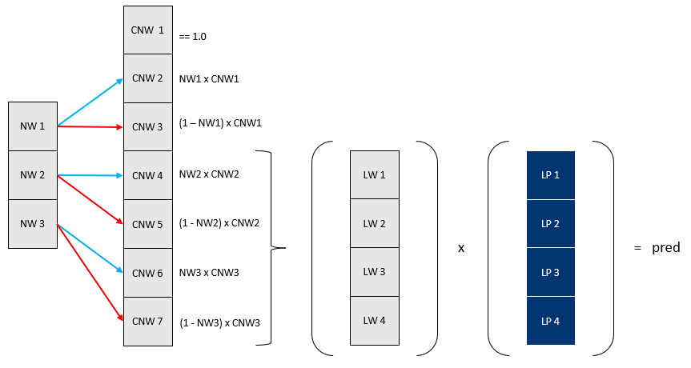
Architecture – Single Tree
From node weights to prediction
Cumulate the node weights. The latest 2^depth nodes are the leaf weights
The dot product of the leaf weight and leaf predictions results in the tree prediction
A single leaf prediction is a vector of values.
For classification, it would be a vector of length K, where K is the number of classes
For a regression task, it would be of length 1: single regression estimate

Slide 6
Architecture – NeuroTree Struct
Tree 1
F1N1T1
F1N2T1
F1N3T1
F1N1T2
F1N2T2
F1N3T2
Feature 1
Node Weights
F2N1T1
F2N2T1
F2N3T1
F2N1T2
F2N2T2
F2N3T2
Tree 1
Node Biases
N1T1
N2T1
N3T1
N3T1
N3T1
N3T1
Tree 1
P1L1T1
P1L2T1
P1L3T1
P1L4T1
P1L1T2
P1L2T2
P1L3T2
P1L4T2
Leaf Predictions
P2L1T1
P2L2T1
P2L3T1
P2L4T1
P2L1T2
P2L2T2
P2L3T2
P2L4T2

Slide 7
Computing node and leaf weights
function leaf_weights!(nw)
cw = ones(eltype(nw), 2 * size(nw, 1) + 1, size(nw)[2:3]...)
for batch in axes(nw, 3)
for tree in axes(nw, 2)
for i = 2:2:size(cw, 1)
cw[i, tree, batch] = cw[i>>1, tree, batch] * nw[i>>1, tree, batch]
cw[i+1, tree, batch] = cw[i>>1, tree, batch] * (1 - nw[i>>1, tree, batch])
end
end
end
@views lw = cw[size(nw, 1)+1:size(cw, 1), :, 1:size(nw, 3)]
return (cw, lw)
end

Slide 8
Architecture – Stack of Trees

Slide 9
NeuroTreeModels.jl
Recipes to build NeuroTree based models.
Chain(
BatchNorm,
NeuroTree,
Dense
)
Chain(
BatchNorm,
NeuroTree,
SkipConnexion(NeuroTree, +),
)
MLJ Integration

Slide 10
Benchmarks - Regression
Boston
model_type | train_time | mse | gini
neurotrees | 12.8 | 18.9 | 0.947
evotrees | 0.206 | 19.7 | 0.927
xgboost | 0.0648 | 19.4 | 0.935
lightgbm | 0.865 | 25.4 | 0.926
catboost | 0.0511 | 13.9 | 0.946
Year
model_type | train_time | mse | gini
neurotrees | 280.0 | 76.4 | 0.652
evotrees | 18.6 | 80.1 | 0.627
xgboost | 17.2 | 80.2 | 0.626
lightgbm | 8.11 | 80.3 | 0.624
catboost | 80.0 | 79.2 | 0.635

Slide 11
Benchmarks - Classification
Titanic
model_type | train_time | mse | gini
neurotrees | 12.8 | 18.9 | 0.947
evotrees | 0.206 | 19.7 | 0.927
xgboost | 0.0648 | 19.4 | 0.935
lightgbm | 0.865 | 25.4 | 0.926
catboost | 0.0511 | 13.9 | 0.946
Higgs
model_type | train_time | mse | gini
neurotrees | 280.0 | 76.4 | 0.652
evotrees | 18.6 | 80.1 | 0.627
xgboost | 17.2 | 80.2 | 0.626
lightgbm | 8.11 | 80.3 | 0.624
catboost | 80.0 | 79.2 | 0.635

Slide 12
Benchmarks – Ranking (MSE)
MSRank
model_type | train_time | mse | gini
neurotrees | 12.8 | 18.9 | 0.947
evotrees | 0.206 | 19.7 | 0.927
xgboost | 0.0648 | 19.4 | 0.935
lightgbm | 0.865 | 25.4 | 0.926
catboost | 0.0511 | 13.9 | 0.946
Yahoo
model_type | train_time | mse | gini
neurotrees | 280.0 | 76.4 | 0.652
evotrees | 18.6 | 80.1 | 0.627
xgboost | 17.2 | 80.2 | 0.626
lightgbm | 8.11 | 80.3 | 0.624
catboost | 80.0 | 79.2 | 0.635

Slide 13
Questions?

