Slide 1

NeuroTree
A differentiable tree operator for tabular data
Jérémie Desgagné-Bouchard
Head of Science at Evovest

Slide 2
Motivation
Why do tree-based models still outperform deep learning on tabular data?
https://arxiv.org/pdf/2207.08815
Tabular data is most common in many fields of practice, incl. finance and insurance
Boosted tree based algos (XGBoost, CatBoost, LightGBM, EvoTrees.jl) have remained on top

Slide 3
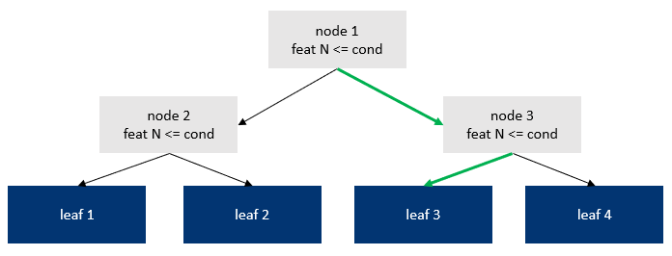
Back to trees

Slide 4
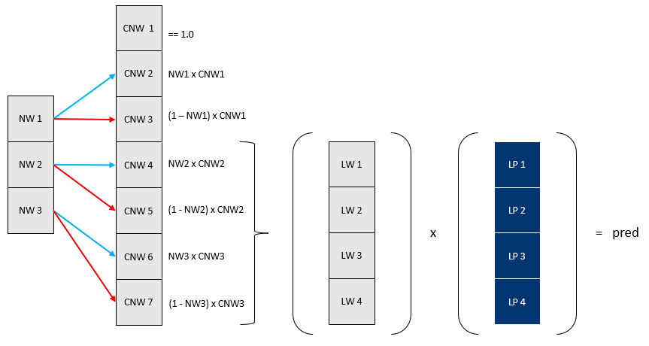
Architecture

Slide 5
Architecture

Slide 6
NeuroTreeModels.jl
Recipes to build NeuroTree based models.
Chain(
BatchNorm,
NeuroTree,
Dense
)
Chain(
BatchNorm,
NeuroTree,
SkipConnexion(NeuroTree, +),
)
MLJ Integration

Slide 7
Benchmarks - Regression
Boston
model_type | train_time | mse | gini
neurotrees | 12.8 | 18.9 | 0.947
evotrees | 0.206 | 19.7 | 0.927
xgboost | 0.0648 | 19.4 | 0.935
lightgbm | 0.865 | 25.4 | 0.926
catboost | 0.0511 | 13.9 | 0.946
Year
model_type | train_time | mse | gini
neurotrees | 280.0 | 76.4 | 0.652
evotrees | 18.6 | 80.1 | 0.627
xgboost | 17.2 | 80.2 | 0.626
lightgbm | 8.11 | 80.3 | 0.624
catboost | 80.0 | 79.2 | 0.635

Slide 8
Benchmarks - Classification
Titanic
model_type | train_time | mse | gini
neurotrees | 12.8 | 18.9 | 0.947
evotrees | 0.206 | 19.7 | 0.927
xgboost | 0.0648 | 19.4 | 0.935
lightgbm | 0.865 | 25.4 | 0.926
catboost | 0.0511 | 13.9 | 0.946
Higgs
model_type | train_time | mse | gini
neurotrees | 280.0 | 76.4 | 0.652
evotrees | 18.6 | 80.1 | 0.627
xgboost | 17.2 | 80.2 | 0.626
lightgbm | 8.11 | 80.3 | 0.624
catboost | 80.0 | 79.2 | 0.635

Slide 9
Benchmarks – Ranking (MSE)
MSRank
model_type | train_time | mse | gini
neurotrees | 12.8 | 18.9 | 0.947
evotrees | 0.206 | 19.7 | 0.927
xgboost | 0.0648 | 19.4 | 0.935
lightgbm | 0.865 | 25.4 | 0.926
catboost | 0.0511 | 13.9 | 0.946
Yahoo
model_type | train_time | mse | gini
neurotrees | 280.0 | 76.4 | 0.652
evotrees | 18.6 | 80.1 | 0.627
xgboost | 17.2 | 80.2 | 0.626
lightgbm | 8.11 | 80.3 | 0.624
catboost | 80.0 | 79.2 | 0.635

Slide 10
Questions?

