Slide 1

NeuroTree
A differentiable tree operator for tabular data
Jérémie Desgagné-Bouchard, FCAS
Head of Science - Evovest

Slide 2
Motivation
Tabular data is most common in many fields of practice, incl. finance and insurance
Boosted tree based algos (XGBoost, CatBoost, LightGBM, EvoTrees.jl) have been top performing models for almost a decade:
Why do tree-based models still outperform deep learning on tabular data? https://arxiv.org/pdf/2207.08815
Tackle design shortcomings of trees:
Myopic view during tree construction
No foresight on future split opportunities
Hard splits: a sub efficient way to represent linear or smooth features to predictions relationships
Opportunity for signal diversification

Slide 3
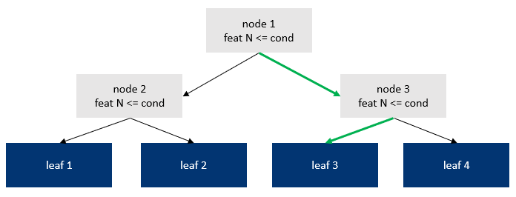
Trees basics
Different perspectives on the nature of the task performed by trees:
Associate an observation to a leaf index based on its features using « depth » binary conditions
Associate an observation to a probability of belonging to each leaf, by using « depth » binary conditions

Slide 4
Single Tree Overview
CNW 1
== 1.0
CNW 2
NW1 x CNW1
NW 1
CNW 3
(1 – NW1) x CNW1
NW 2
CNW 4
LW 1
LP 1
NW2 x CNW2
NW 3
CNW 5
LW 2
LP 2
(1 - NW2) x CNW2
x
= pred
CNW 6
LW 3
LP 3
NW3 x CNW3
CNW 7
LW 4
LP 4
(1 - NW3) x CNW3
From node weights to prediction
Cumulate the node weights. The latest 2^depth nodes are the leaf weights
The dot product of the leaf weight and leaf predictions results in the tree prediction
A single leaf prediction is a vector of values.
For classification, a vector of length K, where K is the number of classes
For a regression task, a vector of length 1: single regression estimate

Slide 5
Soft Node Weights
Feat 1
sigmoid
W1
W2
x
+
bias
=
NW
Feat 2
Differentiable node weights are derived by emulating the two-steps procedure found in traditionnal trees:
Select a feature
dot product of (normalized) features with learnable weights
Results in a linear reprojection of the features, not a hard single feature selection which wouldn’t be differentiable
Select a threshold for that feature
Apply a sigmoid activation following the addition of a bias to the above feature reprojection

Slide 6
Multiple-Tree Structure
Tree 1
F1N1T1
F1N2T1
F1N3T1
F1N1T2
F1N2T2
F1N3T2
Feature 1
Node Weights
F2N1T1
F2N2T1
F2N3T1
F2N1T2
F2N2T2
F2N3T2
Tree 1
Node Biases
N1T1
N2T1
N3T1
N3T1
N3T1
N3T1
Tree 1
P1L1T1
P1L2T1
P1L3T1
P1L4T1
P1L1T2
P1L2T2
P1L3T2
P1L4T2
Leaf Predictions
P2L1T1
P2L2T1
P2L3T1
P2L4T1
P2L1T2
P2L2T2
P2L3T2
P2L4T2

Slide 7
Computing Node and Leaf Weights
function leaf_weights!(nw)
cw = ones(eltype(nw), 2 * size(nw, 1) + 1, size(nw)[2:3]...)
for batch in axes(nw, 3)
for tree in axes(nw, 2)
for i = 2:2:size(cw, 1)
cw[i, tree, batch] = cw[i>>1, tree, batch] * nw[i>>1, tree, batch]
cw[i+1, tree, batch] = cw[i>>1, tree, batch] * (1 - nw[i>>1, tree, batch])
end
end
end
@views lw = cw[size(nw, 1)+1:size(cw, 1), :, 1:size(nw, 3)]
return (cw, lw)
end

Slide 8
NeuroTreeModels.jl
Recipes to build (Flux) models with NeuroTree operator:
chain =
Chain(
BatchNorm(nfeats),
NeuroTree(nfeats => outsize; depth=config.depth, ntrees=config.ntrees),
Dense(nfeats => outsize)
)
chain =
Chain(
BatchNorm(nfeats),
NeuroTree(nfeats => hiddensize;
SkipConnexion(
NeuroTree(hiddensize => hiddensize),
+),
Dense(hiddensize => outsize)
)

Slide 9
NeuroTreeModels.jl
A simple, MLJ compatible, API to for training and inference
using NeuroTreeModels, DataFrames
config = NeuroTreeRegressor(
loss = :mse,
nrounds = 100,
num_trees = 16,
depth = 5,
)
nobs, nfeats = 1_000, 5
dtrain = DataFrame(randn(nobs, nfeats), :auto)
dtrain.y = rand(nobs)
feature_names, target_name = names(dtrain, r"x"), "y"
m = NeuroTreeModels.fit(config, dtrain; feature_names, target_name)
p = m(dtrain)

Slide 10
Benchmarks - Regression
Boston
model_type | train_time | mse | gini
neurotrees | 12.8 | 18.9 | 0.947
evotrees | 0.206 | 19.7 | 0.927
xgboost | 0.0648 | 19.4 | 0.935
lightgbm | 0.865 | 25.4 | 0.926
catboost | 0.0511 | 13.9 | 0.946
Year
model_type | train_time | mse | gini
neurotrees | 280.0 | 76.4 | 0.652
evotrees | 18.6 | 80.1 | 0.627
xgboost | 17.2 | 80.2 | 0.626
lightgbm | 8.11 | 80.3 | 0.624
catboost | 80.0 | 79.2 | 0.635

Slide 11
Benchmarks - Classification
Titanic
model_type | train_time | mse | gini
neurotrees | 12.8 | 18.9 | 0.947
evotrees | 0.206 | 19.7 | 0.927
xgboost | 0.0648 | 19.4 | 0.935
lightgbm | 0.865 | 25.4 | 0.926
catboost | 0.0511 | 13.9 | 0.946
Higgs
model_type | train_time | mse | gini
neurotrees | 280.0 | 76.4 | 0.652
evotrees | 18.6 | 80.1 | 0.627
xgboost | 17.2 | 80.2 | 0.626
lightgbm | 8.11 | 80.3 | 0.624
catboost | 80.0 | 79.2 | 0.635

Slide 12
Benchmarks – Ranking (MSE)
MSRank
model_type | train_time | mse | gini
neurotrees | 12.8 | 18.9 | 0.947
evotrees | 0.206 | 19.7 | 0.927
xgboost | 0.0648 | 19.4 | 0.935
lightgbm | 0.865 | 25.4 | 0.926
catboost | 0.0511 | 13.9 | 0.946
Yahoo
model_type | train_time | mse | gini
neurotrees | 280.0 | 76.4 | 0.652
evotrees | 18.6 | 80.1 | 0.627
xgboost | 17.2 | 80.2 | 0.626
lightgbm | 8.11 | 80.3 | 0.624
catboost | 80.0 | 79.2 | 0.635

Slide 13
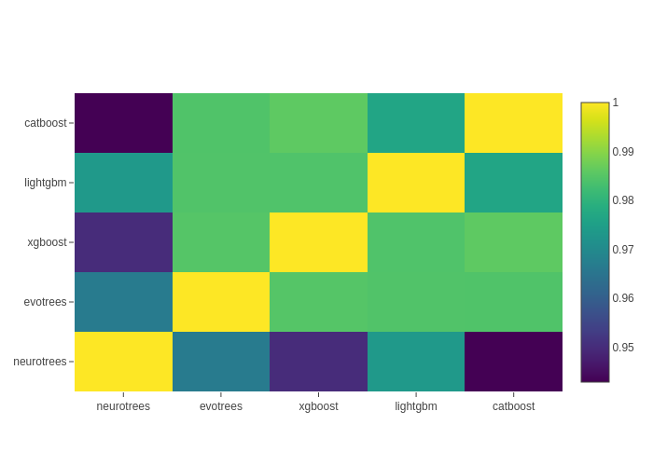
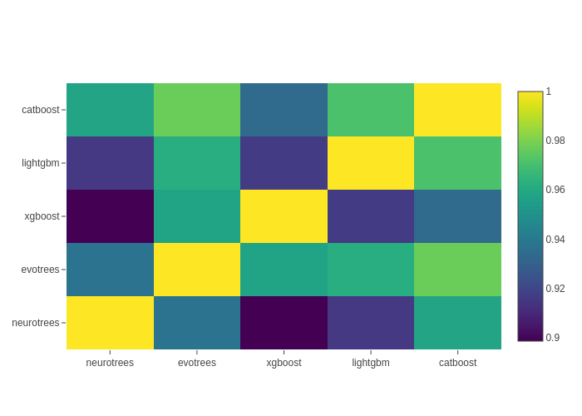
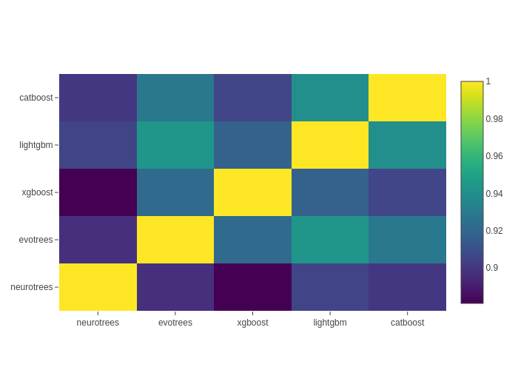
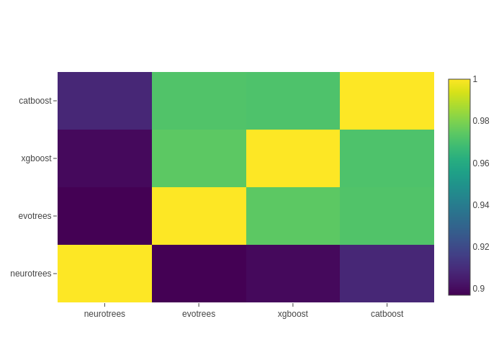
Signal Diversification
Boston
Titanic
Year
MSRank

Slide 14
Future
Performance optimisation
Current parallelization, both on CPU and GPU, is currently fairly naïve.
Support categorical features through embeddings
Integration with Enzyme.jl
Avoiding the need to manually implement the backward rules while maintaining forward implementation performance is a key target feature for Julia’s ML
Expand the scope of the NeuroTree model to support generic tabular oriented differentiable models (MLP, TabNet…)

Slide 15
Questions?

