Slide 1

El Dabaa Nuclear Power Plant
Why Did Egypt Choose Russian VVER-1200 Technology?
A comprehensive analysis of costs, profits, safety, and Egypt's nuclear history — for decision-makers, investors, and the public
Prepared by:
Evronia Romany
Eman Alaa
Shahd Abd Elnasser
Shimaa Elsayed
Under the supervision of:
Alaa Essam
4,800 MW | Four Generation III+ Reactors | Under IAEA Oversight

Slide 2










Table of Contents
Why Egypt needs nuclear energy now
Capital cost: El Dabaa vs. the world's experience
01
06
Egypt's current electricity generation mix
Profitability and return on investment
02
07
Egypt's nuclear journey: from Anshas to El Dabaa
Nuclear safety: data and design
03
08
El Dabaa project: the key facts
Economic impact, strategy, and financing
04
09
Why VVER-1200? Technical and safety selection criteria
Roadmap to full operation by 2030
05
10
2

Slide 3

Why Does Egypt Need Nuclear Energy Now?
Diversifying energy sources has become a strategic necessity, not a luxury
Heavy Reliance on Natural Gas
Rising Electricity Demand
Natural gas is Egypt's primary fuel for electricity generation, leaving the grid exposed to production swings and global market volatility.
Population growth and industrial and urban expansion push electricity demand up every year, requiring massive, reliable generation sources.
Climate Commitments & Vision 2030
Long-Term Electricity Price Stability
Nuclear power delivers clean electricity with no operational carbon emissions, supporting Egypt's 2050 climate change strategy.
Unlike fossil fuels, a nuclear plant's operating cost stays nearly constant for decades, shielding consumers and the state from price shocks.
3

Slide 4
Egypt's Electricity Generation Mix Today
Actual data from 62 Egyptian power plants — natural gas dominates 85% of installed capacity
34,183 MW
Total current installed capacity from Egyptian power plants in the dataset, most of it gas-fired.
Single-Fuel Concentration Risk
An 85% dependence on one fuel source leaves the grid exposed to any disruption in gas supply or global price swings.
El Dabaa Changes the Equation
Adding 4,800 MW of nuclear capacity will meaningfully raise the share of non-fossil sources and ease today's reliance on gas.
Source: Global Power Plant Database — Egypt plant records
4

Slide 5
Egypt's Nuclear Journey
From the first research reactor at Anshas to Egypt's first nuclear power plant at El Dabaa
1954-1961
Egypt's nuclear program begins; the Anshas research reactor (2 MW) starts operating with Soviet cooperation.
1983
El Dabaa selected as the best site among 23 candidates for Egypt's first nuclear plant, following international technical studies.
1986
Project paused after the Chernobyl accident, amid global skepticism toward nuclear power.
2007-2010
Nuclear program relaunched under President Mubarak; the IAEA formally endorses the El Dabaa site.
2015
President El-Sisi and President Putin sign a strategic agreement to build and finance the El Dabaa plant with four reactors.
2017
Final implementation contracts signed for four VVER-1200 units with Russia's Rosatom.
2022-2023
Concrete pouring and actual construction begin for the four units in succession.
2026-2030
Gradual commercial operation of all four units, bringing Egypt into the nuclear energy era.
5

Slide 6






El Dabaa Project: The Key Facts
Egypt's first nuclear power plant, and Africa's second after Koeberg in South Africa
4,800
$28.75
85%
MW | Total capacity (4×1200)
billion | Total project cost
of the cost is a concessional Russian loan
~50%
+50,000
60
of Egypt's future electricity generation capacity
direct and indirect jobs
years | Design life of the plant (extendable to 100)
Source: Egypt's Nuclear Power Plants Authority (NPPA), Rosatom, World Nuclear Association (WNA) — 2025/2026
6

Slide 7




Why Did Egypt Choose VVER-1200 Specifically?
A Generation III+ reactor, compliant with post-Fukushima safety standards
Double Containment & Passive Cooling
Core Catcher
Earthquake & Natural Disaster Resistance
The emergency heat-removal system works without external power or human intervention for up to 72 hours.
Contains any potential core meltdown inside the building, preventing molten material from escaping into the surrounding environment.
Designed to withstand earthquakes up to magnitude 9 on the Richter scale, matching El Dabaa's site requirements.
Aircraft Impact Resistance
Proven Operating Track Record
Technology Transfer & Local Training
The outer structure is designed to withstand the impact of a 400-tonne aircraft — a strict, rarely-applied safety standard.
VVER-1200 technology is already operating in Russia (Novovoronezh, Leningrad) and under construction in Belarus, Turkey, and Bangladesh.
Rosatom supplies nuclear fuel and trains Egyptian staff, and supports operation and maintenance for the first 10 years.
7

Slide 8
Capital Cost per MW: El Dabaa vs. the World's Experience
Data analyzed from an operational database of 24 nuclear plants worldwide (2015–2024)
El Dabaa achieved the lowest capital cost per MW among all Generation III+ reactors in the data — roughly 4x cheaper than the two European EPR-1600 projects that dramatically exceeded their original budgets (Flamanville and Olkiluoto).
8

Slide 9
Profitability: Positive Returns vs. Cost-Overrun Losses
Total net profit recorded per plant over the data period (US$ billion)
El Dabaa recorded the highest total revenue among all compared plants (thanks to its four-unit, 4x1200 MW design) and maintained positive profitability — unlike the AP1000 and EPR-1600 projects, whose returns turned into actual losses due to well-documented global construction cost overruns.
9

Slide 10
El Dabaa's Monthly Operating Cost Structure
Fuel and labor together account for about 65% of total operating cost
Fuel & Labor Dominate: ~65%
Fuel costs stay nearly constant for decades thanks to a long-term supply contract with Rosatom covering the plant's entire lifetime, with no exposure to global uranium market swings.
Maintenance: Just 6.6%
A relatively low share compared to older Generation II plants, thanks to more reliable systems and standardized parts across the Russian fleet.
A Predictable Cost Base
Unlike natural gas, this cost structure allows long-term financial planning for electricity prices without surprises tied to global fuel markets.
10

Slide 11
The Scale Advantage: A Four-Unit Fleet on One Site
The highest total revenue among all plants compared in the data
Spreading infrastructure costs (grid, security, training) across 4 units lowers the fixed cost per MW.
A unified operations and maintenance team serves the whole site, raising overall operating efficiency.
Production continuity: one unit stopping for maintenance doesn't halt output from the entire site.
A larger local industrial base: over 30,000 workers on site during the construction phase.
11

Slide 12
Nuclear Safety: What Do the Data and Design Say?
An objective comparison normalized by installed capacity (events per GW)
Methodological note:
El Dabaa's rate of operational events sits in the middle of the pack among its Generation III+ peers — neither the best nor the worst statistically in this analysis. Real confidence in VVER-1200 safety comes from its internationally certified engineering design:
Formally certified by the IAEA and fully compliant with all post-Fukushima requirements.
Double containment plus passive emergency cooling that needs no electricity or human intervention.
An actual operating record of over 15 years at comparable Russian plants with no major incidents.
12

Slide 13





Economic & Strategic Impact on Egypt
The largest energy project in Egypt's modern history
14 Million Tonnes
+50,000
$2.25 Billion
Annual reduction in carbon emissions compared to equivalent fossil-fuel plants
Direct and indirect jobs during construction and operation phases
Value of subcontracts with international and regional firms, including South Korea's KHNP for buildings and components
Local Industrial Partnership
Building Human Capacity
Regional Standing
Arab Contractors participate in marine and construction works, with contracts exceeding $400 million
Establishment of the El Dabaa Nuclear Technical School, training Egyptian engineers and operators in Russia and Egypt
Egypt becomes the only country in the region with Generation III+ reactors, and Africa's second nuclear plant
13

Slide 14
Financing Structure: How Is El Dabaa Funded?
Structured financing on concessional terms that lowers financial risk for the state and investors
$25 Billion
Value of the Russian loan, provided under an agreement between Egypt's and Russia's Ministries of Finance
22 Years
Loan repayment period, with installments starting once the plant is commercially operational
3% Annually
A very low preferential interest rate compared to commercial financing rates for megaprojects
15%
Egypt's share, financed through the state, private sector, and direct investment
14

Slide 15
Roadmap to Full Operation
Four units coming online in succession through 2030
2022
2023-2025
2026
2028-2029
2030
Construction Begins
Construction Progress
First Commercial Operation
Units 2 & 3 Online
Full Operation
First concrete pour for Unit 1, and its construction license issued by Egypt's nuclear regulatory authority
Installation of all four reactor vessels, with over 25,000 workers active on site
Unit 1 (1,200 MW) enters commercial service on the national grid
Units two and three enter service in succession during this period
The fourth and final unit enters service, bringing total capacity to 4,800 MW
15

Slide 16



The Takeaway: What Does This Mean for Each Audience?
For Investors
For the State & Policymakers
For the Public
The lowest capital cost per MW among all Generation III+ reactors worldwide
Energy security and independence from global gas and fuel market volatility
Cleaner electricity with greater long-term price stability
Stable positive profitability under a long-term, state-guaranteed power purchase agreement
A proven operating record and technology certified by the IAEA
A design matching the highest global safety standards post-Fukushima
Structured government financing that reduces liquidity risk over 22 years
Building a genuine local industrial and technical base with knowledge transfer for decades to come
Real job opportunities and development for the El Dabaa area and Matrouh Governorate
16

Slide 17
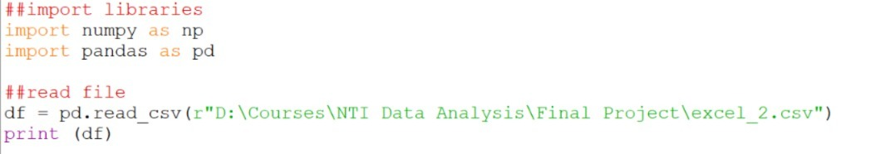
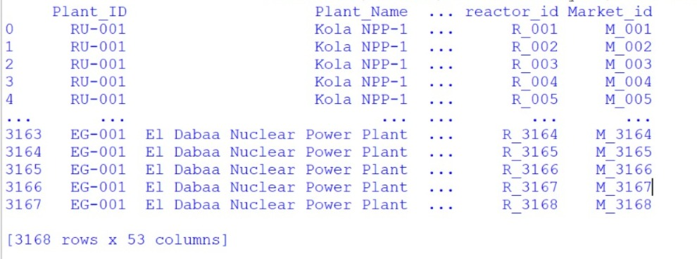
Appendix: Data Exploration Methodology (Python / Pandas)
Importing Libraries & Reading the Data File

Slide 18


Appendix: Data Exploration Methodology (Python / Pandas)
Dataset Dimensions (df.shape)
Result: 3,168 rows x 53 columns

Slide 19

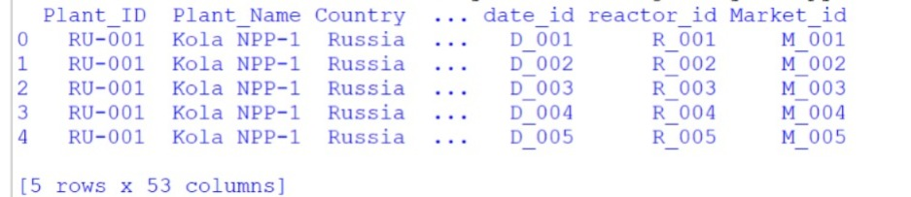
Appendix: Data Exploration Methodology (Python / Pandas)
First 5 Rows of Data (df.head())

Slide 20

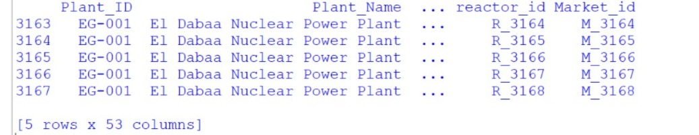
Appendix: Data Exploration Methodology (Python / Pandas)
Last 5 Rows of Data (df.tail())

Slide 21

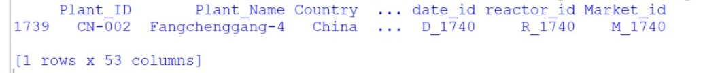
Appendix: Data Exploration Methodology (Python / Pandas)
Random Sample of Data (df.sample())

Slide 22

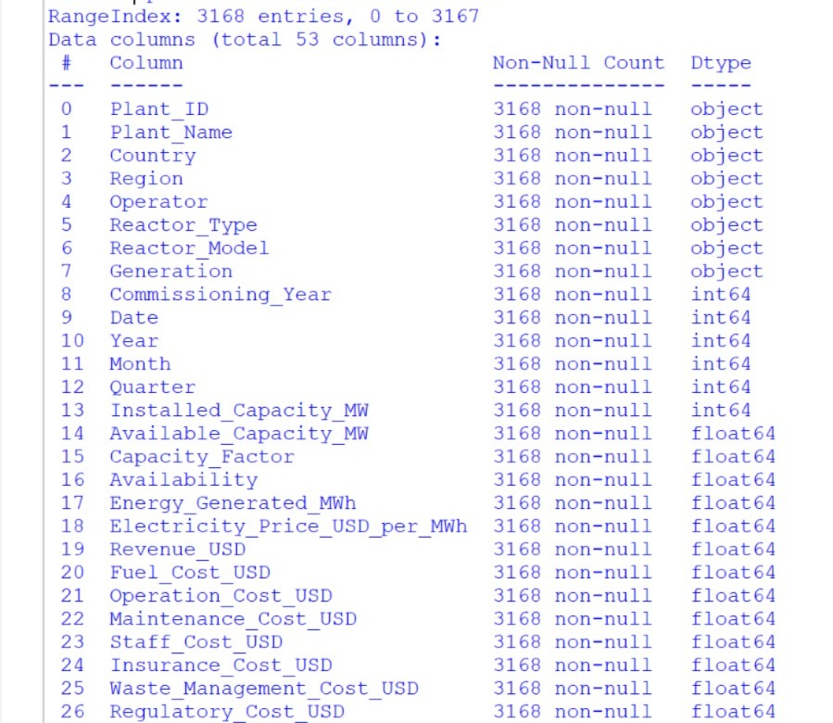
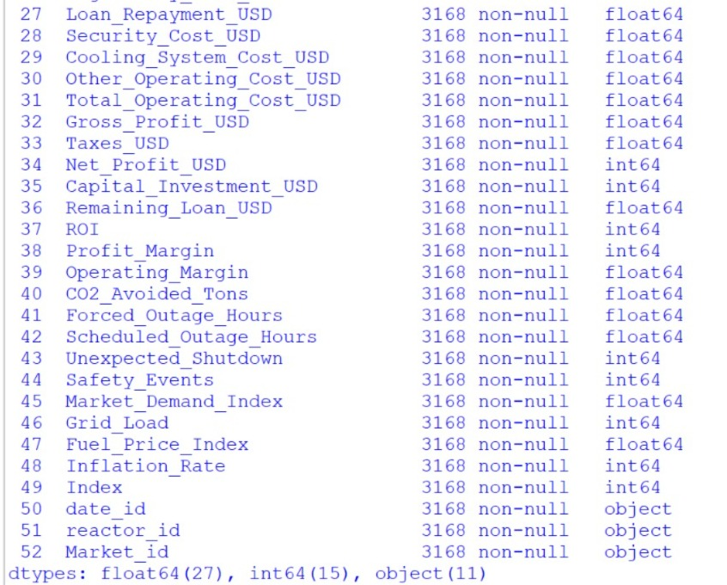
Appendix: Data Exploration Methodology (Python / Pandas)
Full Column Information (df.info())

Slide 23

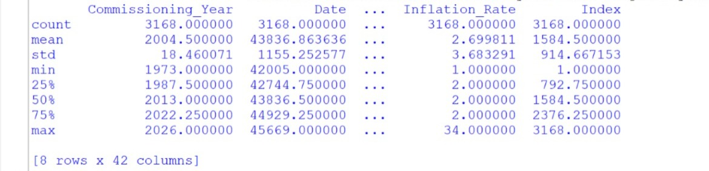
Appendix: Data Exploration Methodology (Python / Pandas)
Statistical Summary of Numeric Columns (df.describe())

Slide 24

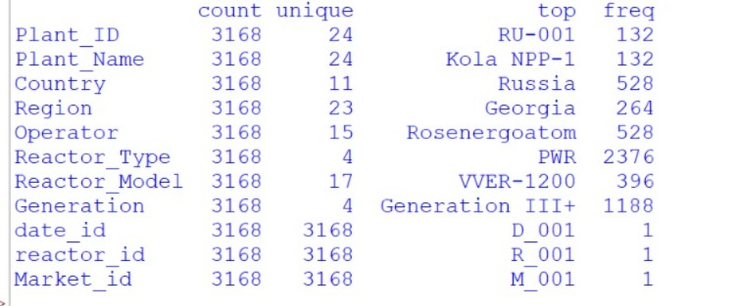
Appendix: Data Exploration Methodology (Python / Pandas)
Statistical Summary of Text Columns (df.describe(include=object))

Slide 25

Appendix: Data Exploration Methodology (Python / Pandas)
Distinct Countries in the Data (Country.unique())

Slide 26


Appendix: Data Exploration Methodology (Python / Pandas)
Count of Distinct Countries (Country.nunique())

Slide 27

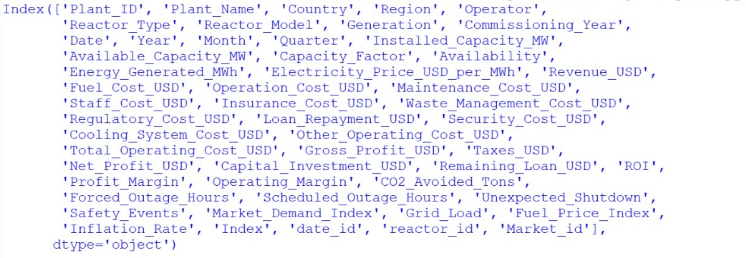
Appendix: Data Exploration Methodology (Python / Pandas)
All Column Names (df.columns)

Slide 28

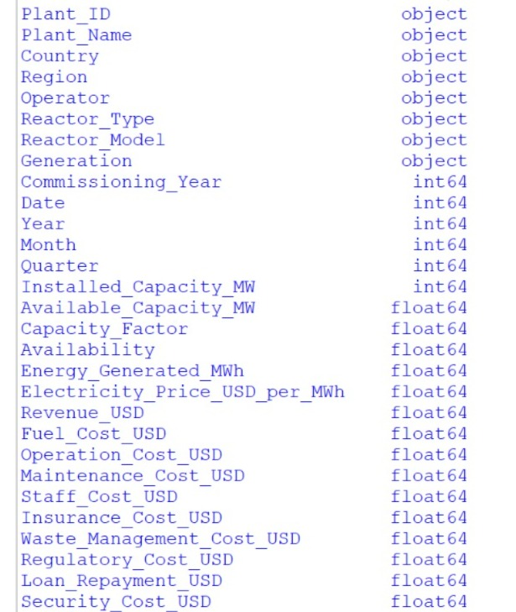
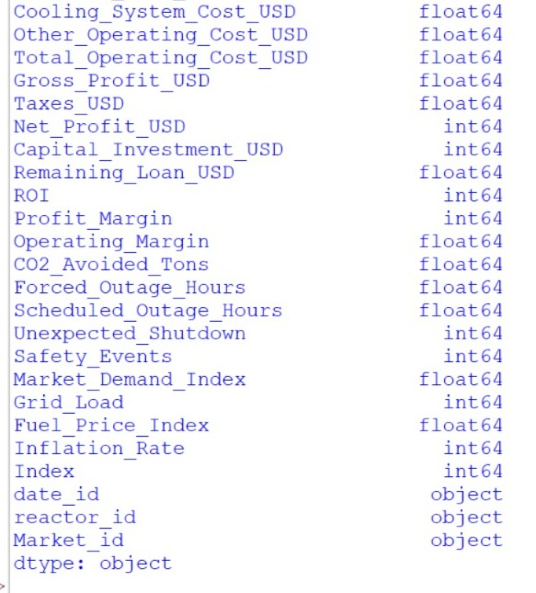
Appendix: Data Exploration Methodology (Python / Pandas)
Data Type of Each Column (df.dtypes)

Slide 29

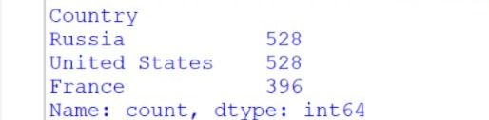
Appendix: Data Exploration Methodology (Python / Pandas)
Top 3 Most Frequent Countries (value_counts)

Slide 30

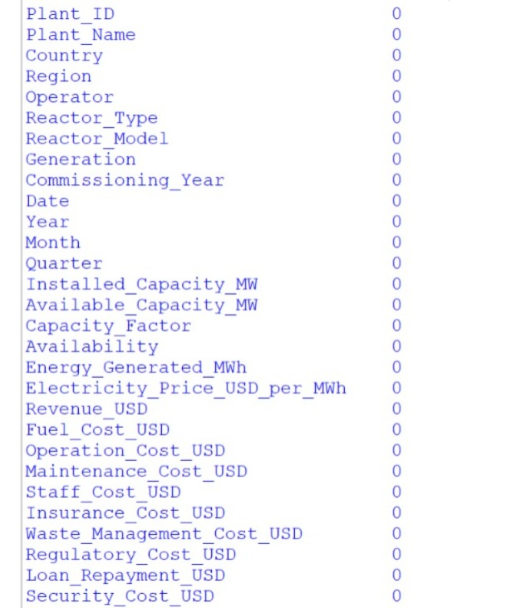
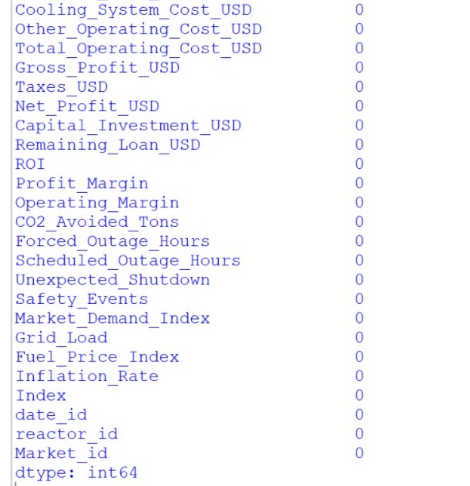
Appendix: Data Exploration Methodology (Python / Pandas)
Checking for Missing Values (df.isna().sum())

Slide 31


Appendix: Data Exploration Methodology (Python / Pandas)
Checking for Duplicate Rows (df.duplicated().sum())
Result: zero duplicates — the data is completely clean

Slide 32
El Dabaa: Egypt's Investment in Its Energy Future
A deliberate decision on cost, profitability, safety, and history — not just a technical choice
Thank You
32

