Slide 1
Body Area Network
Demo Test Report
April 25, 2019 Foxconn ZZDC

Slide 2
Introduce
0

Slide 3
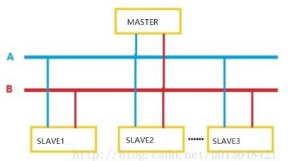
RS485 feature
485 is Fully balanced
485 handles multiple drivers and receivers
Better common-mode noise rejection (-7 to +12Volts)
Sensitivity of ś200mV in receivers
Drivers give up to 5 volts balanced output
Can stand contention, driver shuts down by itself
High input resistance (12K ohms)
Hysteresis of 50 mv to overcome diﬀ. noise
Figure: 485NET
1

Slide 4
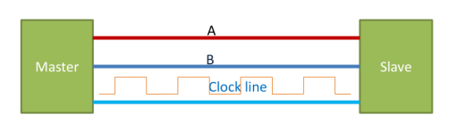
The Principle of The BAN’s Clock Synchronization
In order to synchronize the device clock, it is necessary to add a clock line between Master and Slave, where Master generates
synchronous clock square wave.
Figure: synchronous
2

Slide 5
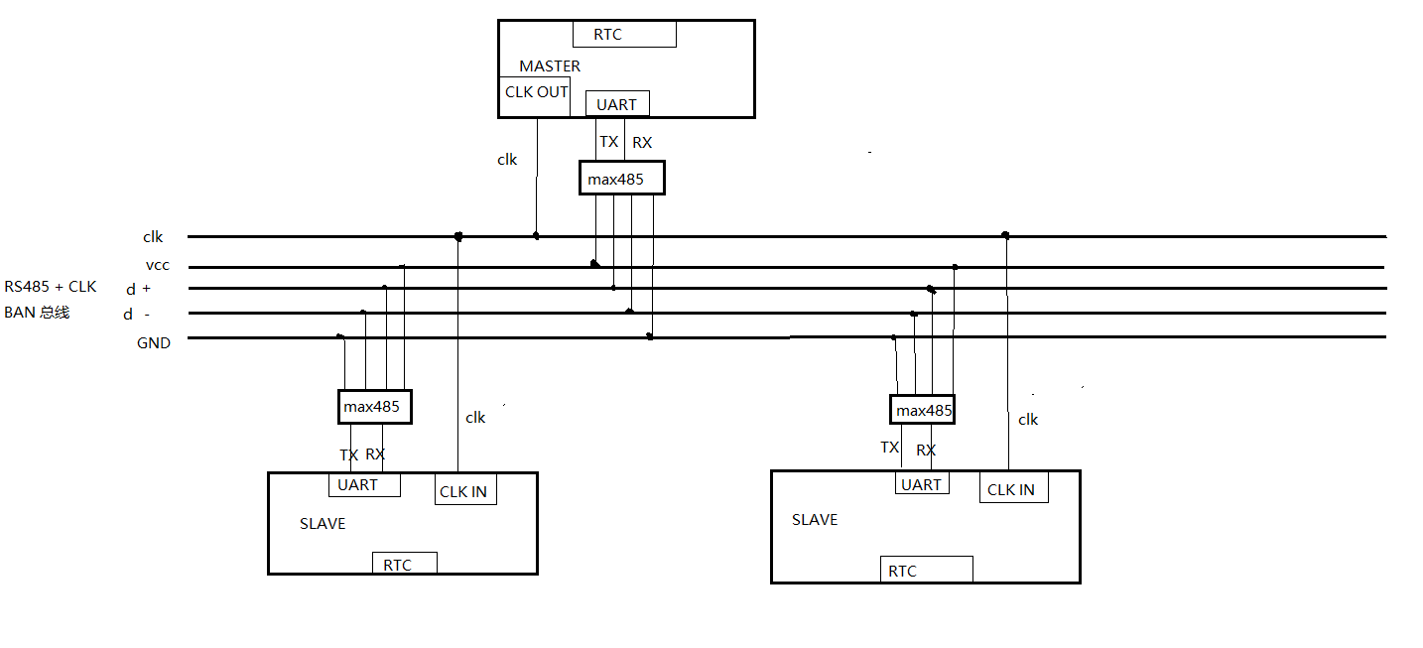
Our Design
We designed it like this：
Figure: BAN
3

Slide 6
1. Adding a clock line from RS485 to form the basic hardware circuit of BAN bus.
BUS
The clock line is used to generate Millisecond-level pulses for clock synchronization.Later aliases:SYNC_CLK
D + D - is a data signal after diﬀerential processing.
figure6 assumed that the device mounted on the bus has one Master and two Slaves.
4

Slide 7
Local Clock Counter & SYNC_CLK
Local Clock Counter , Each device has a local clock counter. The timing granularity is 100us.
SYNC_CLK,The device on BAN bus uses clock line to complete clock synchronization. Master’s timer generates synchronization pulse, Slave’s timer captures synchronization pulse to complete synchronization.
5

Slide 8
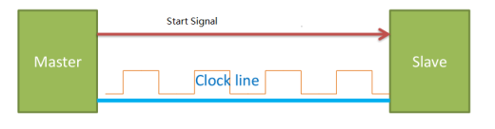
Synchronization process
a. master and slave power on and initialize peripherals.
b. master starts sending square wave signals,at The first rising edge of square wave signal:
The master starts Master’s Local Clock Counter(MLCC).
Slave captures this rising edge at the same time.Then start Slave’s Local Clock Counter(SLCC).
The delay of the rising edge of the clock line transmission can be neglected, so we think that MLLC and SLLC start counting at the same time.
c. Slave calibrates SLCC for each subsequent SYNC_CLK rising edge.
Figure: BAN
6

Slide 9
Clock Diﬀerence Calibration
SYNC_CLK is produced by Master with fixed period and precise time.Let’s take a period of 16 milliseconds for example.
MLLC and SLLC start counter at the sametime(first SYNC_CLK rising edge). Their timing granularity is small, 100 microseconds.
So when the system runs, there are two counts on each device, the Local Clock Count(Every 100 microseconds plus 1) and the SYNC_CLK Count(Every 16 milliseconds plus 160).Slave calibrates SLCC at each
subsequent SYNC_CLK rising edge by Make those two counts the same.
7

Slide 10
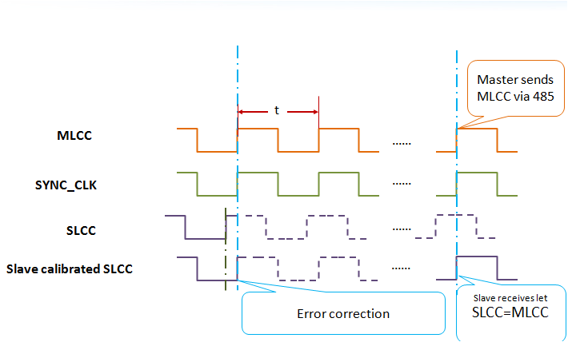
Clock Diﬀerence Calibration
Figure: BAN
8

Slide 11
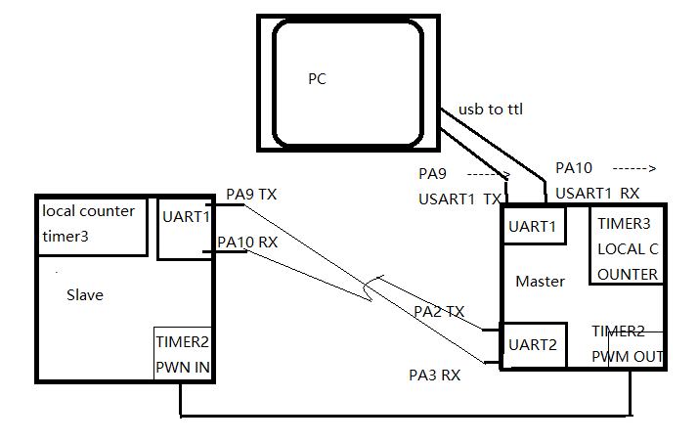
Demo implementation
The following is the demo wiring and structure：
Figure: demo
9

Slide 12
workflow

Slide 13
Demo workflow: two instructions
Master and Slave Power on 。 Peripheral Driver Initialization,Slave enters the rising edge capture state and waits for an rising edge coming.
When Master receives "begin" instruction from PC.
a.Forward to Slave first.
b. start timer3 for MLCC(Master Local Clock Counter).
c. start timer2 to Generating Pulse Square Wave for synchronous 。
When Slave receives the "begin" instruction from Master, and Slave captures the first rising edge of SYNC_CLK:
a. start timer3 for SLCC(Slave Local Clock Counter).
b. Continue to capture the rising edge.
"report" instructions:
a.when Master receives the "report" instruction and reports its own timestamp(MLCC) to PC.
b.when Slave receives the "report" instruction, reports its own timestamp(SLCC) to Master, and Master forwards it to PC.

Slide 14
Demo Workflow: Synchronize details
local_tm_t is the type of time described in Master and Slave code:
1
2
3
4
5
6
7
8
t y p e d e f s t r u c t l o c a l _ t i m e _ s t r u c t { u n s i g n e d c h a r s e c : 7 ; // s e c o n d u n s i g n e d c h a r min : 7 ; // min
u n s i g n e d c h a r h o u r : 5 ; // h o u r u n s i g n e d i n t d a y ; // d a y u n s i g n e d i n t j i f f i e s ; //LCC
u n s i g n e d i n t j i f f i e s _ p w m ; //SYNC_CLK c o u n t e r
} l o c a l _ t m _ t ;

Slide 15
Slave Rising Edge Capture Interrupt
tick_sync is called every 8ms to synchronize the local timestamp:
1 /∗ e v e r y 8ms 8 0 ∗ 1 0 0 u s ∗/
2 v o i d t i c k _ s y n c ( v o i d )
3 {
4 i f ( d e v . l o c a l _ t m . j i f f i e s _ p w m + 80 < 10000 ) {
5 d e v . l o c a l _ t m . j i f f i e s _ p w m = d e v . l o c a l _ t m . j i f f i e s _ p w m + 8 0 ;
}
i f ( d e v . l o c a l _ t m . j i f f i e s _ p w m + 80 >= 10000 ) { d e v . e v t . s e c _ n e e d _ u p d a t e =1;
6
7
8
9
d e v . l o c a l _ t m . j i f f i e s _ p w m = 80 − ( 1 0 0 0 0 − d e v . l o c a l _ t m .
j i f f i e s _ p w m ) ;
10
11
}
d e v . l o c a l _ t m . j i f f i e s = d e v . l o c a l _ t m . j i f f i e s _ p w m ; ^ ^ I ^^ I // s y n c h r o n o u s
12 }

Slide 16
Synchronize details:test point
Enter this code every 100us：
1 /∗
2 e n t e r t h i s c o d e e v e r y 100 u s 。
3 ∗/
4 v o i d T i c k ( v o i d )
5 {
6 d e v . l o c a l _ t m . j i f f i e s ++;
7 i f ( d e v . l o c a l _ t m . j i f f i e s % 80 == 0 ) {
8 //GPIO A5 f o r c o m p a r e .
9 HAL_GPIO_WritePin ( GPIOA , GPIO_PIN_5 ,1 −HAL_GPIO_ReadPin (
10 }
11
12
13
14 }
15 }
GPIOA , GPIO_PIN_5 ) ) ;
/∗ o n e s e c o n d p a s s e d ∗/
i f ( d e v . l o c a l _ t m . j i f f i e s >= 10000 ) { d e v . l o c a l _ t m . j i f f i e s = 0 ;
Here the slave GPIOA5 has square wave output relative to the clock synchronization line. It’s a test point.
13

Slide 17
TEST Data
13

Slide 18
Time stamp of serial port printing
After the "report" instruction is sent to the Master, the following code segments are executed:
1
2
3
4
5
6
7
8
/∗
r e p o r t t h e j i f f e s t o t h e PC
∗/
v o i d r e p o r t _ j i f f e s ( v o i d )
{
p r i n t f ( " m a s t e r ␣ r j : \ t%d \ r \n " , d e v . l o c a l _ t m . j i f f i e s ) ; p r i n t f ( " m a s t e r ␣ r j : \ t%d \ r \n " , d e v . l o c a l _ t m . j i f f i e s ) ; p r i n t f ( " m a s t e r ␣rj_PWM : \ t%d \ r \n " , d e v . l o c a l _ t m .
j i f f i e s _ p w m ) ;
p r i n t f ( " m a s t e r ␣rj_PWM : \ t%d \ r \n " , d e v . l o c a l _ t m . j i f f i e s _ p w m ) ;
}
9
10
This code reports the values of jiﬃes ( local time count) and jiﬃes PWM sync time count to the PC.
14

Slide 19
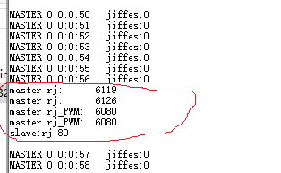
Time stamp of serial port printing
Figure: report jiﬃes
After entering the "report" command, output is as shown above (in red circles), combined with the previous code, you can see that:
In order to print log in the above code, the execution time of printf is about (6126-6119=7)*100us.Here, the printf is a non-blocking, lightweight, full-featured printf for transplantation.
Slave and Master have transmission delays.
15

Slide 20
Waveform: Unsynchronized
Let:
The local clock inverts the GPIOA5 level state every 8ms. This test channel is marked CH_LOCAL.
The synchronous line generates a synchronous square wave with a half period of 8ms from the Master. This test channel is marked CH_SYNC.
In the interrupt processing function of the slave to capture the rising edge of the synchronization line, the clock is not synchronized, that is to say, the following code is commented out:
1
// d e v . l o c a l _ t m . j i f f i e s = d e v . l o c a l _ t m . j i f f i e s _ p w m ; ^ ^ I
^^ I // s y n c h r o n i z e c o d e
The following screenshots show the unsynchronized screenshots:

Slide 21
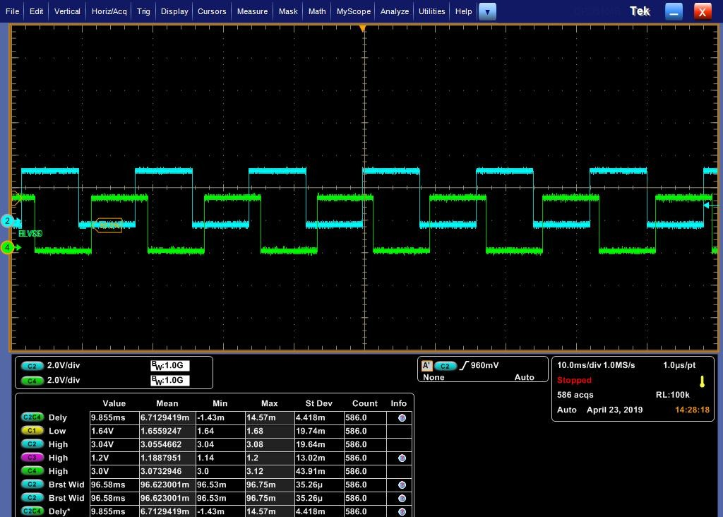
Waveform: Unsynchronized
Unsynchronized waveform 1：

Slide 22
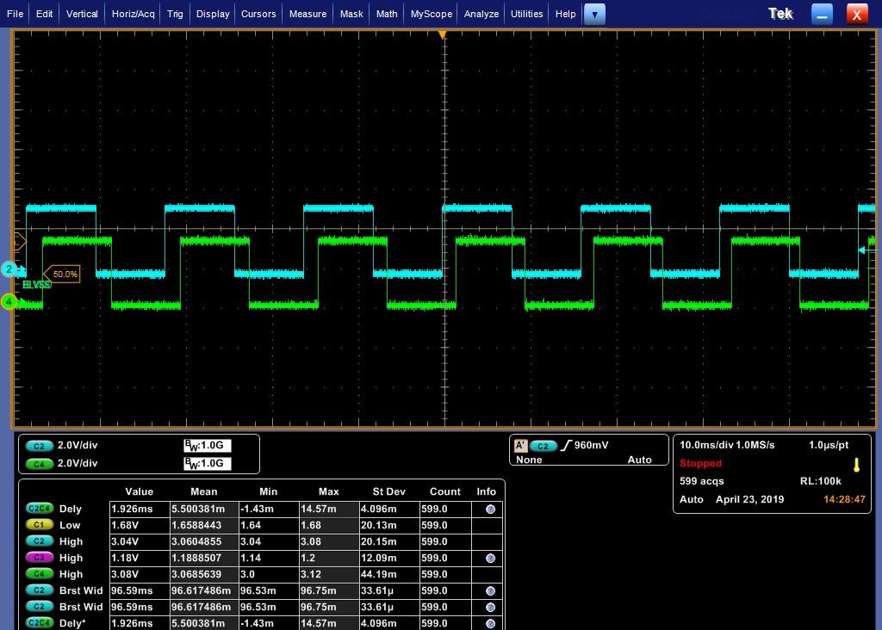
Waveform: Unsynchronized
Unsynchronized waveform 2：

Slide 23

Waveform: Unsynchronized
Unsynchronized waveform 3：

Slide 24

Waveform: Unsynchronized
Unsynchronized waveform 4：

Slide 25
Some explanations of unsynchronized waveforms
Return this document to unsynchronized waveform 1 ( 17) and turn the page with the right key of the keyboard direction key (from unsynchronized waveform 1 to unsynchronized waveform 4). At this time, the animation eﬀect on the screen can restore the appearance of the oscilloscope at that time.
Because the local clock is not synchronized, each diﬀerence accumulates, resulting in such a dynamic eﬀect.

Slide 26
Waveform: Synchronization
Let:
The local clock inverts the GPIOA5 level state every 8ms. This test channel is marked CH_LOCAL.
The synchronous line generates a synchronous square wave with a half period of 8ms from the Master. This test channel is marked CH_SYNC.
In the interrupt processing function of the slave capturing the rising edge of the synchronization line, the clock is synchronized, that is to say, the following code is active:
1
d e v . l o c a l _ t m . j i f f i e s = d e v . l o c a l _ t m . j i f f i e s _ p w m ; ^ ^ I ^^ I
// s y n c h r o n i z e c o d e
The following screenshots show the screenshots in the case of synchronization.

Slide 27

Waveform: Synchronization
synchronized waveform :

Slide 28
Waveform: Synchronization
Since the rising edge of each synchronization line is captured by slave computer, synchronization interrupt will be triggered. In interrupt processing, the local clock error of each cycle will be eliminated.
So the synchronized waveform looks fixed and the phase is relatively consistent. But:
If we amplify the size of the oscilloscope, we will find that there are diﬀerence. The following are some synchronization delay. The size of the oscilloscope is already 50us. We are concerned about the synchronization time.

Slide 29
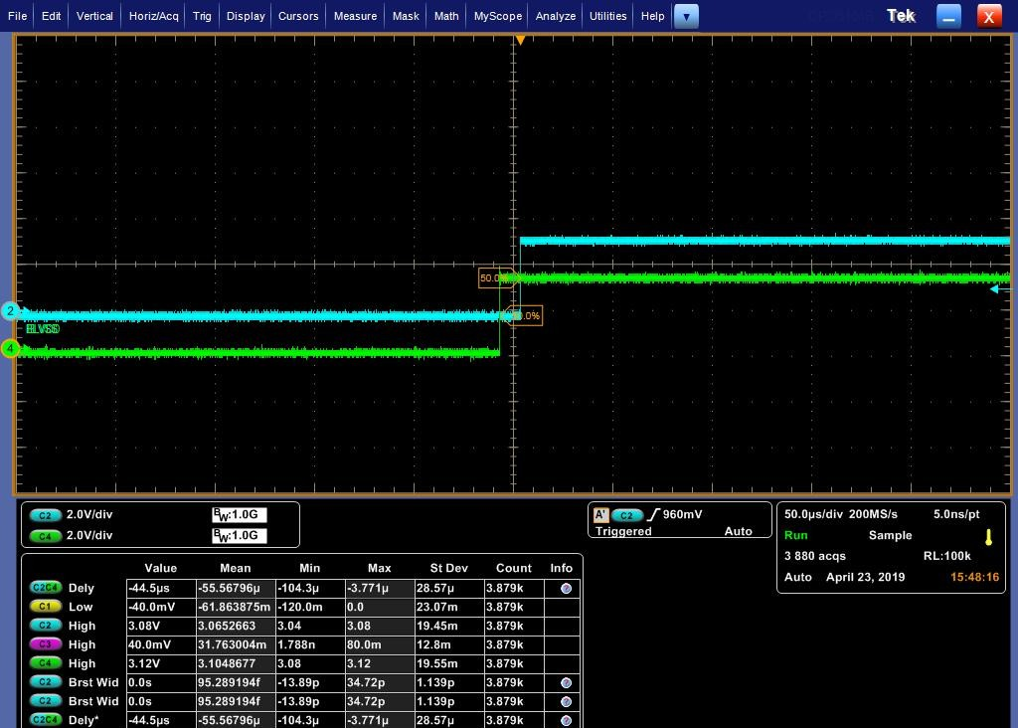
Waveform: Synchronization
Synchronization delay:

Slide 30
Synchronization delay
Synchronization delay:

Slide 31
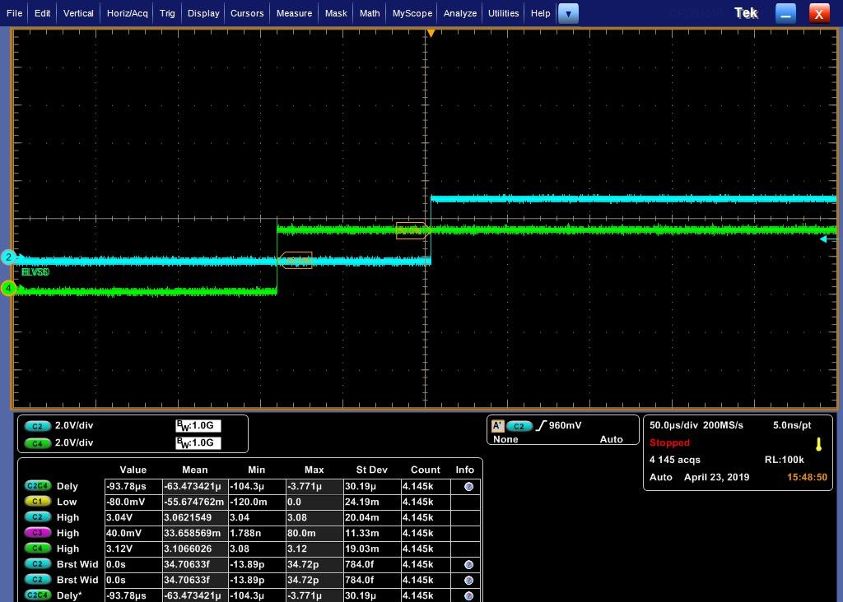
Synchronization delay
Synchronization delay:

Slide 32

Synchronization delay
Synchronization delay:

Slide 33
Synchronization delay
Figure: delay
As can be seen from the figure above, the maximum phase diﬀerence between CH_LOCAL and CH_SYNC is -3.771 （- -104.3）= 100.529us when sampling 4.155k times.

Slide 34
summary
Data transmission through serial ports can cause some delays (although there is no blocking at the time of sending, receiving in the interrupt, reading registers directly). The baudrate we used in this example is 115200*2.
Software-only CRC verification will inevitably lead to a certain delay. If it is necessary to verify, the driver of CRC hardware peripherals should be realized in this project.
The error of demo synchronization has been tested many times, among which there are transformed master-slave roles, and the maximum error is less than 500 us. The most common is within 300us.
The test code logic is not complex, real-time processing is in the interrupt context, and STM32F4 uses Cortex M4’s Nested Vectored Interrupt Controller (NVIC) real-time is very high, there should be little
optimization space. ₃₀

