Slide 1
INSURTECH · ML
DriveScore
Insurance Premium Prediction from Telematics Data
A supervised machine learning pipeline · Synthetic telematics dataset · 5,000 policies
5,000
4
85.5%
18
Policies
Models Compared
Best R² Score
Features
Taiwo Oloko

Slide 2
Problem & Motivation
Traditional Pricing Fails
Telematics-Based Solution
✕ Static factors ignore how people actually drive
✔ Real driving data: speed, braking, cornering, phone use
✕ Young safe drivers pay as much as reckless peers
✔ Per-driver risk scoring — fair, transparent, explainable
✕ Adverse selection: riskier drivers drawn to flat-rate policies
✔ Gradient Boosting achieves R² = 0.855 vs 0.693 linear
✕ Insurers lack real predictive power — ~69% R² with legacy models
✔ Rewards safe drivers with lower premiums (up to 25% off)

Slide 3
Dataset & Features
Driver Profile
Telematics Signals
Derived Features
› Age & years licensed
› Avg speed (mph)
› Driving risk score
› Vehicle type & age
› Hard braking / trip
› Mileage per trip
› Annual mileage
› Sharp cornering / trip
› Experience ratio
› Prior claims history
› Phone use / trip
› % time speeding
Target Variable: Annual Insurance Premium ($400 – $3,290) | n = 5,000 policies | Mean = $1,528

Slide 4
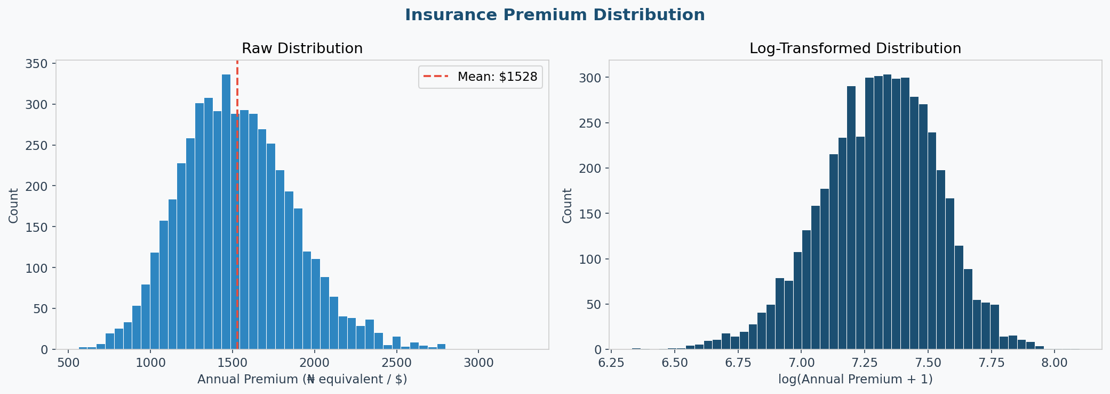
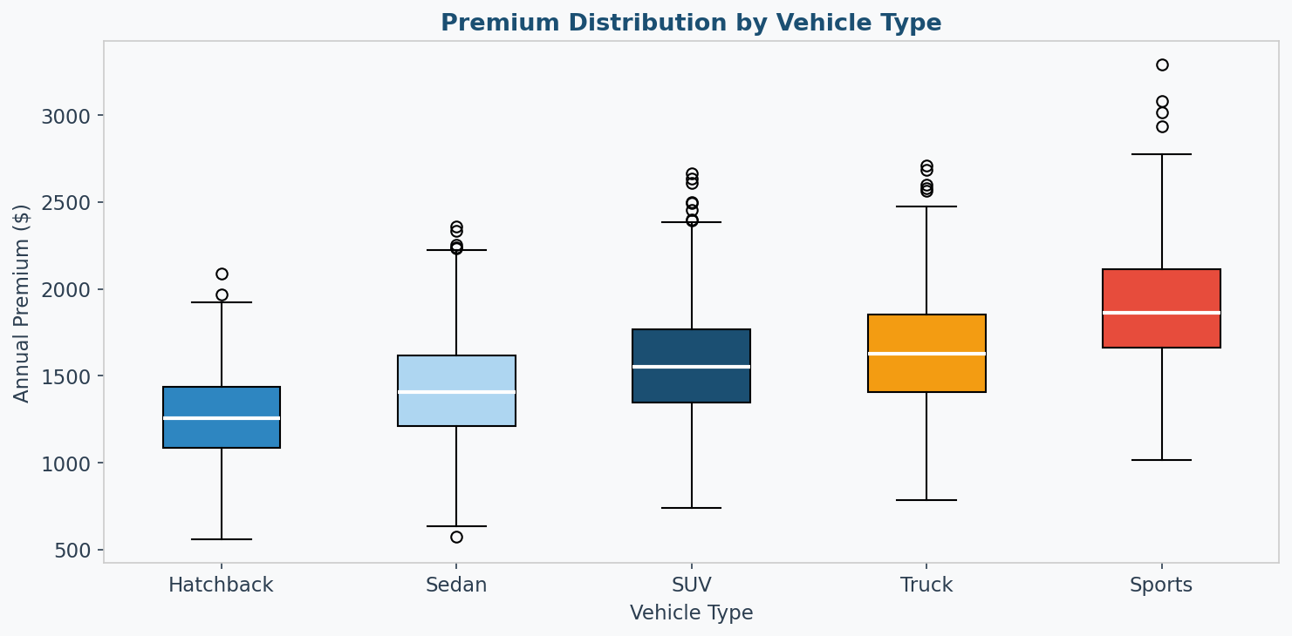
Exploratory Data Analysis
Key EDA Insights
Right-skewed distribution
Mean $1,528; most policies cluster between $900–$2,000
Sports cars pay most
$1,750 median vs $1,350 for Hatchback
Speed & braking corr > 0.6
Strong positive correlation with premium
Age effect is non-linear
Young (<25) and older (>65) both pay more

Slide 5
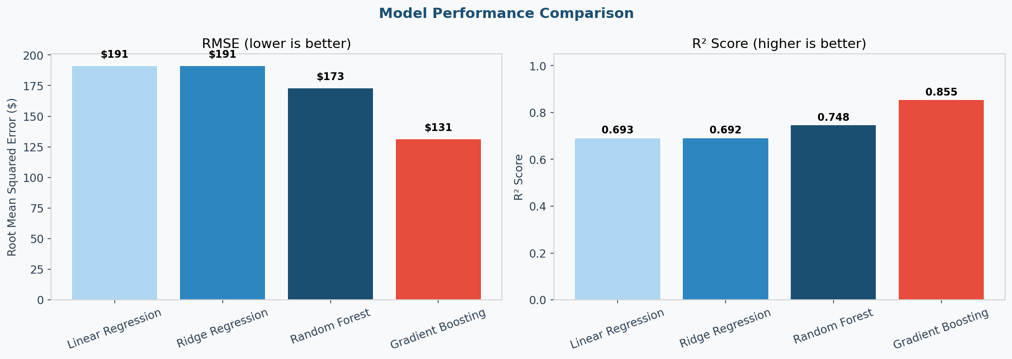
Model Training & Results
Baseline
Regularized
Ensemble
★ Best Model
Linear Regression
Ridge Regression
Random Forest
Gradient Boosting
RMSE
RMSE
RMSE
RMSE
$191
$191
$173
$131
R² Score
R² Score
R² Score
R² Score
0.693
0.692
0.748
0.855

Slide 6
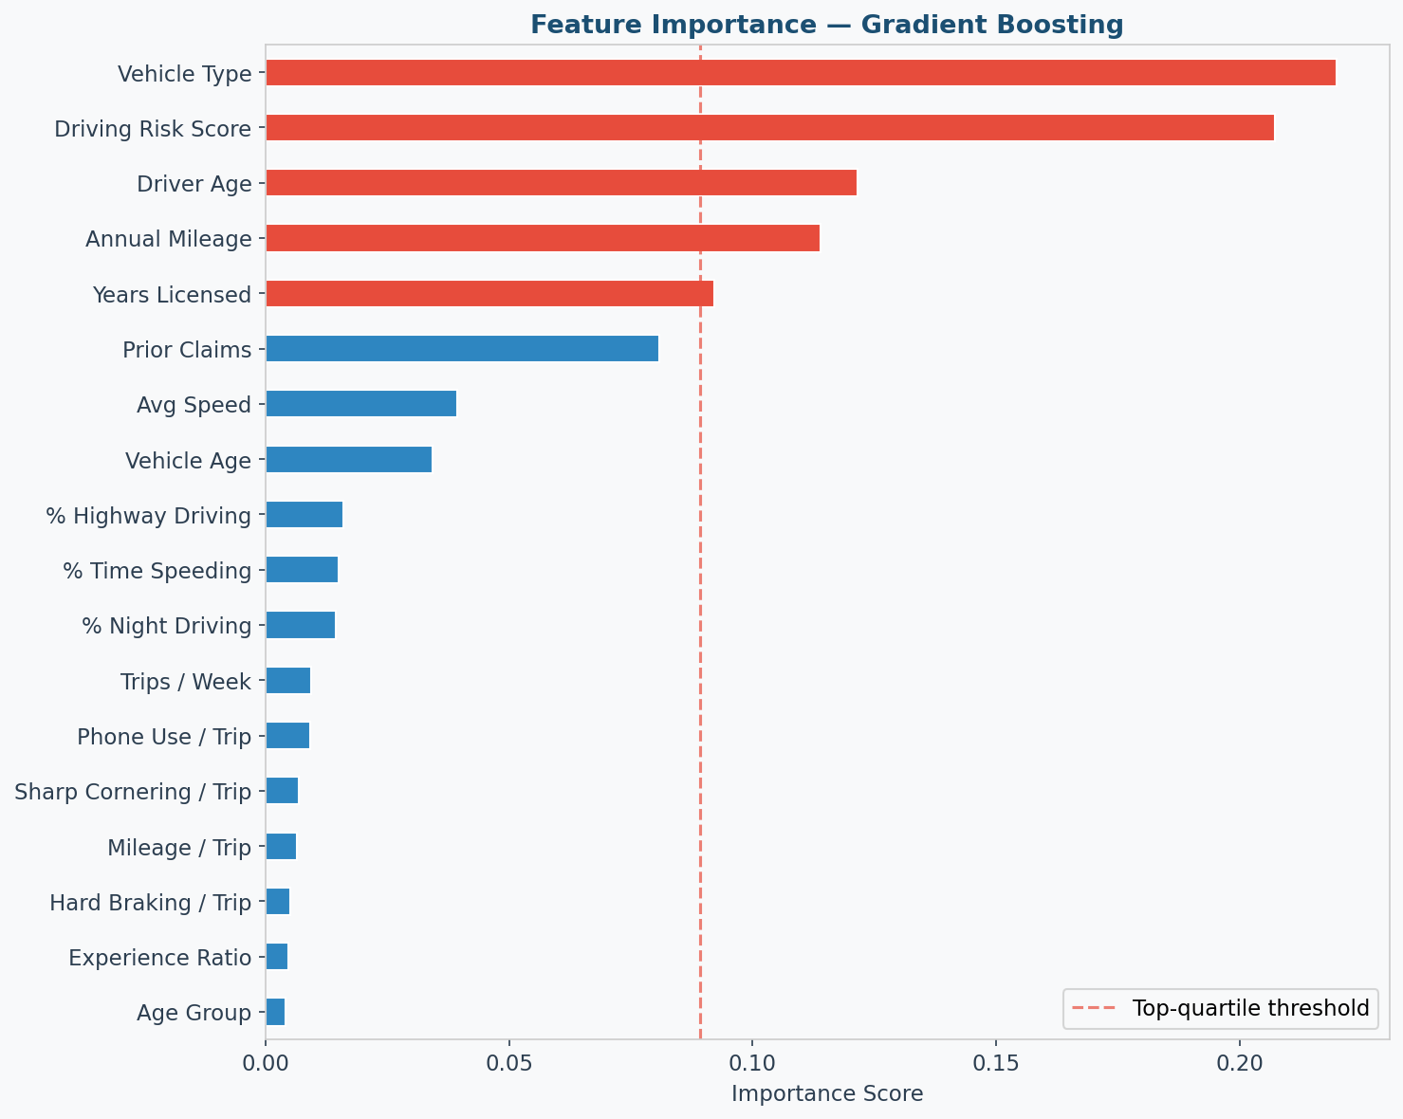
Feature Importance & Explainability
Top Signal Drivers
1
Driving Risk Score
Composite of 5 telematics signals; single most predictive feature
2
Hard Braking
Each additional event/trip adds ~$55 to expected premium
3
Avg Speed
Strong linear relationship; high-speed drivers pay 30% more
4
Phone Use
Most actionable: coaching could reduce this and premiums
5
Prior Claims
Legacy signal still powerful — validates hybrid approach

Slide 7
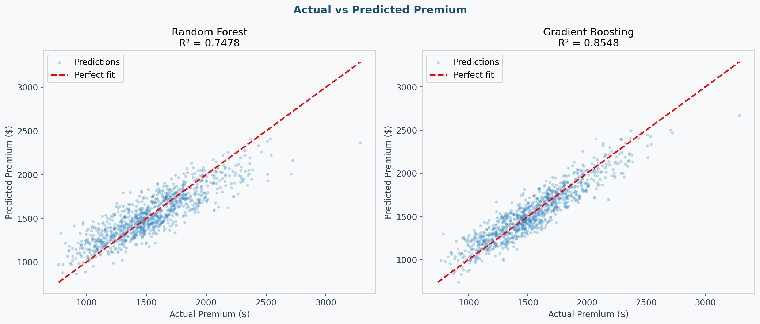
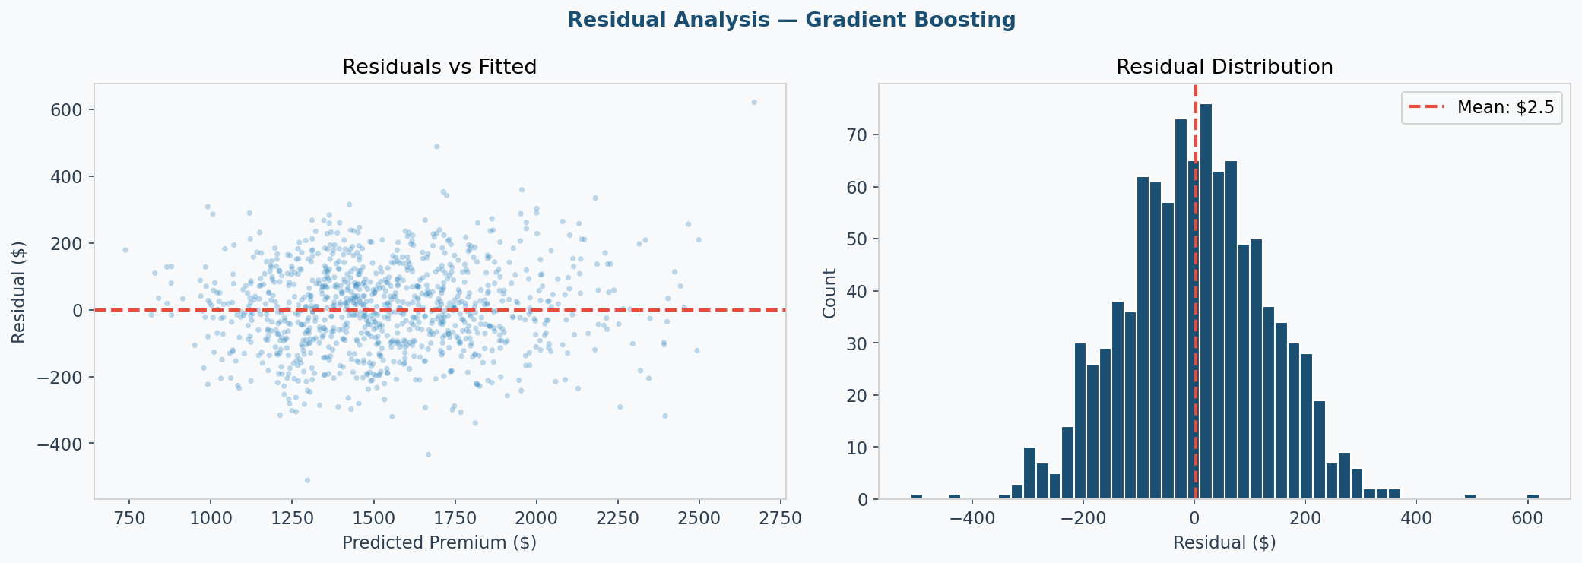
Model Validation
Gradient Boosting
Test Set Performance
85.5%
Variance Explained (R²)
$131
Root Mean Squared Error
$104
Mean Absolute Error
~73%
Predictions within ±$100

Slide 8
Business Insights & Next Steps
💰
UBI Pricing Strategy
📱
Phone Use Intervention
Safe-driver discount of 15–25% is financially viable; accurate pricing reduces adverse selection
Highest-impact lever: in-app coaching or blocking while driving could cut risk score by 20%
⚖️
Fair & Explainable AI
🚀
Production Roadmap
Reduces reliance on proxy variables (zip code, demographics). Meets regulatory explainability standards
Next: SHAP explainer, REST API deployment, real-time telematics stream integration

Slide 9
Project Summary
What I Built
› Generated a 5,000-record synthetic telematics dataset with 14 raw + 4 engineered features
› Built a complete ML pipeline: EDA → feature engineering → 4 models → evaluation
› Gradient Boosting achieved R² = 0.855, RMSE = $131 — 24% improvement over linear baselines
› Identified top risk signals: driving composite score, hard braking, speed, phone use
› Translated model findings into actionable UBI pricing and customer coaching strategies
Taiwo Oloko · Data Science Portfolio · InsurTech / ML

