Slide 1
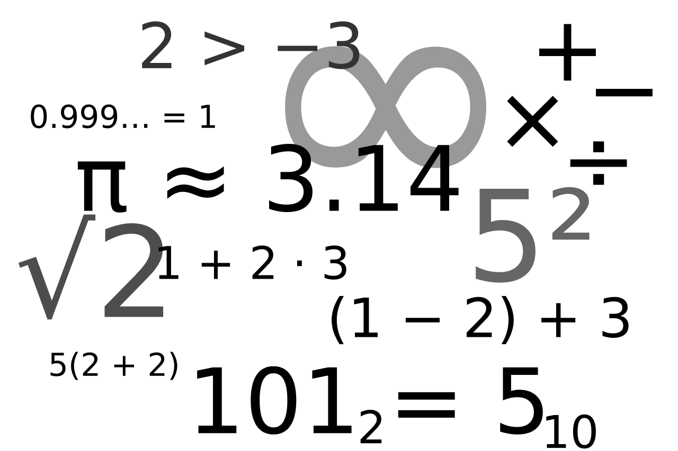
Is there in math no beauty?
Notes:
This presentation was created while interviewing in CVS for a training position.

Slide 2
I hate math……
I hate bills….
Notes:
We all remember the chore of learning math as kids and unfortunately it adds to the burden of budgeting as adults.

Slide 3

Guess what!
Notes:
It’s actually not that bad, but most of us were scared by early experiences.

Slide 4

The force is an energy force that gives the Jedi his power and binds all living things together .
Notes:
You don’t have to be part of a fictional mystic order created by George Lucas and trained for decades in the jedi way to embrace the beauty of math… you can be an american schoolchild!
In star wars, obi want explains the force to luke – it’s an energy force that gives the jedi his power and binds all living things together.
In real life, it’s not the force that flows through nature binding things together – it’s math. And I have good news – it’s not the proprietary domain of a mystic order of specialty –trained experts. It’s easy.

Slide 5
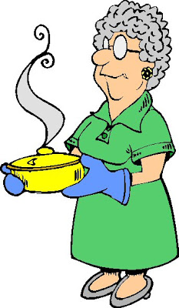
Notes:
Math is behind such everyday beautiful events as the number of petals growing on flowers, the science of lightning, the science of grandma’s cooking, music, the physics of rowing and whatever else we like to create. We may not be aware of it.

Slide 6

1 + 1?
Anyone Can Add…
2 + 1?
3 + 2?
1, 1, 2, 3, 5, 8, 13, 21, …
Notes:
We all learned this in grade school… easy as pie… let’s do some adding…

Slide 7
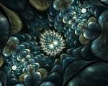

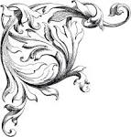


These Are A Few Of My Favorite Things!
Notes:
The addition we just did created the Fibonacci sequence which results the underlying math behind some of this beauty.

