Slide 1

URI Writing / Rhetoric Department Finding Aid
Evelyn Livant
Alex Chen
Kyle Lema
Sourivong Thepsimoung

Slide 2
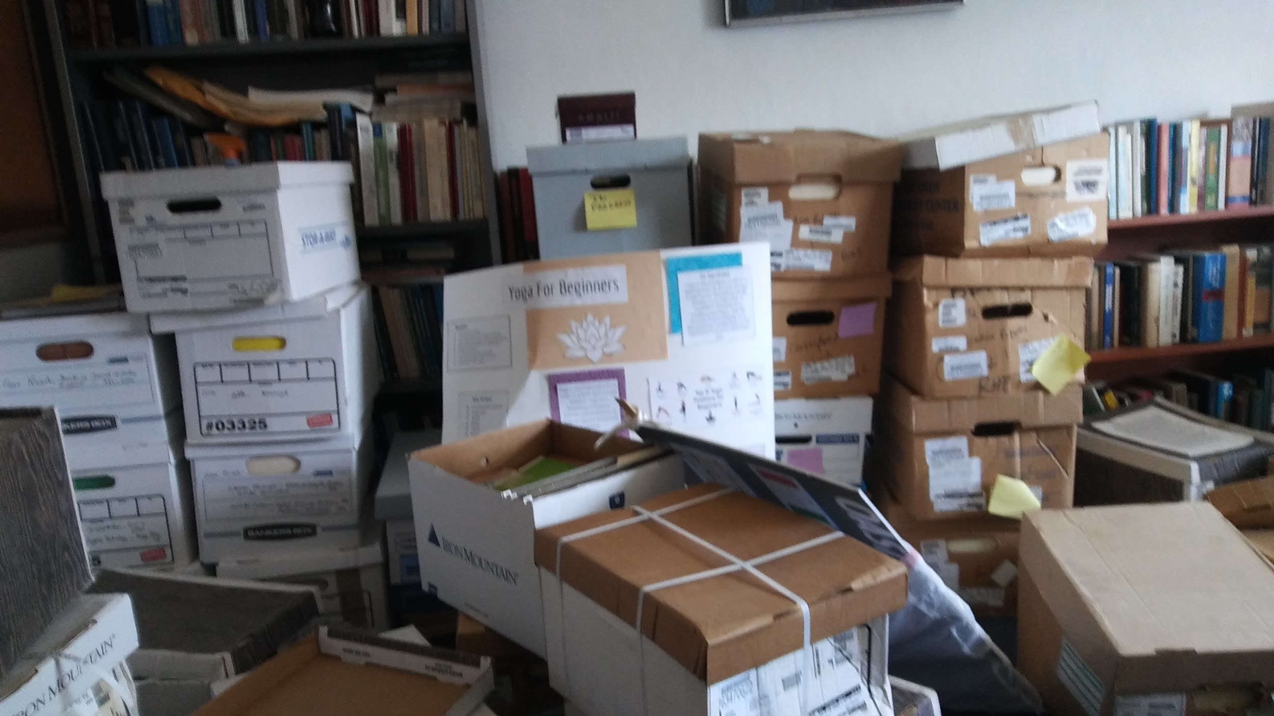
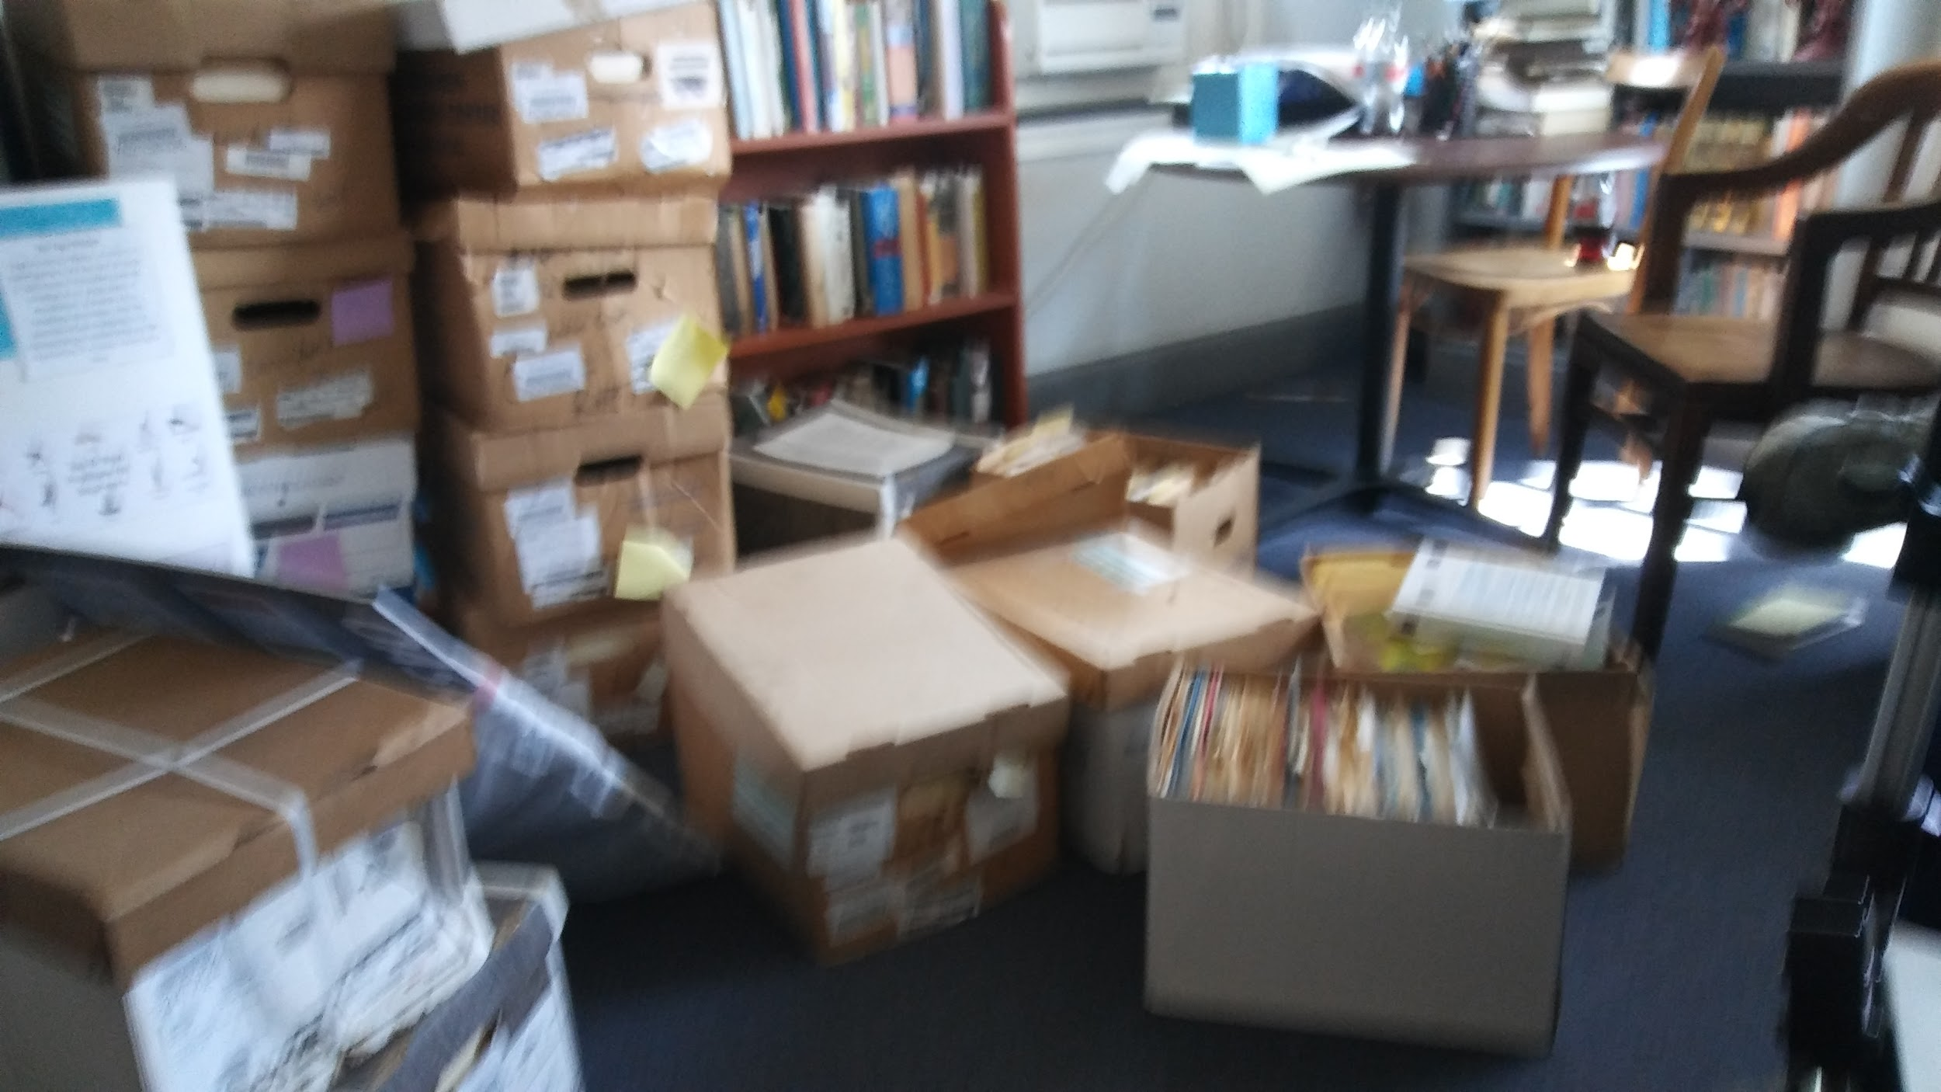
Statement of Problem
University receives documents regularly to be stored and archived
Archive documents are currently being stored in Dr. Robert A. Schwegler’s office
Uncomfortable Work Environment
Space Limitations
Documents requests is timely
Notes:
Due to space limitations, a set of these archived documents are currently being stored in Dr. Robert A. Schwegler’s office. With the overload of boxes in the office of Dr. Robert A. Schwegler, creating an uncomfortable work environment, reducing the space of his office, as well as creating an illusion in which the boxes would come alive and attack him thereby creating a stressful work environment. Additionally, retrieval of the documents in response to a request is timely and cumbersome.

Slide 3
What is to be done?!?

Slide 4

Solution
Create an online, searchable Finding Aid
Alleviate the Space Situation
More efficient research service
Faster response of Documentation
Natural language processing may improve search and retrieval services
This Photo by Unknown Author is licensed under CC BY-NC
Notes:
The Expert Consulting Agency has inspected the documents and would be happy to undertake designing a scalable solution to this issue. We are recommending creating an online, searchable Finding Aid. This would alleviate the space problem and would have the added benefit of facilitating more efficient research and response from URI to research requests from other institutions. Eventually, natural language processing algorithms may be implemented to provide better research services.

Slide 5

Information Details
Data Requirements
Catalog of papers in box
Each box contains folders
Boxes indexed by folder name
Preserves context - donor - original donor and label

Slide 6
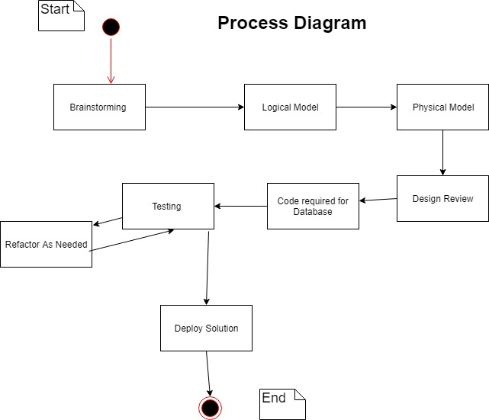
The Software Lifecycle

Slide 7
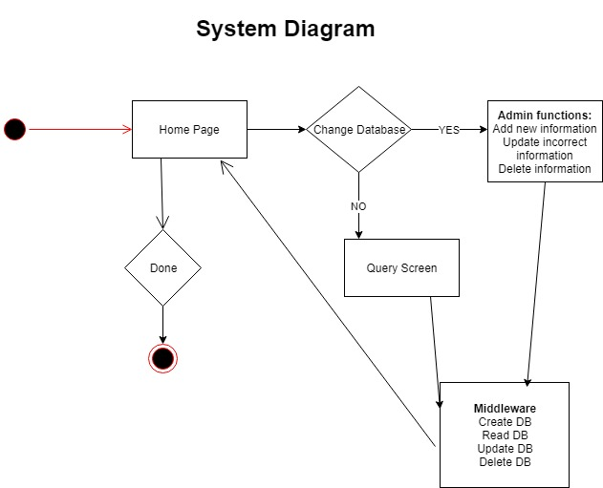
System Design
Drove our development decisions

Slide 8
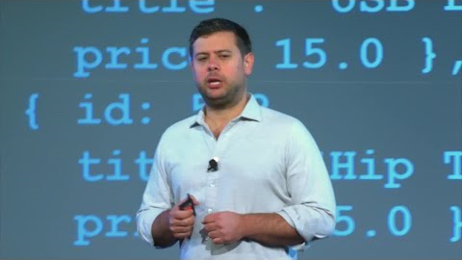
A little about MongoDB
What makes it work

Slide 9

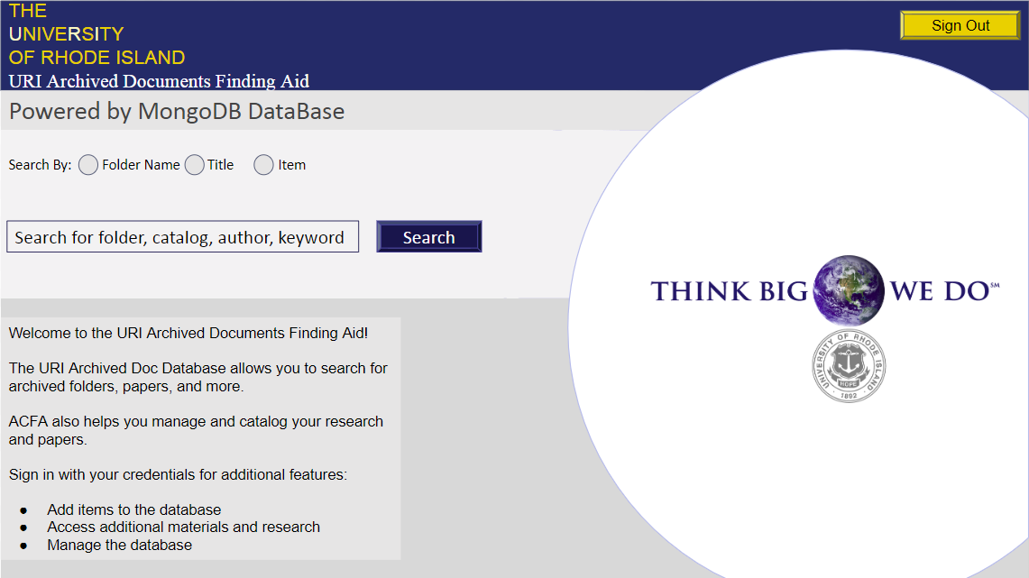
Finding Aid
Notes:
This is the web user interface that all users will have access to. There will be an admin account for Dr. Schwegler to update new information and make changes as well as a regular user account for remote research facilities to search documents and request materials.

Slide 10
Next Steps
Design Document
What has been done
What needs to be done
How to do it
Who to reach out to
Notes:
Design document

Slide 11
Works Cited
(2019). Shrieking book [GIF]. Retrieved from https://harrypotter.fandom.com/wiki/Shrieking_book.
Foote, K. (2018). Artificial Neural Networks: An Overview . [Image]. Retrieved from https://www.dataversity.net/artificial-neural-networks-overview/#
Horowitz, Eliot. (2018, February 13). MongoDB in 5 Minutes with Eliot Horowitz [Video file]. Retrieved from https://www.youtube.com/watch?v=EE8ZTQxa0AM.

