Slide 1
White Privilege
Why I care about this topic
Utilized concept mapping tool in InfoRhode Tutorial Tool “Identify – Refine the Topic Develop a Search Strategy” (“Identify ”)
“What it takes to be racially literate” (Vulchi, Priya, and Winona Guo)
"a form of racial socialization and antiracist training that...parents of African-descent children practiced in their efforts to defend their children against racism " (“Racial Literacy")
Research Question: How is racial literacy currently implemented in the United States to resolve white privilege?
Notes:
#1 – because I’m white. Tell story about Diane
#2 – how I focused my topic and research
#3 – I was affronted, but I watched the TED Talk because it was a requirement. How could I need racial literacy? I have many friends of many different races who talk to me about their experiences.

Slide 2
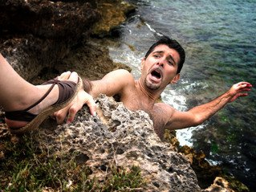
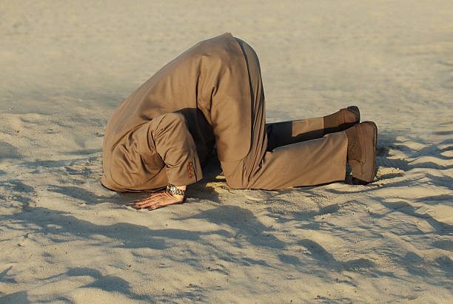
Identified twofold problem: (Vulchi, Priya, and Winona Guo)
Heart Problem
“Girlfriend’s Revenge.” Free Water Gutter Images, Pictures, and Royalty-Free Stock Photos - FreeImages.com, Getty Images, 2018, www.freeimages.com/search/hate. Accessed 7 Jun 2018.
Mind Problem
“Businessman With Head Stuck In Sand At The Beach.” Free Water Gutter Images, Pictures, and Royalty-Free Stock Photos - FreeImages.com, Getty Images, 2018, www.freeimages.com/search/hate. Accessed 7 Jun 2018.
Notes:
How racial literacy is implemented
The two women who conducted the TED talk identified two problems. They felt that telling personal stories was a solution to the heart problem and information was the solution to the mind problem.
I chose to focus on the heart problem.

Slide 3
I have an agenda! It’s my goal to affect how you choose to interact with the world around you.
Notes:
My goal is for you to choose how you interact with the world based on your individual conscience

Slide 4
So What?
Why should I care?
Why do I need racial literacy?
Hey Lady -- Go kick rocks!!
Notes:
I’m a good person
I’m going to try to make case why you should consider this
There are three kinds of people, those who watch things happen, those who make things happen and those who wonder what happened
SO LETS TURN THE PAGE….

Slide 5
“There is no more neutrality in the world. You either have to be part of the solution, or you're going to be part of the problem.”
-- Eldridge Cleaver.
“Returning hate for hate multiplies hate, adding deeper darkness to a night already devoid of stars. Darkness cannot drive out darkness; only light can do that. Hate cannot drive out hate; only love can do that.”
-- Martin Luther King Jr.
Notes:
Because no one lives isolated from other people.
Sooner or later we encounter others different than ourselves.
The unknown is scary -- Fight or flight
I would recommend you plan for that time – for the time you will feel uncomfortable, left-out, a stranger in your own country. How does this work out in reality?
If you don’t have a solution in mind, just set in your mind that hatred is not an acceptable form of solution. It will enable you to find other solutions.

Slide 6
Dominant Narrative
“A dominant narrative is an explanation or story that is told in service of the dominant social group’s interests and ideologies.” (“Dominant Narratives”)
Notes:
These stories can be told and retold so often that they become accepted as factual or truthful.

Slide 7
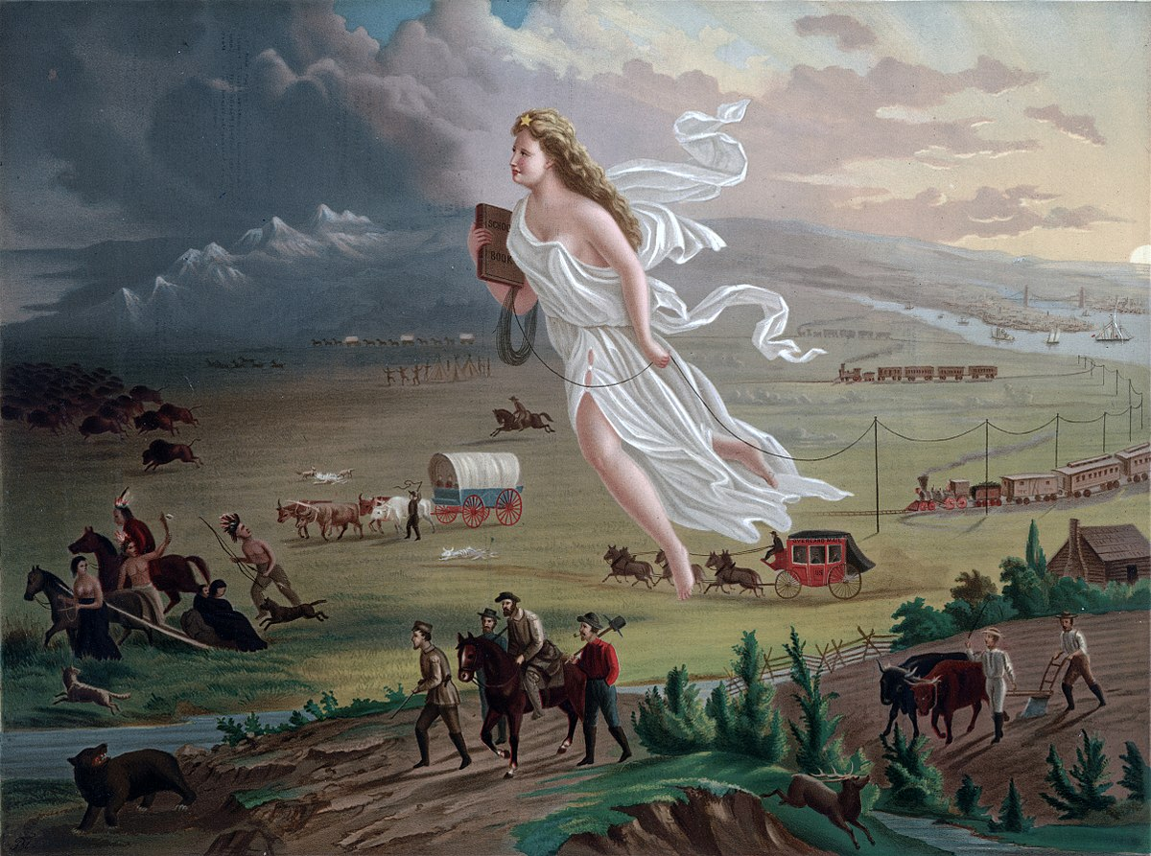
“File:American Progress.JPG.” Wikipedia Commons, Wikimedia Commons, the Free Media Repository, 27 May 2018, 12:40, commons.wikimedia.org/wiki/File:American_progress.JPG. Accessed 31 May 2018.

Slide 8
“File:American Progress.JPG.” Wikipedia Commons, Wikimedia Commons, the Free Media Repository, 27 May 2018, 12:40, commons.wikimedia.org/wiki/File:American_progress.JPG. Accessed 31 May 2018.
Manifest Destiny
Notes:
As an example of dominant narrative
Manifest Destiny held that the United States was destined—by God to expand its dominion and spread democracy and capitalism across the entire North American continent.
Instead of being taught as a prevailing belief, it was taught as fact.
Who does this narrative benefit? Who does it harm?
How is this narrative perpetuated?
How were you taught this narrative and by whom?

Slide 9


Works Cited
“Dominant Narratives.” Inclusive Teaching, University of Michigan, 24 Aug. 2017, sites.lsa.umich.edu/inclusive-teaching/2017/08/24/dominant-narratives/. Accessed 31 May 2018.
“File:American Progress.JPG.” Wikipedia Commons, Wikimedia Commons, the Free Media Repository, 27 May 2018, 12:40, commons.wikimedia.org/wiki/File:American_progress.JPG. Accessed 31 May 2018.
“Racial Literacy.” Wikipedia, Wikimedia Foundation, 10 June 2018,
en.wikipedia.org/wiki/Racial_literacy. Accessed 11 Jun 2018.
“Stages Of Freedom.” African American Culture for Everyone, Stages of Freedom, 2018,
www.stagesoffreedom.org/. Accessed 12 Jun 2018.
“Identify .” InfoRhode Tutorials Main Menu, University of Rhode Island , 2018, sakai.uri.edu/access/content/group/adeeb594-1c46-4add- a411c05d214d5582/inforhodeIDENTIFY/inforhodeIDENTIFY/multiscreen.html. Accessed 23 May 2018.
Vulchi, Priya, and Winona Guo. “What it takes to be racially literate.” TED Ideas worthspreading, November 2017, www.ted.com/talks/priya_vulchi_and_winona_guo_what_it_takes_to_be_racially_lit erate. Accessed 23 May 2018.
Vulchi, Priya, and Winona Guo. “What it takes to be racially literate.” TED Ideas worthspreading, November 2017, www.ted.com/talks/priya_vulchi_and_winona_guo_what_it_takes_to_be_racially_lit erate. Accessed 23 May 201

Slide 10
Theme: Dominant Narrative Possible topics:
Americans are losing jobs and benefits to illegal immigrants
Police are killing black people
Chinese can’t be trusted
Story Circle

Slide 11
Call To Action
University of Rhode Island Diversity Classes 2018
Stages Of Freedom
Stages Of Freedom
Our Mission:
1) To provide youth of color access to swimming programs in order to reduce the number of drownings in the minority community.
2) To build community by creating and providing programming about Black Rhode Island life and culture to a wide audience.
3) To educate and empower inner-city youth by providing cultural opportunities and access to museums and live performance.
GWS 386: The Economics of Race, Gender, and Class
LEC: (3 crs.) An economic examination of the historical interrelations of race, class, and gender issues. (Lec. 3) Pre: ECN 100 or 201 or permission of instructor.
GWS 387: Latin American History at the Movies
LEC: (3 crs.) Latin Americans see themselves very differently than how they are perceived by North Americans. Their self-portrayal, in literature and film, is the key to understanding their history and conflicts. (Lec. 3) Pre: HIS 180 is suggested but not required.

