Slide 1

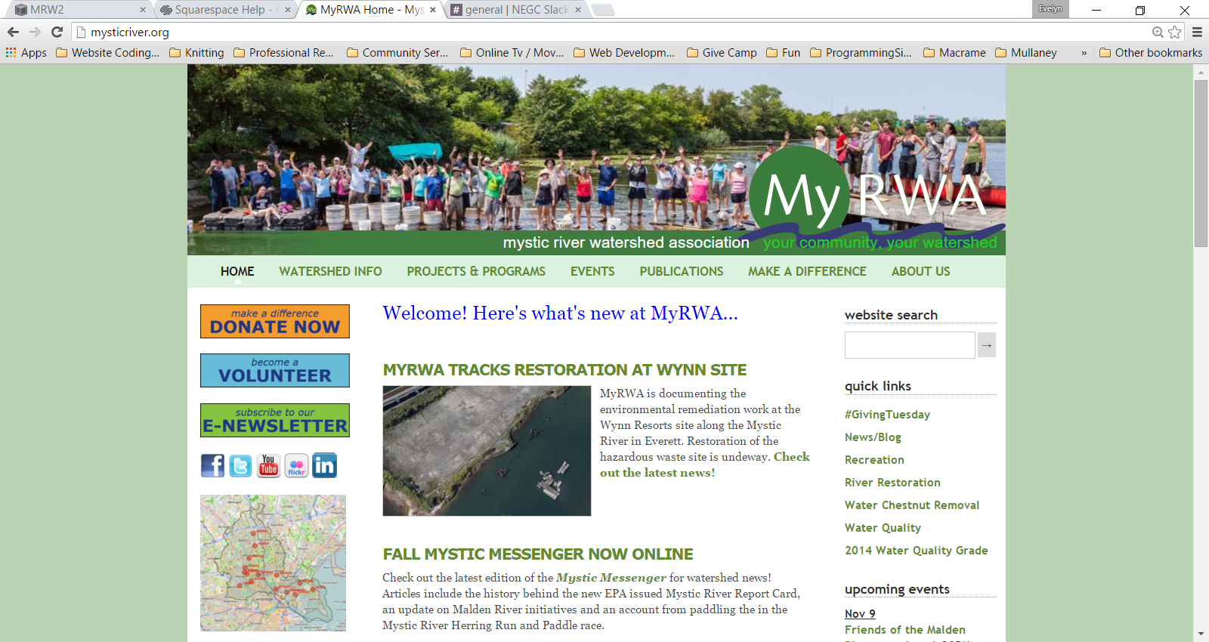
Mystic River Watershed

Slide 2

Site Redesign / Architecture
Sell ourselves - sell our brand
Explain WHAT we do better
“To protect and restore the Mystic River, its
tributaries and watershed lands for the
benefit of present and future generations
and to celebrate the value, importance
and great beauty of these natural resources.”
Take more credit for our work
Get people to take action

Slide 3
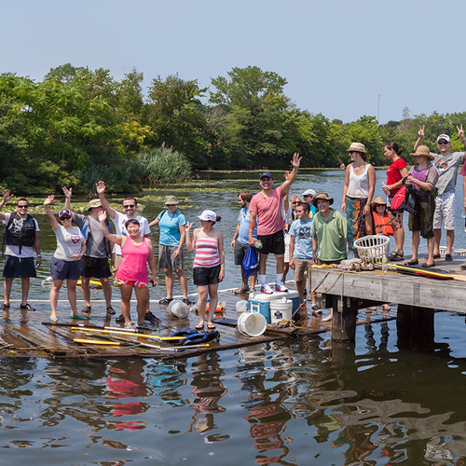

Slide 4

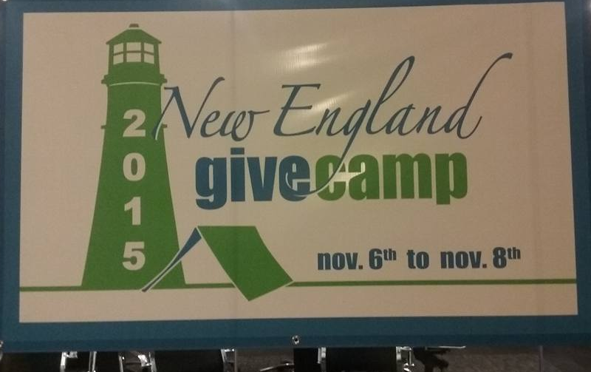
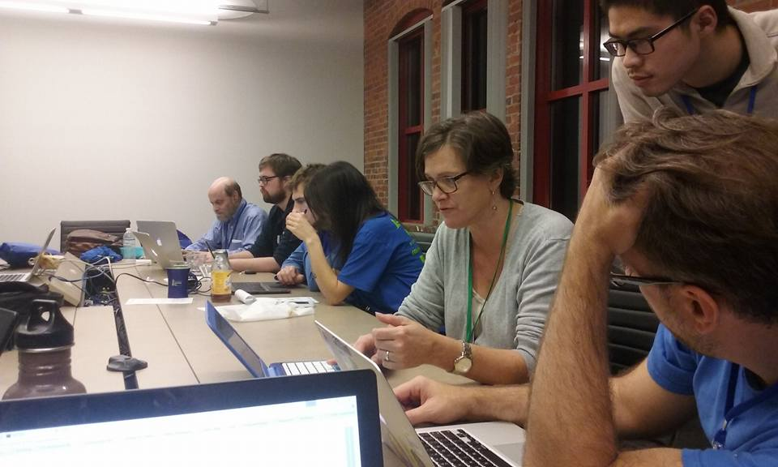
Thank You, Team Mystic River Watershed!

