Slide 1

Changes to web_app
MERN stack

Slide 2
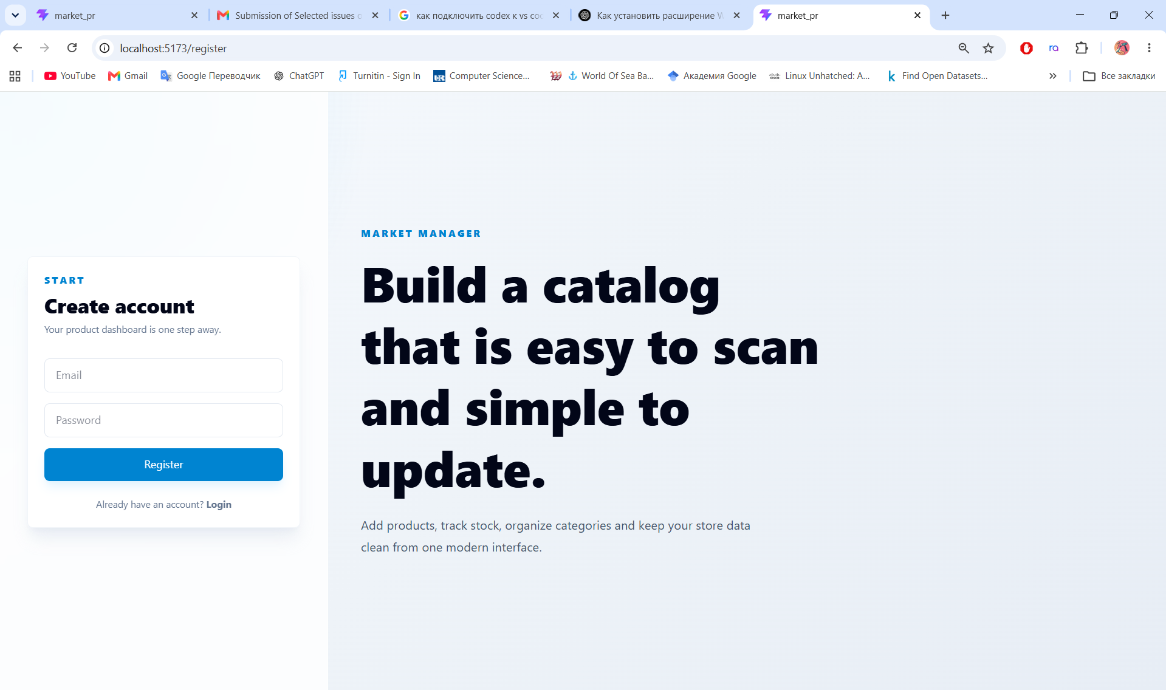
Registration

Slide 3
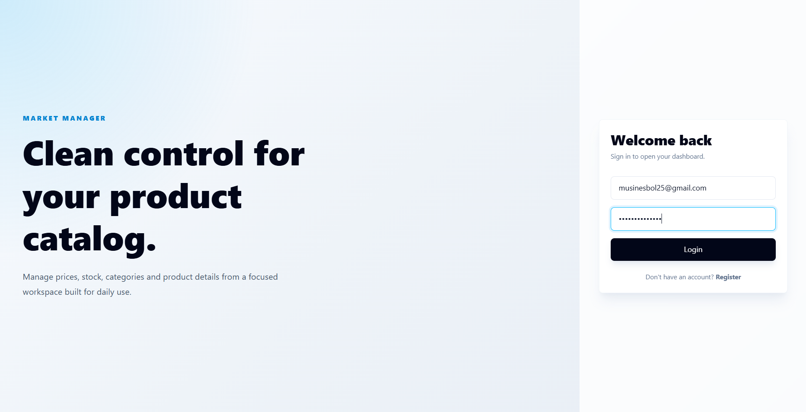
Auth

Slide 4
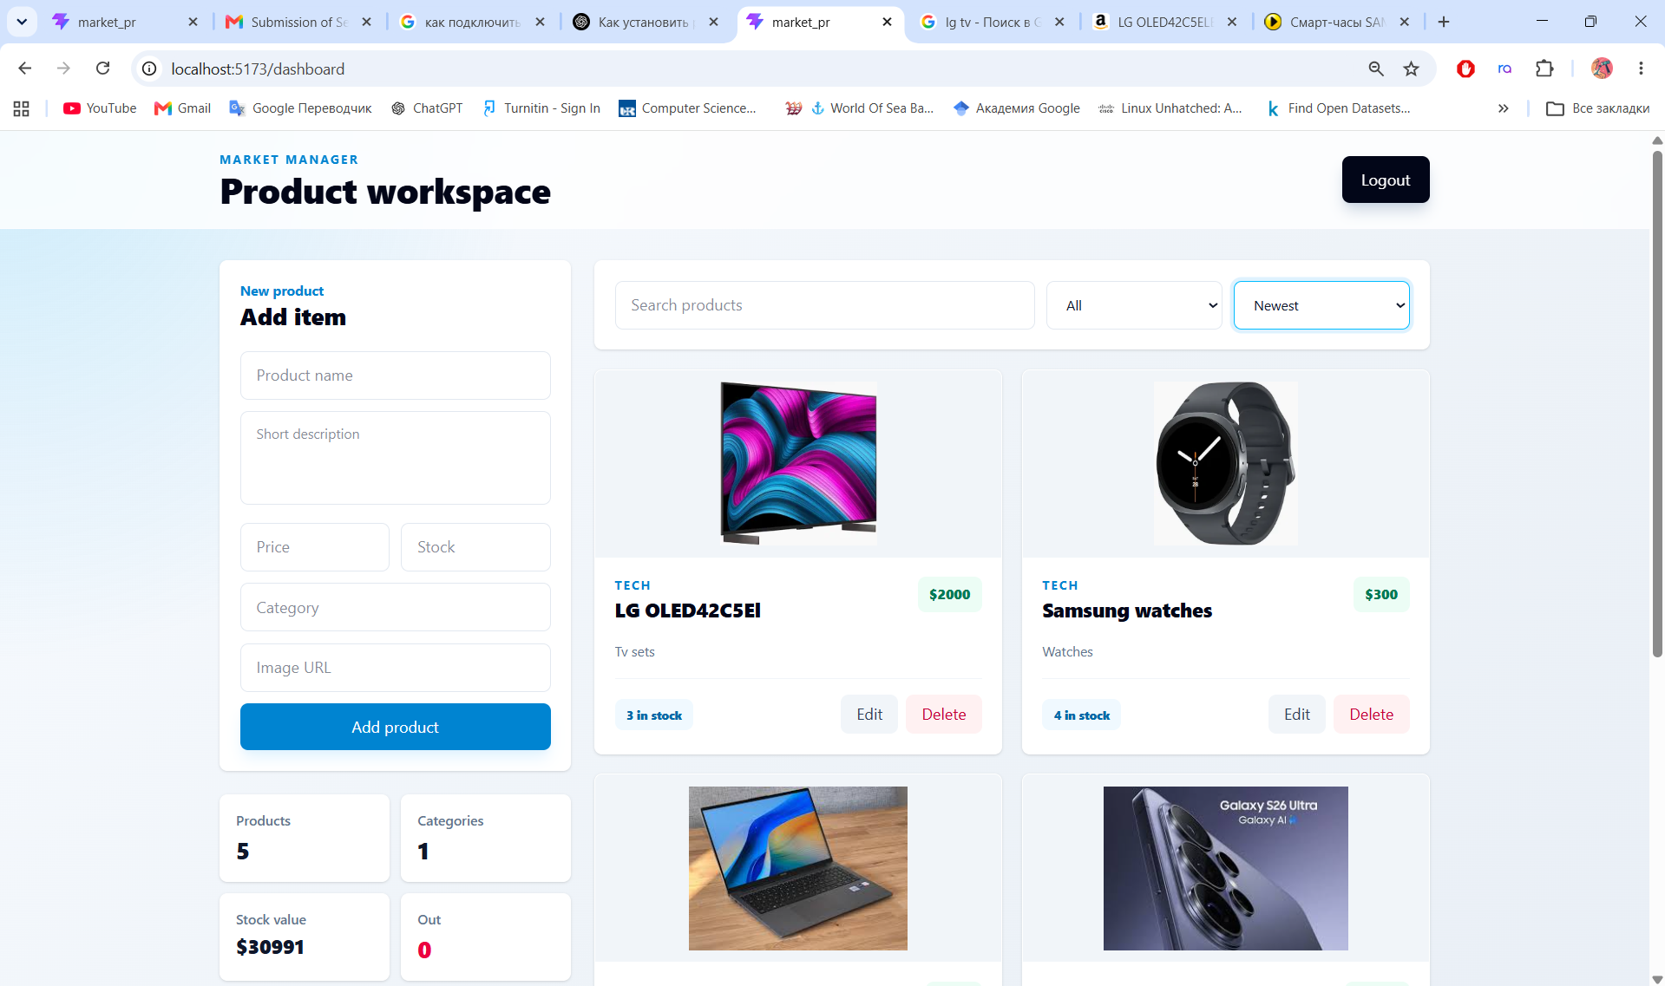
Dashboard(control sys)

Slide 5
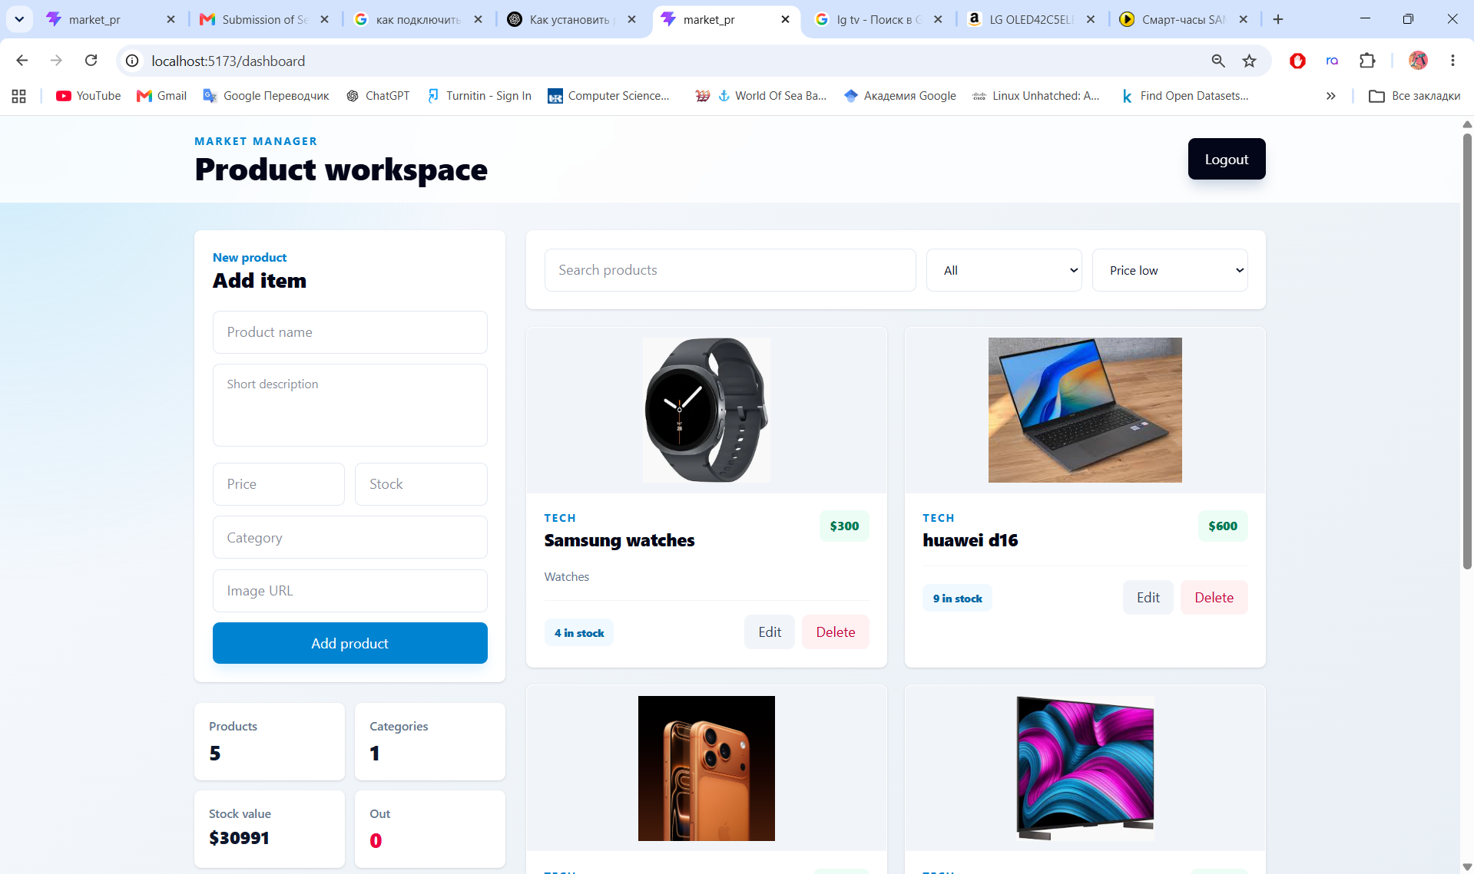
New filter

