Slide 1

Steam Game Success Predictor
KNN, SVM, Random Forest and Deep Learning
Author: Mussin Yesbol
Professor: Piotr Wozniak
Module: Machine learning in Python
Binary classification project based on Steam game data
Four trained models compared in one Streamlit deployment
Includes evaluation, cross-validation and documentation

Slide 2
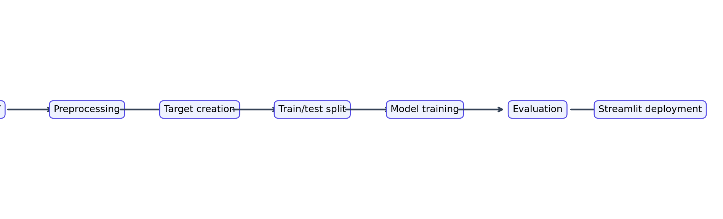
Project Goal
Predict whether a Steam game is successful or not successful
Use numerical features such as reviews, playtime, price and CCU
Compare classical ML models with a neural network
Deploy all models in a single interactive application

Slide 3

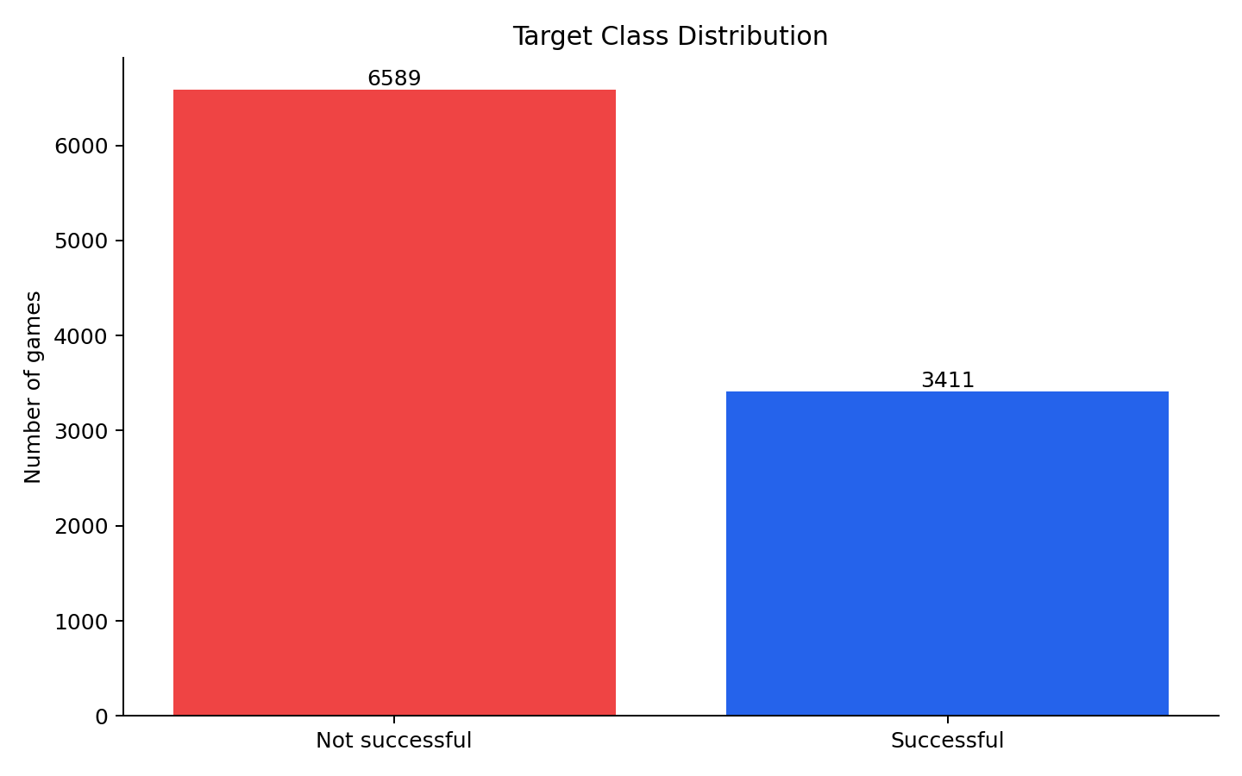
Dataset and Target Variable
Target variable: success
Success is based on rating ratio and concurrent user activity
Leakage columns are removed from improved models

Slide 4
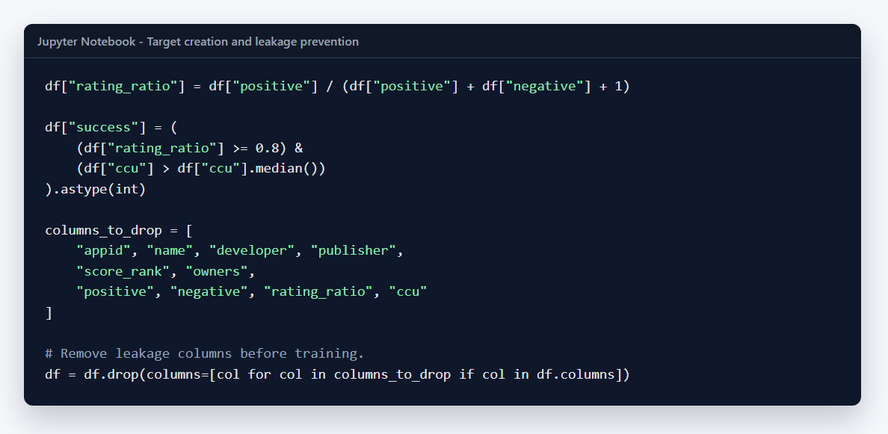
Preprocessing in Jupyter
Create rating_ratio and success
Remove text columns and leakage-related columns
Prepare final feature matrix for model training

Slide 5
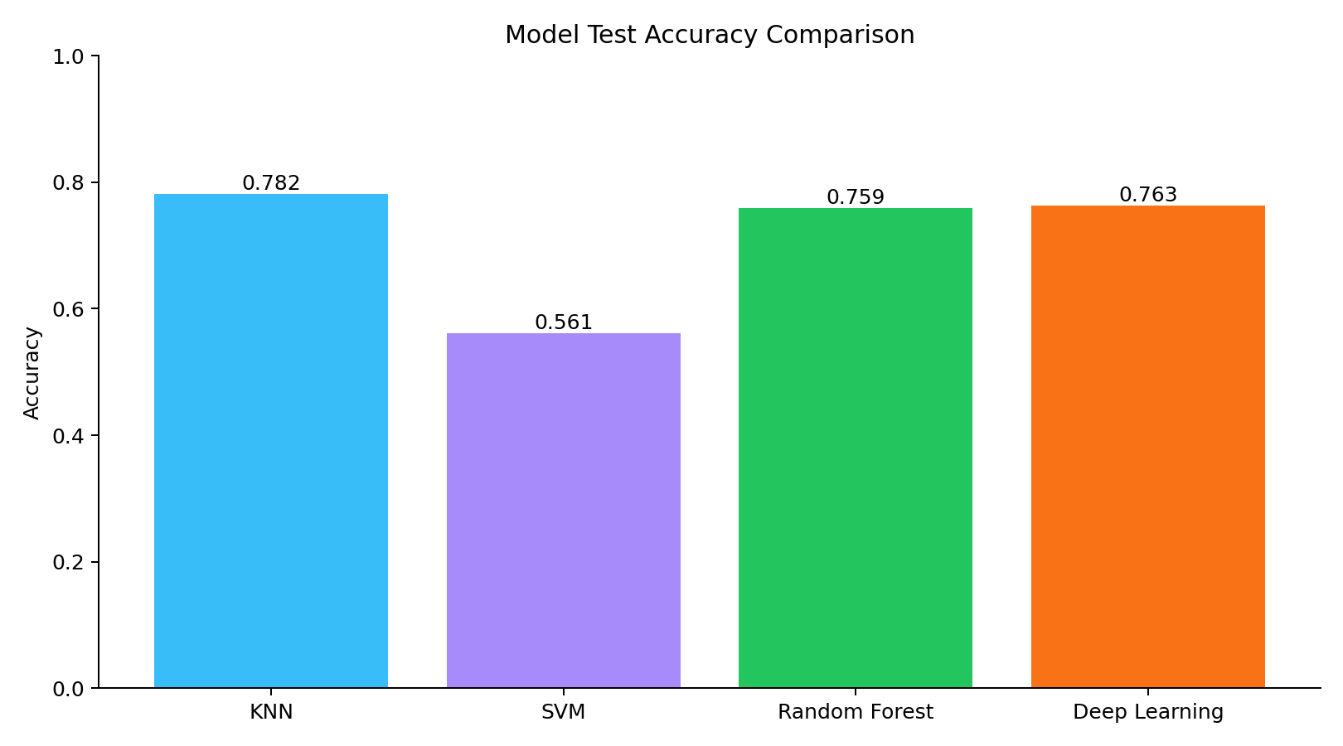
Implemented Models
KNN: distance-based baseline model
SVM: RBF kernel with balanced class weights
Random Forest: tree ensemble for tabular data
Deep Learning: dense neural network with sigmoid output

Slide 6
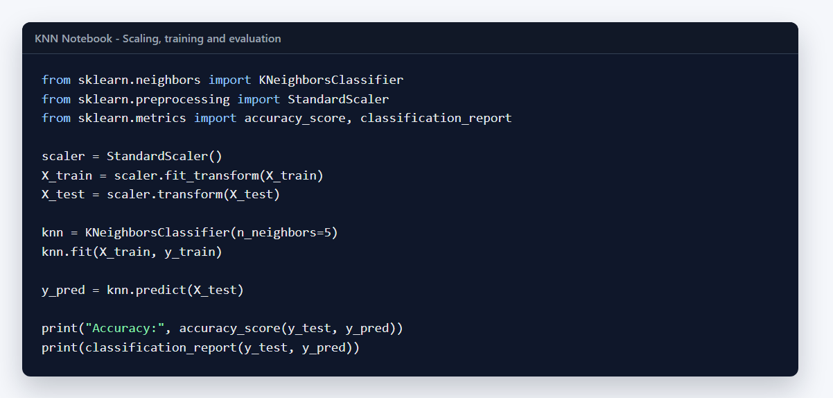
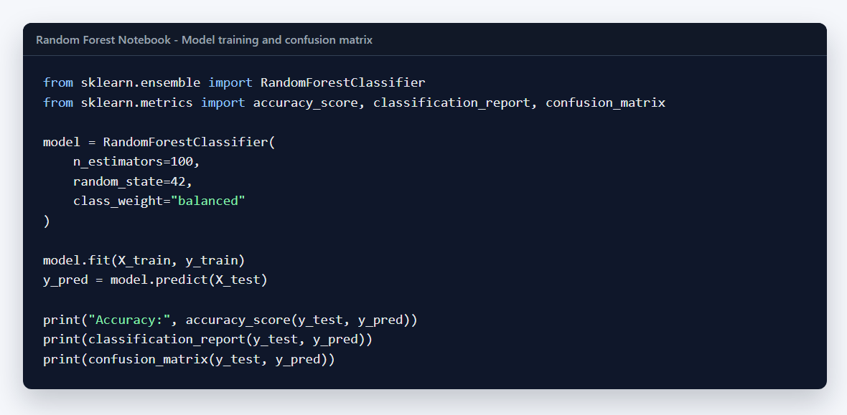
Classical ML Notebook Code
KNN and SVM use StandardScaler
Random Forest uses class_weight='balanced'
Models are evaluated with accuracy, classification report and confusion matrix

Slide 7
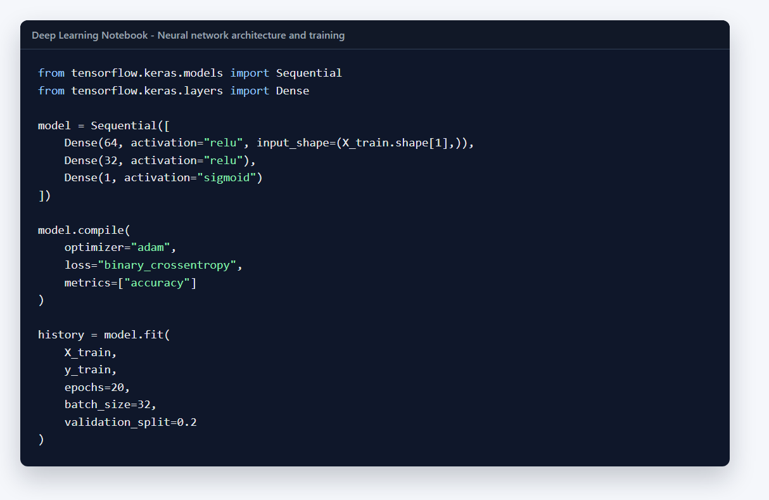
Deep Learning Model
Neural network built with TensorFlow/Keras
Dense layers with ReLU activations
Sigmoid output for binary classification

Slide 8
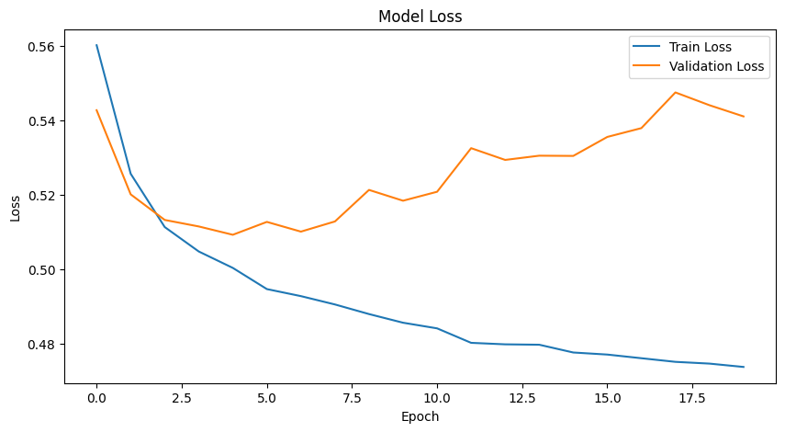
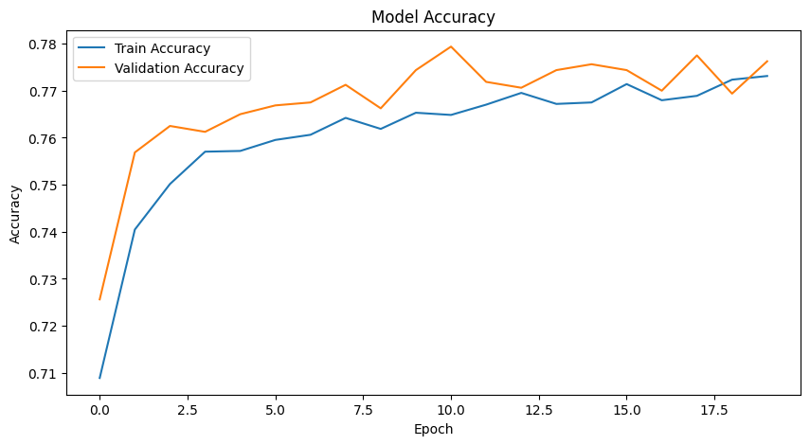
Deep Learning Training Curves
Accuracy increases during training
Validation loss suggests possible later overfitting
Final test accuracy is approximately 0.763

Slide 9
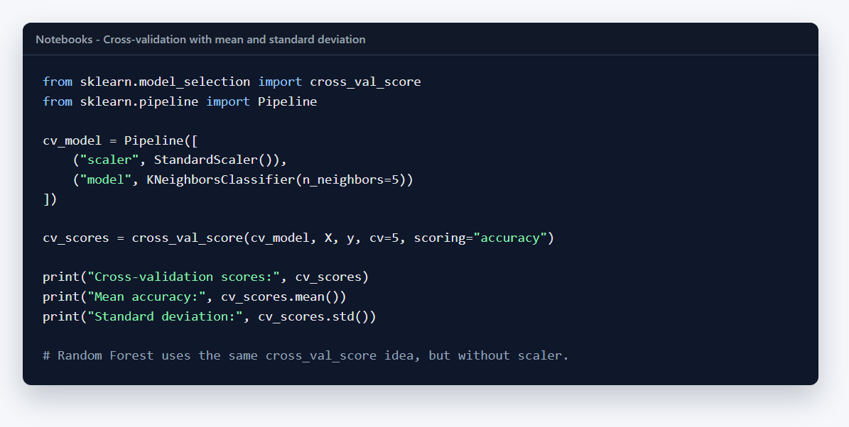
Cross-Validation
Added to KNN, SVM and Random Forest notebooks
Mean accuracy shows average model performance
Standard deviation shows model stability between folds
KNN and SVM use Pipeline to avoid scaling leakage

Slide 10
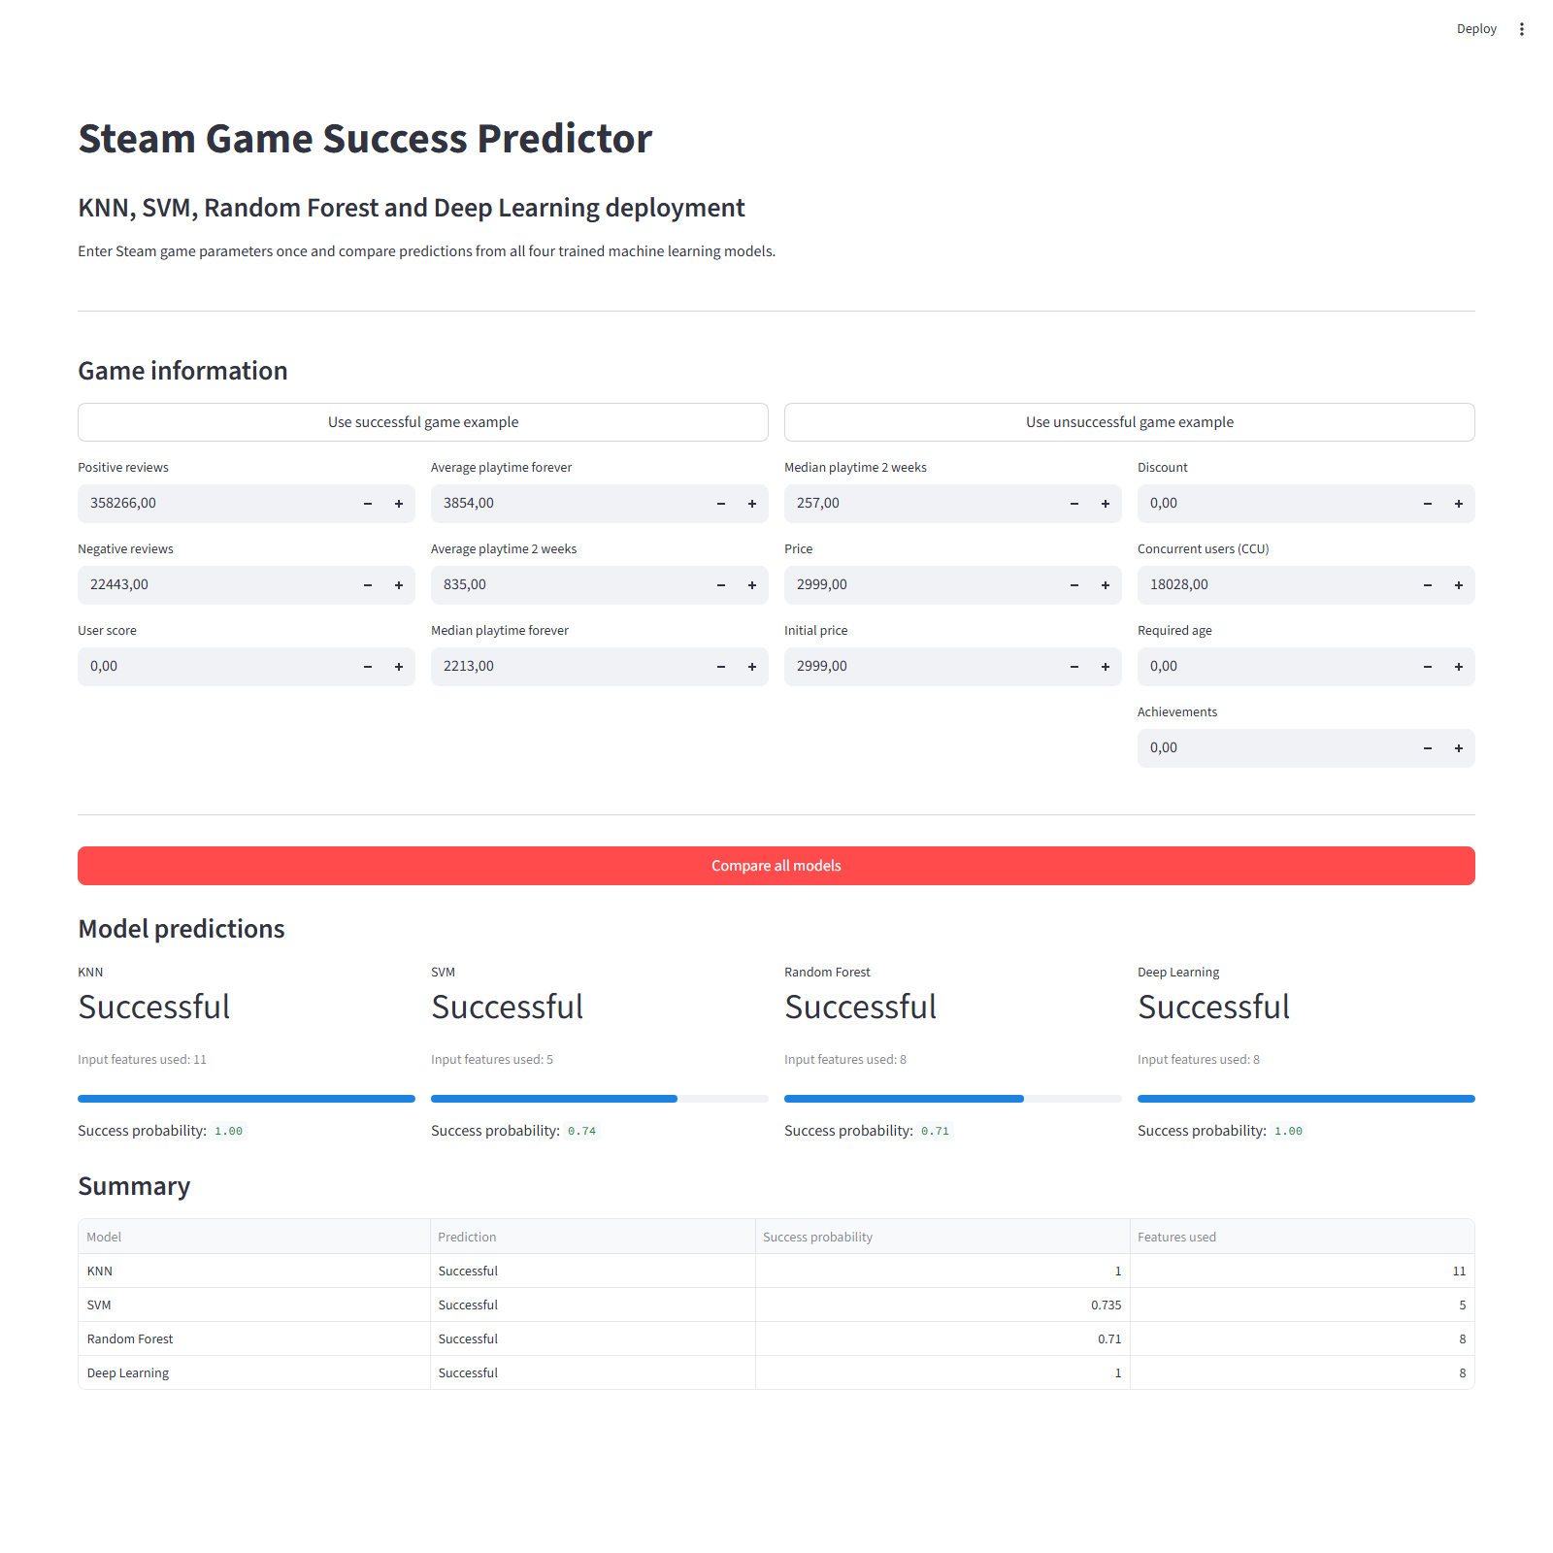
Combined Streamlit Deployment
Root app.py loads all four saved models
One input form is shared by all models
Results are shown side by side with probability or score

Slide 11
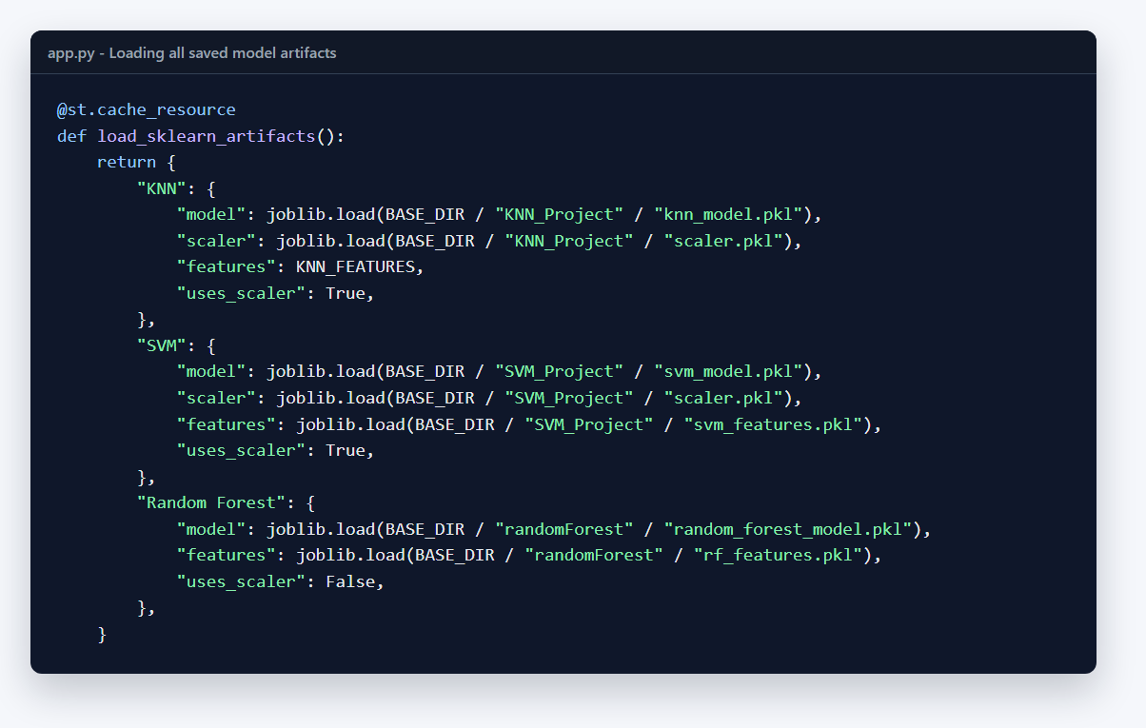
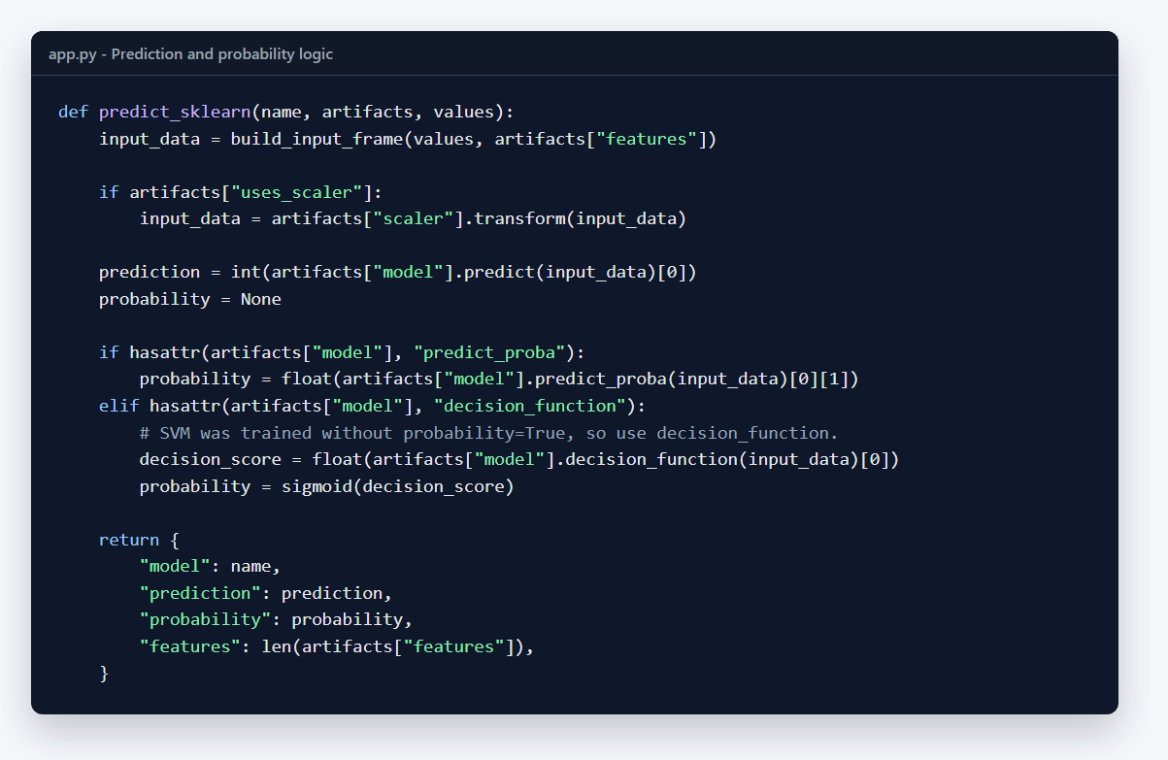
Deployment Code
Models and scalers are loaded from project folders
SVM uses decision_function because it was trained without probability=True
Preset buttons fill examples for successful and unsuccessful games

Slide 12

Limitations and Future Work
Success definition is an approximation, not real revenue
SVM probability should be calibrated by retraining with probability=True
Future work: GridSearchCV, ROC-AUC, more features, online deployment
Project demonstrates the full ML pipeline from data to deployment

Slide 13
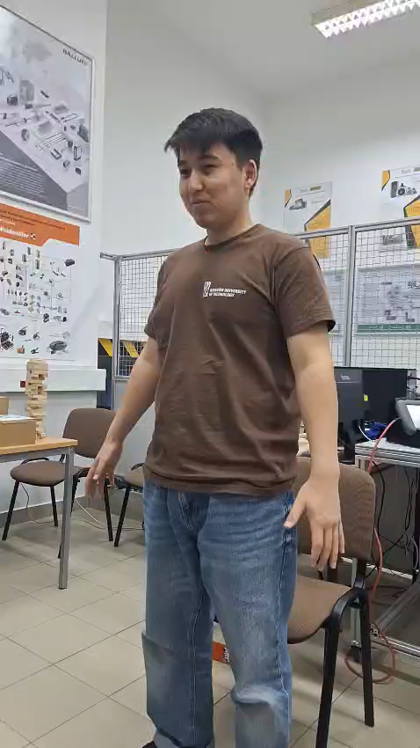

Video, can be seen after downloading the file from google drive
Thank You
It was pleasure for me working with nice people of RzIT and make a lot of projects together
P.S. Besides this project i really liked working on the PerfMon project and robot ALF I (Alf Pierwszy)

