Slide 1
DIALIGN
Finding local similarities by multiple sequence alignment
BERLIOZ Thomas
DIALIGN Thomas BERLIOZ

Slide 2
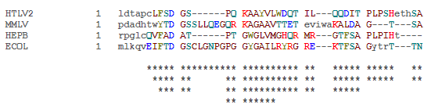
DIALIGN, what is it?
Algorithm that constructs alignments to compare whole segments of DNA or protein sequences instead of single nucleic or amino acids.
For instance, it will be able to compare similarities between those 4 sequences with no penalty for added gaps.
DIALIGN Thomas BERLIOZ

Slide 3

How does it work?
Two different parts
1 - Alignment
2 - Scoring
DIALIGN Thomas BERLIOZ

Slide 4
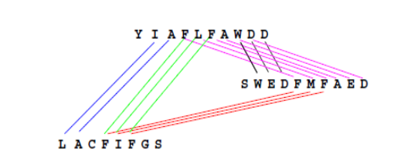
Alignment (1/2)
Step 1: Fragments detection
Fragments:
Common parts between 2 sequences
Each fragment has a weight (to rate its quality, length, …)
Will be used to build aligned sequences
Algorithm:
Build L the list of fragments pairs:
Iterate though each pair of sequences
Find the matching substrings
Evaluate each block one to associate a weight
Add it to L
DIALIGN Thomas BERLIOZ

Slide 5
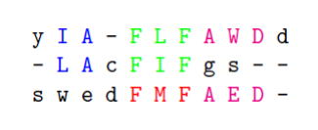
Alignment (2/2)
Step 2: Alignment build
Add fragments to alignment with a coherent order
Algorithm (original):
While L is not empty:
Add the fragment f with the highest value to the alignment
Delete all the fragments that are not compatible with f
Not compatible means it would create a conflict to add both
Algorithm (mine):
Sort fragments by weight in decreasing order
For each fragment:
If the fragment fits in alignment of both sequences:
Add it to both alignements
DIALIGN Thomas BERLIOZ

Slide 6

Scoring
Once the alignment is done, we can just iterate on the aligned sequences and rate each “column”
DIALIGN Thomas BERLIOZ

Slide 7

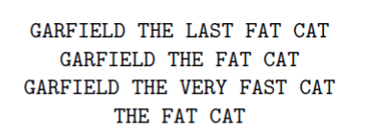
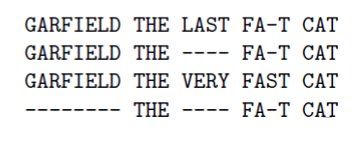
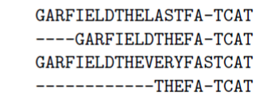
Concrete example
Input
Output (DIALIGN)
Output (CLUSTAL)
DIALIGN Thomas BERLIOZ

Slide 8
Thank you for your attention
Code browsing and demo time!
Any questions?
DIALIGN Thomas BERLIOZ

