Slide 1

LSE Winter Days
Nov. 6/7 2021
Blind Date,
a journey into Blind ROP exploitation technique
Thomas Berlioz

Slide 2

The challenge
Blind Date
The LSE intern from Summer 2019 coded an online service to welcome new lab’ students. Legend says he hid a flag on the machine running the service… Prove the old heads you deserve your place by compromising the server using the remote service only.
Originally a challenge from FCSC 2021
No access to source code nor the compiled binary
We want to get a shell on the server

Slide 3
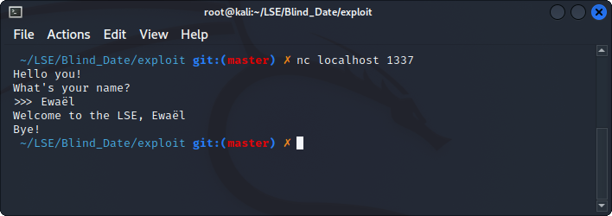
Understanding the service
[DEMO SERVICE]
Looks like an echo server, 2 possible vulnerabilities:
format string attack
buffer overflow

Slide 4
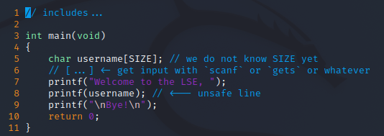
A format string bug?
Well known vulnerability occurring with an unsafe usage of a printf function supporting formatting
The code would look like this:

Slide 5
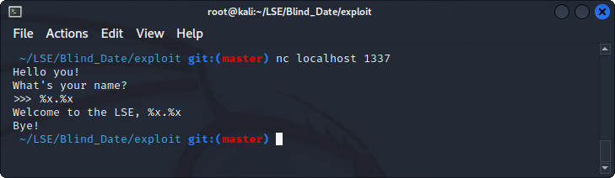
More like a buffer overflow…
We can easily test by sending a formatting string which would leak the stack if there was an vulnerable printf call
[DEMO FMT]
Not a format string attack! Let’s check the overflow…

Slide 6
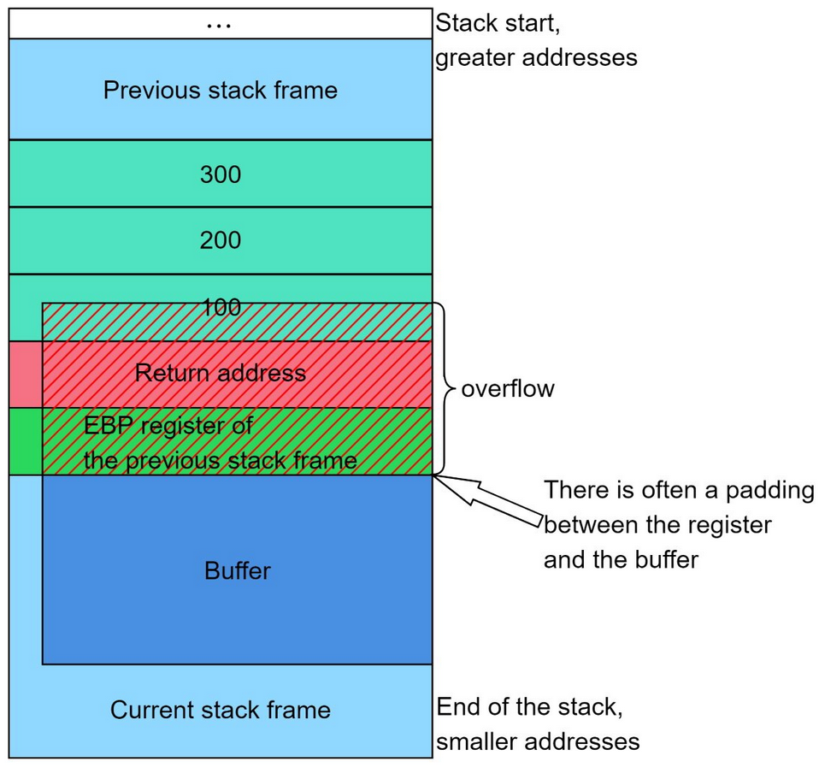
What’s a stack buffer overflow?
Occurs when we do not check if the user input fits in the buffer it went in
If there is no protection such as canary, we can overwrite data behind the buffer
It means that we can take control of execution flow because the return address we jump on is located on the stack
RET is equivalent to POP RIP

Slide 7
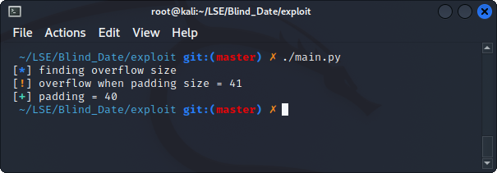
Recon
Increment input size until program crashes
Check the protections:
on the binary (PIE, canary)
on the server (ASLR)
[DEMO PADDING + DEMO LEAKADDR]
Program crashes after 40 bytes
= (probably stack) buffer overflow

Slide 8
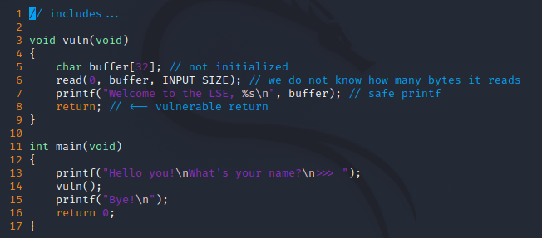
Recap
x86-64 addresses = 64-bit executable running
We always leak the same bytes which looks like an address:
PIE off
no canary
The stack addresses are randomized = ASLR on
Crash after 40 bytes, trash in buffer = char buffer[32];
Does not print “ Bye! ” when it crashes = intermediate function
Ok cool bro, but what’s next?

Slide 9
Return Oriented Programming
Once we control the execution flow = we control RIP
Use gadgets to execute instructions sequences from the binary itself and jump somewhere else using RET
We control the stack values with the stack buffer overflow!
For instance, this gadgets allows the attacker to control RDI, which is the first argument in the x64 calling convention.

Slide 10
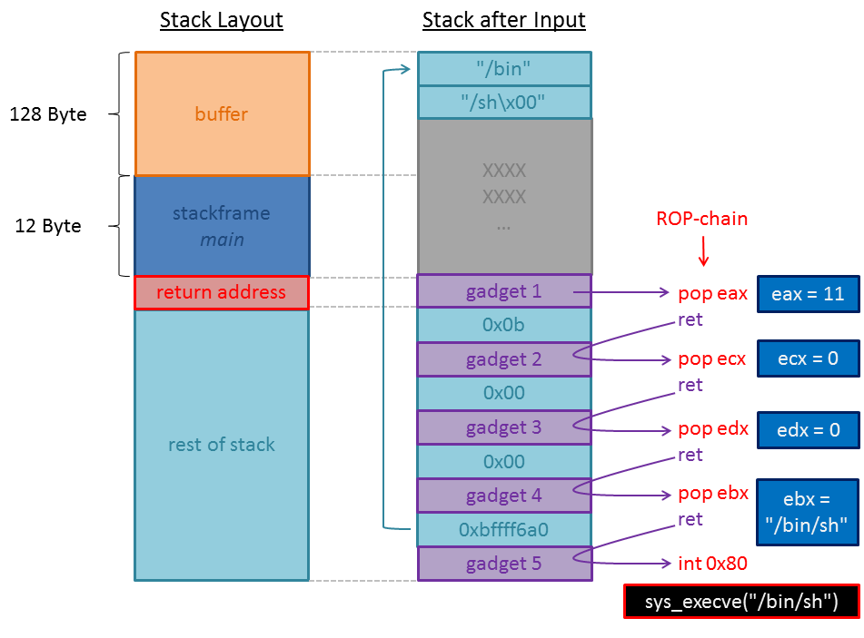
A visual representation
Ok cool bro, but...
We can’t locate the gadgets without the binary!

Slide 11
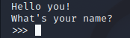
The stop gadget
Most important gadget!
Essential to confirm we regain execution flow control during each step
In our case, we expect that there’s an address that, if we jump on it, produces the following output:
How do we find it?
we fill the buffer and RBP
then we overwrite the return address with an address X from the binary
we loop until the address X produces the expected output (called reference)
Be careful, several addresses could produce this output!

Slide 12
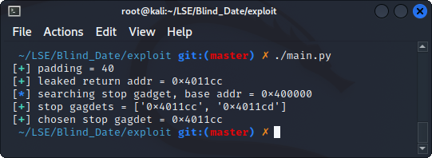
The stop gadget
[DEMO STOP GADGET]
We know that, if we trigger the reference used for this stop gadget, it means we hit one of those addresses
We have a reliable way to know when we control RIP!

Slide 13
The BROP gadget

