Slide 1

LSE Winter Days
Nov. 6/7 2021
Blind Date,
a journey into Blind ROP exploitation technique
Thomas Berlioz

Slide 2

The challenge
Blind Date
The LSE intern from Summer 2019 coded an online service to welcome new lab’ students. Legend says he hid a flag on the machine running the service… Prove the old heads you deserve your place by compromising the server using the remote service only.
Originally a challenge from FCSC 2021
No access to source code nor the compiled binary
We want to get a shell on the server

Slide 3
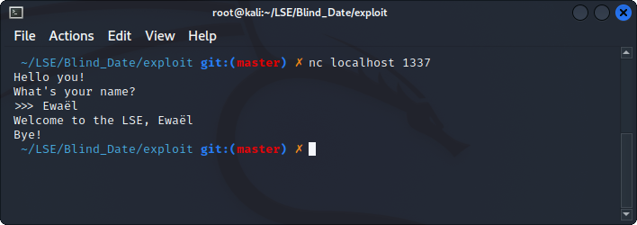
Recon
Looks like an echo server, 2 possible vulnerabilities:
format string attack
buffer overflow

Slide 4
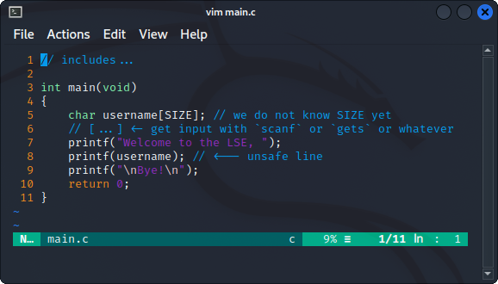
A format string bug?
Well known vulnerability occurring with an unsafe usage of a printf function supporting formatting
The code would look like this:

