Slide 1

LSE Winter Days
Nov. 6/7 2021
Blind Date,
a journey into Blind ROP exploitation technique
Thomas Berlioz

Slide 2

The challenge
Blind Date
The LSE intern from Summer 2019 coded an online service to welcome new lab’ students. Legend says he hid a flag on the machine running the service… Prove the old heads you deserve your place by compromising the server using the remote service only.
Originally a challenge from FCSC 2021
No access to source code nor the compiled binary
We want to get a shell on the server

Slide 3
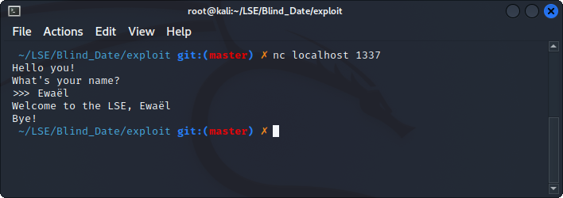
Understanding the service
[DEMO SERVICE]
Looks like an echo server, 2 possible vulnerabilities:
format string attack
buffer overflow

Slide 4
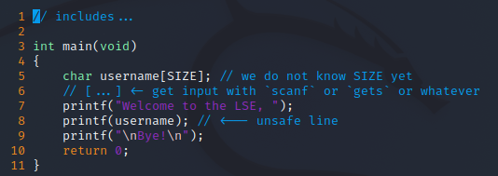
A format string bug?
Well known vulnerability occurring with an unsafe usage of a printf function supporting formatting
The code would look like this:

Slide 5
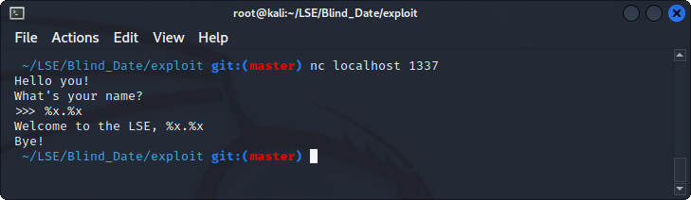
More like a buffer overflow…
We can easily test by sending a formatting string which would leak the stack if there was an vulnerable printf call
[DEMO FMT]
Not a format string attack! Let’s check the overflow…

Slide 6
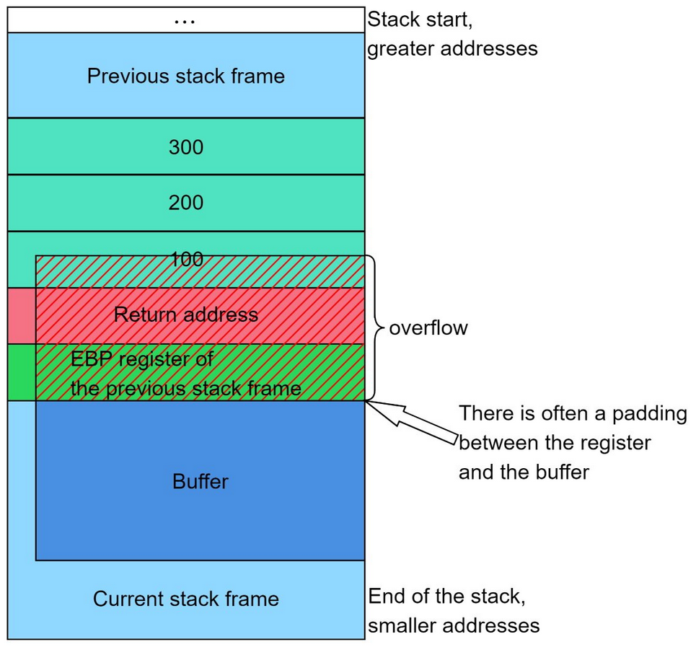
What’s a stack buffer overflow?
Occurs when we do not check if the user input fits in the buffer it went in
If there is no protection such as canary, we can overwrite data behind the buffer
It means that we can take control of execution flow because the return address we jump on is located on the stack
RET is equivalent to POP RIP

Slide 7
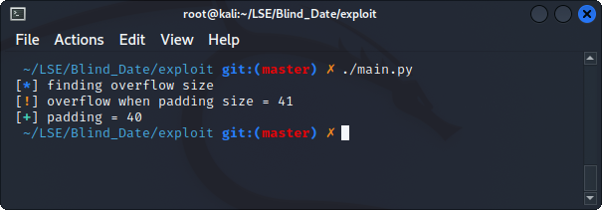
Recon
Increment input size until program crashes
Check the protections:
on the binary (PIE, canary)
on the server (ASLR)
[DEMO PADDING + DEMO LEAKADDR]
Program crashes after 40 bytes
= (probably stack) buffer overflow

Slide 8
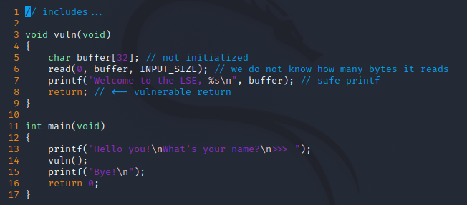
Recap
x86-64 addresses = 64-bit executable running
We always leak the same bytes which looks like an address:
PIE off
no canary
The stack addresses are randomized = ASLR on
Crash after 40 bytes, trash in buffer = char buffer[32];
Does not print “ Bye! ” when it crashes = intermediate function
Ok cool bro, so what?

Slide 9
Return Oriented Programming
Once we control the execution flow = we control RIP
Use gadgets to execute instructions sequences from the binary itself and jump somewhere else using ret instruction
We control the stack values with the stack buffer overflow!
For instance, this gadget allows the attacker to control RDI, which is the first argument in the x64 calling convention.

Slide 10
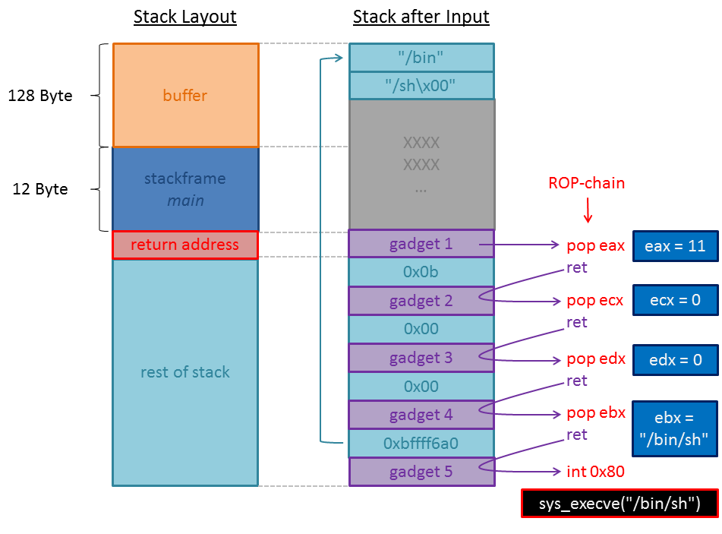
A visual representation
Ok cool bro, but...
We can’t locate the gadgets without the binary!

Slide 11
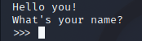
The stop gadget
Most important gadget
Essential to confirm we regain execution flow control during each step
In our case, we expect that there’s an address that, if we jump on it, produces the following output:
How do we find it?
we fill the buffer and RBP
then we overwrite the return address with an address X from the binary
we loop until the address X produces the expected output (called reference)
Be careful, several addresses could produce this output!

Slide 12
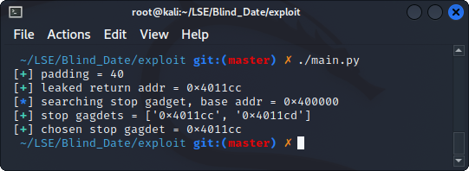
The stop gadget
[DEMO STOP GADGET]
We know that, if we trigger the reference used for this stop gadget, it means we hit one of those addresses
We have a reliable way to know when we control RIP!

Slide 13
The attack plan
ASLR on:
leak a libc address
find the libc version
get offsets for `/bin/sh` string and system function
system(“/bin/sh”)
We need to control the first argument = RDI in x64 calling convention
Ok cool bro… But we still have no clue which gadgets we can find in the binary… Do we?

Slide 14
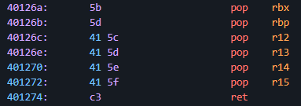
The BROP gadget
The ultimate gadget
Almost all binaries have it because it’s located at the end of `__libc_csu_init` which is part of the libc startup routine
Easy to spot as it pops 6 values from the stack = very unlikely to get a false positive
Ok cool bro… But we can’t control RDI with it

Slide 15

PWN IS AWESOME
What if we jump on 0x401273... ?
We get a new gadget inside the BROP gadget!

Slide 16
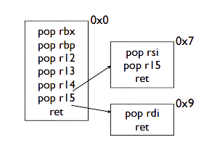
Recap
To find it:
overwrite RIP with the address we increment at each loop
followed by 6 trash addresses that should be popped into RBX, RBP, R12, R13, R14 and R15 if the address is the right one
followed by our stop gadget loaded into RIP by the last `ret`
if the address is the good one, we will get our reference in the output!
Finding the BROP gadget means being able to control RDI and RSI = two first arguments of a function

Slide 17
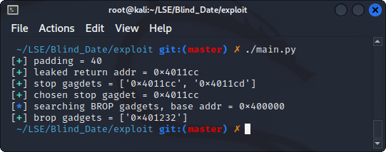
Let the hunt begin…
[DEMO BROP GADGET]
No false positive!
We can now control registers!

Slide 18
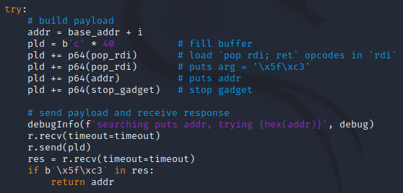
Here comes puts
Quick reminder: we need to leak an address from the GOT to identify the libc
Problem: we have no idea where the relocation table is located in the binary, and even if we knew it, we would have no idea which symbol we leak
Solution: we control at least 2 arguments, we know puts is used, let’s try to leak its address in order to print whatever we want next!

Slide 19
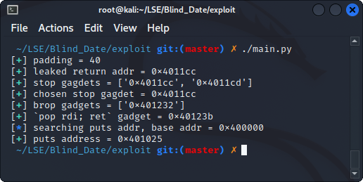
Getting puts address
[DEMO PUTS ADDRESS]
We can now call puts with any argument we want!
We can leak the whole binary to find interesting addresses!

Slide 20
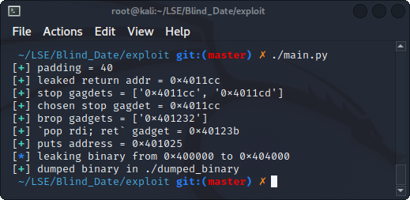
Leaking the ELF
Loop over the whole ELF addresses and call puts with the address
Parse the output to get the leaked data
No data means a null byte at this address
Actually a very simple part:
we can call puts
with any argument we want
[DEMO BINARY LEAK]

Slide 21
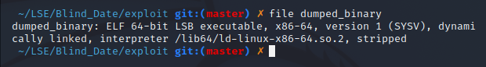
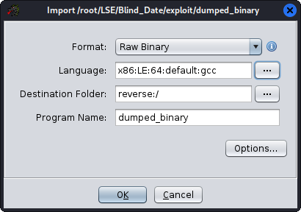
Let’s analyze it!
we correctly dumped the ELF
Load binary into Ghidra:
Identify functions
Find puts call
Find puts GOT entry

Slide 22
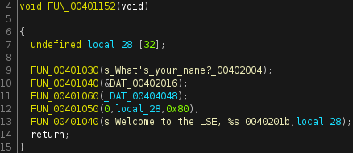
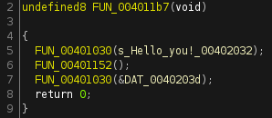
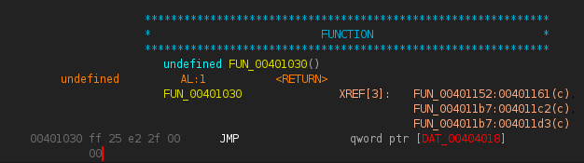
Dissect the binary
[DEMO GHIDRA]
puts GOT entry!
We could do the same with printf

Slide 23
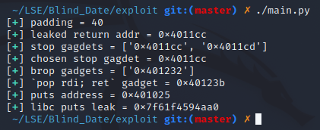

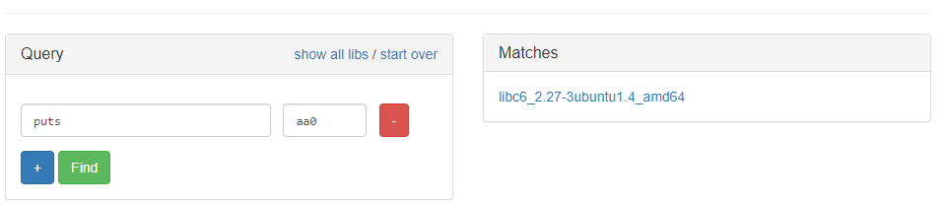
Leaking the LIBC
For the functions we know (puts / printf):
call puts(function_got) and return on main to flush stdout
the output will be the function address in the libc
then use libc.blukat.me to deduce the libc version
[DEMO LIBC LEAK]

Slide 24

The final strike
Compute the libc base
Compute the interesting functions addresses
We can FINALLY call system(“/bin/sh”) !

Slide 25
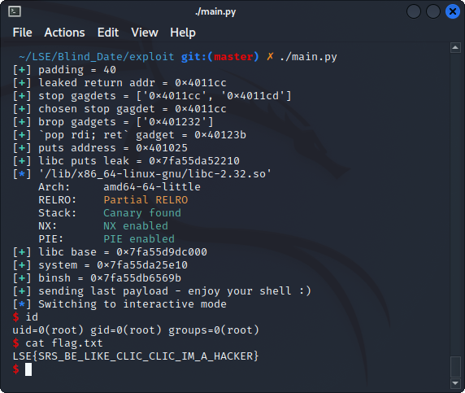
I am (g)root
[DEMO FULL EXPLOIT]

Slide 26
Blind Date,
a journey into Blind ROP exploitation technique
LSE Winter Days
Nov. 6/7 2021
Thomas Berlioz
La root est longue mais la voie est libre
All files (including original challenge) are available on github.com/Ewael/LSE
Thank you for your attention, any question?

