Slide 1



Understanding the information content in diverse observations of forest carbon stocks and fluxes for data assimilation and ecological modelling
NERC CASE partnership with Forest Research
Ewan Pinnington
Supervised by Dr. Tristan Quaife, Dr. Sarah Dance, Dr. Amos Lawless, Prof. Nancy Nichols and Dr. James Morison

Slide 2
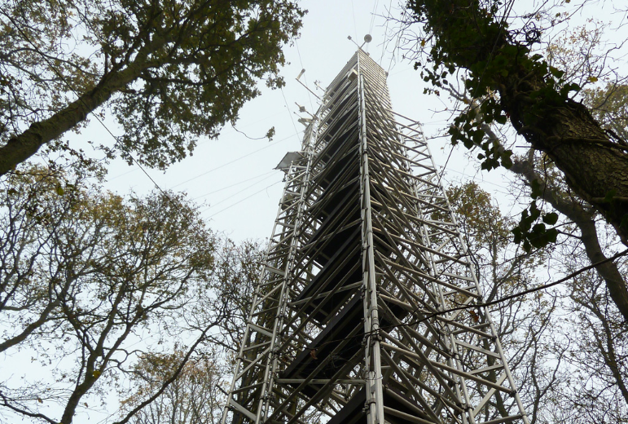
Project overview
Lack of understanding of the optimal set of observations for understanding the carbon balance of a forest.
CASE partner: Climate Change Group at Forest Research.
Working with Forest Research to help devise tools to plan measurement campaigns.
Flux tower at Forest Research site, Alice Holt.

Slide 3
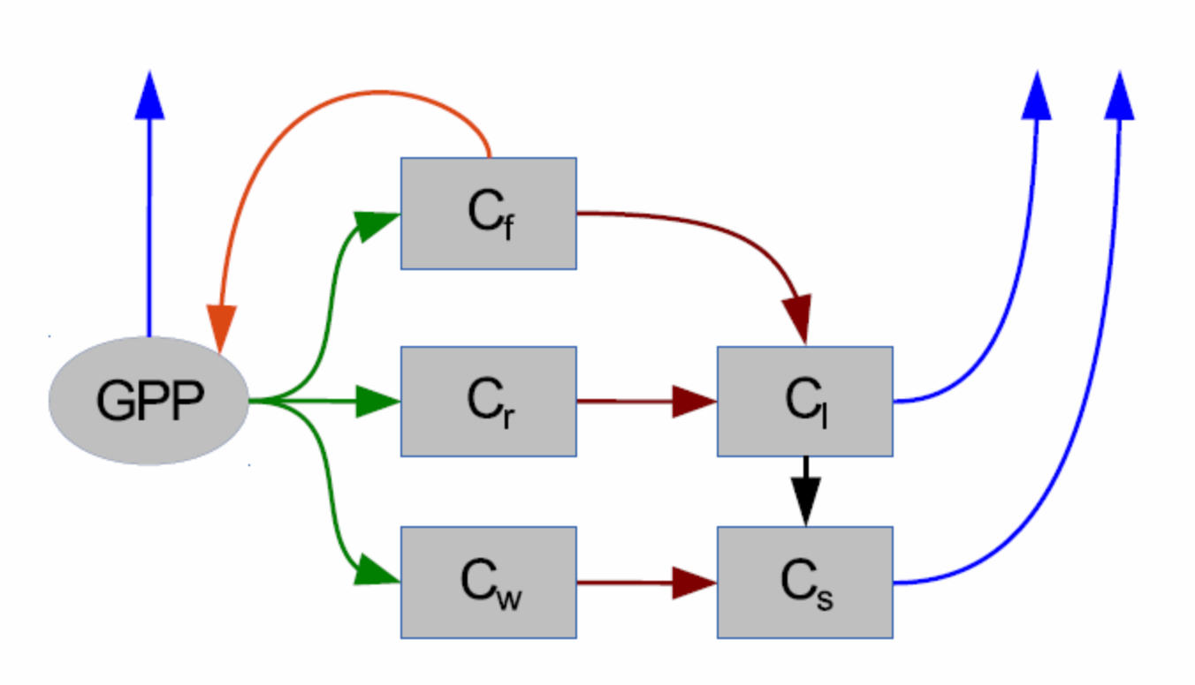
Science behind project
Using DALEC as a simple model of carbon balance to interpret observations.
DALEC captures the main processes that describe the carbon balance of a forest.
DALEC forest carbon balance model [1].

Slide 4
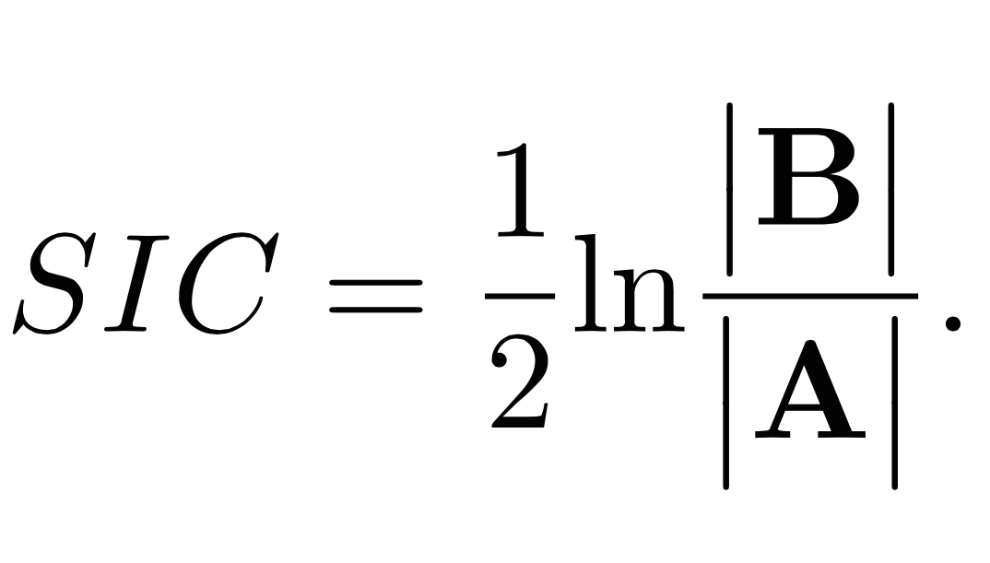
Science behind project
Shannon Information Content (SIC) [2].
B represents uncertainty in the model, A represents the uncertainty in our model after observations have been assimilated.

Slide 5
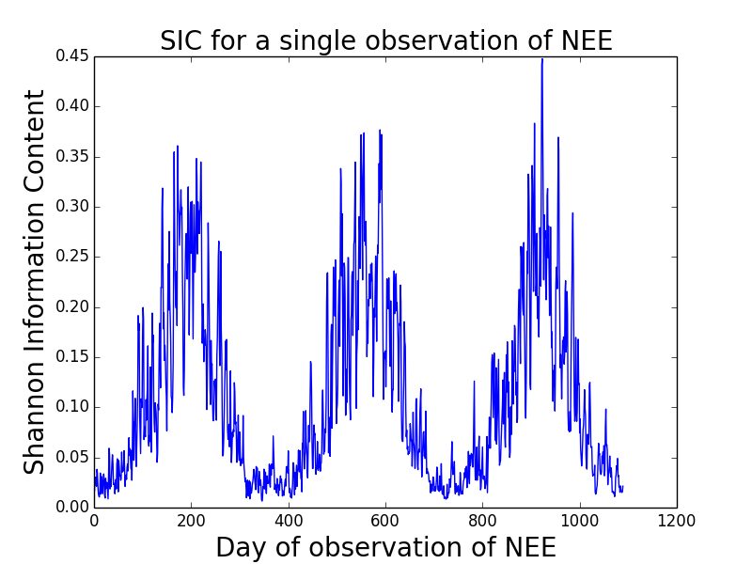
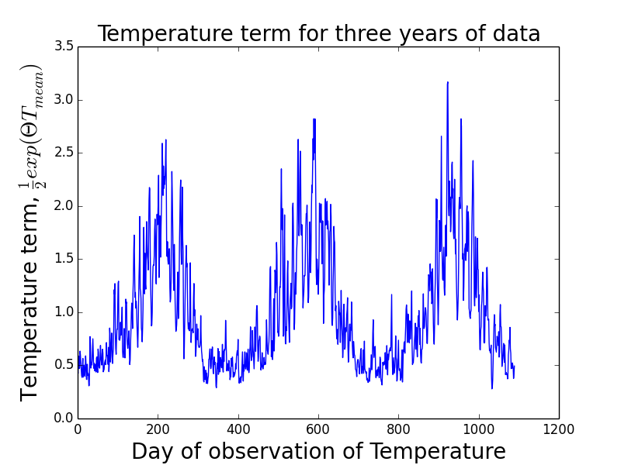
(Left) SIC for three years of NEE observations, (Right) value of DALEC temperature term for the same data.

Slide 6
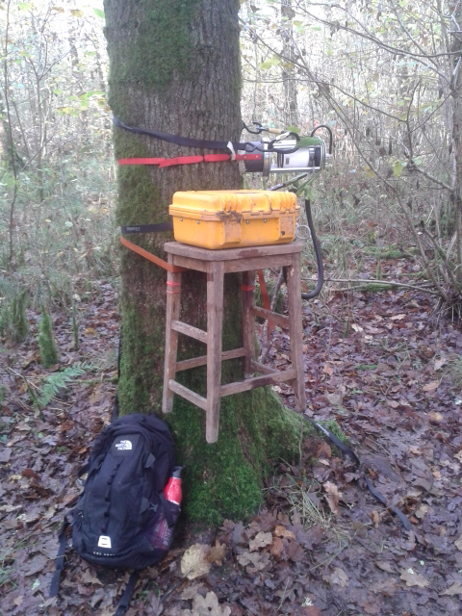
Experience with Forest Research
Spend one day a week at Forest Research.
Collecting measurements that form part of a pre-existing measurement campaign.
Learning relevant skills for PhD and helping Forest Research with measurements they require.
Tree chamber at Alice Holt.

Slide 7
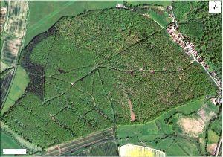
Future Plans
Implementing fieldwork campaign designed using modelling and mathematical work.
Outputs will be scientific papers written with the partner and a software tool that will allow Forest Research to assess the value of introducing new observations into their existing data streams.
Straits Inclosure, CO2 flux measurement site, Alice Holt

Slide 8
References
Sylvain Delahaies, Ian Roulstone, and Nancy Nichols. A regularization of the carbon cycle data-fusion problem. In EGU General Assembly Conference Abstracts, volume 15, page 4087, 2013.
Clive D Rodgers and Others. Inverse methods for atmospheric sounding: Theory and practice, volume 2. World scientific Singapore, 2000.

Slide 9
