Slide 1

Scalable hydrogen Storage technology
Ewan Matheson

Slide 2
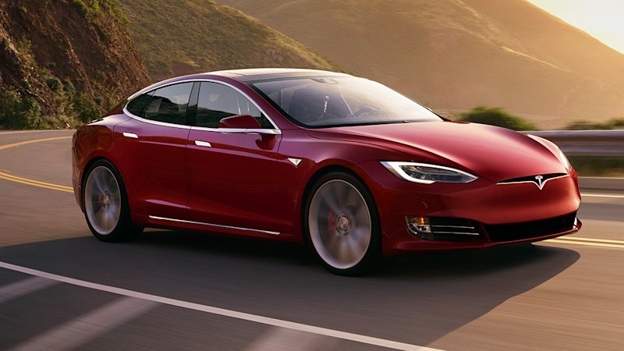
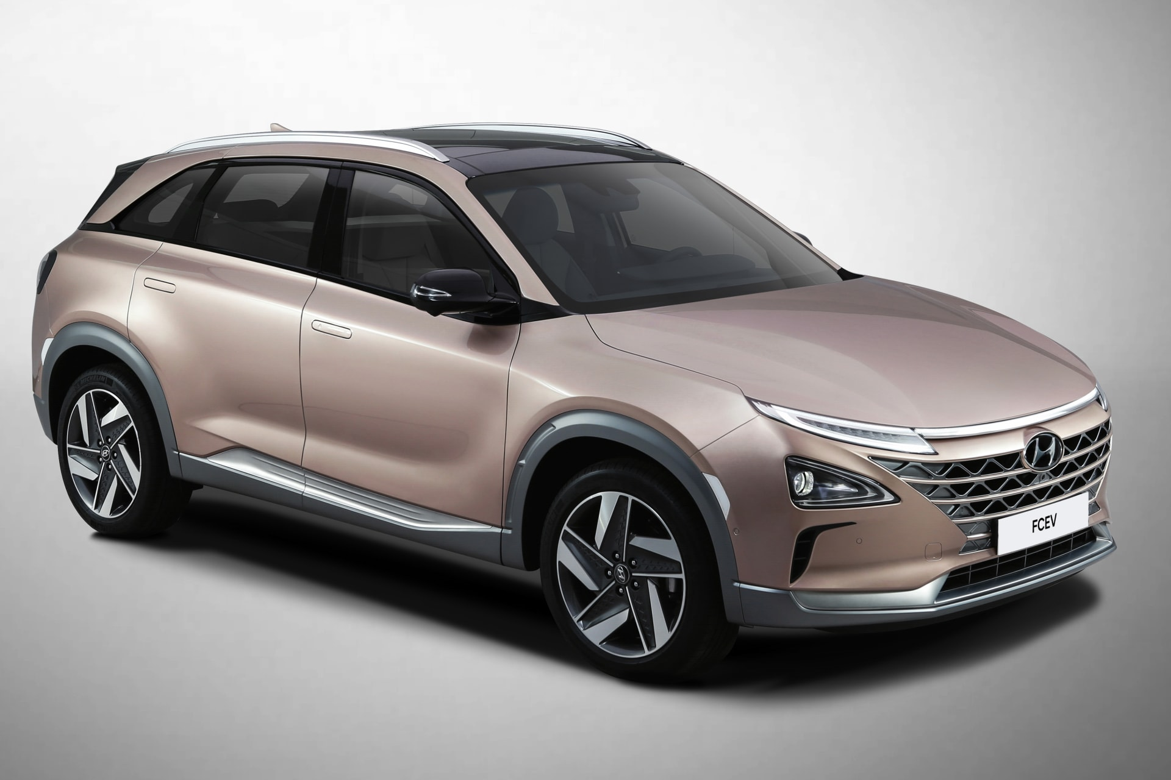
Zero emission Vehicles
Up to 100kWh battery (400V).
Vehicle weighs 2,250kg.
Charge time up to 7 hours (down to 42 mins fast charge).
Range up to 379 miles.
Vehicle weighs 2,340kg.
Capacity 156.6L.
Charge time up to 5 mins.
Range up to 414 miles.
£70,000 – £80,000
£68,856

Slide 3
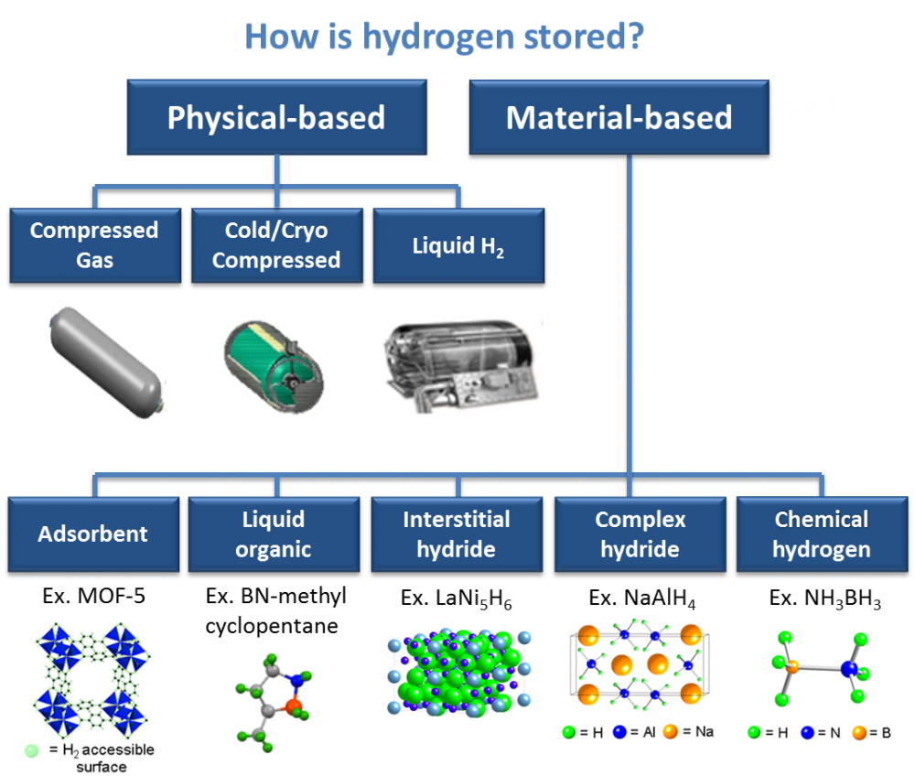
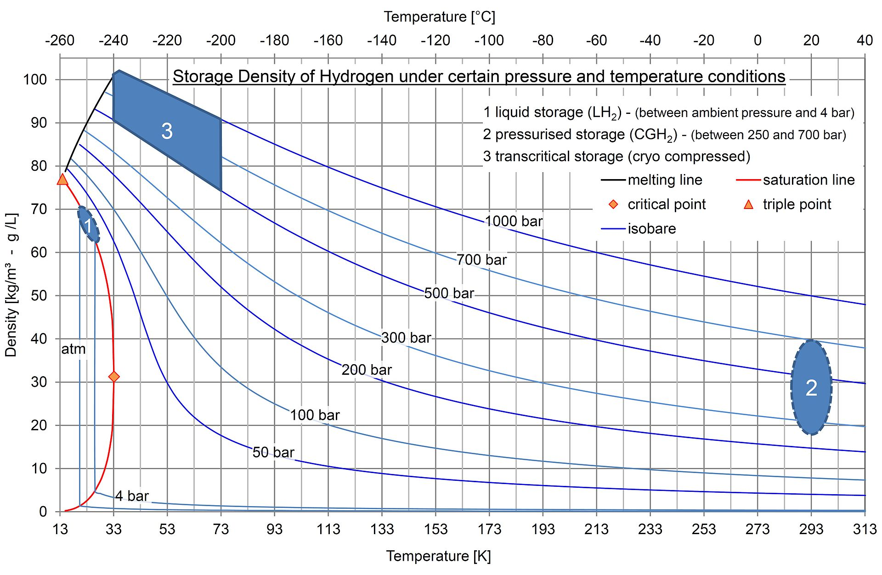
Hydrogen storage methods
$$2H_{2}\left(g\right)+O_{2}\left(g\right)=2H_{2}O\left(g\right)+572kj$$

Slide 4
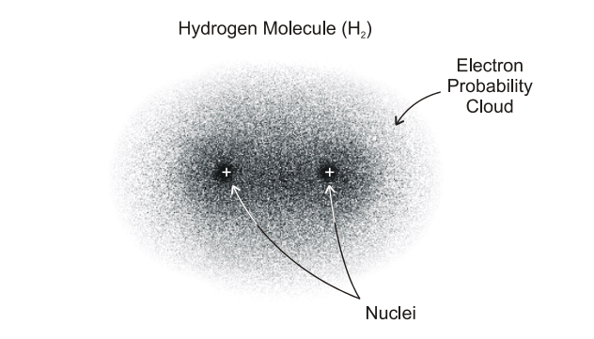
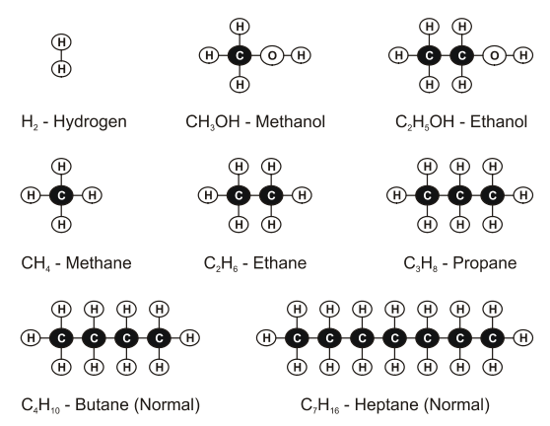
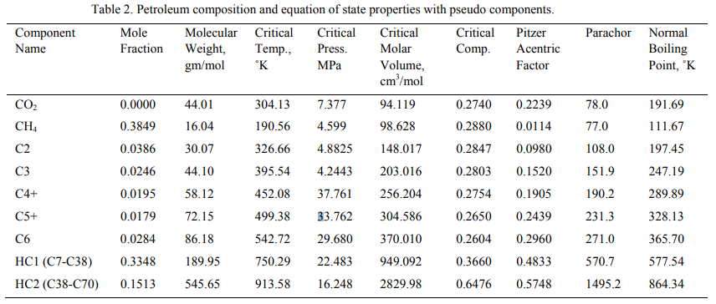
Challenges of liquification
In molecular hydrogen, each proton has a field associated to it, and is described mathematically as “spin-up/down”. Molecules which both protons have the same spin are called orthohydrogen. Molecules which have opposite spin are called parahydrogen. Over 75% of room temperature hydrogen is orthohydrogen, however this becomes unstable at low temperatures and stabilises to parahydrogen releasing energy in the form of heat in the process. This heat can complicate low temperature hydrogen storage.

Slide 5
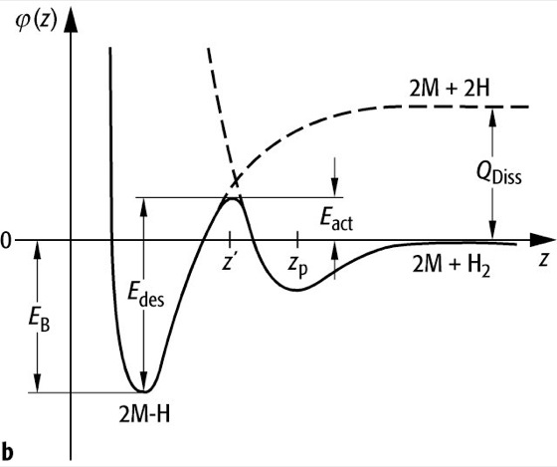
Solid state solutions
Hydrogen can be stored in porous solids by physisorption, whereby the acting forces are comparable to Van der Waals. The electronic structures of adsorbate and surface are barely perturbed during this process and typical binding energies are in the range 10 to 100meV.

Slide 6
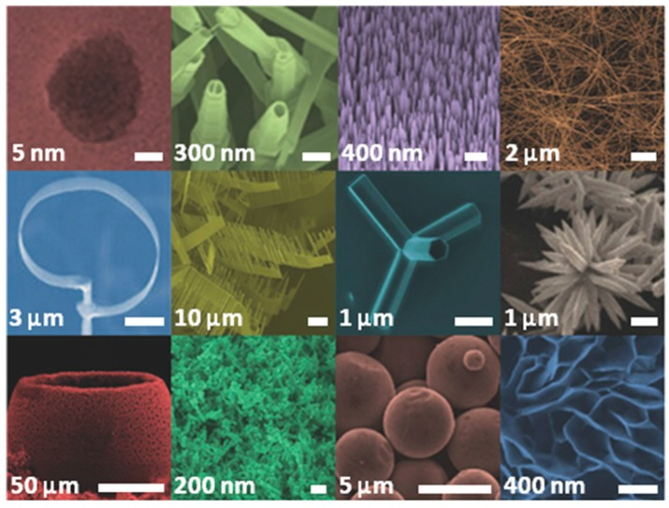
Zinc oxide nanostructures
Various ZnO nanostructure morphologies. From left to right and from top to bottom: Quantum dot; Nanotubes; Nanowires; Nanobelts; Nanoring; Nanocombs; Tetrapod; Nanoflowers; Hollow spheres; Sponge-like film; Nanosphere; Nanoplates

Slide 7
Atomic Layer Deposition

Slide 8
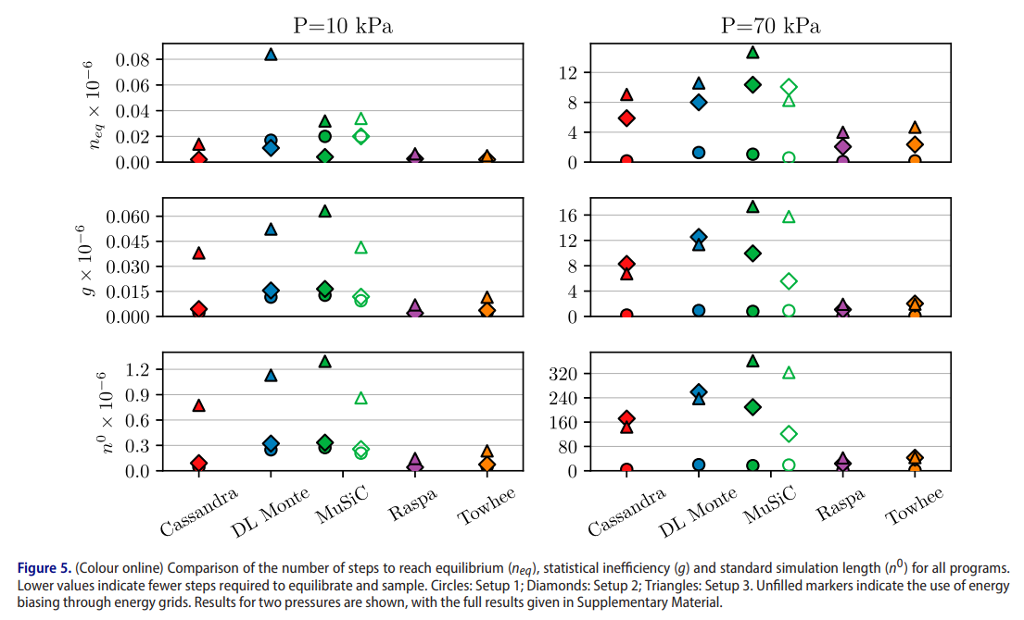
Modelling and SImulation
MCCCS Towhee will be used for simulation work. This
Richard J. Gowers, Amir H. Farmahini, Daniel Friedrich & Lev Sarkisov (2018) Automated analysis and benchmarking of GCMC simulation programs in application to gas adsorption, Molecular Simulation, 44:4, 309-321, DOI: 10.1080/08927022.2017.1375492

