Slide 1
Your mission: Update your _people profile
1 go here:
https://github.com/UK-NABES/UK-NABES.github.io
2 _people folder > template.md > copy RAW
3 _people folder > Create new file > yourname.md > rename file and paste
4 fill in some info about yourself
5 add your picture

Slide 2
Your mission: Update your _people profile
1 go here:
https://github.com/UK-NABES/UK-NABES.github.io

Slide 3
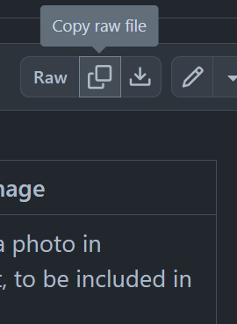
2 _people folder > template.md > copy RAW

Slide 4
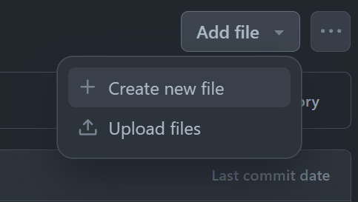
3 _people folder > Create new file > yourname.md > rename file and paste

Slide 5
4 fill in some info about yourself
https://www.harper-adams.ac.uk/general/staff/profile/201620/Edwin-Harris/
I am a statistician and data scientist at Harper Adams University with over 20 years of experience in experimental design and data analysis, research, and consulting in academia and the private sector, with subject expertise in agriculture, ecology, and conservation. I have extensive experience building complex solutions to data analytic problems and in communicating results to diverse stakeholders, including academics, business professionals, the media, and the public. My specific research interests include computer vision applications in agri-tech and ecology. I am the Director of the Agriculture Data Science Research Centre at Harper Adams University and a Fellow of the Royal Statistics Society.
Outside of work I love wildlife spotting and riding all kinds of motorcycles in all kinds of places.

Slide 6
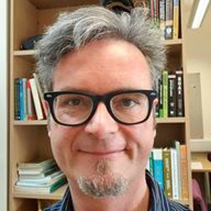
5 add your picture (png or jpeg)

