Slide 1
Condition workshop slides
Ewan McHenry

Slide 2
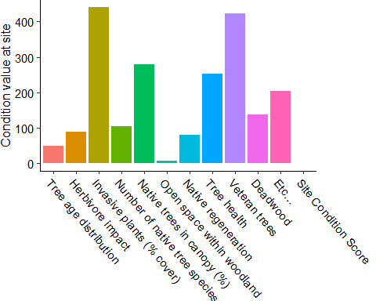
Example: Value of each indicators for site condition

Slide 3
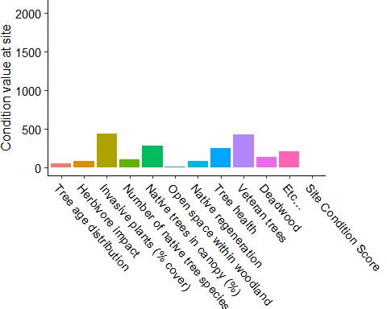
Combining the value of indicators

Slide 4
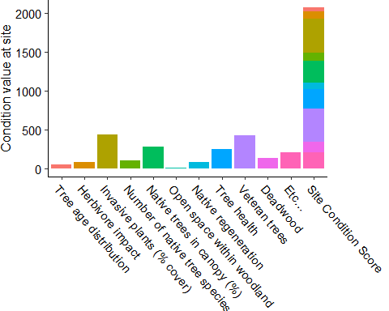
Combining the value of indicators: Site condition score

Slide 5
What if we use less indicators?

Slide 6
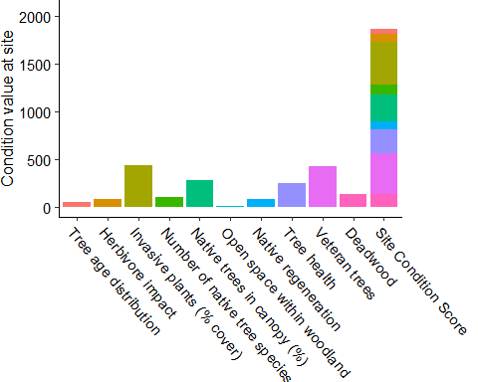
What if we use less indicators? - Condition drops!

Slide 7
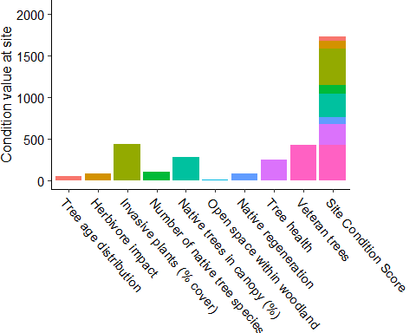
What if we use less indicators? - Condition drops!

Slide 8
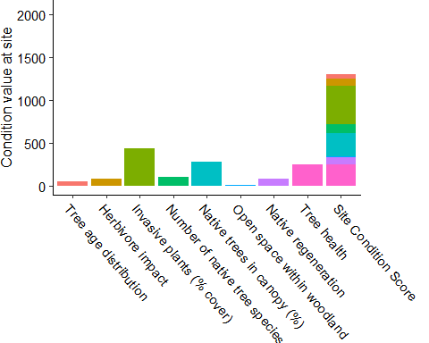
What if we use less indicators? - Condition drops!

Slide 9
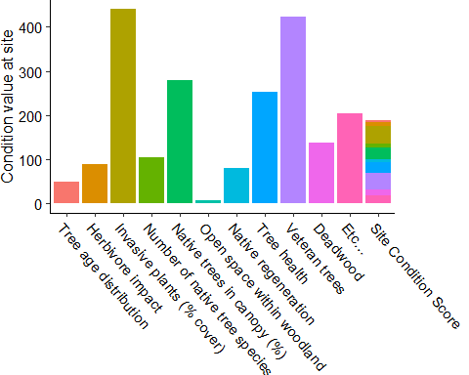
Scaling solves this:

Slide 10
Condition score always out of 100
Scoring is consistent even if:
We decide we need more/less indicators in the future
Certain woodland types use more/less indicators

Slide 11
Scaling to a score out of 100 solves this:

Slide 12
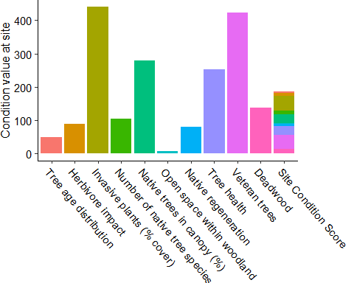
Scaling to a score out of 100 solves this:

Slide 13
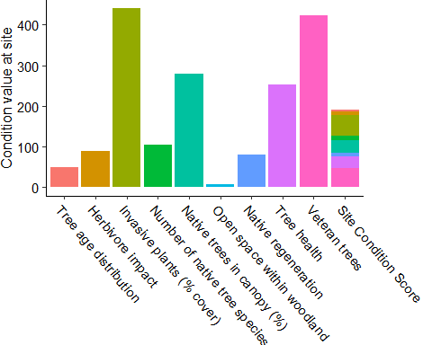
Scaling to a score out of 100 solves this:

Slide 14
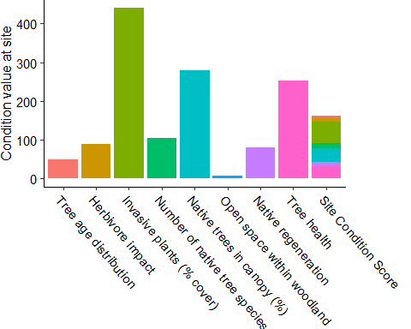
Scaling to a score out of 100 solves this:

Slide 15
Scaling to a score out of 100 solves this:

