Slide 1
Improve your time management
Offered by
Natasha Taljaard and
Buyiswa Mpini

Slide 2

Objectives of the session
Discuss what is effective time management
Look at the benefits of having a time schedule
Start drawing up a time schedule

Slide 3
What are the benefits of good time management?

Slide 4

Benefits of good time management
Less stress
Know exactly where you are with your work
The possibility of being overwhelmed is less
Be flexible
Prevent procrastination & excuses
More in control, motivated & positive
Carry your workload calmly & efficiently,
facilitates creative & critical thinking.
Self-discipline
Achieving your goals
Lifelong pursuit

Slide 5
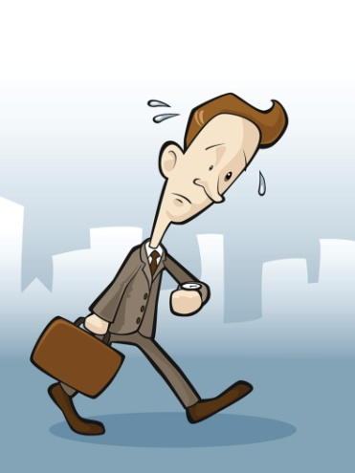
Welcome students
Do Time checklist

Slide 6

Effective time management
Set goals
Determine priorities
Plan your weekly schedule
Adhere to your plan
Use diary, term and year planner

Slide 7
Create a weekly schedule
Draw up a weekly schedule
- Plan carefully
- Time between classes
- Realistic
- Same time study rhythm
- 45-90 minutes, break
- 4 study activities (pre-reading, attend lectures,
make summaries and learn/revise)
- Start with difficult / boring work

Slide 8

Daily and weekly planning
Write academic & social
To do list
Estimate time
Flexible
Weekly review
Deadlines, tests, study plans, personal

Slide 9

Reasons for procrastination:
  Waiting for the right mood
  Waiting for the right time
  Lack of clear goals
  Fear of making wrong decisions
  Lack of confidence
  Poor organisational skills
  Not taking responsibility for yourself
  Feeling overwhelmed
  Not understanding the tasks/do not know where to begin
  Perfectionism

Slide 10

Overcoming procrastination
Recognise it & work out why
Prioritize
Get started whether you feel like it or not
Consider what rewards versus the effects of putting it off.
Plan – set reasonable goals & time periods.
Stick to your plan & try to complete at least one task.

Slide 11
Overcoming procrastination 2
Do not expect perfection
Smaller manageable tasks.
Difficult / important things first.
Move the deadline earlier
Reward
Ask someone to check up on you
Ask for help

Slide 12
What are your time wasters?

Slide 13

Time wasters
Visitors
A note on your door?
Discuss with friends
Phones
Switch off your phone, let it take messages
Internet and email
What is the purpose of what you are doing
Have a specific time for Internet browsing.
Determine (before you start) for how long you need
TV
Plan specific times

Slide 14

Time savers
It is okay to say “no” - be assertive.
Find a quiet place
Delegate
When tasks are similar, do them all at one time
Split large tasks into smaller ones
Must everything be done perfectly?
Do not get over involved or over-committed
Revisit your schedule at least once a week to check what your responsibilities are for the next week
Make sure you understand the instructions of the lecturer
Read your study guides – know what is expected of you!

Slide 15

Quote
“Time is the most precious element of human existence. The successful person knows how to put energy into time and how to draw success from time.”
Denis Waitley

Slide 16
Quotes
Decide what you want, decide what you are willing to exchange for it. Establish your priorities and get to work. H.L. Hunt
"Don't start your day until you have it finished on paper first.“ Jim Rohn
"A man who dares to waste one hour of life has not discovered the value of life." Charles Darwin
And remember that time waits for no one. Yesterday is history. Tomorrow is a mystery. Today is a gift. That's why it's called the present.

Slide 17

Thank you
For more information please contact the us:
Natasha Taljaard at 041-5043241 or
Natasha.Taljaard@nmmu.ac.za
Buyiswa Mpini at 041-5043594 or
Buyiswa.Mpini@nmmu.ac.za
Ronelle Plaatjes at 041 – 5049055 or
Ronelle.Plaatjes@nmmu.ac.za

