Slide 1
Hurtownie Danych
#/## and CTE

Slide 2
CTE, Temp Tables

Slide 3
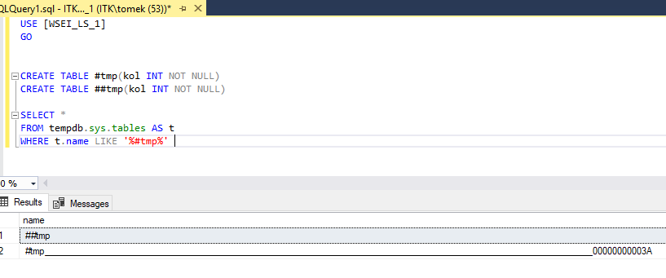
Temporary Tables (#/##)
If a temporary table is created with a named constraint and the temporary table is created within the scope of a user-defined transaction, only one user at a time can execute the statement that creates the temp table.
For example, if a stored procedure creates a temporary table with a named primary key constraint, the stored procedure cannot be executed simultaneously by multiple users.

Slide 4
Common Table Expressions (CTE)
Specifies a temporary named result set, known as a common table expression (CTE). This is derived from a simple query and defined within the execution scope of a single SELECT, INSERT, UPDATE, or DELETE statement.
A CTE must be followed by a single SELECT, INSERT, UPDATE, or DELETE statement that references some or all the CTE columns. A CTE can also be specified in a CREATE VIEW statement as part of the defining SELECT statement of the view.
Multiple CTE query definitions can be defined in a nonrecursive CTE. The definitions must be combined by one of these set operators: UNION ALL, UNION, INTERSECT, or EXCEPT.
A CTE can reference itself and previously defined CTEs in the same WITH clause. Forward referencing is not allowed.

Slide 5
Common Table Expressions (CTE) - Recursive
The recursive CTE definition must contain at least two CTE query definitions, an anchor member and a recursive member. Multiple anchor members and recursive members can be defined; however, all anchor member query definitions must be put before the first recursive member definition. All CTE query definitions are anchor members unless they reference the CTE itself.
Anchor members must be combined by one of these set operators: UNION ALL, UNION, INTERSECT, or EXCEPT. UNION ALL is the only set operator allowed between the last anchor member and first recursive member, and when combining multiple recursive members.
The number of columns in the anchor and recursive members must be the same.
The data type of a column in the recursive member must be the same as the data type of the corresponding column in the anchor member.

