Slide 1
Hurtownie Danych
#03 Zapytania Analityczne

Slide 2
CTE, Temp Tables

Slide 3
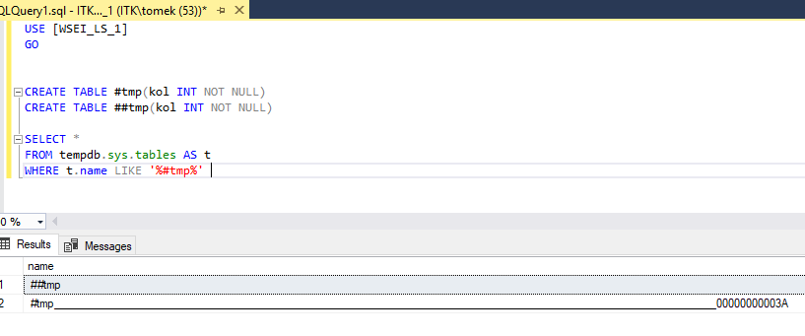
Temporary Tables (#/##)
If a temporary table is created with a named constraint and the temporary table is created within the scope of a user-defined transaction, only one user at a time can execute the statement that creates the temp table.
For example, if a stored procedure creates a temporary table with a named primary key constraint, the stored procedure cannot be executed simultaneously by multiple users.

Slide 4
Common Table Expressions (CTE)
Specifies a temporary named result set, known as a common table expression (CTE). This is derived from a simple query and defined within the execution scope of a single SELECT, INSERT, UPDATE, or DELETE statement.
A CTE must be followed by a single SELECT, INSERT, UPDATE, or DELETE statement that references some or all the CTE columns. A CTE can also be specified in a CREATE VIEW statement as part of the defining SELECT statement of the view.
Multiple CTE query definitions can be defined in a nonrecursive CTE. The definitions must be combined by one of these set operators: UNION ALL, UNION, INTERSECT, or EXCEPT.
A CTE can reference itself and previously defined CTEs in the same WITH clause. Forward referencing is not allowed.

Slide 5
Common Table Expressions (CTE) - Recursive
The recursive CTE definition must contain at least two CTE query definitions, an anchor member and a recursive member. Multiple anchor members and recursive members can be defined; however, all anchor member query definitions must be put before the first recursive member definition. All CTE query definitions are anchor members unless they reference the CTE itself.
Anchor members must be combined by one of these set operators: UNION ALL, UNION, INTERSECT, or EXCEPT. UNION ALL is the only set operator allowed between the last anchor member and first recursive member, and when combining multiple recursive members.
The number of columns in the anchor and recursive members must be the same.
The data type of a column in the recursive member must be the same as the data type of the corresponding column in the anchor member.

Slide 6
GROUP BY

Slide 7
GROUP BY
A SELECT statement clause that divides the query result into groups of rows, usually for the purpose of performing one or more aggregations on each group. The SELECT statement returns one row per group.
Aggregate Functions
COUNT()
COUNT_BIG()
SUM()
MIN()
MAX()
STDEV()/STDEVP()
VAR()/VARP()

Slide 8
GROUP BY ROLLUP()
Creates a group for each combination of column expressions. In addition, it "rolls up" the results into subtotals and grand totals. To do this, it moves from right to left decreasing the number of column expressions over which it creates groups and the aggregation(s).
GROUP BY CUBE()
GROUP BY CUBE creates groups for all possible combinations of columns. For GROUP BY CUBE (a, b) the results has groups for unique values of (a, b), (NULL, b), (a, NULL), and (NULL, NULL).+
Using the table from the previous examples, this code runs a GROUP BY CUBE operation on Country and Region.
GROUP BY GROUPING_SETS()
The GROUPING SETS option gives you the ability to combine multiple GROUP BY clauses into one GROUP BY clause. The results are the equivalent of UNION ALL of the specified groups.

Slide 9
GROUPING()
Indicates whether a specified column expression in a GROUP BY list is aggregated or not. GROUPING returns 1 for aggregated or 0 for not aggregated in the result set. GROUPING can be used only in the SELECT <select> list, HAVING, and ORDER BY clauses when GROUP BY is specified.
GROUPING_ID()
Is a function that computes the level of grouping. GROUPING_ID can be used only in the SELECT <select> list, HAVING, or ORDER BY clauses when GROUP BY is specified.

Slide 10
OVER

Slide 11
OVER Clause (Window Functions)
Determines the partitioning and ordering of a rowset before the associated window function is applied. That is, the OVER clause defines a window or user-specified set of rows within a query result set. A window function then computes a value for each row in the window. You can use the OVER clause with functions to compute aggregated values such as moving averages, cumulative aggregates, running totals, or a top N per group results.
More than one window function can be used in a single query with a single FROM clause. The OVER clause for each function can differ in partitioning and ordering. If PARTITION BY is not specified, the function treats all rows of the query result set as a single group.

Slide 12
Ranking/Analytic Functions (Window Functions)
RANK()
DENSE_RANK()
ROW_NUMBER()
NTILE()
FIRST_VALUE()
LAST_VALUE()
LAG()
LEAD()
CUME_DIST()

Slide 13
Ranking Functions (Window Functions)
RANK()
DENSE_RANK()
ROW_NUMBER()
NTILE()

Slide 14
Analytic Functions (Window Functions)
FIRST_VALUE()
LAST_VALUE()
LAG()
LEAD()
CUME_DIST()

Slide 15
Aggregate Functions (Window Functions)
COUNT()
COUNT_BIG()
SUM()
MIN()
MAX()
STDEV()/STDEVP()
VAR()/VARP()

