Slide 1
Modele Analizy Danych
KPIs, Actions, Calculated Members&Sets

Slide 2
KPI

Slide 3
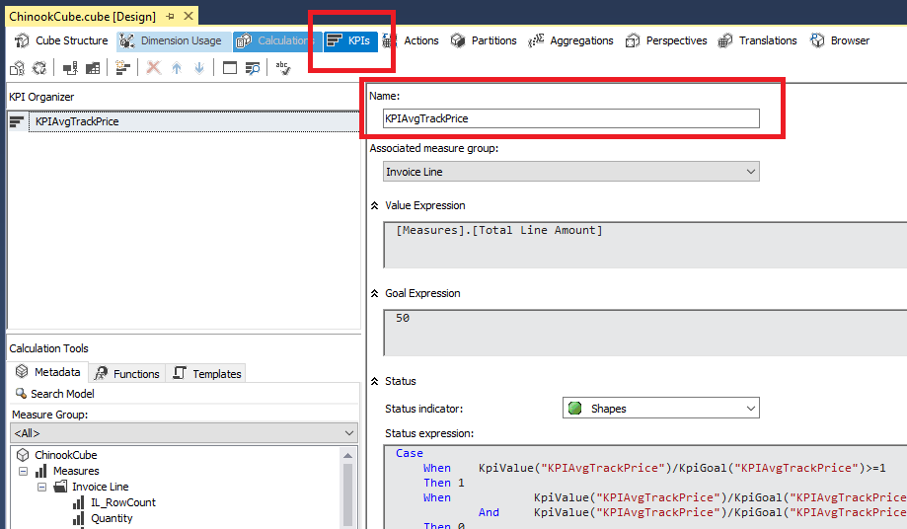
KPI
KPIs provide a framework for defining server-side calculations that measure your business, and they standardize how the resulting information is displayed. KPIs can be displayed in reports, portals, and dashboards, through data access APIs, and through Microsoft tools and third-party tools. KPIs are metadata wrappers around regular measures and other Multidimensional Expressions (MDX) expressions.

Slide 4
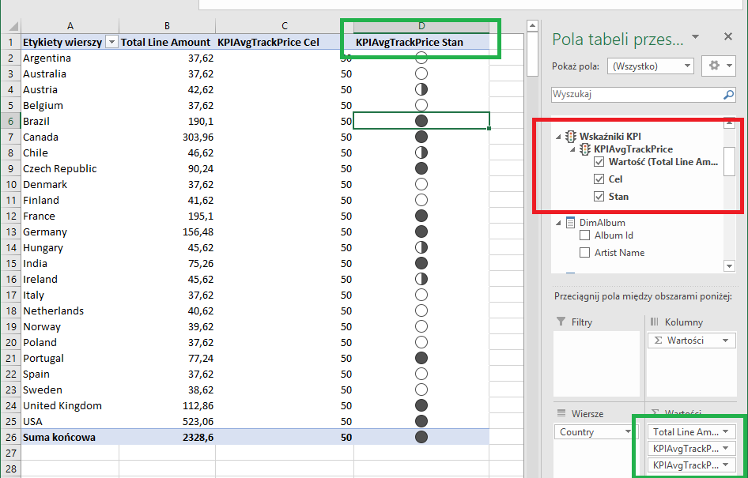

Slide 5
KPI Tutorial #1
To define key performance indicators (KPIs), you first define a KPI name and the measure group to which the KPI is associated. A KPI can be associated with all measure groups or with a single measure group.
The value expression
A value expression is a physical measure such as Sales, a calculated measure such as Profit, or a calculation that is defined within the KPI by using a Multidimensional Expressions (MDX) expression.
The goal expression
A goal expression is a value, or an MDX expression that resolves to a value, that defines the target for the measure that the value expression defines. For example, a goal expression could be the amount by which the business managers of a company want to increase sales or profit.
The status expression
A status expression is an MDX expression that Analysis Services uses to evaluate the current status of the value expression compared to the goal expression. A goal expression is a normalized value in the range of -1 to +1, where -1 is very bad, and +1 is very good. The status expression displays a graphic to help you easily determine the status of the value expression compared to the goal expression.

Slide 6
KPI Tutorial #2
The trend expression
A trend expression is an MDX expression that Analysis Services uses to evaluate the current trend of the value expression compared to the goal expression. The trend expression helps the business user to quickly determine whether the value expression is becoming better or worse relative to the goal expression. You can associate one of several graphics with the trend expression to help business users be able to quickly understand the trend.

Slide 7
Action

Slide 8
Action
An action is just a Multidimensional Expressions (MDX) statement that is stored in Analysis Services and which can be incorporated into client applications and started by a user.
Analysis Services supports the types of actions that are described in the following table.
CommandLine Executes a command at the command prompt
Dataset Returns a dataset to a client application.
Drillthrough Returns a drillthrough statement as an expression, which the client executes to return a rowset
Html Executes an HTML script in an Internet browser
Proprietary Performs an operation by using an interface other than those listed in this table.
Report Submits a URL-based request to a report server and returns a report to a client application.
Rowset Returns a rowset to a client application.
Statement Runs an OLE DB command.
URL Displays a dynamic Web page in an Internet browser.

Slide 9
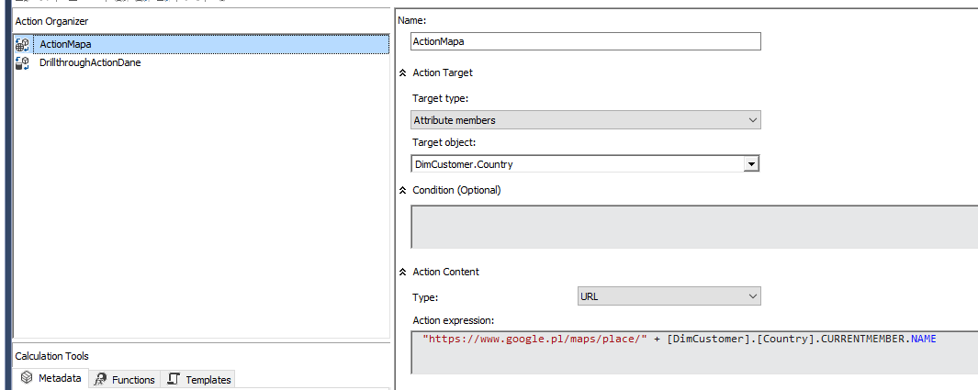
Actions #1 - URL

Slide 10
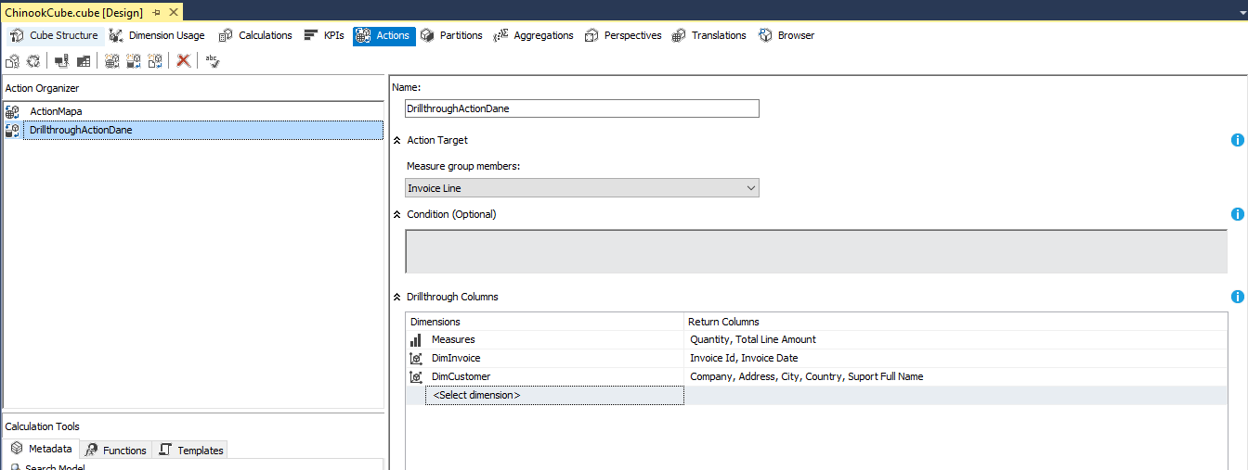
Actions #2 - DrillThrough

Slide 11
Calculated Member

Slide 12
Calculated Members
Calculated members are members of a dimension or a measure group that are defined based on a combination of cube data, arithmetic operators, numbers, and functions.
For example, you can create a calculated member that calculates the sum of two physical measures in the cube. Calculated member definitions are stored in cubes, but their values are calculated at query time.
To create a calculated member, use the New Calculated Member command on the Calculations tab of Cube Designer. You can create a calculated member within any dimension, including the measures dimension.

Slide 13
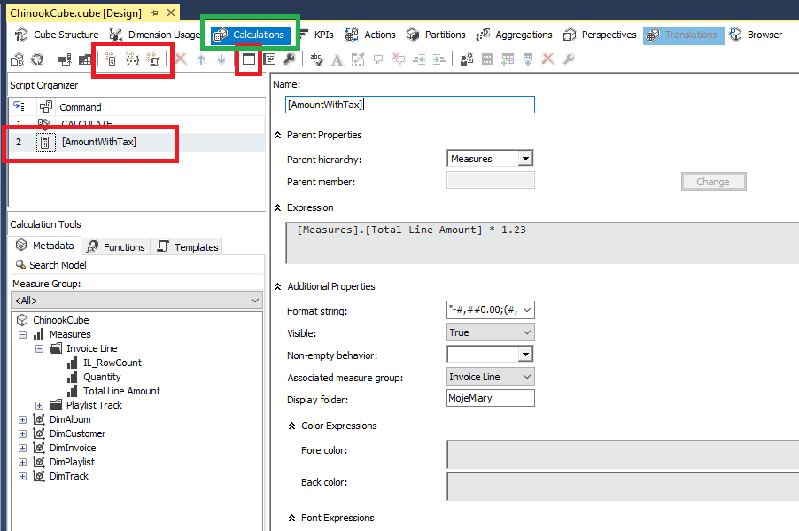
Calculated Measure #1

Slide 14
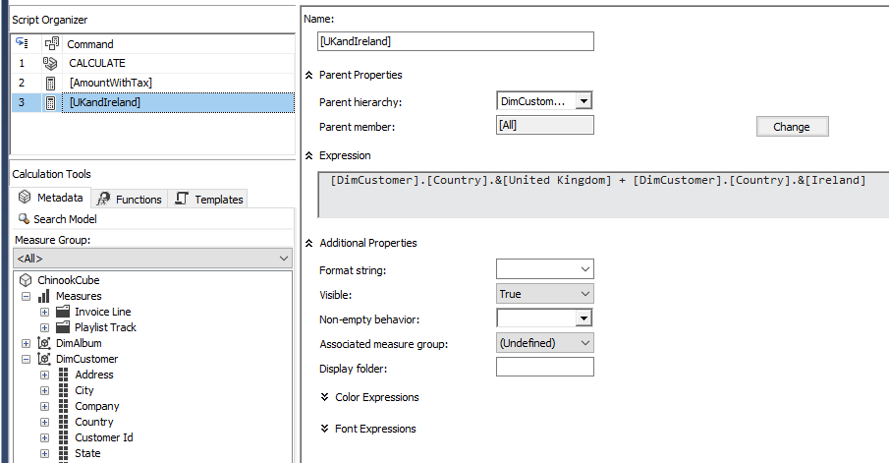
Calculated Dimensision Member

Slide 15
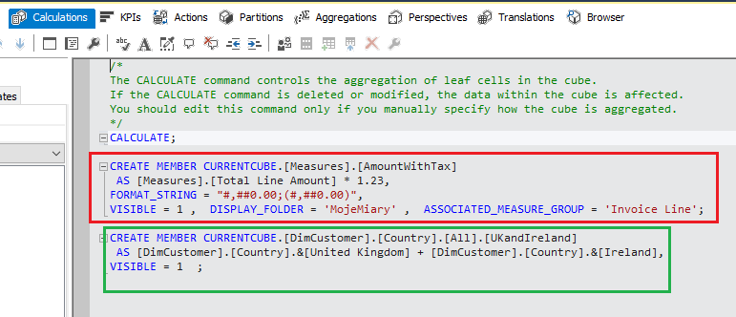
MDX

Slide 16
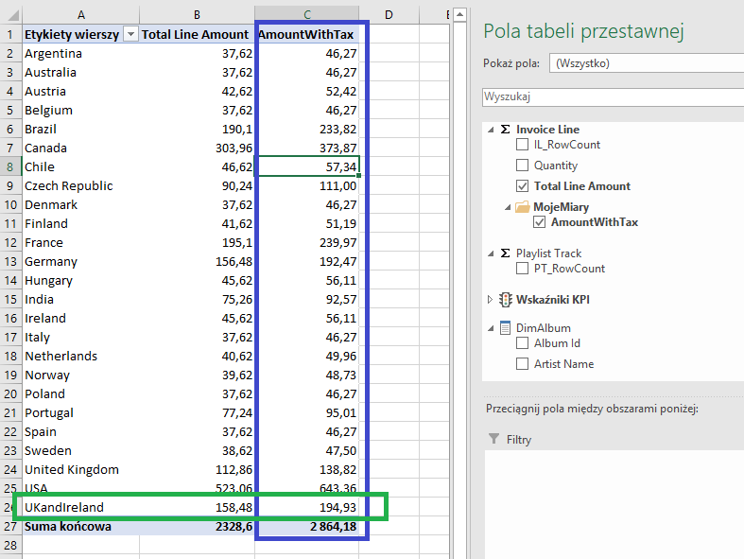
Excel

Slide 17
Calculated Set

Slide 18
Calculated Set
A named set is a Multidimensional Expressions (MDX) expression that returns a set of dimension members.
You can define named sets and save them as part of the cube definition; you can also create named sets in client applications.
You create named sets by combining cube data, arithmetic operators, numbers, and functions. Named sets can be used by users in MDX queries in client applications and can also be used to define sets in subcubes.
A subcube is a collection of crossjoined sets that restricts the cube space to the defined subspace for subsequent statements. Defining a restricted cube space is a fundamental concept to MDX scripting.

Slide 19
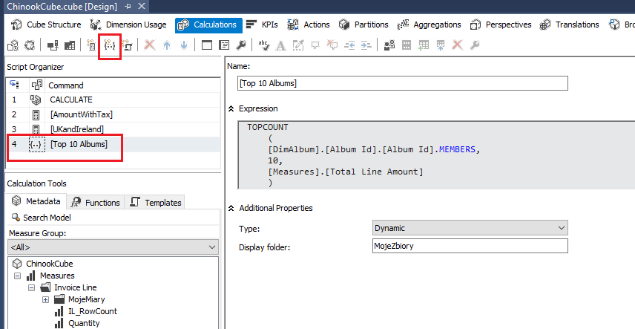
Calculated Set

Slide 20
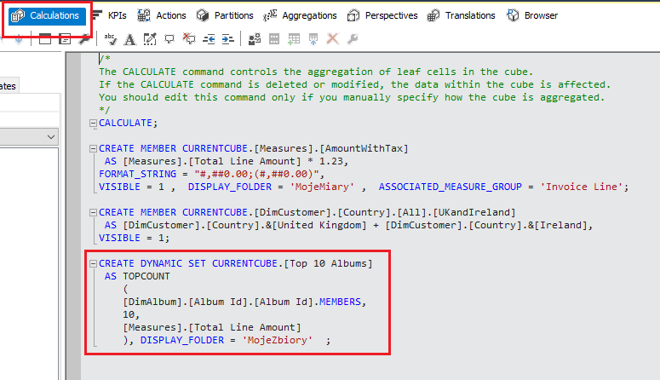
MDX

Slide 21
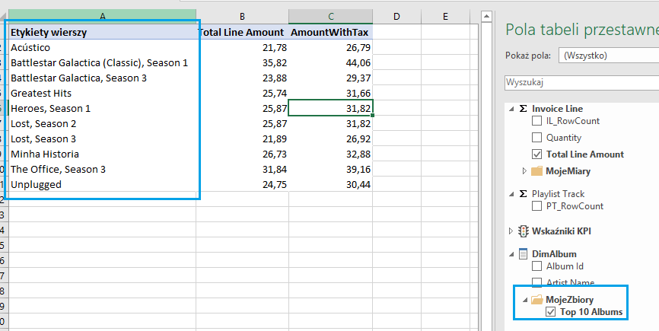
Excel

Slide 22
Linki:
https://docs.microsoft.com/en-us/sql/analysis-services/multidimensional-models/key-performance-indicators-kpis-in-multidimensional-models?view=sql-analysis-services-2017
https://docs.microsoft.com/en-us/sql/analysis-services/lesson-7-defining-key-performance-indicators-kpis?view=sql-analysis-services-2017
https://docs.microsoft.com/en-us/sql/analysis-services/multidimensional-modeling-adventure-works-tutorial?view=sql-analysis-services-2017

