Slide 1
Modele Analizy Danych
Security

Slide 2
Security

Slide 3
Security #1
Microsoft SQL Server Analysis Services relies on Microsoft Windows to authenticate users.
By default, only authenticated users who have rights within Analysis Services can establish a connection to Analysis Services. After a user connects to Analysis Services, the permissions that user has within Analysis Services are determined by the rights that are assigned to the Analysis Services roles to which that user belongs, either directly or through membership in a Windows role.

Slide 4
Security #2
Analysis Services contains a single fixed server role, which grants its members permission to perform any task within the entire instance.
Users who are not members of the fixed server role can be made members of one or more database roles. Each database role has a customized set of permissions to let users access data and perform tasks within a particular database.
A database role can be granted administrator permissions, process object permissions, view object metadata permissions, and permissions to view or modify data at multiple levels within each Analysis Services database.
Members of a database role that has administrator permissions can view or update all data within the database.
Members of other database roles can only view or update the data objects to which they have specifically been granted such permissions.

Slide 5
Security #3
Although members of the server role automatically have complete administrator rights, members of a database role do not. A database role can be granted Full Control, otherwise known as Administrator, rights or a more limited set of administrator rights from the following list:
Process the database
Read database metadata
Process one or more dimensions
Read the definition of one of more dimensions
Process one or more cubes
Read the definition of one or more cubes
Read the definition of one or more data sources

Slide 6
Roles

Slide 7
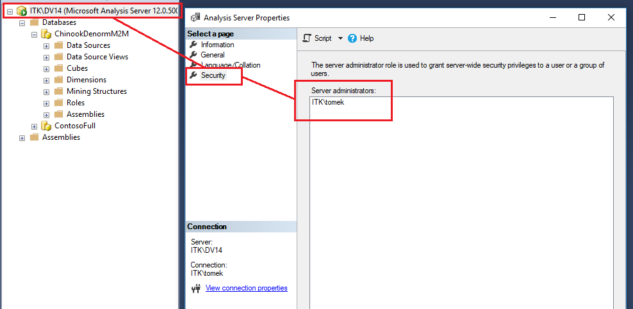
Server Role
There is only one server role, and members of this role have complete administrator rights within the instance of Analysis Services.

Slide 8
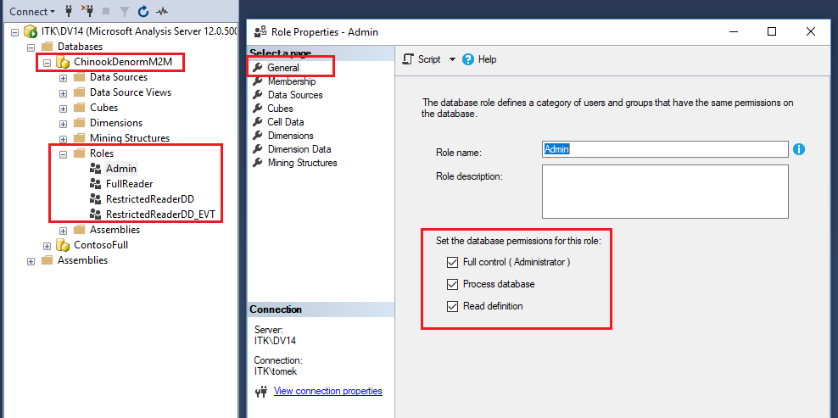
Database Role #1
There can be multiple database roles. Members of the server role create these database roles within each database, grant administrative or user permissions to these database roles such as read or read/write permission to cubes, dimensions, cells, mining structures, mining models, and data source objects), and then add Windows users and groups to these database roles.

Slide 9
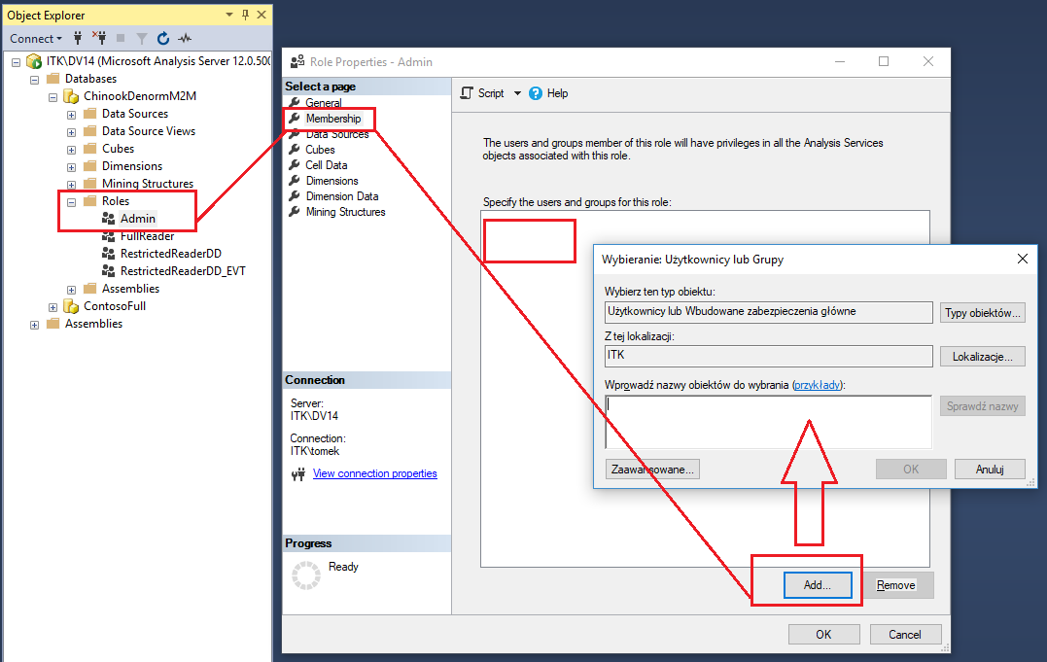
Database Role #2

Slide 10
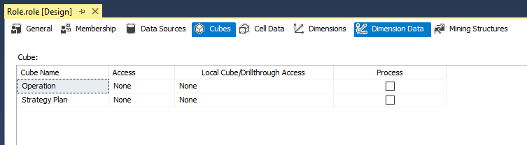
Cube-Level Security
A database role can specify whether its members have read or read/write permission to one or more cubes in a database. If a database role is not granted permissions to read or read/write at least one cube, members of the database role have no permission to view any cubes in the database, despite any rights those members may have through the role to view dimension members.

Slide 11
Dimension-Level Security
A database role can specify whether its members have permission to view or update dimension members in specified database dimensions.
Moreover, within each dimension to which a database role has been granted rights, the role can be granted permission to view or update specific dimension members only instead of all dimension members. If a database role is not granted permissions to view or update a particular dimension and some or all the dimension's members, members of the database role have no permission to view the dimension or any of its members.

Slide 12
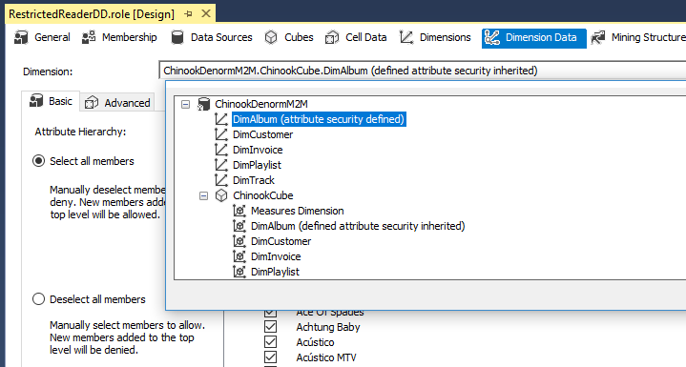
Dimension Data #1

Slide 13
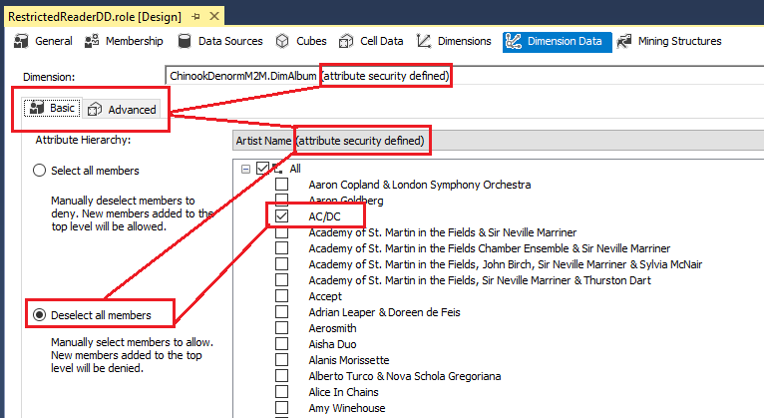
Dimension Data (Basic)

Slide 14
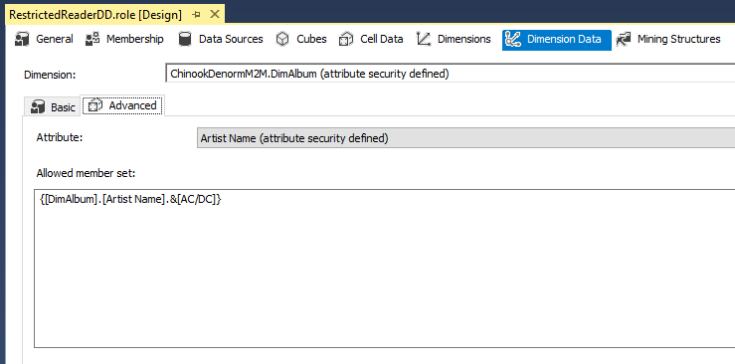
Dimension Data (Advanced)

Slide 15
Dimension-Level Security
A database role can specify whether its members have permission to view or update dimension members in specified database dimensions.
Moreover, within each dimension to which a database role has been granted rights, the role can be granted permission to view or update specific dimension members only instead of all dimension members. If a database role is not granted permissions to view or update a particular dimension and some or all the dimension's members, members of the database role have no permission to view the dimension or any of its members.

Slide 16
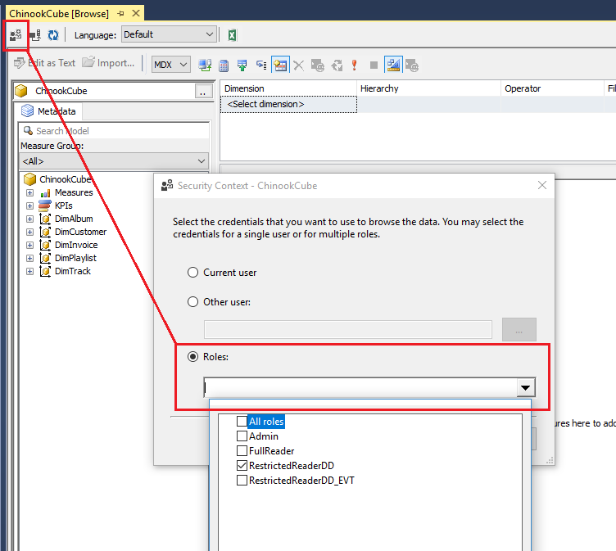
Security Context - Testing
https://www.sqlchick.com/entries/2012/10/7/unit-testing-role-security-in-analysis-services.html
https://bennyaustin.wordpress.com/2009/10/28/testing-cube-security-from-ssms/

