Slide 1
Modele Analizy Danych
NullProcessing, ErrorConfiguration

Slide 2
Errors #1
Error configuration properties on cube, partition, or dimension objects determine how the server responds when data integrity errors occur during processing.
Duplicate keys, missing keys, and null values in a key column typically trigger such errors, and while the record causing the error will not be added to the database, you can set properties that determine what happens next.
By default, processing stops. However, during cube development, you might want processing to continue when errors occur so that you can test cube behaviors with imported data, even if it is incomplete.
The server always executes NullProcessing rules before ErrorConfiguration rules for each record. This is important to understand because null processing properties that convert nulls to zeroes can subsequently introduce duplicate key errors when two or more error records have zero in a key column.

Slide 3
Errors #2 – Error Limit
By default, processing stops at the first error implicating a key column. This behavior is controlled by an error limit that specifies zero as the number of allowed errors and the Stop Processing directive that tells the server to stop processing when the error limit is reached.
Records triggering an error, due to null or missing or duplicate values, are either converted to the unknown member or discarded. Analysis Services will not import data that violates data integrity constraints.

Slide 4
Errors #3 - Types
KeyNotFound
Occurs when a foreign key in a fact table does not have a matching primary key in a related dimension table (for example, a Sales fact table has a record with a product ID that doesn't exist in the Product dimension table). This error can occur during partition processing, or dimension processing of snowflaked dimensions.
KeyDuplicate
Occurs when duplicate attribute keys are found in a dimension. In most cases, it is acceptable to have duplicate attribute keys, but this error informs you of the duplicates so that you can check the dimension for design flaws that might lead to inconsistent relationships between attributes.

Slide 5
Errors #4 - Types
NullKeyNotAllowed
Occurs when NullProcessing = Error is set on a dimension attribute or when null values exists in an attribute key column used to uniquely identify a member.
NullKeyConvertedToUnknown
Occurs when null values are subsequently converted to the unknown member. Setting NullProcessing = ConvertToUnknown on a dimension attribute will trigger this error.

Slide 6
Null Processing

Slide 7
NullProcessing #1
Null foreign keys in a fact table (KeyNotFound)
By default, a null value in a foreign key column of a fact table is converted to zero. Assuming zero is not a valid foreign key value, the KeyNotFound error will be logged and counted towards the error limit that is zero by default.
To allow processing to continue, you can handle the null before it is converted and checked for errors. To do this, set NullProcessing to Error.

Slide 8
NullProcessing #2
Null keys in a dimension
To continue processing when null values are found in foreign keys in a snowflaked dimension, handle the null values first by setting NullProcessing on the KeyColumn of the dimension attribute. This discards or converts the record, before the KeyNotFound error can occur.
You have two options for handling nulls on dimension attribute:
Set NullProcessing=UnknownMember to allocate records with null values to the unknown member. This produces the NullKeyConvertedToUnknown error, which is ignored by default.
Set NullProcessing=Error to exclude records with null values. This produces the NullKeyNotAllowed error, which is logged and counts toward the key error limit. You can set error configuration property on Null Key Not Allowed to IgnoreError to allow processing to continue.

Slide 9
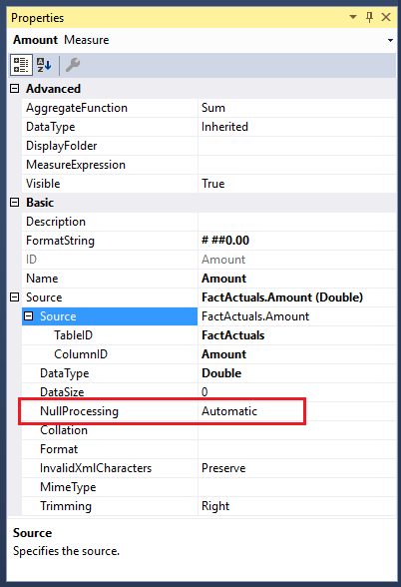
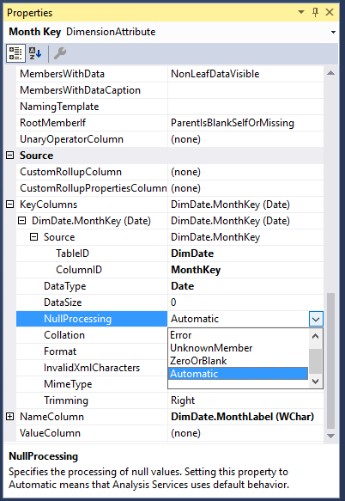
NullProcessing #3

Slide 10
Error Configuration

Slide 11
Error Configuration #1
Duplicate keys resulting inconsistent relationships (KeyDuplicate)
By default, the presence of a duplicate key does not stop processing, but the error is ignored and the duplicate record is excluded from the database.

Slide 12
Error Configuration #2
Change the error limit or error limit action
You can raise the error limit to allow more errors through during processing. There is no guidance for raising the error limit; the appropriate value will vary depending on your scenario. Error limits are specified as KeyErrorLimit in ErrorConfiguration properties in SQL Server Data Tools, or as Number of Errors in the Error Configuration tab for properties of dimensions, cubes, or measure groups in SQL Server Management Studio.

Slide 13
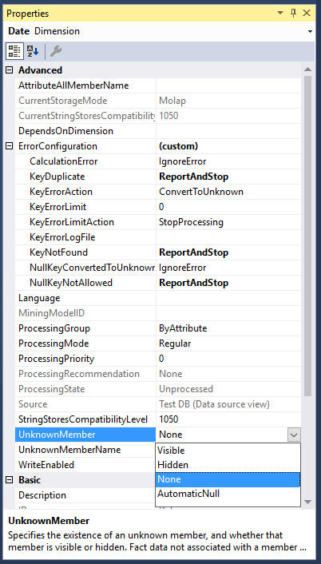
Error Configuration #3 – Unknown Member

Slide 14
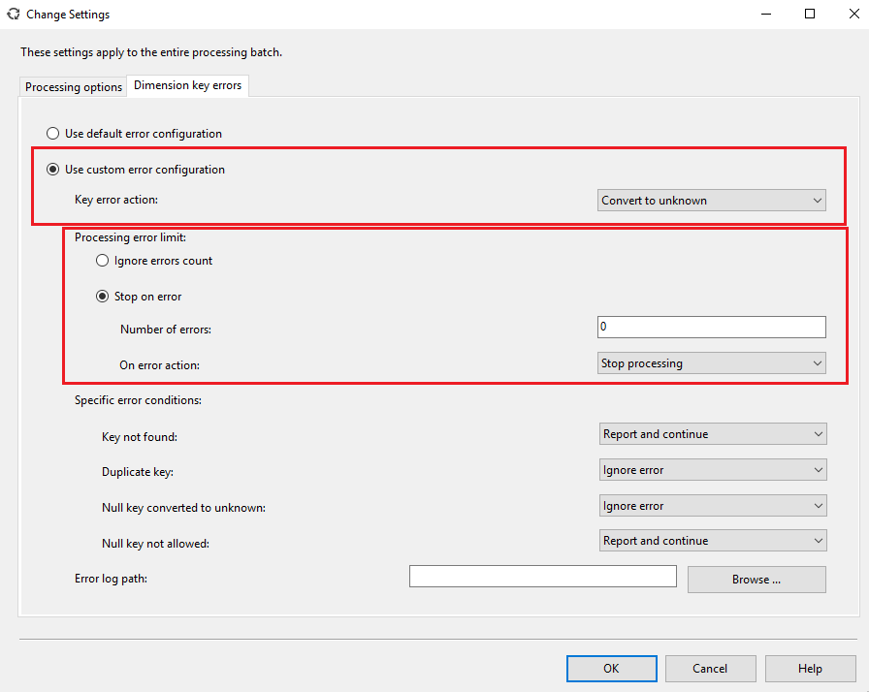
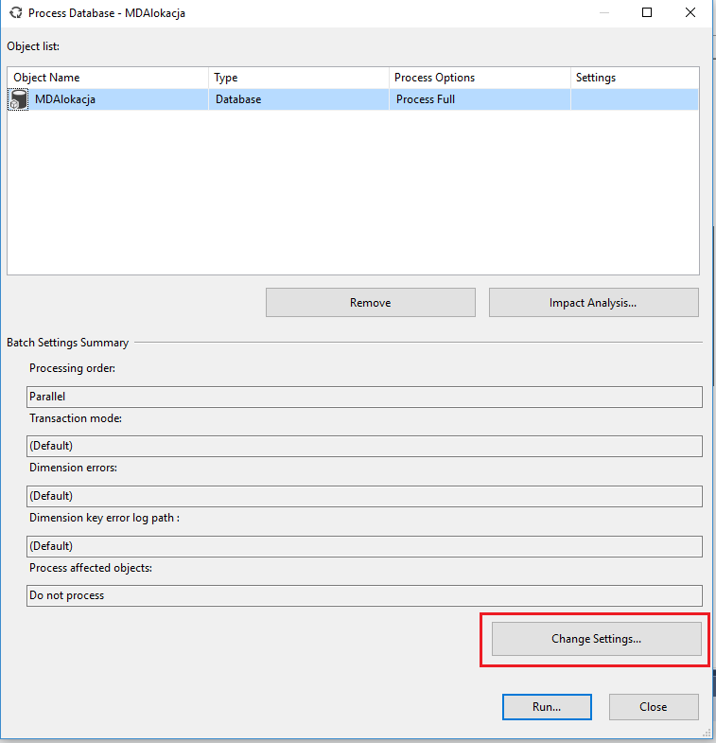
Error Configuration #4

Slide 15
links:
https://docs.microsoft.com/en-us/sql/analysis-services/multidimensional-models/error-configuration-for-cube-partition-and-dimension-processing?view=sql-analysis-services-2017

