Slide 1
Modele Analizy Danych
Optimization

Slide 2
Processing

Slide 3
Processing #1
Processing is the step, or series of steps, in which Analysis Services loads data from a relational data source into a multidimensional model. For objects that use MOLAP storage, data is saved on disk in the database file folder.
By default, processing occurs when you deploy a solution to the server. You can also process all or part of a solution, either ad hoc using tools such as Management Studio or SQL Server Data Tools, or on a schedule using Integration Services and SQL Server Agent.
When making a structural change to the model, such as removing a dimension or changing its compatibility level, you will need to process again to synchronize the physical and logical aspects of the model.

Slide 4
Processing #2
Processing affects the following Analysis Services objects:
measure groups
partitions
dimensions
cubes
mining models
mining structures
databases
When an object contains one or more objects, processing the highest-level object causes a cascade of processing all the lower-level objects.
For example, a cube typically contains one or more measure groups (each of which contains one or more partitions) and dimensions.
Processing a cube causes processing of all the measure groups within the cube and the constituent dimensions that are currently in an unprocessed state.

Slide 5
Process Full
cubes
databases
dimensions
measure groups
mining models
mining structures
partitions
Processes an Analysis Services object and all the objects that it contains. When Process Full is executed against an object that has already been processed, Analysis Services drops all data in the object, and then processes the object. This kind of processing is required when a structural change has been made to an object, for example, when an attribute hierarchy is added, deleted, or renamed.

Slide 6
Process Update
Dimensions
Forces a re-read of data and an update of dimension attributes. Flexible aggregations and indexes on related partitions will be dropped.
Process Default
Cubes, databases, dimensions, measure groups, mining models, mining structures, and partitions.
Detects the process state of database objects, and performs processing necessary to deliver unprocessed or partially processed objects to a fully processed state. If you change a data binding, Process Default will do a Process Full on the affected object.

Slide 7
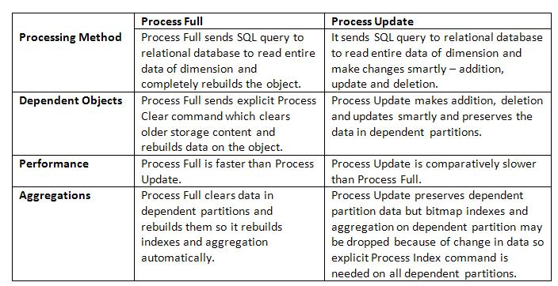
Procesing
https://msbistackworld.wordpress.com/2012/09/27/difference-between-process-update-vs-process-full-2/

Slide 8
Processing #3
Processing a Database
In Analysis Services, a database contains objects but not data. When you process a database, you direct the server to recursively process those objects that store data in the model, such as dimensions, partitions, mining structures, and mining models.
A cube can be thought of as a wrapper object for measure groups and partitions. A cube is made of dimensions in addition to one or more measures, which are stored in partitions. Dimensions define how data is laid out in the cube. When you process a cube, an SQL query is issued to retrieve values from the fact table to populate each member in the cube with appropriate measure values.
When you process a cube, Analysis Services processes any unprocessed dimensions in the cube, and some or all partitions within the measure groups in the cube.

Slide 9
Processing #4
Processing a Dimension
When you process a dimension, Analysis Services formulates and runs queries against dimension tables to return information that is required for processing.
The processing itself turns the tabular data into usable hierarchies. These hierarchies are fully articulated member names that are internally represented by unique numeric paths. The following example is a text representation of a hierarchy.
Dimension processing does not create or update calculated members, which are defined at the cube level. Calculated members are affected when the cube definition is updated. Also, dimension processing does not create or update aggregations. However, dimension processing can cause aggregations to be dropped. Aggregations are created or updated only during partition processing.
When you process a dimension, be aware that the dimension might be used in several cubes. When you process the dimension, those cubes are marked as unprocessed and become unavailable for queries.

Slide 10
Processing #5
Processing a Measure Group
When you process a measure group, Analysis Services processes some or all partitions within the measure group, and any unprocessed dimensions that participate in the measure group. Specifics of the processing job depend on the processing option that you select. You can process one or more measure groups in Analysis Services without affecting other measure groups in a cube.
Processing a Partition
Effective administration of Analysis Services involves the practice of partitioning data. Partition processing is unique because it involves consideration of hard disk use and space constraints, combined with data structure limitations imposed by Analysis Services. To keep query response times fast and processing throughput high, you have to regularly create, process, and merge partitions.

Slide 11
Partitions

Slide 12
Partitions #1
A partition is a container for a portion of the measure group data. Partitions are not seen from MDX queries; all queries reflect the whole content of the measure group, regardless of how many partitions are defined for the measure group.
The data content of a partition is defined by the query bindings of the partition, and by the slicing expression.
Partitions are not visible to business users of the cube. However, administrators can configure, add, or drop partitions. Each partition is stored in a separate set of files. The aggregate data of each partition can be stored on the instance of Analysis Services where the partition is defined, on another instance of Analysis Services, or in the data source that is used to supply the partition's source data.
Partitions allow the source data and aggregate data of a cube to be distributed across multiple hard drives and among multiple server computers. For a cube of moderate to large size, partitions can greatly improve query performance, load performance, and ease of cube maintenance.

Slide 13
Partitions #2
The storage mode of a partition affects the query and processing performance, storage requirements, and storage locations of the partition and its parent measure group and cube. The choice of storage mode also affects processing choices.
A partition can use one of three basic storage modes:
Multidimensional OLAP (MOLAP)
Relational OLAP (ROLAP)
Hybrid OLAP (HOLAP)

Slide 14
MOLAP
The MOLAP storage mode causes the aggregations of the partition and a copy of its source data to be stored in a multidimensional structure in Analysis Services when the partition is processed.
This MOLAP structure is highly optimized to maximize query performance. The storage location can be on the computer where the partition is defined or on another computer running Analysis Services.
Because a copy of the source data resides in the multidimensional structure, queries can be resolved without accessing the partition's source data. Query response times can be decreased substantially by using aggregations. The data in the partition's MOLAP structure is only as current as the most recent processing of the partition.
As the source data changes, objects in MOLAP storage must be processed periodically to incorporate those changes and make them available to users. Processing updates the data in the MOLAP structure, either fully or incrementally.

Slide 15
ROLAP
The ROLAP storage mode causes the aggregations of the partition to be stored in indexed views in the relational database that was specified in the partition's data source.
Unlike the MOLAP storage mode, ROLAP does not cause a copy of the source data to be stored in the Analysis Services data folders. Instead, when results cannot be derived from the query cache, the indexed views in the data source is accessed to answer queries.
Query response is generally slower with ROLAP storage than with the MOLAP or HOLAP storage modes. Processing time is also typically slower with ROLAP.
However, ROLAP enables users to view data in real time and can save storage space when you are working with large datasets that are infrequently queried, such as purely historical data.

Slide 16
HOLAP
The HOLAP storage mode combines attributes of both MOLAP and ROLAP. Like MOLAP, HOLAP causes the aggregations of the partition to be stored in a multidimensional structure in an SQL Server Analysis Services instance. HOLAP does not cause a copy of the source data to be stored. For queries that access only summary data in the aggregations of a partition, HOLAP is the equivalent of MOLAP.
Queries that access source data—for example, if you want to drill down to an atomic cube cell for which there is no aggregation data—must retrieve data from the relational database and will not be as fast as they would be if the source data were stored in the MOLAP structure.
With HOLAP storage mode, users will typically experience substantial differences in query times depending upon whether the query can be resolved from cache or aggregations versus from the source data itself.
Partitions stored as HOLAP are smaller than the equivalent MOLAP partitions because they do not contain source data and respond faster than ROLAP partitions for queries involving summary data.

Slide 17
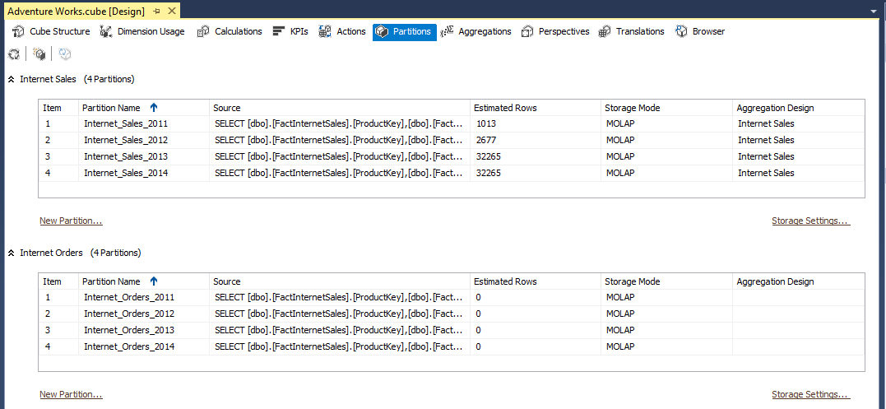
Partitions AWDW #1

Slide 18
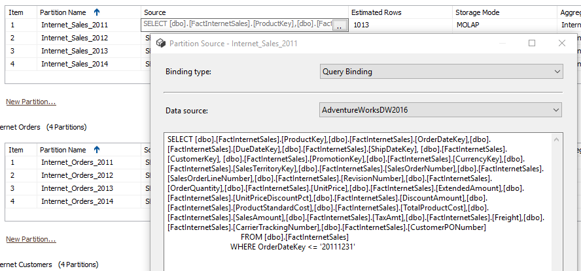
Partitions AWDW #2

Slide 19
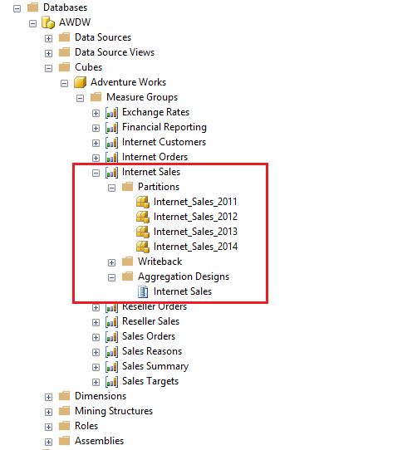
Partitions AWDW #3

Slide 20
Aggregations

Slide 21
Aggregations #1
Aggregations are precalculated summaries of cube data that help enable Analysis Services to provide rapid query responses.
To set storage options and design aggregations for a partition, use the Aggregation Design Wizard. The wizard operates on a single partition of a measure group at a time so that you can select different options and designs for each partition. The wizard takes you through steps to configure storage and design aggregation for a partition.
The goal is to design the optimal number of aggregations. This number should not only provide satisfactory response time, but also prevent excessive partition size. A greater number of aggregations produces faster response times but it also requires more storage space and may take longer to compute.

Slide 22
Aggregations #2
The Aggregation Design Wizard provides options for you to specify storage and percentage constraints on the algorithm to achieve a satisfactory tradeoff between query response time and storage requirements. However, the Aggregation Design Wizard's algorithm assumes that all possible queries are equally likely.
The Usage-Based Optimization Wizard lets you adjust the aggregation design for a measure group by analyzing the queries that have been submitted by client applications. By using the wizard to tune a cube's aggregation you can increase responsiveness to frequent queries and decrease responsiveness to infrequent queries without significantly affecting the storage needed for the cube.

Slide 23
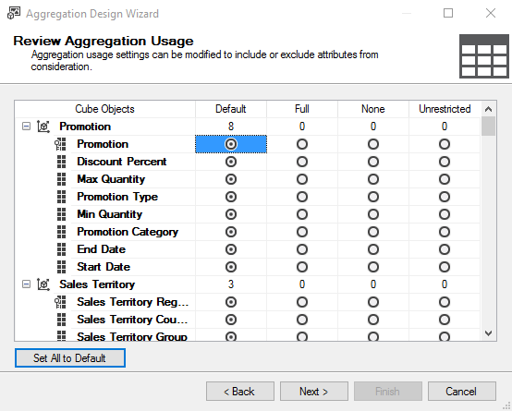
Before the aggregation's design, the database has to be processed and partitions and dimensions should have data. Using aggregation design wizard aggregations can be created.
Default: Designer will decide the rule based on the dimension attribute Full: Designer must include the dimension attribute None: No aggregations for the dimension attribute Unrestricted: Designer does not impose any restriction but dimension attribute must be evaluated to decide whether to include the attribute or not.

Slide 24
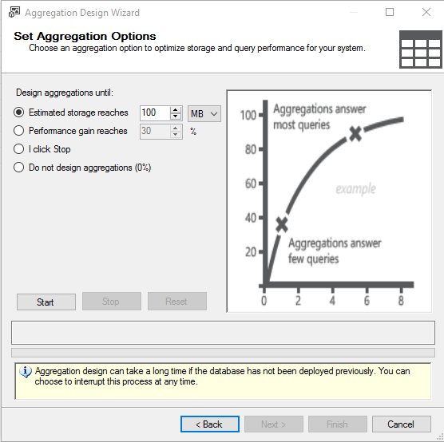
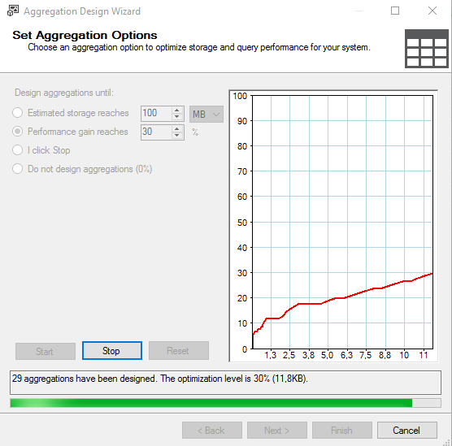

Slide 25
links:
https://docs.microsoft.com/en-us/sql/analysis-services/multidimensional-models/error-configuration-for-cube-partition-and-dimension-processing?view=sql-analysis-services-2017
https://docs.microsoft.com/en-us/sql/analysis-services/multidimensional-models-olap-logical-cube-objects/aggregations-and-aggregation-designs?view=sql-analysis-services-2017
https://social.technet.microsoft.com/wiki/contents/articles/18137.aggregations-in-ssas.aspx

