Slide 1
Modele Analizy Danych
Analysis Services Multidimensional – MDX

Slide 2
MDX stands for 'Multi-Dimensional Expressions' and is the standard language defined by Microsoft to query OLAP servers.
At first glance, it may appear similar to SQL. However, MDX is a completely new language.
SQL was designed to query dimensional data structures, called tables, where data are organized in rows and columns.
In OLAP, data are organized around multiple measures, dimensions, hierarchies, and levels.

Slide 3
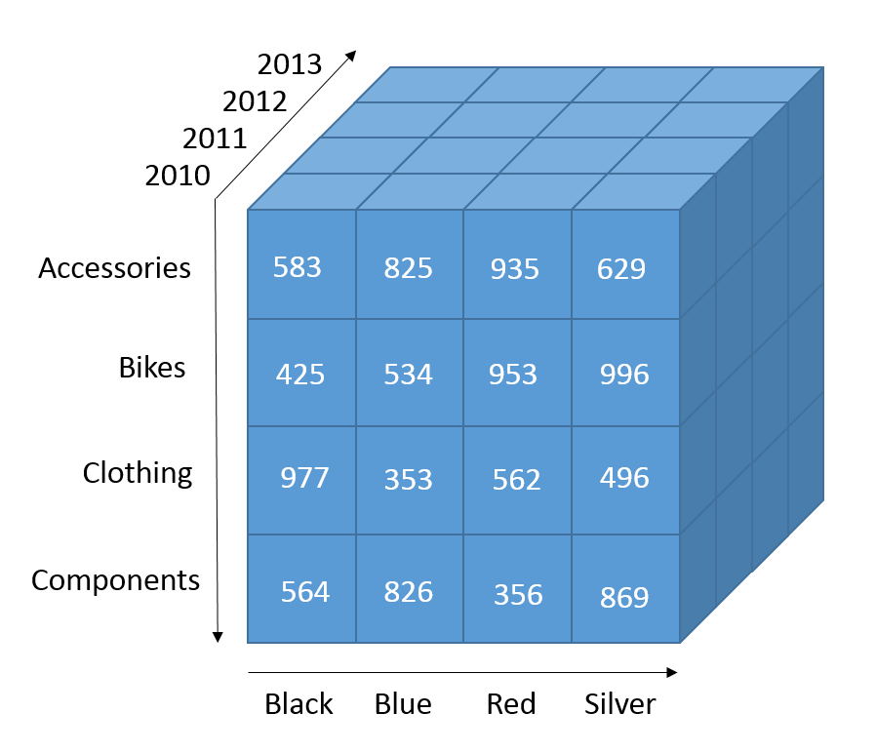

Slide 4
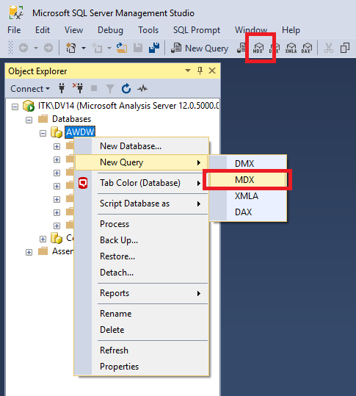
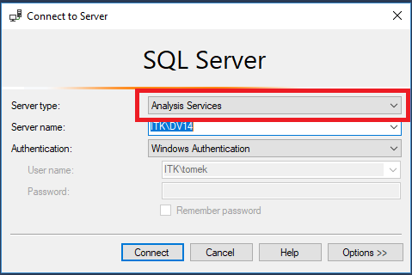

Slide 5
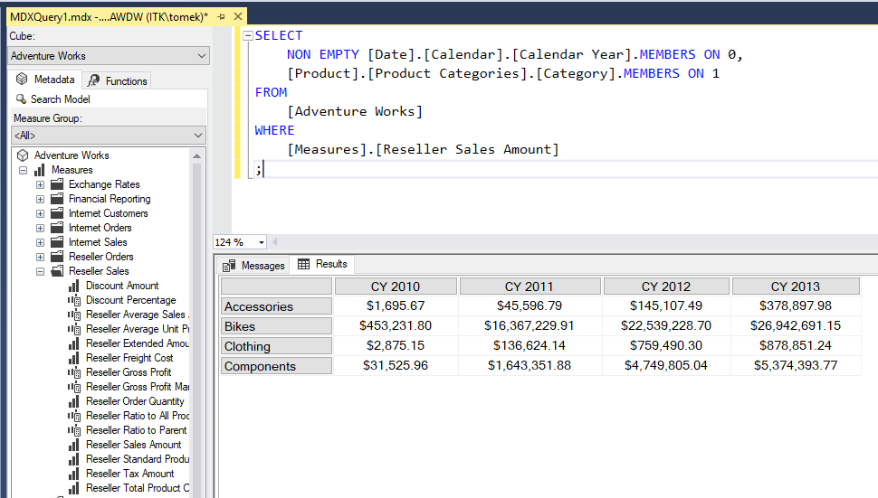

Slide 6
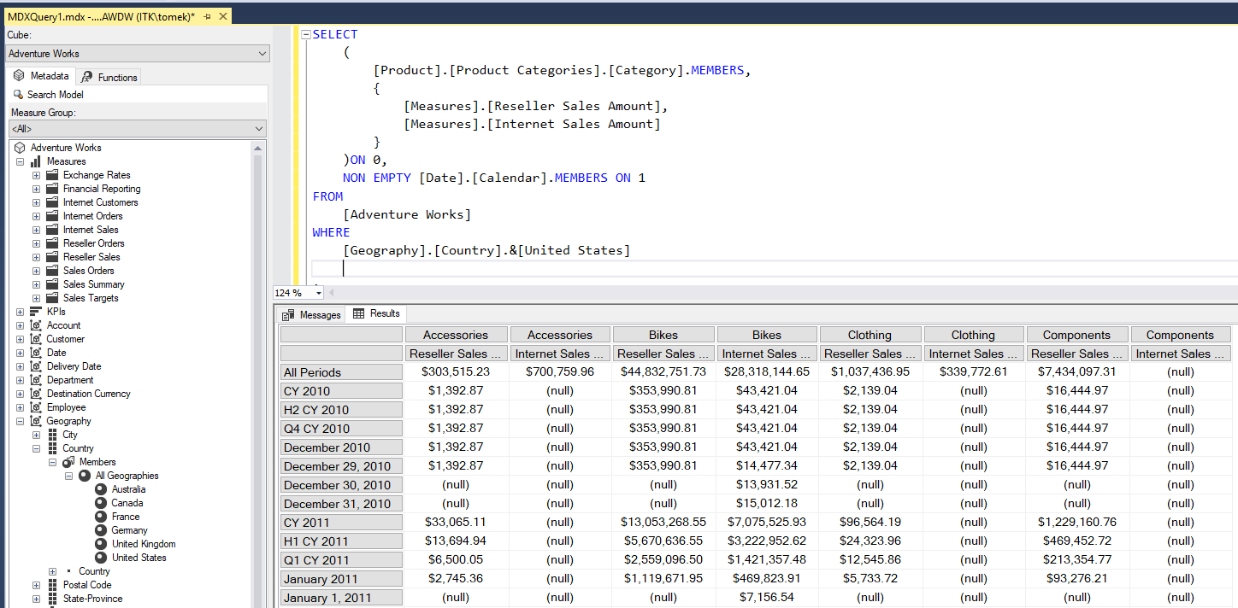

Slide 7
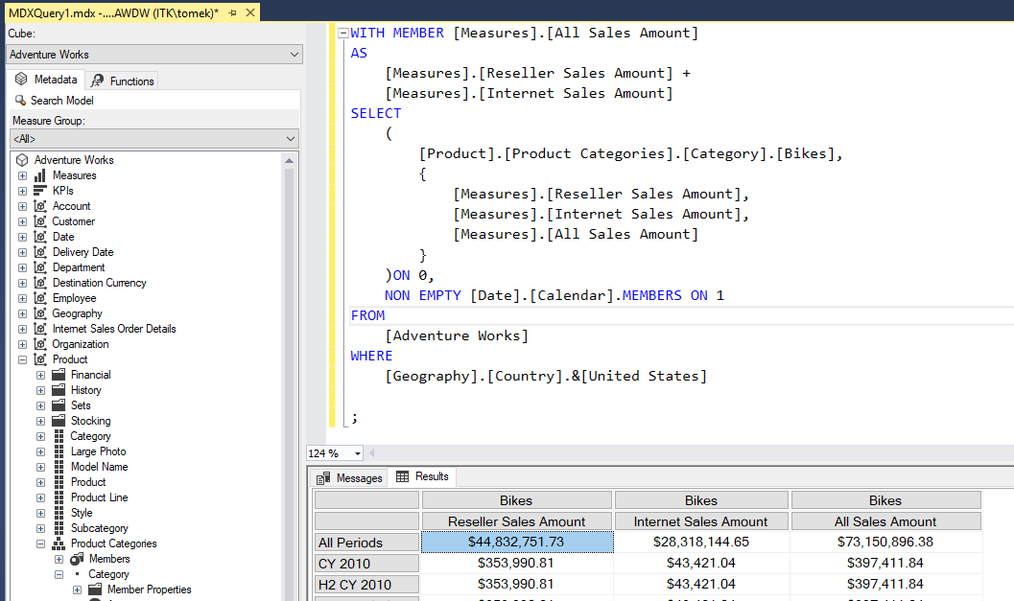

Slide 8
https://www.iccube.com/support/documentation/mdx_tutorial/gentle_introduction.php
http://www.sqlservercentral.com/stairway/72404/

