Slide 1
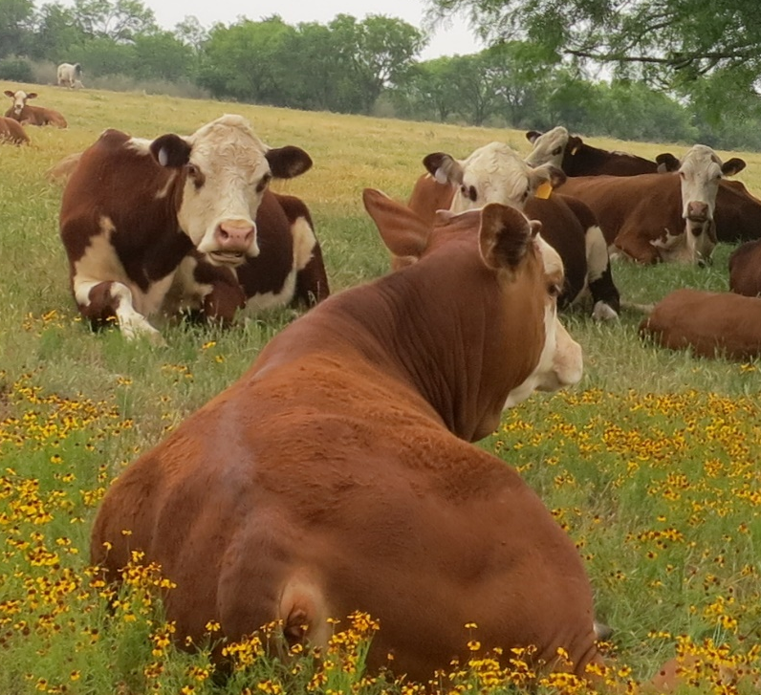
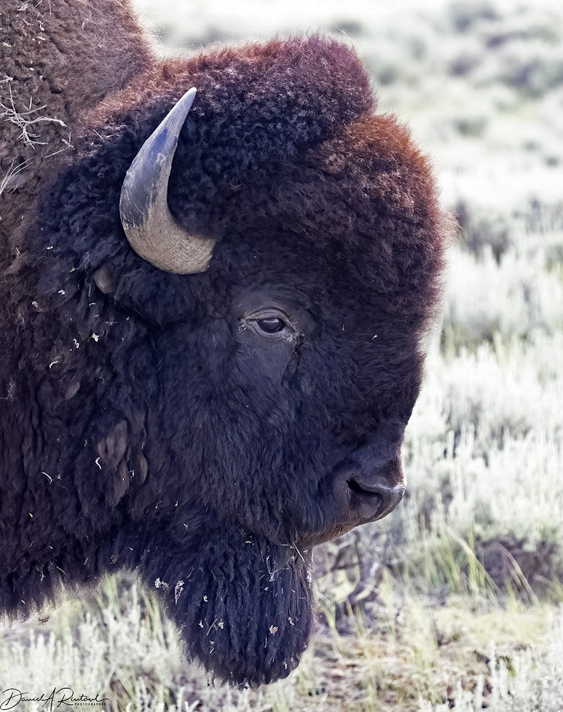
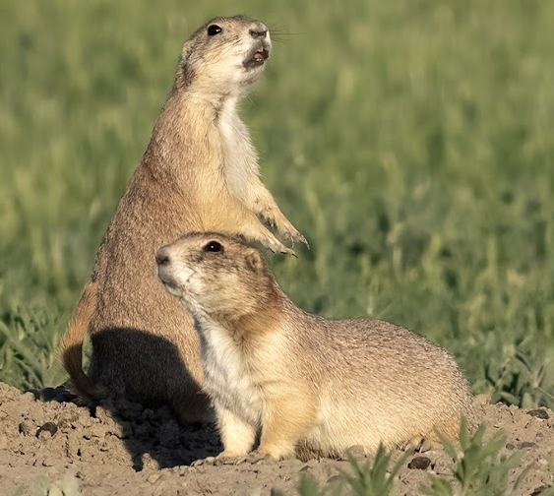
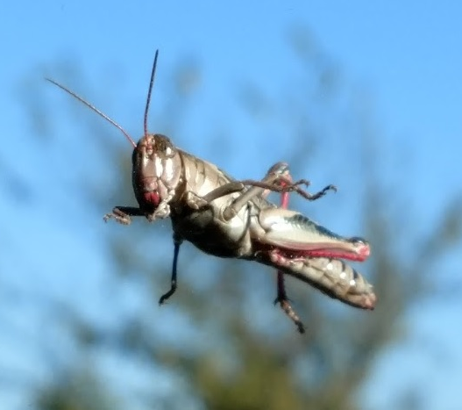
Grass N
R² = 0.77
Soil C & N
R² = 0.27
Grass P
R² = 0.63
Grass K
R² = 0.75
Plant Mg
R² = 0.44
Plant Na
R² = 0.26
Month
Plant Si
R² = 0.76

